Slide 1
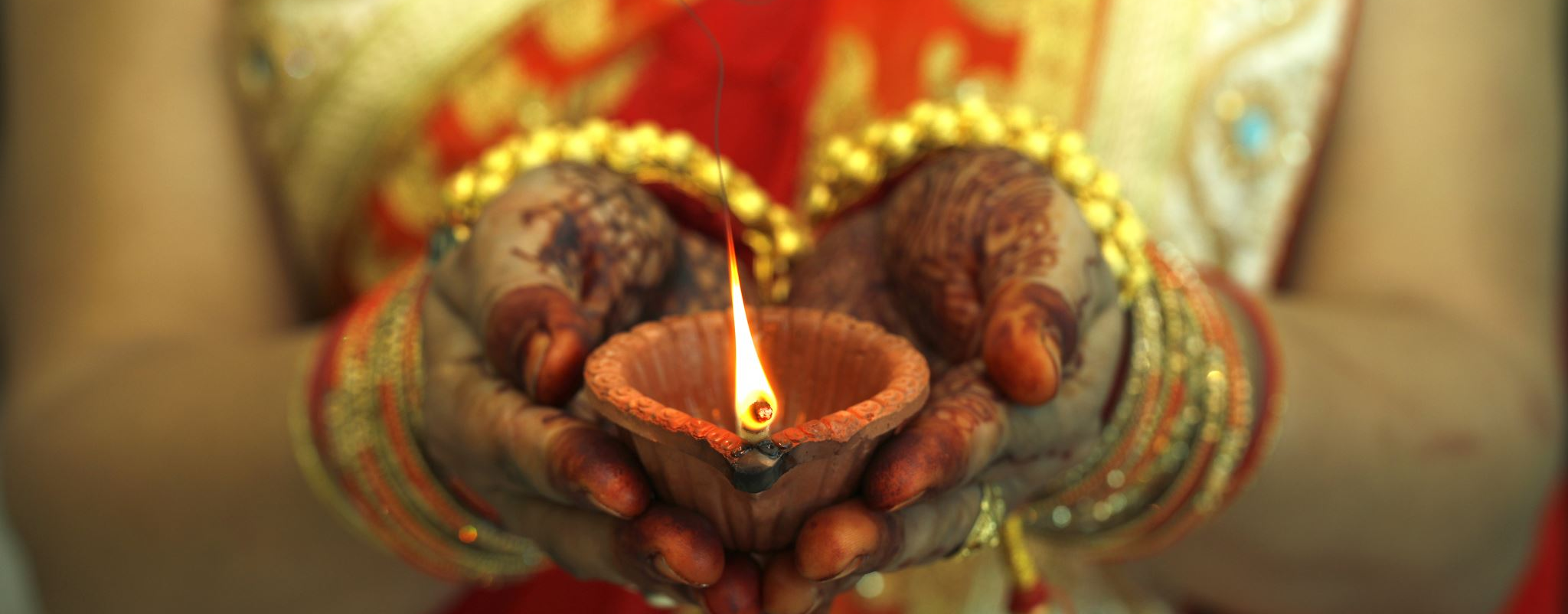
Initiation Ceremony
Comparative Religion
Grades 1-5
Slides by: Shiraz Antia and Temi Mehta

Slide 2
Rituals
A ritual is a sequence of activities involving gestures, words, actions, or objects, performed in a certain place and according to a set sequence.

Slide 3
Examples of Rituals
Holidays
A special trip
Birthday celebrations
Passing down heirlooms
Prayer or meditation
Family dinner
What else?

Slide 4
What is an Initiation Ceremony?
A ritual during which a person is admitted to an organization or given secret knowledge; sometimes contains one or more tests that have to be passed or endured. This is called an Initiation Ceremony.
Many Religions have Initiation Ceremonies, today we will learn about some!

Slide 5
What is the Zoroastrian Initiation Ceremony?
Navjote- means new (nav) worshipper (jote).
The term Navjote is used primarily by the Zoroastrians of India (the Parsis), while Sedreh Pushi is used primarily by the Zoroastrians of Iran. Sedreh Pushi means wearing of the sedreh.
The child prepares for months or years learning the prayers and religious education of the basic concepts of the faith. In Parsi tradition, the ceremony should be done before a boy or girl reaches puberty. During the Navjote ceremony, the child wears the Sudreh (undergarment) and the Kusti (sacred thread) for the first time.
In the Iranian tradition, Sedreh Pushi can be performed at any age but is is usually celebrated when the child reaches 15 years of age.

Slide 6
What does the Navjote Symbolize?
If the child goes through Navjote or Sedreh Pushi at a young age, it will be the responsibility of the parents to guide their child in further religious and moral education.
The sacred thread and shirt also teach children responsibility, as they are to be untied before certain practices, such as bathing, and re-tied shortly after the task is completed.
Wearing the kushti/koshti acts as a reminder and a conscious and willful decision to make good choices and do good deeds daily.

Slide 7
Other Religions Have Initiation Ceremonies
Islam: -
Christianity: Baptism Holy Communion Confirmation
Hinduism: Upanayana
Judaism: Bar/Bat Mitzvah

Slide 8
The Seven Christian Sacraments
Christians believe there are seven sacraments that are critical religious ceremonies/rituals within one’s lifetime. Three of those sacraments are considered initiations, they include:
Baptism
Holy Communion
Confirmation

Slide 9
Baptism
Baptism is considered the Christian initiation to the faith. A child (or actually at any age) is meant to be cleansed of original sin, starting fresh and new.
For Catholics, baptism is the sacrament of salvation (which they believe is necessary for entering heaven) and the door to all other sacraments.
In the ceremony, holy water is sprinkled, and a priest says a blessing.

Slide 10
Holy Communion
Typically, around age 8 or 9, Christian children receive their First Holy Communion.
This is the first time they get to have a sip of wine and bread as given by a priest in church signifying the blood and body of Christ (they call it the Eucharist). Christians believe that when you partake in the Eucharist you become closer to Jesus Christ.
Every time after this, they can receive the Eucharist when they go to mass at church.

Slide 11
Confirmation
Typically, around age 12 or 13, Christian children have their confirmation ceremony.
Young people are asked to stand to renew the promises made for them at Baptism by their parents and godparents. In this way they are committing themselves anew to following Christ. They make a declaration of faith in God, Jesus, and the Church.

Slide 12
Bar / Bat Mitzvah Ceremony
In Judaism, the Bar (son) or Bat (daughter) Mitzvah ceremony signifies the coming of age for a child. Around 12 or 13 years old, the child will have the ceremony where they are now accountable for their actions.
The child now bears their own responsibility for Jewish ritual law, traditions and ethics and now can participate in all areas of Jewish Community life.

Slide 13
Bar / Bat Mitzvah Ceremony
Prior to the ceremony the Jewish child will attend lessons, usually at the synagogue, in Hebrew and in how to read the Torah aloud.
During the ceremony, the child will read aloud part of the Torah. The Rabbi will address part of his talk to the child and the child might give a talk to the rest of the assembly. The child's father will then recite a prayer of thanks for his child’s coming of age.
After the service there will usually be a party to celebrate the Bar Mitzvah.

Slide 14
Initiation in Islam
Islam technically does not have a formal initiation ceremony into the religion.
There are no ceremonies or rituals for conversion to Islam.
Once a person has studied, discussed and has satisfied his heart and mind makes a personal declaration alone or in the presence of other people. The focus is more on internal acceptance of truth and making a commitment to lead one’s life in accordance with the Will of God.

Slide 15
Upanayana Ceremony
Upanayana, is the Hindu ritual of initiation, but restricted to the three upper varnas, or social classes, that marks the male child’s entrance upon the life of a student and his acceptance as a full member of his religious community.
The ceremony is performed between the ages of 5 and 24, the wide variance reflecting the different educational requirements of the three upper classes—Brahmans (priests and teachers), Kshatriyas (warriors and rulers), and Vaishyas (merchants and tradesmen).

Slide 16
Upanayana Ceremony
Before the ceremony, the boy takes a ritual bath, and then is brought before his guru (personal spiritual guide).
They are given a deerskin to use as an upper garment, a staff, and the sacred thread (upavita). The thread, consisting of a loop made of three symbolically knotted and twisted strands of cotton cord, is replaced regularly so that it is worn throughout the lifetime of the owner, normally over the left shoulder and diagonally across the chest to the right hip.

