Slide 1
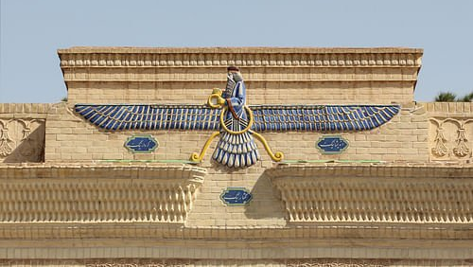
Zoroastrianism
Comparative Religion

Slide 2
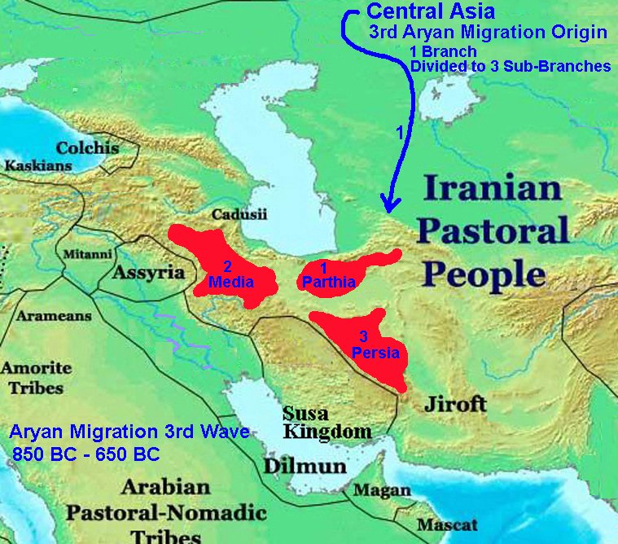
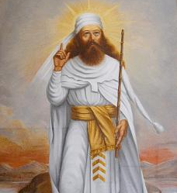
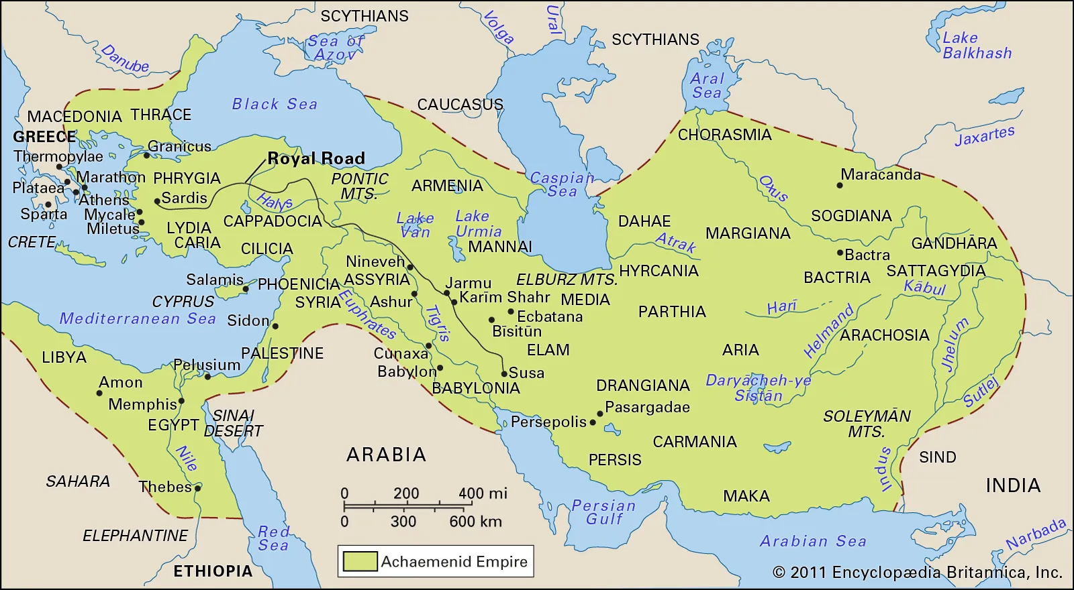
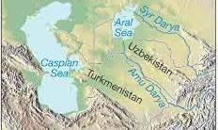
The Prophet
Zarathushtra Spitama
When did he live?
He lived about 3500-3700 years ago
Where did he live?
South of the Aral Sea
His physical and economic status
The tribe he lived in, what they believed and what did most people do for a living?
What bothered him? Why?
How did he solve it?

Slide 3
His message
It is acknowledged as the earliest monotheistic faith
He delivered his message through hymns or songs
Why is his message in song?
Did he do this on purpose?
He called the message Daena Vanguhi in his language (old Avestan or Gathic)
Daena Vanguhi means to live with a Good Conscience
His message embraces the worship of one supreme God whom he called Ahura Mazda
The name means Lord of Supreme Wisdom
What does this choice of name say about his message?
His view of the world encompasses renovation and perfection through the collective good acts of humanity

Slide 4
Religious view of Zarathusthra in the Gathas
The world we live in is in constant conflict between two morally opposed forces
Mental attitudes in psychological domain
Moral vectors in all creation
The nature of these two forces is defined by Asha (Ultimate Truth, Righteousness, Law as Ahura Mazda envisioned for the world to be)
We view the world as good and of Divine creation
that has been shifted due to wrongful actions, humans have the choice of promoting good and rejecting evil to move the scale toward Asha.
This is at the heart of Zarathushtra’s doctrine. The mission is to promote good toward a world without evil.

Slide 5
Moving toward Asha
Each human being cultivated to different degrees possesses Good Mind=Vohu Manah=Divine creation
Vohu Manah enables us to recognize Asha (the right path)
This form of moral awareness is good thought, which in turn guides us to good words and good deeds

Slide 6
A new message
For the first time in human history, Zarathushtra introduced the concept of choice and free will.
Man must think for himself
This gave rise to concepts that are still important is the modern world.
Democracy
Gender equality
Human rights
Brotherhood of mankind
Ethical principles of life
Can you give examples of current issues relating to the above?

Slide 7
How does Zarathushtra view God?
Zarathushtra views Ahura Mazda as the creator, all knowing and all powerful, but never to be feared.
Ahura Mazda is our friend and our ally
Man can both serve and honor God through a rational and ethical structure and not through blind faith or instinctive worship
What do you think of this concept of serving God?

Slide 8
How does Zarathushtra view religion?
It is the quest of the human spirit seeking significance in one’s existence.

Slide 9
Zarathushtra’s life view is based on the fulfillment and triumph of man
A life of joy, happiness, and prosperity
How does happiness and joy relate to prosperity?
Bringing Ushta or happiness to oneself and others
Why should we make others happy?
Harmony in environment and creation
How does this affect us?
Rightful hard work always results in reward
This reward is gained both physically and spiritually in one’s life
Does hard honest work always lead to reward?

Slide 10
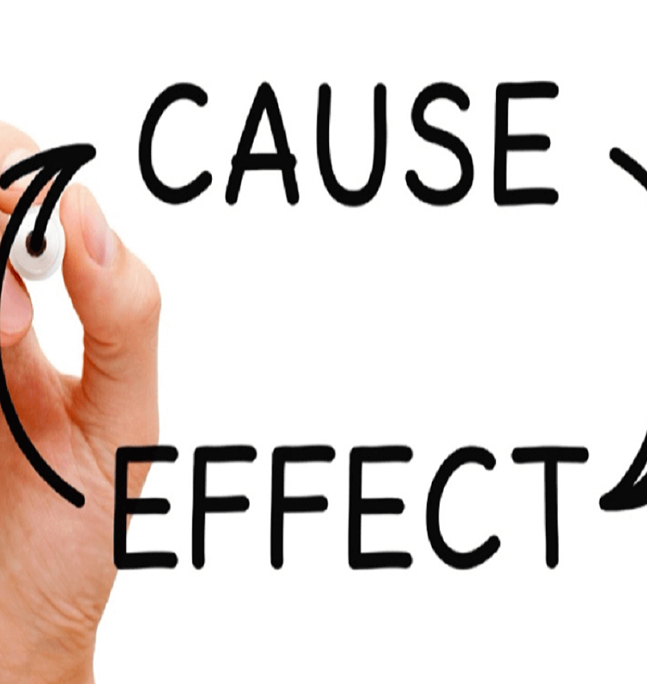
Zarathushtra’s teaching is based on personal responsibility
Based on cause and effect
Every thought, word and deed has an effect, and we must take responsibility for our thoughts, words and actions.
World’s happiness or unhappiness depends on our individual actions.
Zarathushtra believed that humankind has the ability to become completely good.
Frashokereti is the word he used for this all-good existence.
That is where the word fresh comes from (to renew, renovate, improve)

Slide 11
Protecting the Environment
The Zoroastrian religion teaches us to
Protect the environment because it is our responsibility.
Be respectful of Mother Nature and all God’s creation
Are we doing this on a global level?
How can we contribute on a personal level?

Slide 12
How do Zoroastrians serve Ahura Mazda?
Praying is a personal choice to commune with Ahura Mazda
The best way to serve Ahura Mazda is to
Help those in need
Establish a peaceful, prosperous, loving and just world

Slide 13
Death in the Gathas - who were they sung for?
Life after death is viewed as a state of being in the Gathas
It is the consequence of the moral quality of one's life
The righteous will reach the House of Songs or the state of best consciousness
The wrongful will be in a state of worse consciousness in the House of Falsehood
Every consciousness will ultimately reach the House of Songs.
The Gathas are a guide for the living
Achieving individual and communal bliss depends on enlightened human thinking and right-minded human resolve.

Slide 14
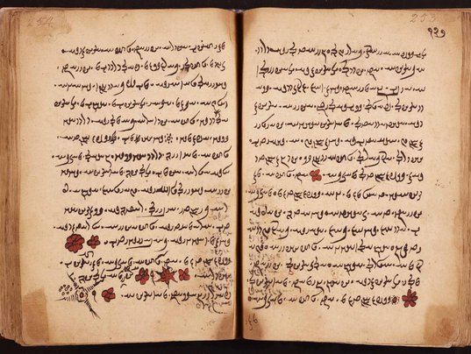
Zoroastrian Scriptures
What are the Zoroastrian scriptures called?
The entirety of Zoroastrian scriptures is known as the Avesta
The Gathas or Zarathushtra’s sublime songs are in the Yasna section of the Avesta
The Gathas are comprised of 17 songs
Linguistically they are the oldest part of the Avesta
They were composed by Zarathushtra
They form the core of the Zoroastrian religion
Khordeh Avesta is a compilation of daily prayers
What is the difference between the Avesta and the Gathas?

Slide 15
Theology of the Gathas
It is a reflective religion
It is a way of life
A believer is one who upon reflection adopts their teachings as worthy of acceptance and commits himself/herself to the way of life presented within.

Slide 16
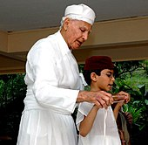
Zoroastrian Initiation Ceremony
Sedreh Pooshi among Iranians and Navjote among Parsis
Usually performed around 7 years of age for Parsis and early teen years or older for Iranians
It’s a day when the initiate chooses for himself/herself to live according to Asha (Truth and Righteousness) to make his/her choices using good thoughts, words and deeds.
He/she celebrates this great day of choosing with family and friends.
The initiate wears a white cotton shirt called sedreh and a band made of sheep’s wool around the waist symbolizing one’s intension of doing good deeds.
Have you gone through Sedreh Pooshi? Do you want to? Why or why not?

Slide 17
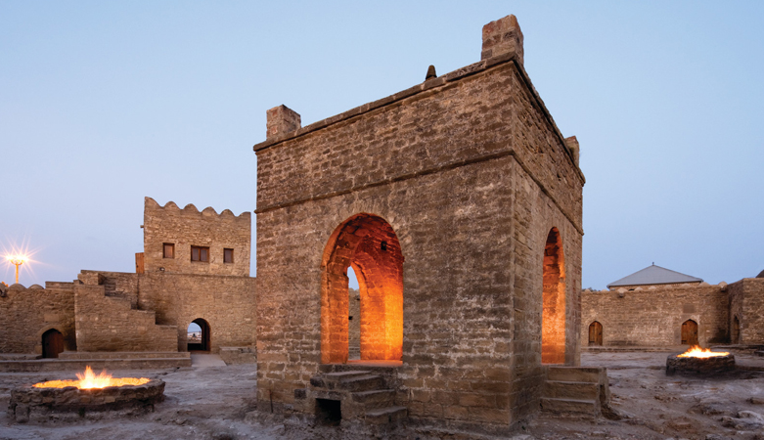
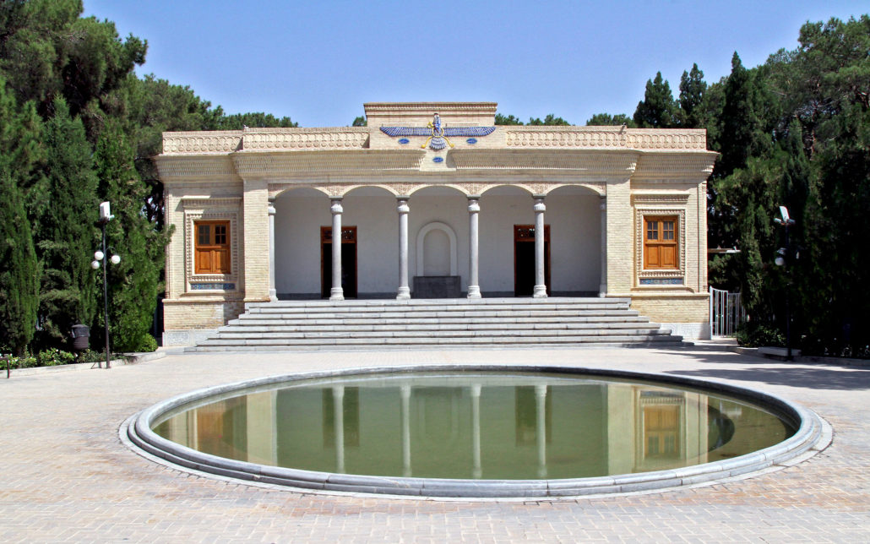
Priests and Place of Worship
Do you know what we call a Zoroastrian priest?
How does one become an Ervad/Mobed?
In order to become a priest, the individual studies the scriptures and after a special ceremony, becomes a priest
Priests are called Ervad among Parsis and Mobed among Iranians
Places of worship
Atash Bahram, Agirary or Dadgah among Parsis
Atash Kadeh among Iranians
Fire Temple among all
Why do Zoroastrians pray in front of fire?
Zoroastrians pray in front of fire because it is a symbol of
Ahura Mazda’s Asha (Truth and Righteousness)
Enlightenment

Slide 18
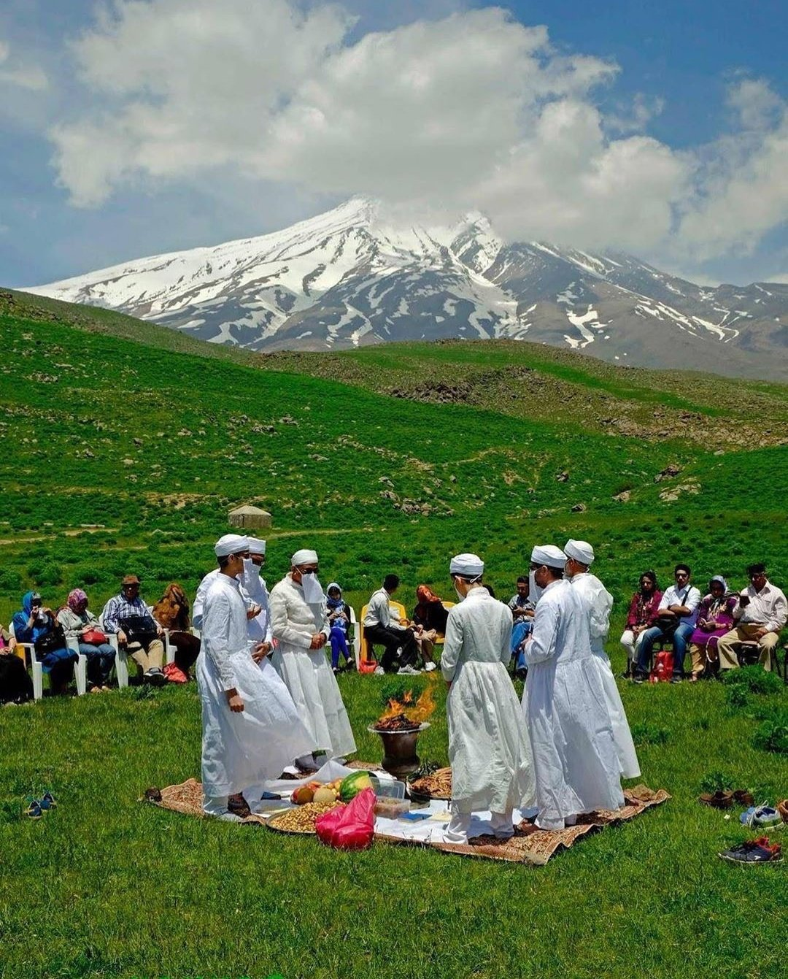
Jashan or Jashn
A ceremony performed for any personal or communal event either joyous or solemn. For example:
A new home, temple or business
Marriage or anniversary
In honor or the departed
Seasonal celebrations-Gahanbars

Slide 19
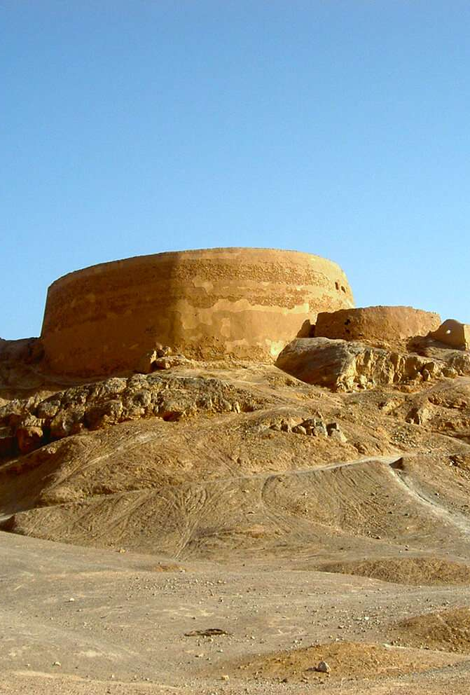
Concept of Death in Zoroastrianism
Zoroastrians see death as a transformation and not total destruction
It is the passing away of the spiritual element of a human being from its physical element
The dead body is considered a source of contamination which can cause disease
Hence Zoroastrians believe in disposing of the body in a way that causes the least harm to humans and nature
Dakhmeh (Tower of Silence in India)
Burial or cremation
Prayers are performed for several days after one’s passing to remember our loved one and soothe his/her family and friends.

Slide 20
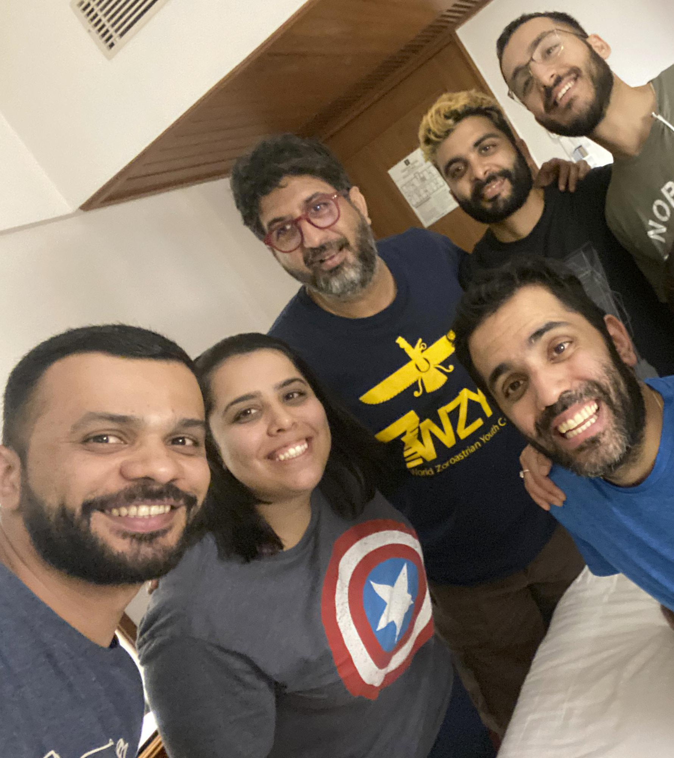
Zoroastrians in the World
Zoroastrianism at one time was the religion of a vast stretch of land known as the Persian Empire
Cyrus the Great who is known to the Western world as the king who ordered the establishment of the first known bill of human rights was the man who established the Achaemenid Empire, the first of three Persian empires.
The Persian Empire at its greatest expanse covered the area from China to Europe for over a 1000 years.
After the Muslim-Arab invasion of Iran around 700 CE, due to religious and social persecution, and to preserve their lives, many Zoroastrians fled to India.
In India they became a very successful and well-respected community
Zoroastrians who chose to stay in Iran became well-respected contributors to society whenever the political environment allowed
Today Zoroastrians live in communities all around the world.

Slide 21
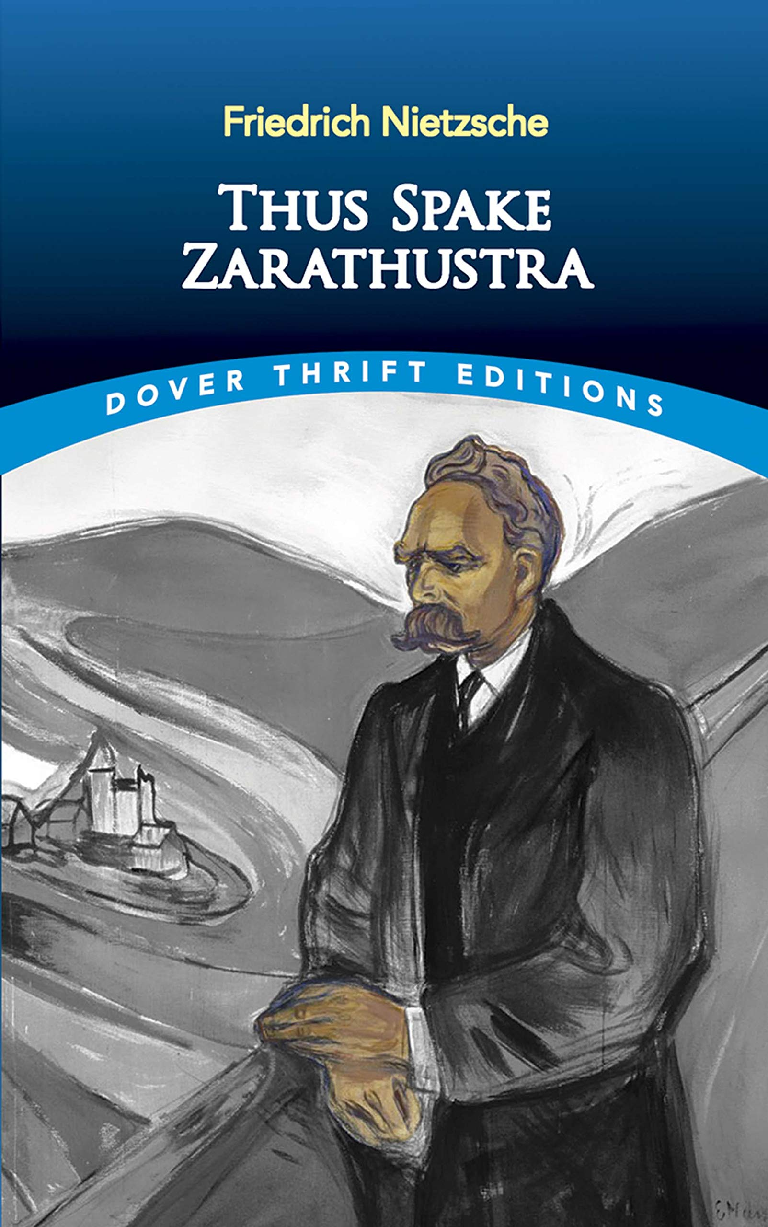
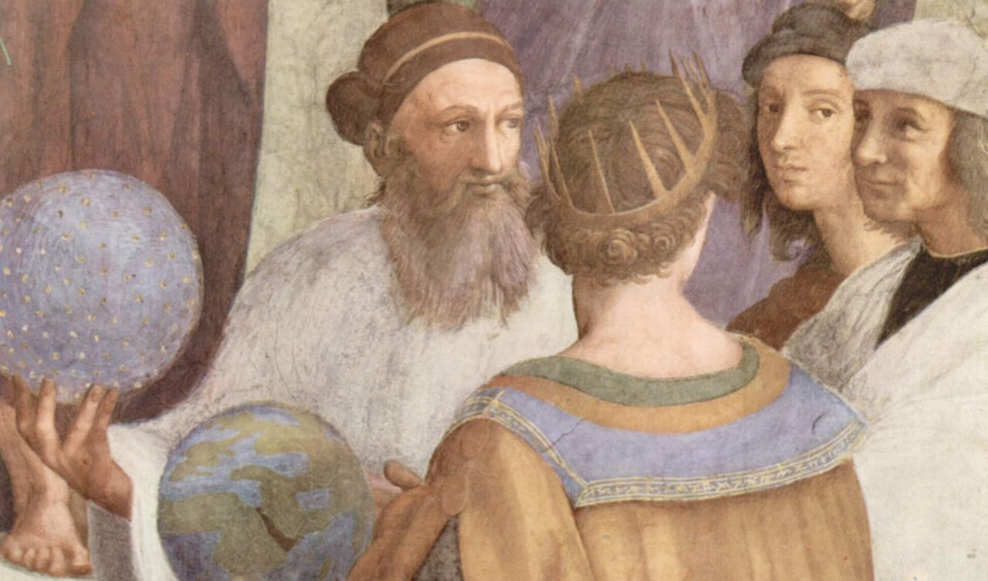
Zarathushtra’s teachings have had a profound effect from his time till today
Influence on major religions such as Judaism, Christianity and Islam
Greek philosophers such as Plato
Western philosophers such as Nietzsche and Voltaire
Great musicians such as Mozart

Slide 22
What is the purpose of life in Zoroastrianism?
To continuously further the progress of our world; continuously contribute towards establishing peace, prosperity, and brotherhood of mankind in our world so that we leave this world a better place than when we came into it!
The mission is to promote good toward a world without evil, to live in accordance with Asha.

Slide 23
Above your sheet of paper write Zoroastrianism
Write down some of the things you learned today.
Share with the class.

Slide 24
What did we learn today?

Slide 25
My answers. Let’s compare.
Name of Religion | Messenger | Area and year it was first founded | God in the religion | Purpose of Life | Religious text | What are the celebrations centered around? | Belief after death
Zoroastrianism | Zarathushtra Spitama | Northeastern Iran 1500-1700 BCE | Ahura Mazda | Move the world toward Asha | Gatha-Zarathushtra’s hymns Avesta- Zoroastrian cannon | Nature | A good and a bad state of being. House of Songs and House of Druj

