Slide 1
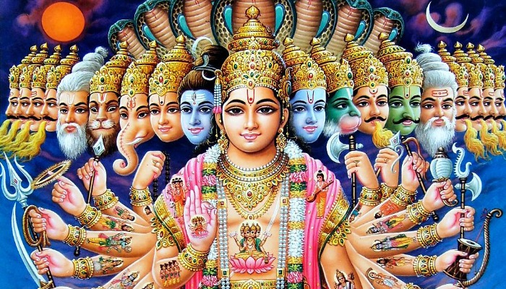
Hinduism
Comparative Religion

Slide 2
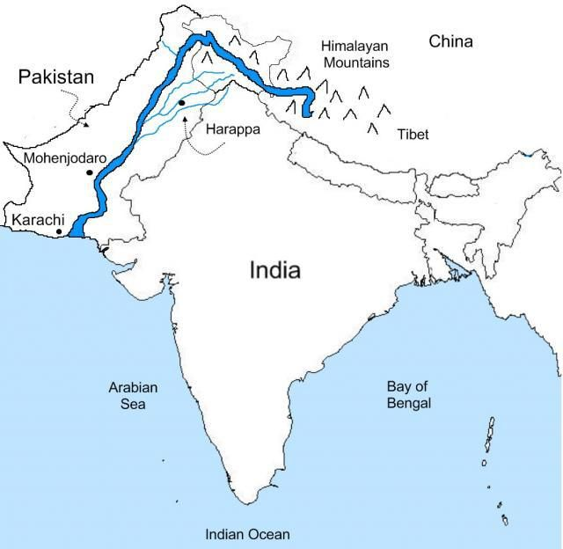
Hinduism
One of the oldest religions in the world
About 1000-3000BCE
Many Hindus believe that the religion is timeless and has always existed.
Most scholars think it began in the Indus valley-Today’s Pakistan
There are about 1.2 billion Hindus in the world.
Majority of the followers live in India and Nepal

Slide 3
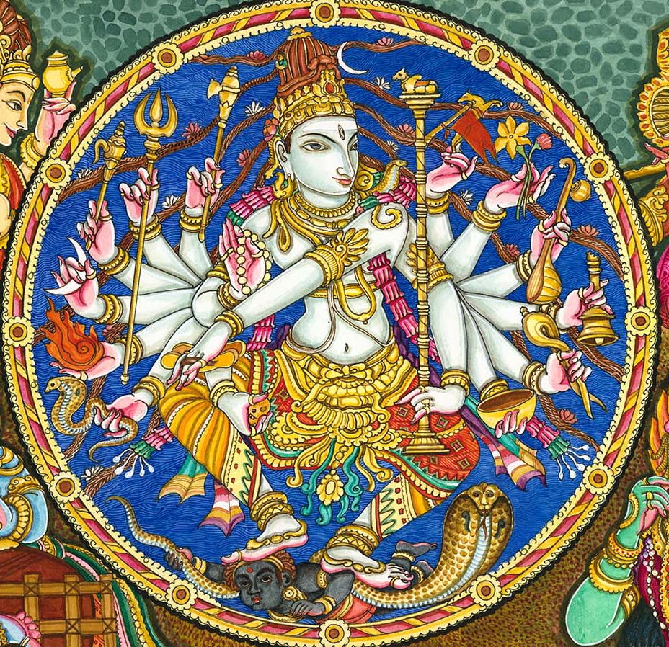
Hinduism’s founder or prophet
The religion does not have a
single founder
is not based on a single scripture
Indians call the religion Sanatana Dharma
The faith with no beginning and no end.

Slide 4
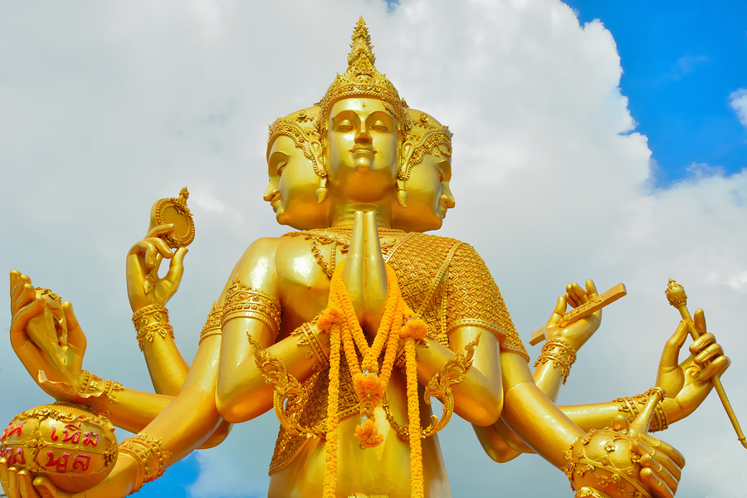
Hindus’ belief in the divine
They believe in one Supreme God called Brahman
They also accept the existence of lower gods and goddesses that reflect the Hindu value system.
Anything beautiful, valuable, and awe-inspiring is associated with a god.
Therefore plants, wealth, knowledge, etc. each have their corresponding gods or goddesses.

Slide 5
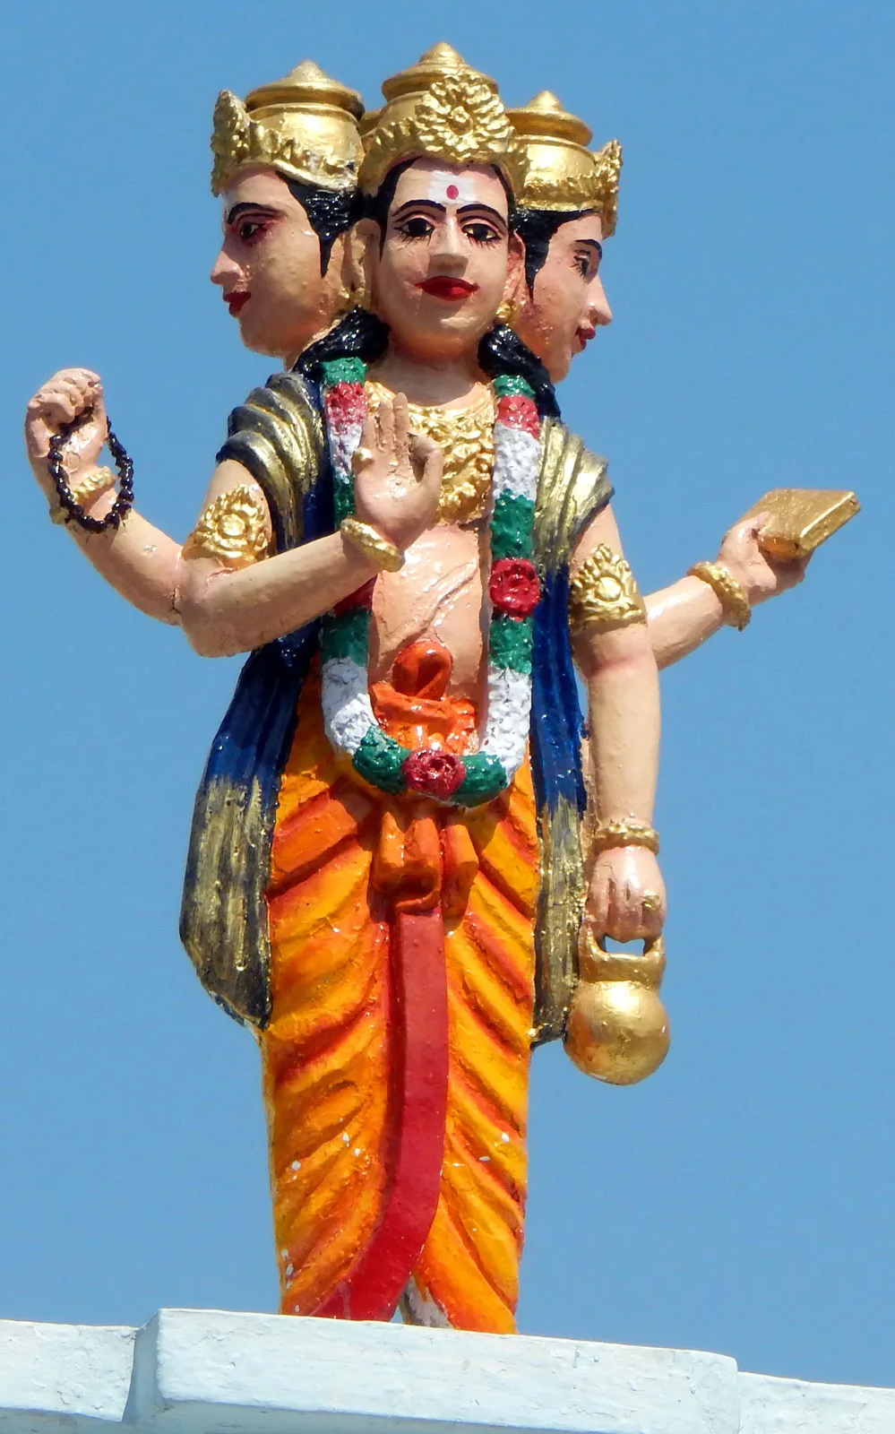
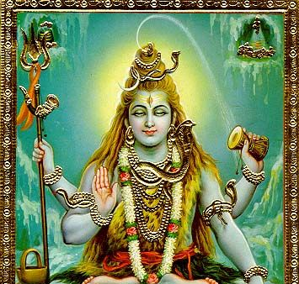
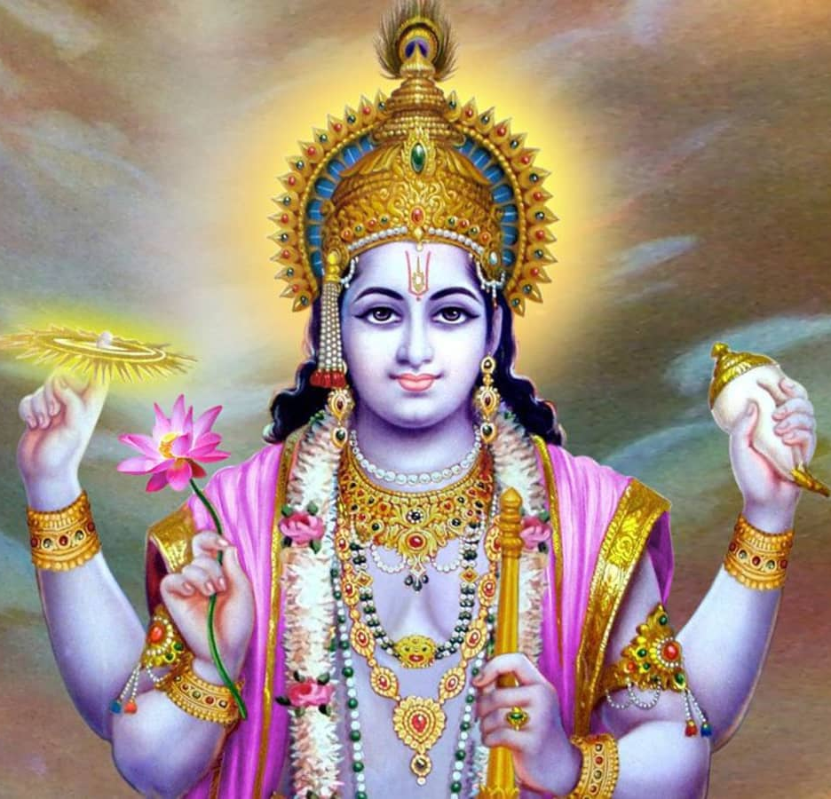
Hindu Trinity=Three most powerful gods
Brahma-The Creator
Vishnu-The Preserver
Shiva-The Destroyer
Reflecting the circle of life.

Slide 6
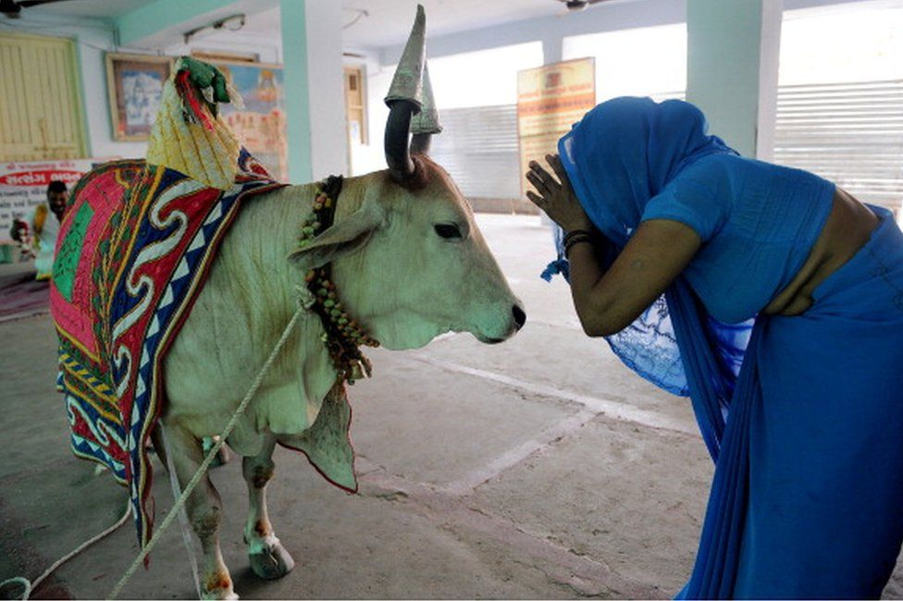
Divine mother
The cow is sacred to the Hindus and worshiped as the Divine mother.
Life-sustaining milk
Symbol of fertility
Cow in the Gathas and in Indo-Iranian culture
Almost every animal is associated with a Hindu god, and this is the reason why most Hindus are vegetarian.

Slide 7
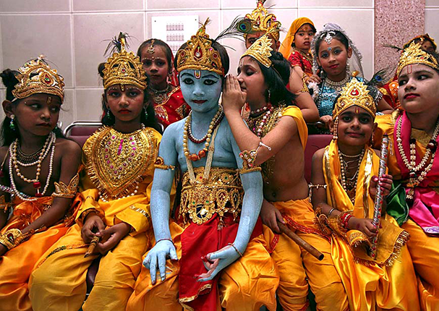
Sacred Texts
The religion has many sacred texts.
They are written in Sanskrit and common regional dialects.
The religion spread throughout the Indus Valley using these texts, rituals, and visual performances.
https://www.youtube.com/watch?v=JWhA3ldZcyY

Slide 8
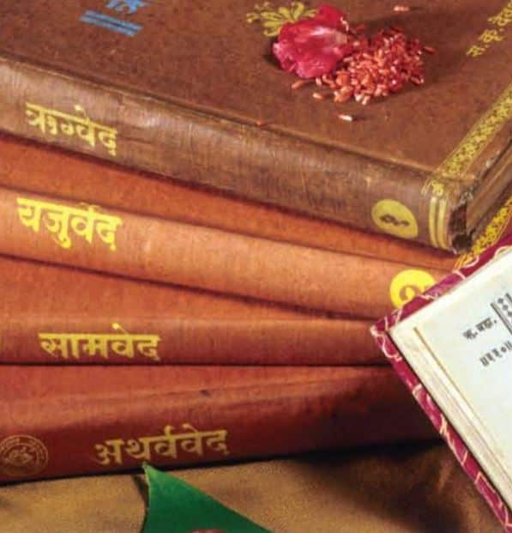
More on Hindu texts
The most ancient of the texts is called the Vedas
Vedas means “knowledge”
Written in Sanskrit
The language of Sanskrit is very close to Avestan. It was through Sanskrit that the scholars were able to translate the Gathas and the older sections of the Avesta.
The Vedas contain songs, prayers, and philosophical discussions.
To simplify the philosophical discussions for the common people, legends were created in the form of epic stories.
These stories teach people righteous living.

Slide 9
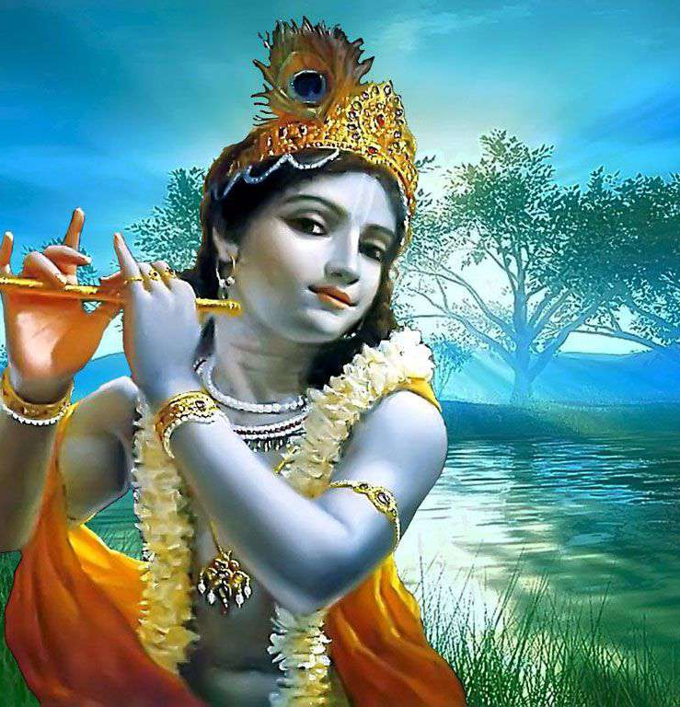
Bhagavad Gita
Is one of these philosophical discussions in the form of a song
Lord Krishna (one of the avatars or God incarnated in Hindu religion) speaks to people about three paths:
Path of mental discipline for intellectuals
Pursuit of love and devotion for the emotional
Selfless service for those who believe in public service to serve God.
Lord Krishna’s general advice to all is to follow nonviolence, truth and detachment.

Slide 10
Stages of life in Hindu religion
Childhood-joy and innocence
Student life-discipline of mind and body
Married life-family and household
Old age-renounce material things to prepare for final years

Slide 11
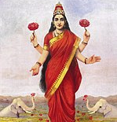
Women in Hinduism
Ancient Hindu texts do not put men and women at different levels
In later times, restrictions were put on women
Were not allowed to read Vedic texts
Prohibiting re-marriage
Not having property rights
100 CE text Manu-smriti
marriage replaces the student stage for women
In the household stage: woman’s role is to give service to their husband
https://www.hinduamerican.org/blog/hinduism-101-women-and-hinduism

Slide 12
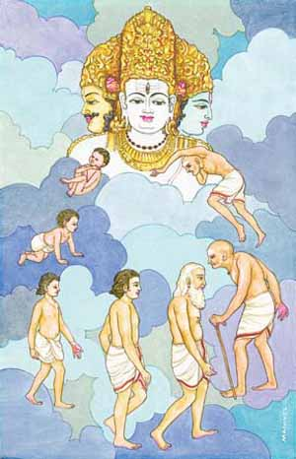
Reincarnation in Hinduism
Hindus believe in rebirth (samsara) and karma (good actions bring a good result and bad actions a bad result)
A life lived with desire and indulgence binds one’s spirit (jiva) to a series of births and deaths.
Reaching Moksha (enlightenment) breaks the cycle of birth and rebirth when the spirit joins Brahman or the Creator.
How do you think one can reach Moksha?

Slide 13
Purpose of life in Hinduism
To achieve four things (Purusharthas)
Dharma- to act righteously
Artha-pursuit of wealth and prosperity
Kama-obtain enjoyment from life
Moksha-enlightenment
Moksha is the most important element.
When Moksha is achieved (oneness with God) then the cycle of birth and rebirth breaks
https://www.youtube.com/watch?v=IGV6M4wQ8Os

Slide 14
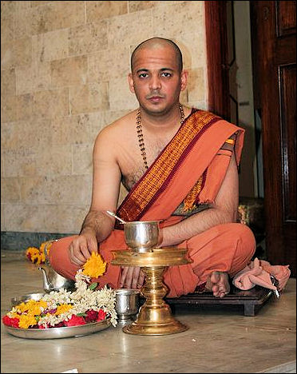
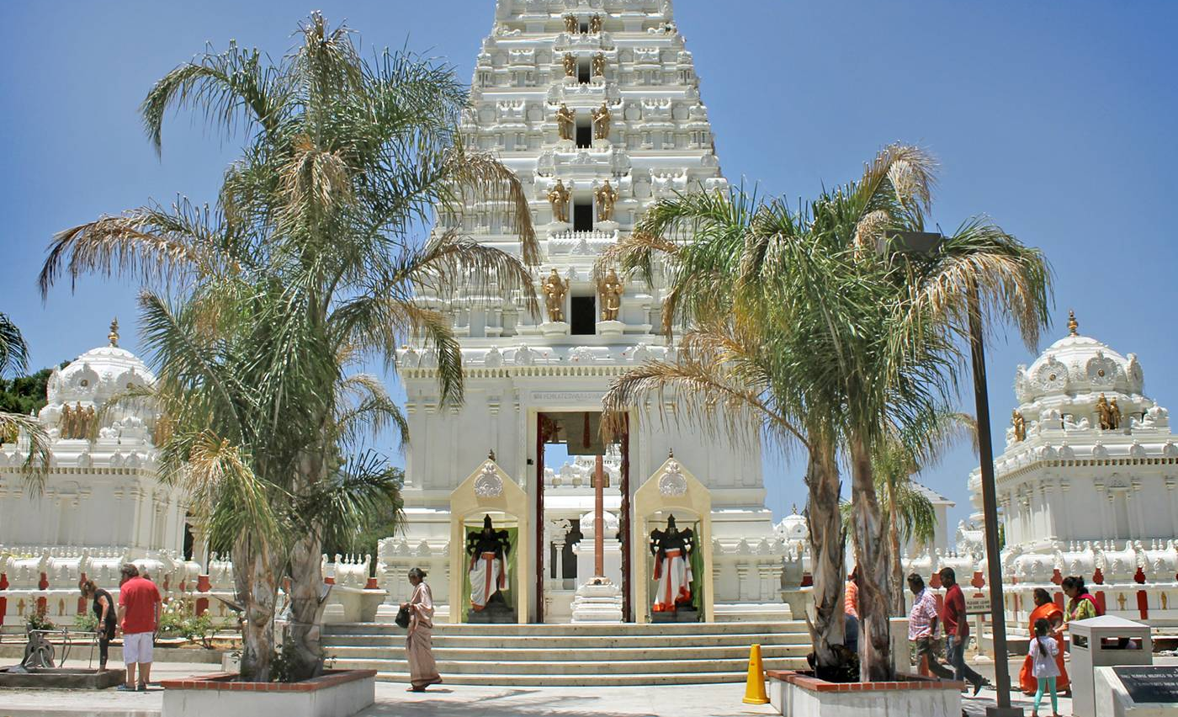
Hindu priest
Is called Brahmin
Hindu priests can marry and have a family
Hindu temple is called a Mandir (Mändēr)

Slide 15
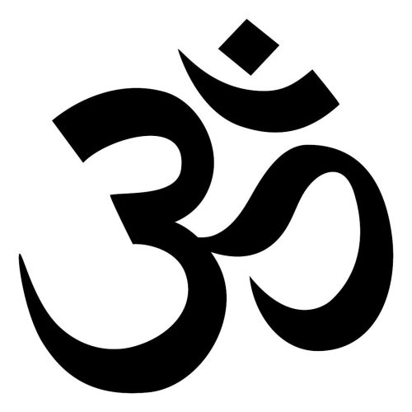
Symbol of Hinduism
Hinduism has many symbols
Aum, also written “Om” and called pranava, is the most important Hindu symbol
It is believed to be the sound through which the universe was created
https://iskconeducationalservices.org/HoH/lifestyle/expressions-of-faith/hindu-symbols/

Slide 16
Early Hinduism
Similarities to Indo-European heritage
Moving around the sacred fire during Hindu wedding ceremony
Ritualistic sacrifices
Worship of male sky gods
“world of the fathers” resembles the Germanic Valhalla
Similarity to Indo-Iranian heritage
Initiation ceremony like Zoroastrianism- tying of a sacred cord
Sea god Varuna possesses many features of Zoroastrian God Ahura Mazda
Sacred drink soma like homa in Zoroastrianism
Influenced by the people of Indian subcontinent
Some of the Hindu gods do not have equal counter parts in Indo-European heritage therefore it is believed that they have been adopted after migration to Indus valley area and influenced by the native people of the area.
https://www.britannica.com/topic/Hinduism#ref261604

Slide 17
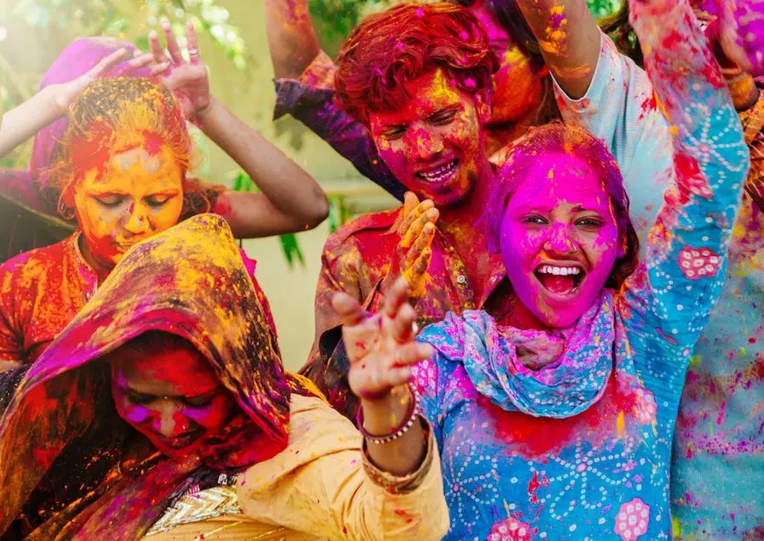
Hindu celebrations
Based on their gods and goddesses’ birthdays and anniversaries
The celebration is conducted in homes and temples
Some of the more famous of the celebrations are
Diwali-the festival of light-October
https://www.youtube.com/watch?v=VtMwjW6Gzqs&t=122s
Holi- the festival of colors-March
https://www.youtube.com/watch?v=E7NZEtivn0s
Which Zoroastrian celebration is about the same time as Diwali and Holi?

Slide 18
How does one officially join Hinduism?
There is no one conventional way of joining the religion.
Some say you can’t become a Hindu
Others say to become a Hindu you need to practice the Hindu way of life
Other communities want you to
join a Hindu community
study Hindu scripture and write a paper
go to your former religious institution and get a letter from them that you have renounced your former religion
pick a Hindu name and change all your legal papers to that name
name-giving-rite ceremony where a certificate is issued
have an announcement in local paper announcing your change in faith and new name
keep a copy of this process.
https://www.hinduismtoday.com/hindu-basics/how-to-formally-enter-hinduism/

Slide 19
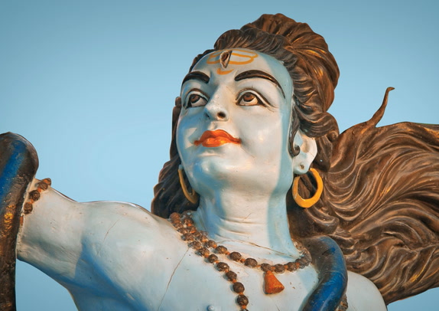
How do Hindus deal with the dead body
Cremation
They believe it is the quickest way to release the spirit for reincarnation

Slide 20
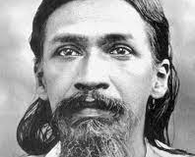
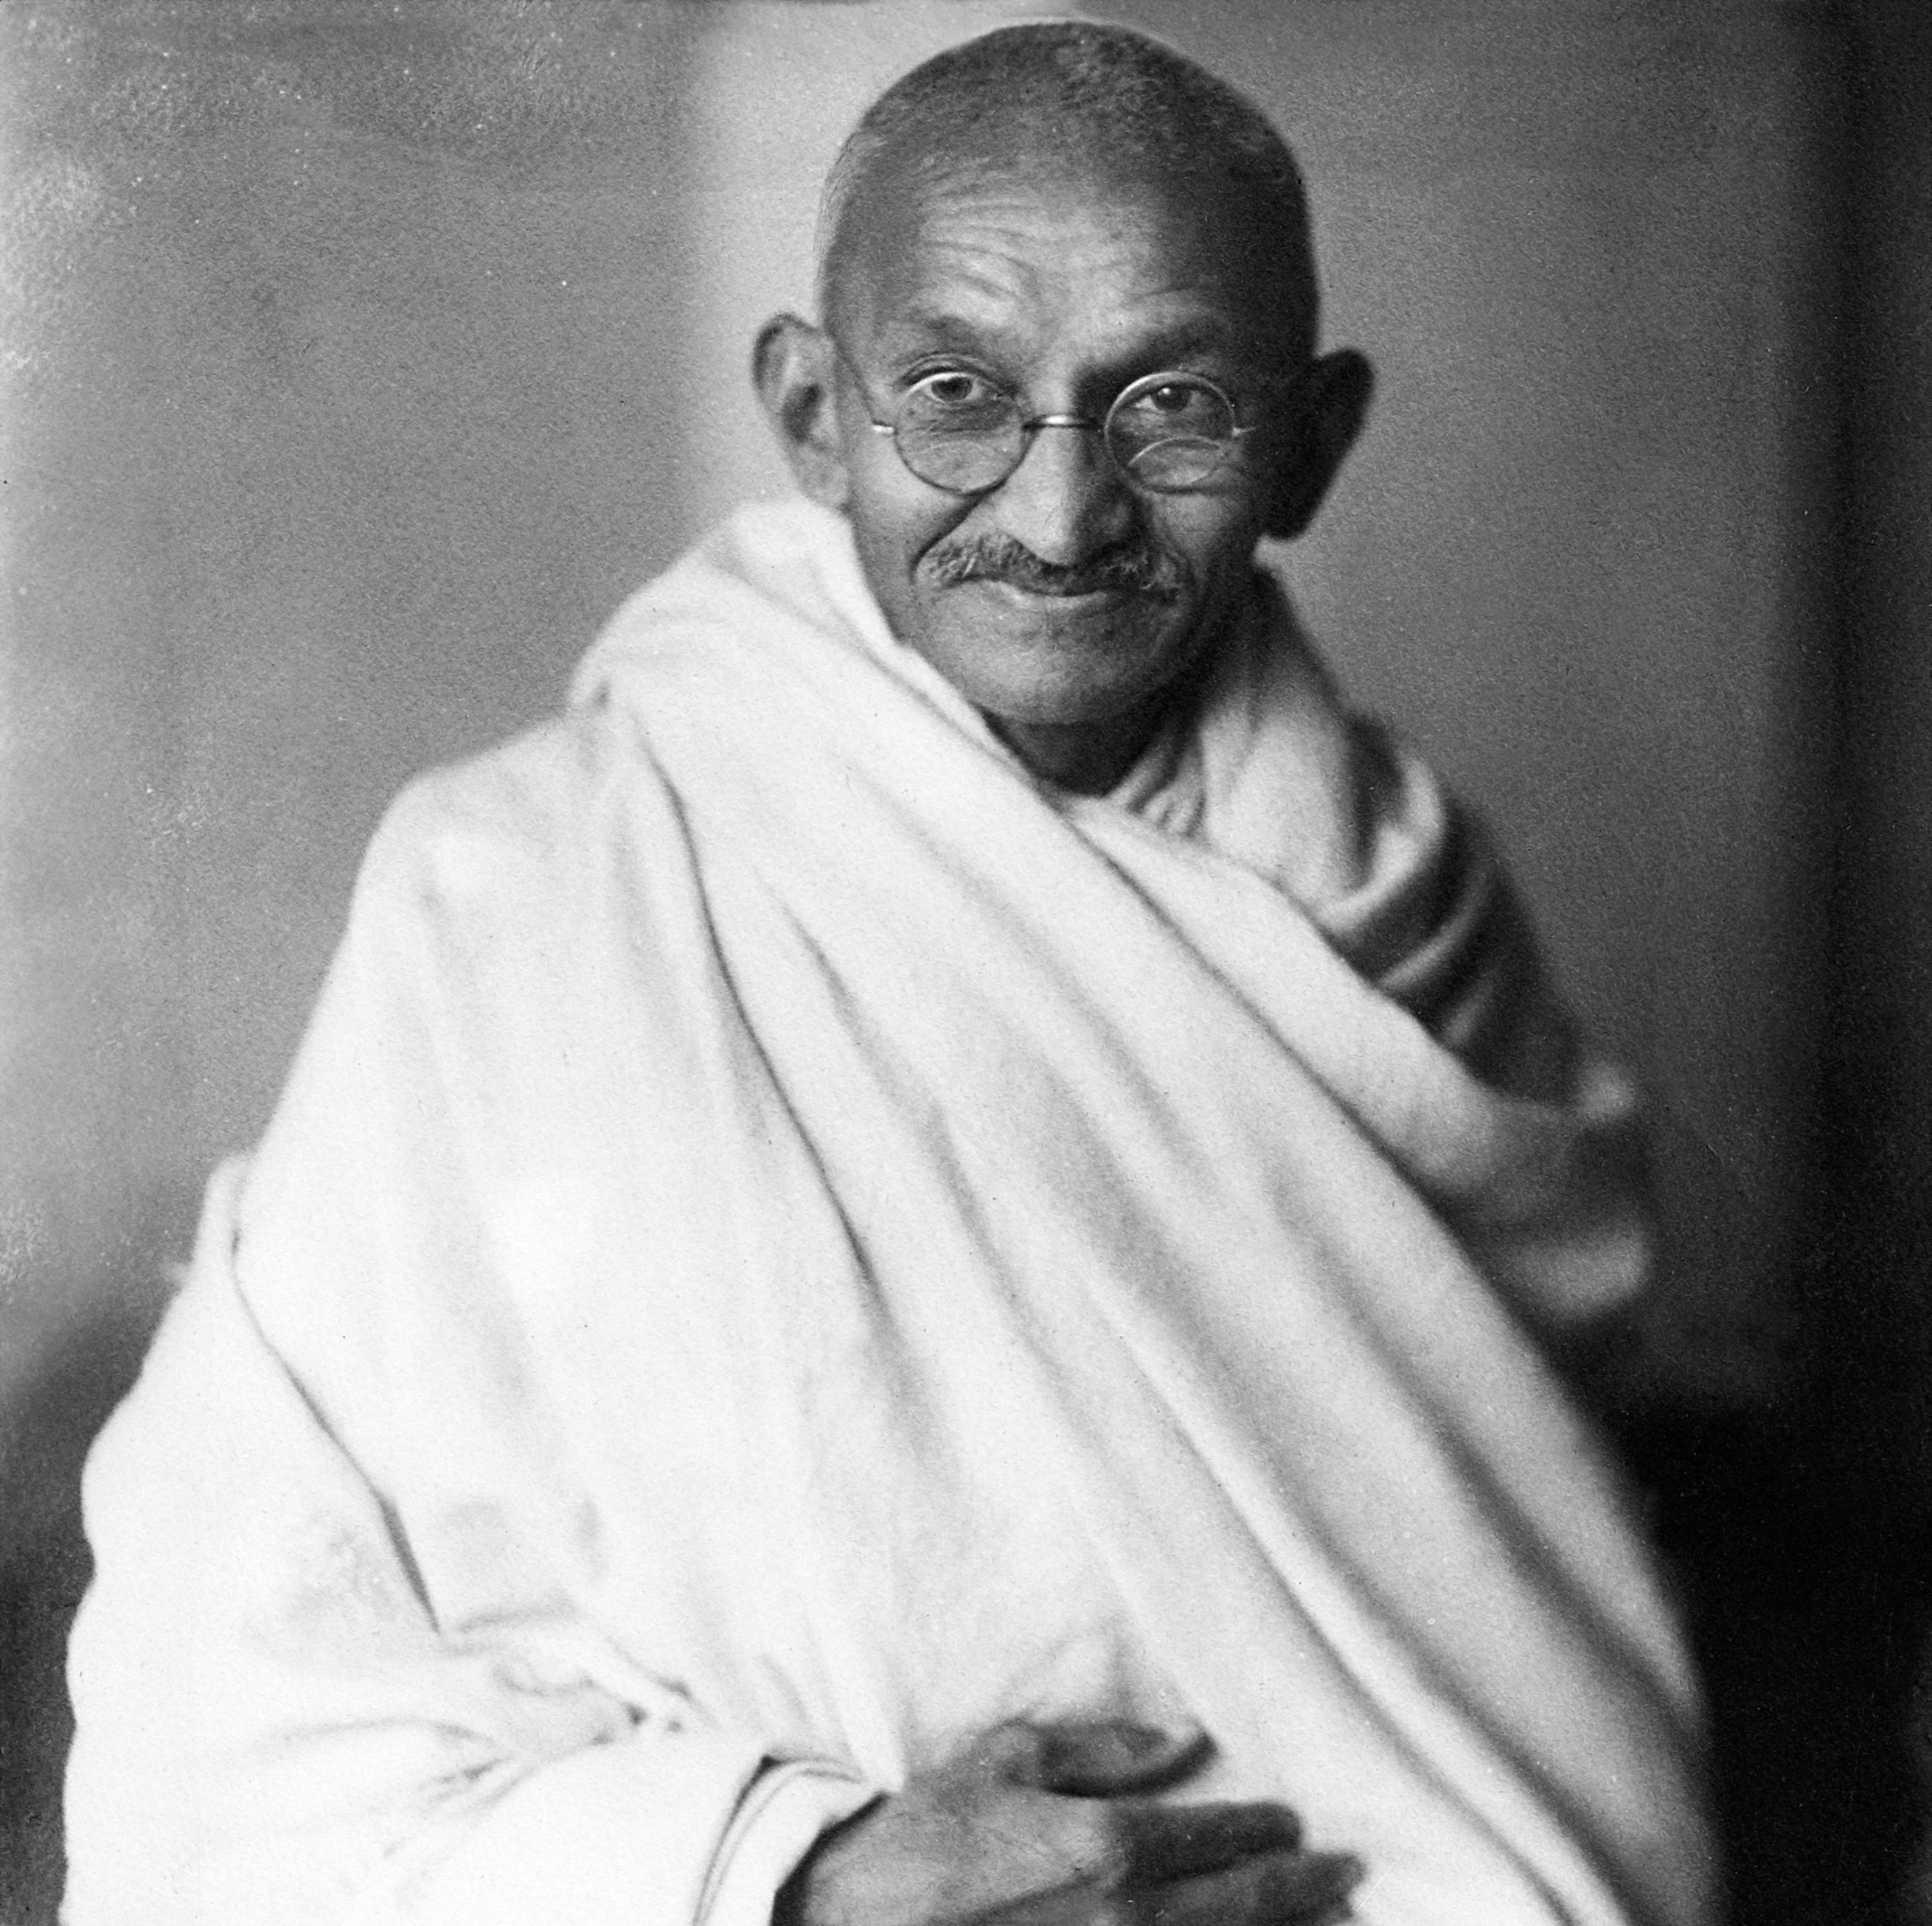
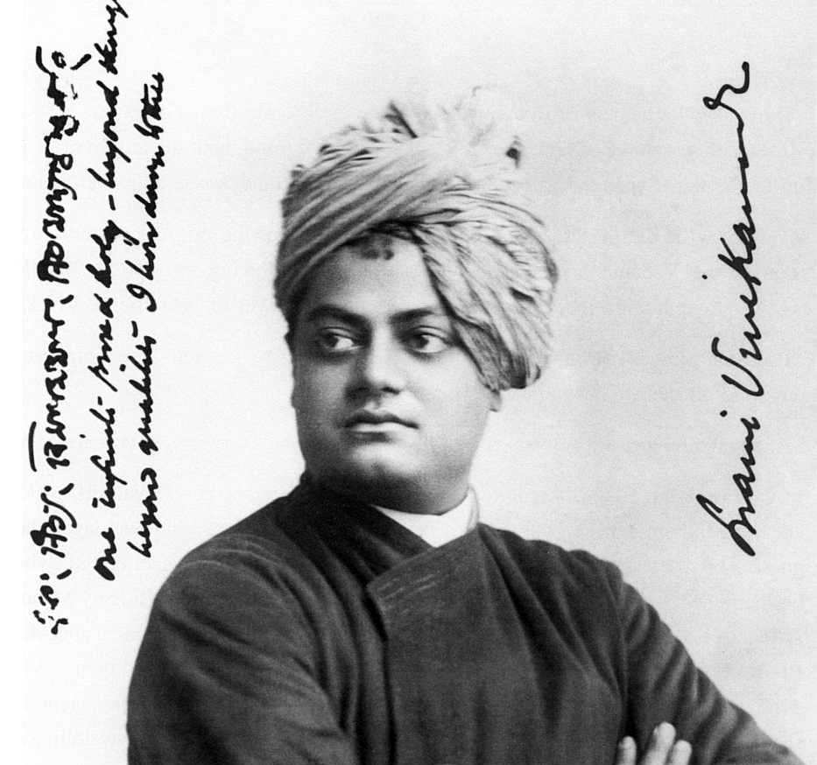
Hindu leaders
Swami Vivekananda- Hindu monk, credited with bringing Yoga to the western world, raising interfaith awareness, and bringing Hinduism to the status of world religion.
Mohandas Gandhi-Lawyer, anit-colonial nationalist and civil rights activist practicing non-violence.
Aurobindo Ghosh-philosopher, yogi, Indian nationalist-Influential against British colonial rule, and developed a spiritual practice called internal yoga-divine life in a divine body.

Slide 21
Let’s go over our chart
Name of Religion | Messenger | Area and year it was first founded | God in the religion | Purpose of Life and our role as the follower of the faith | Religious text | What are the celebrations centered around? | Belief after death
Zoroastrianism
Hinduism

Slide 22
My answers. Let’s compare.
Name of Religion | Messenger | Area and year it was first founded | God in the religion | Purpose of Life | Religious text | What are the celebrations centered around? | Belief after death
Zoroastrianism | Zarathushtra Spitama | Northeastern Iran 1500-1700 BCE | Ahura Mazda | Move the world toward Asha | Gatha-Zarathushtra’s hymns Avesta- Zoroastrian cannon | Nature | A good and a bad state of being. House of Songs and House of Druj
Hinduism | No messenger | Indus Valley 1000-3000 BCE | Brahman and Hindu Trinity 1.Brahma 2.Vishnu 3. Shiva | Achieve Purushrthas Ultimate achievement is Moksha=enlightenment | Many texts oldest of which are the Vedas | Based on god and goddesses' birthdays and anniversaries | Reincarnation until Moksha=enlightenment and release from the cycle of birth and re birth

