Slide 1
Buddhism
Comparative Religion

Slide 2
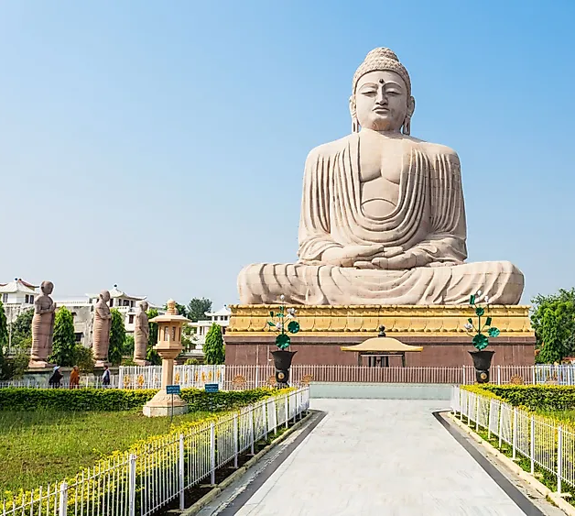
What do you know about Buddhism?
Who was the messenger of the faith?
When and where was he born?
What was his message?
Do you have Buddhist friends?
What do they celebrate?
How do they worship?

Slide 3
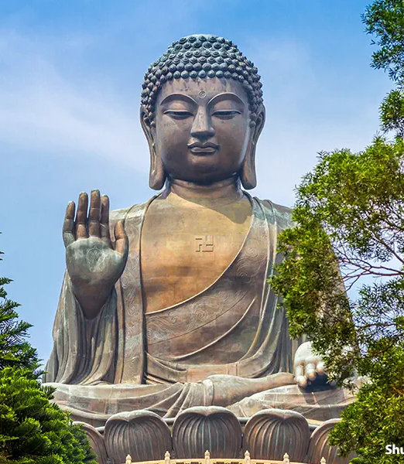
Who is the founder and when was it founded?
The messenger of Buddhism is Siddhartha Gautama called the Buddha
Buddha means the “awakened one”
He was born about 563 BCE in Nepal
When is this in relation to Zoroastrian history?
Zarathushtra lived about 1700 BCE
In 563 BCE the Medes were in power in Iran
The religion was founded about 525 BCE in India.
Buddhism is disappearing from India except for Buddhist immigrants and those who convert from lower Hindu sects.
525 BCE Cambyses II was the king of Achaemenid Empire

Slide 4
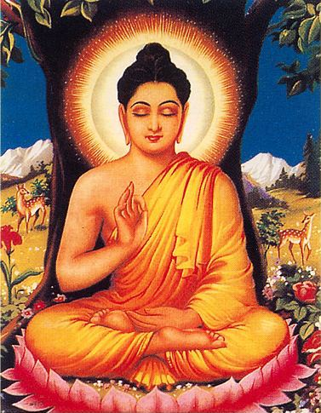
Messenger or Founder of Buddhism
Siddhartha Gautama was born a prince and raised in luxury
At 29 years of age, he gave up material goods and went in search of finding the solution to suffering.
After six years (age 35) he found enlightenment.
He spent the next 45 years of his life teaching and establishing a community of nuns and monks (sangha) to continue his work.
After his death, his teachings were transmitted orally until the 1st century BCE when they were written down.
Parthians were in power in Iran
How is this similar or different from Zarathushtra’s life and how he ensured a continuity of his teachings?

Slide 5
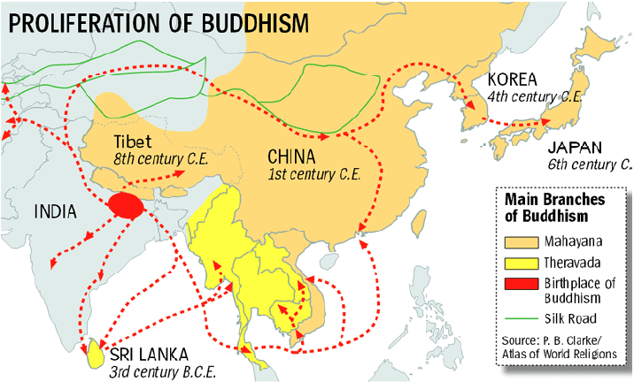
Followers of Buddhism
There are 300 million Buddhists worldwide.
They are 6.6% of world’s population
18.2% of Buddhists live in Taiwan (Republic of China)=largest population of Buddhists in the world
Thailand, Myanmar and Japan follow in line after China
https://worldpopulationreview.com/country-rankings/buddhist-countries

Slide 6
Spread of Buddhism
In 3rd century BCE, the Indian emperor Asoka supported and greatly strengthened Buddhism.
End of Parthian and beginning of Sassanid empires
He sent missionaries as far as Syria.
How is this similar to Zoroastrianism?
Sri Lanka converted to Buddhism in 3rd century BCE and has remined dominantly Buddhist since.

Slide 7
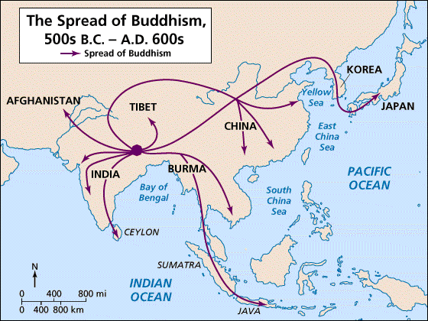
Buddhism in Tibet
Buddhism entered Tibet in 7th century CE
End of Sassanid empire
Influenced by Vajrayana Buddhism that Nirvana (end to suffering) can be attained in this lifetime.
They developed the institution of clergy called “lamas” leaded by “Dalai Lama”

Slide 8
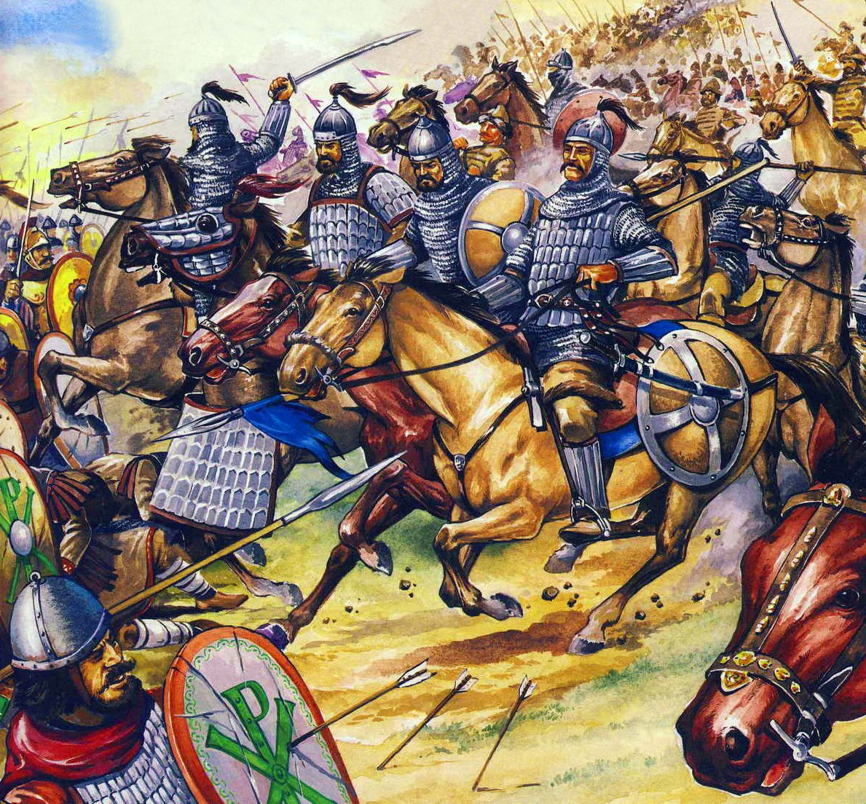
Extinction of Buddhism in India by 13th century CE
Hinduism revival
Invasion of Huns in 6th century CE
Muslim invasion in 11th century CE
How is this similar to Zoroastrian history?

Slide 9
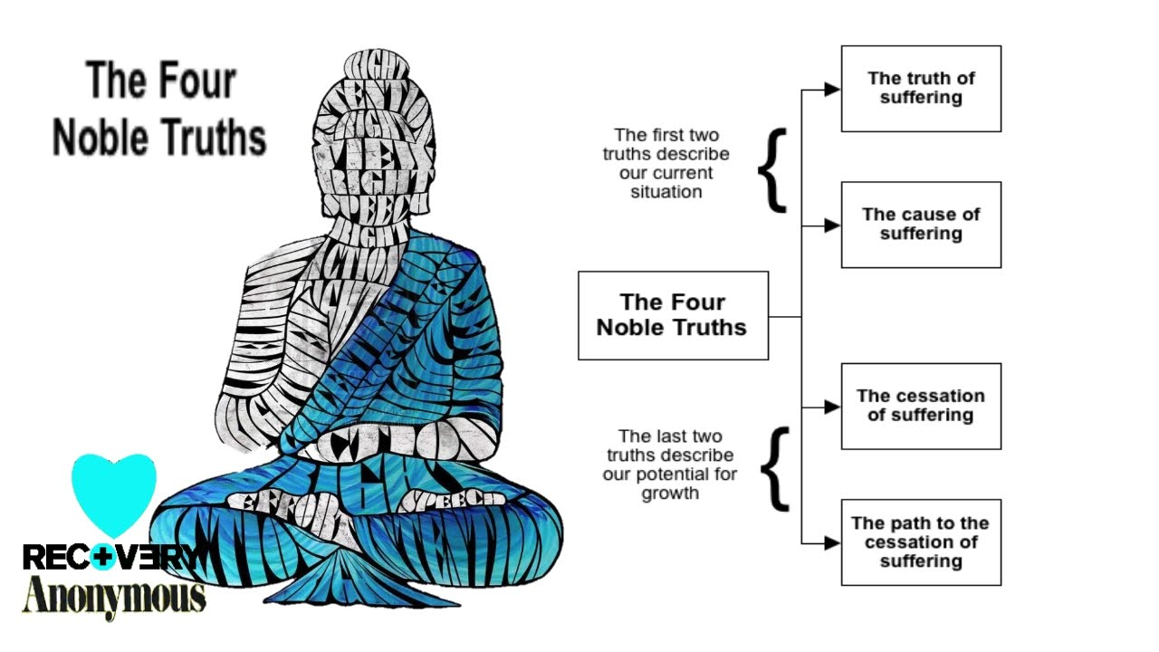
Basic beliefs: Four noble truths
Dukhka- Life is suffering
Trishna- Suffering has a cause= craving and attachment
Nirvana- There is a way to end suffering
There is a path to end the suffering (this is the Eightfold path)
What is Zoroastrians’ basic beliefs?

Slide 10
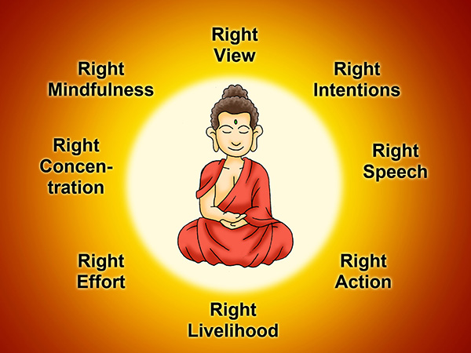
What is the Eightfold path to end suffering?
Right views
Right resolve
Right speech
Right action
Right livelihood
Right effort
Right mindfulness
Right concentration
What is the Zoroastrian path to end suffering?

Slide 11
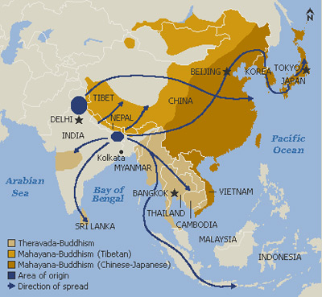
Different Schools of Buddhism
Theravada or Hinayana
In Sri Lanka and SE Asia
Emphasizes personal liberation
Preserve the original and orthodox teachings of Buddha
Mahayana
China
Mongolia
Korea
Japan
Emphasizes collective liberation (not for monks only but everyone)
More flexible (enjoy the pleasures of life and have hope of salvation)
Does Zoroastrianism have different schools?
https://www.onmarkproductions.com/html/theravada-hinayana-buddhism.html

Slide 12
Traditional Theravada Buddhism
Regular people were not expected to meditate or know the scriptures (only monks and nuns)
Regular people should
Support Sangha (monks and nuns)
Live a life of devotion
Through worship and ethical living
Visit stupas (an important teacher, burial mound, shrine containing words of Buddha)
Recite prayers about the importance of Buddha in their lives
What is expected of Mobeds and non-Mobeds in Zoroastrianism?

Slide 13
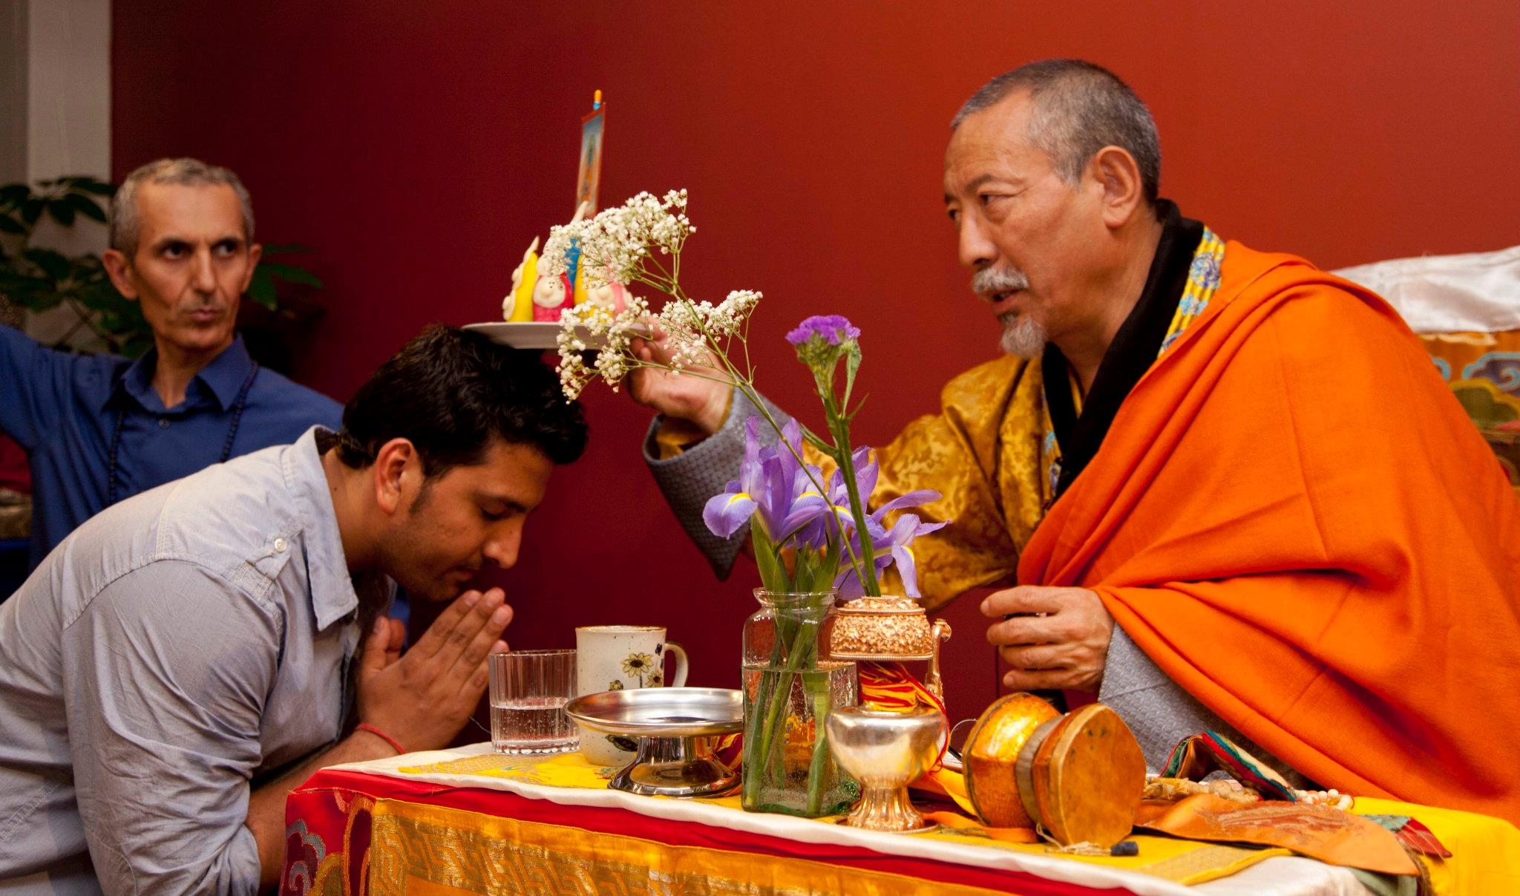
Can one be initiated into Buddhism?
Yes
By believing in the four noble truths and the Eightfold path.
The ceremony differs from country to country.
Can a non-born Zoroastrian be initiate into Zoroastrian religion?
https://buddhismzone.org/how-to-convert-to-buddhism/

Slide 14
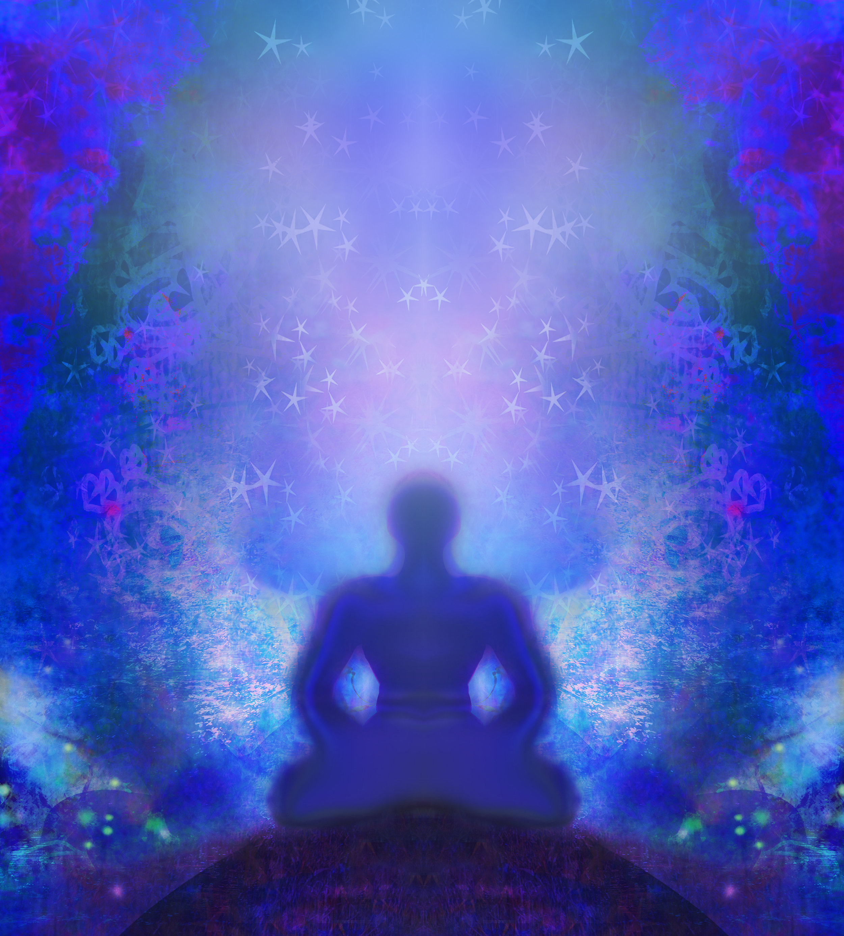
Buddhist goal in life
All life is suffering, and suffering is caused by desire.
Achieve a state of Nirvana (state that is free of desire and suffering) through meditation.
Nirvana means “the state of a flame being blown out”
It represents the quiet state of mind that exists when the fires of attachment and desire are no longer present.
How is it similar or different from Hinduism?
Do Zoroastrians believe that life is suffering? What is our goal in life?
https://www.onmarkproductions.com/html/theravada-hinayana-buddhism.html

Slide 15
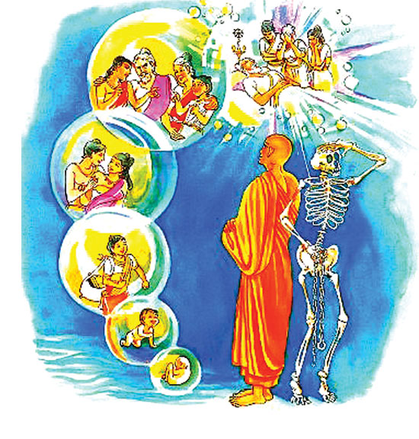
Reincarnation: Birth and Rebirth
Buddhism believe that living beings are trapped in a continual cycle of birth and death.
Our karma (actions and thoughts in this life) determine our condition in next life-similar to Hinduism
Nirvana is the release from this cycle of birth and re birth.
Nirvana is moving beyond physical needs and into a spiritual or religious state
How does Nirvana compare to Moksha in Hinduism? Do we have such a state in Zoroastrianism?

Slide 16
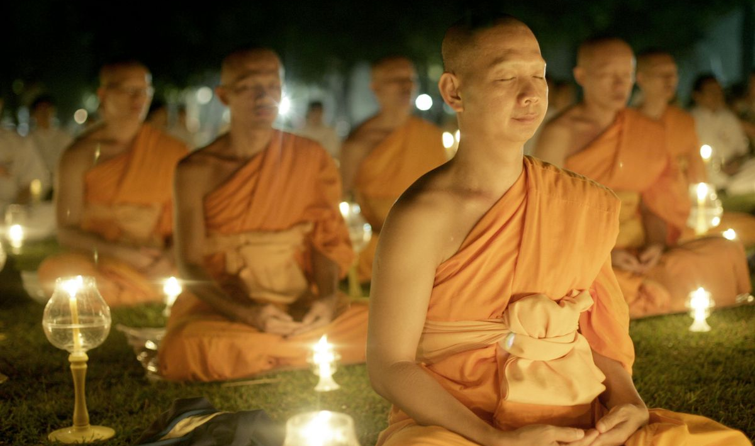
How should a Buddhist act?
Meditation
Righteous (moral) rules to be followed
By monks and regular people
Refrain from taking life
Refrain from stealing
Refrain from acting unchastely
Refrain from speaking falsely
Refrain from drinking intoxicants.
Additional rules to be followed by monks only
Refrain from viewing secular entertainment
Refrain from using garlands, perfumes, and other bodily adornments
Refrain from sleeping in high or wide beds
Refrain from receiving money
How should a Zoroastrian act?
How should a Mobed act?
Are the actions between a Zoroastrian and a Mobed different?

Slide 17
Buddhism Sacred Text
Tripitaka (Tipitaka in Pali)
It was first transmitted orally by monks
Written in ancient Indian language called Pali 1st century BCE in Sri Lanka
Pali language is very close to the language of Buddha himself.
What is the sacred text of Zoroastrians?
https://www.bl.uk/sacred-texts/articles/the-buddhist-canon

Slide 18
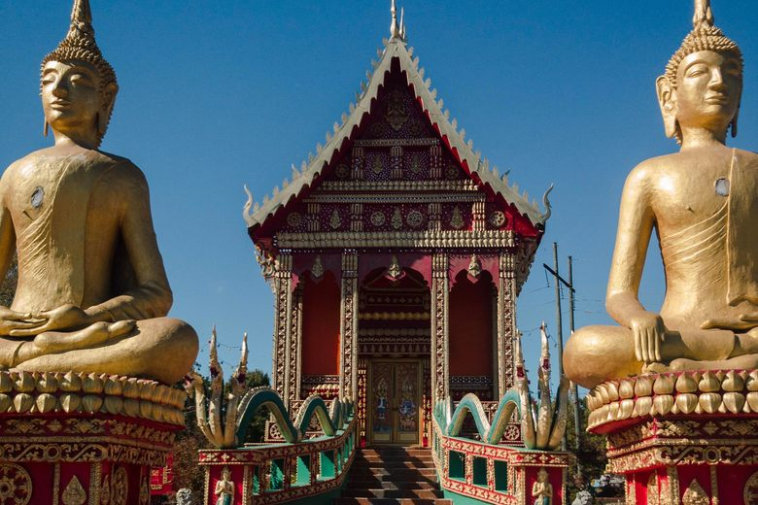
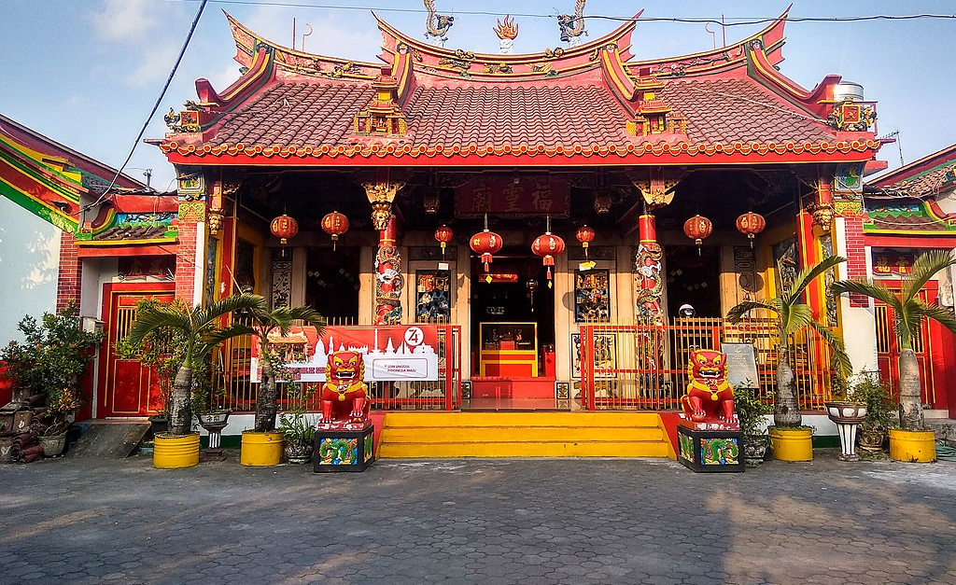
The Buddhism Temple
Buddhism temples are centers of worship
Worship includes chanting from the scriptures
Giving offerings in front of an image of Buddha
Lighting candles
Burning incense
Meditating
Listening to sermons
How do Zoroastrians worship in their temples or homes?

Slide 19
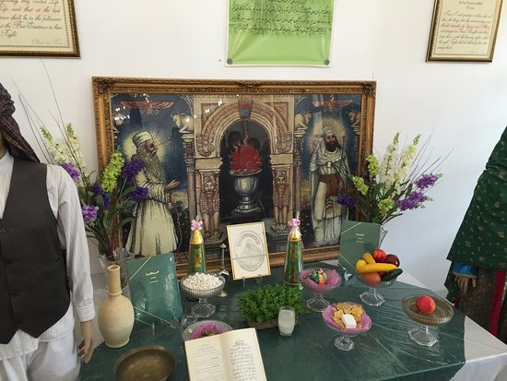
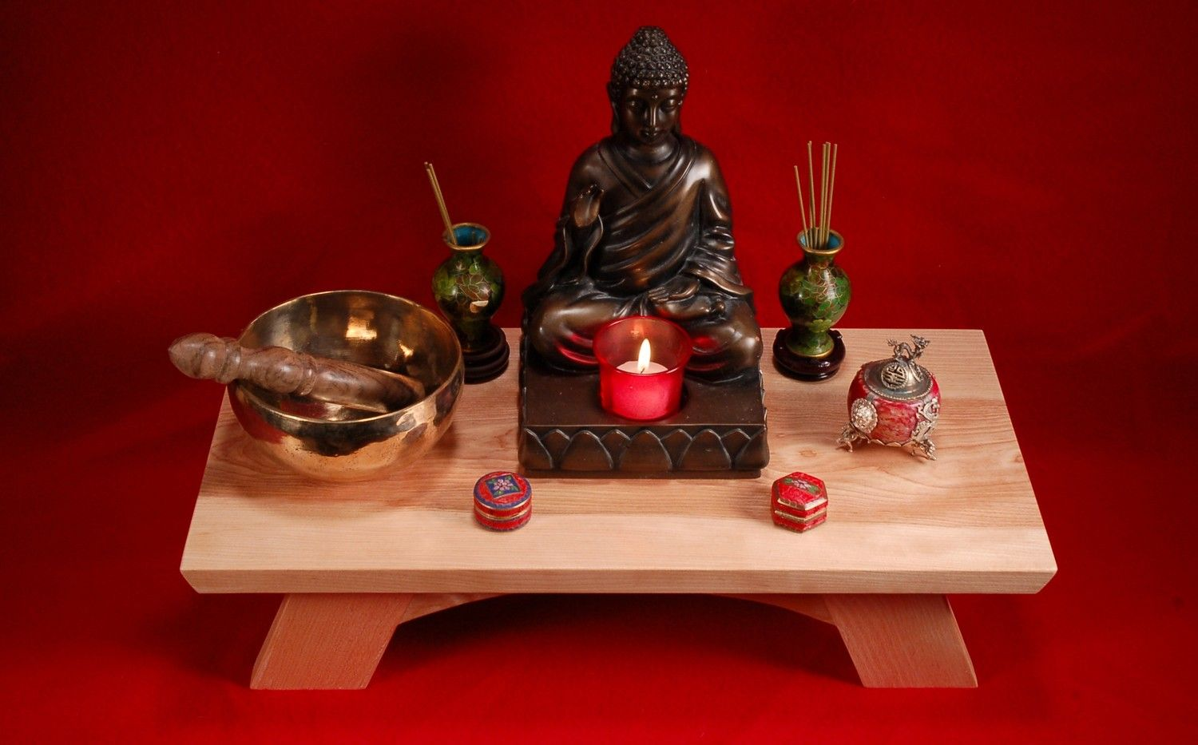
Shrine Room
Important part of Buddhist temple is the shrine room
The shrine room contains one or more Buddharupas (statues of Buddha)
Any room that contains a statue of Buddha used in worship is a shrine.
A shrine can be in a temple or in private homes
Entering a shrine room
Take off shoes
Dress modestly (in white in Theravada countries)
Bow in front of Buddharupas
Sit with feet tucked under
Bowls of water and food offerings are placed before Buddharupa on a raised platform
Do Zoroastrians have a shrine room?
If yes what is placed in a Zoroastrian shrine room?

Slide 20
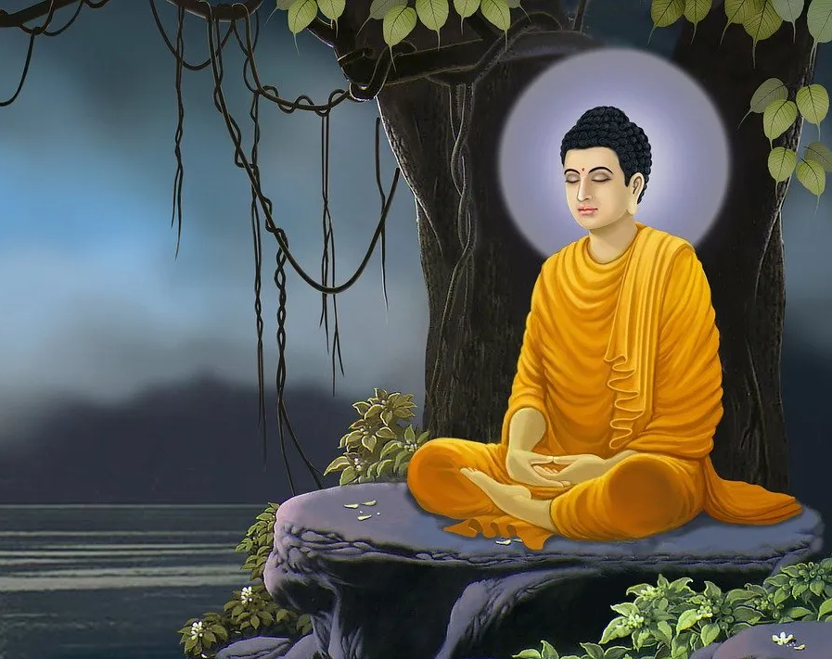
Divinity or God in Buddhism
There is no creator God or supreme being in Buddhism.
Buddha achieved enlightenment through his own findings and not through a message from God
How is this similar or different to Zarathushtra’s path to enlightenment?
Denial of soul
We change in each moment therefore there is no constant or permanent soul.

Slide 21
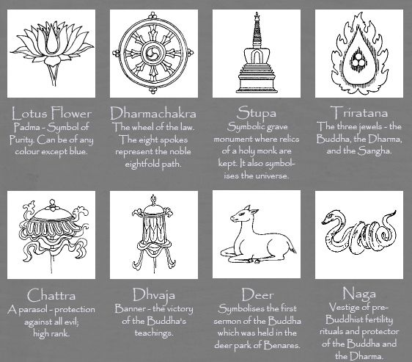
https://buddhismforkids.net/symbols.html
Symbols of Buddhism

Slide 22
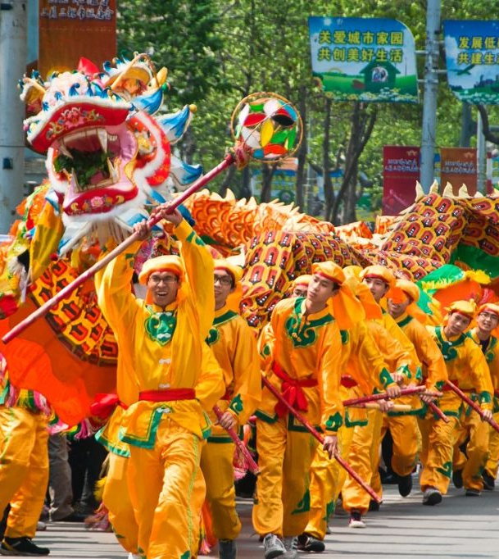
Buddhist Celebrations
Lunar New Year or commonly known as Chinese New Year (Jan/Feb)
Families put up red decorations and lanterns
Give red envelopes of money to children
Pay respect to household gods and ancestors
Enjoy a feast
Communities perform lion dance to bring good luck
https://www.youtube.com/watch?v=fhniCJjdECI
Wesak-Buddha’s birth for some Buddhist also his death and enlightenment
Statues of Buddha are decorated
Offerings taken to monasteries
A time when Buddha has reached Nirvana (freedom from physical life, enlightenment and end or reincarnation circle)
Higan-e in March and September (Spring and Fall equinox)
Six components should be practiced at these weeklong festivals to help reach one to Nirvana
Giving, precepts, perseverance, diligence, meditation, and wisdom
Customs include offering rice cakes, and sweets
Offerings to Buddha at the temple
Visit the ancestors in cemetery
Which two Zoroastrian celebrations are at the same time as Higan-e?

Slide 23
Let’s go over our chart
Name of Religion | Messenger | Area and year it was first founded | God in the religion | Purpose of Life and our role as the follower of the faith | Religious text | What are the celebrations centered around? | Belief after death
Zoroastrianism
Hinduism
Buddhism

Slide 24
My answers. Let’s compare.
Name of Religion | Messenger | Area and year it was first founded | God in the religion | Purpose of Life | Religious text | What are the celebrations centered around? | Belief after death
Zoroastrianism | Zarathushtra Spitama | Northeastern Iran 1500-1700 BCE | Ahura Mazda | Move the world toward Asha | Gatha-Zarathushtra’s hymns Avesta- Zoroastrian cannon | Nature | A good and a bad state of being. House of Songs and House of Druj
Hinduism | No messenger | Indus Valley 1000-3000 BCE | Brahman and Hindu Trinity 1.Brahma 2.Vishnu 3. Shiva | Achieve Purushrthas Ultimate achievement is Moksha=enlightenment | Many texts oldest of which are the Vedas | Based on god and goddesses' birthdays and anniversaries | Reincarnation until Moksha=enlightenment and release from the cycle of birth and re birth
Buddhism | Buddha Born in Nepal | 525 BCE India | Do not believe in God | Nirvana- end of suffering and breaking the cycle of birth and rebirth | Tripikata | -Buddha’s birth, death and enlightenment -Seasons | Reincarnation until Nirvana=end of suffering and breaking the cycle of birth and re birth

