Slide 1
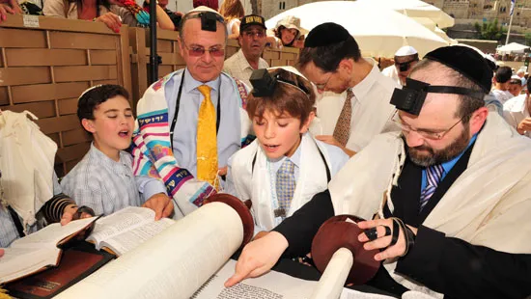
Judaism
Comparative Religion

Slide 2
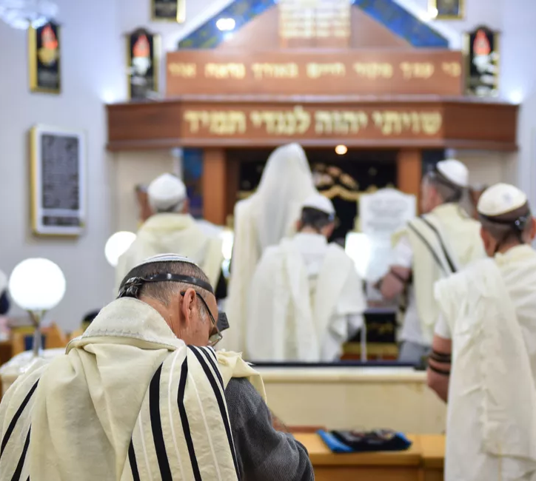
What do you know about Judaism?
Who was the messenger of the faith?
When and where was he born?
What was his message?
Do you have Jewish friends?
What do they celebrate?
How do they worship?

Slide 3
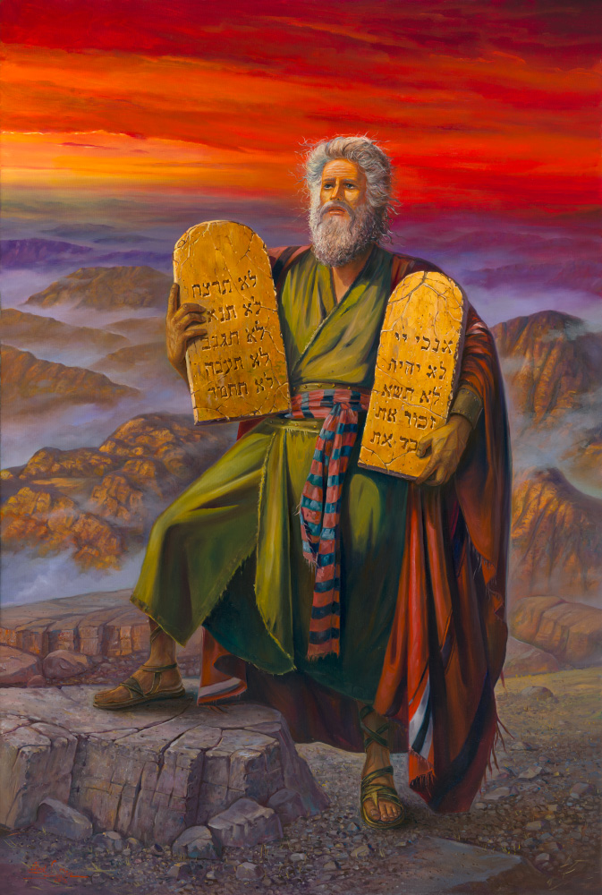
Who was the founder and when was it founded?
Jewish history and culture goes back a long time.
Jews believe in a line of prophets.
Do Zoroastrians believe in more than one prophet?
Abraham was the first Jew to make an agreement with God.
Therefore Judaism, Christianity, Islam and Bahaism who recognize Abraham as part of their faith are among Abrahamic religions.
Moses - the giver of Law – is considered the most important prophet for Jews.
He was born 1300 BCE
How does the time of his birth compare to that of Zarathushtra?
Why isn’t Judaism considered the first monotheistic religion?

Slide 4
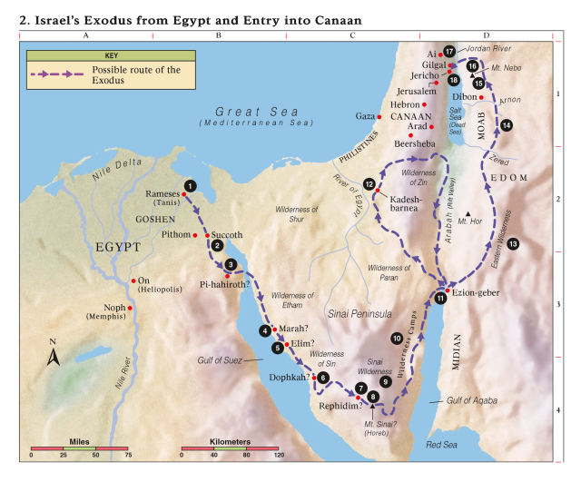
Messenger or Founder of Judaism
Jews believe that infant Moses was protected by God.
As a young man Mosses received a special calling from God and through him God declared his Laws which included the Ten Commandments
In his old age, when the Hebrews were at Jordan River ready to cross, God showed him the image of the Promised Land.
Moses died before reaching the Promised Land (Palestine/Israel) and was buried in Moab (today’s Jordan)

Slide 5
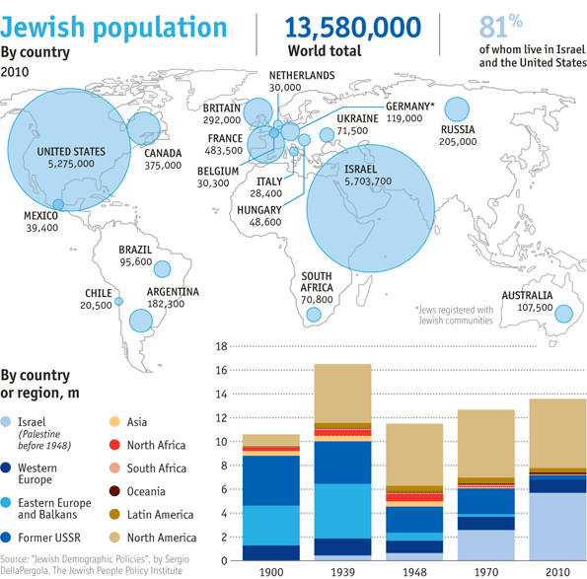
Followers of Judaism
Some people identify ethnically and culturally as Jewish but may not practice the religion.
Top three countries with largest Jewish population
Israel- 6.8 million
United States- 5.7-6.7 million
France- 450K
Where do most Zoroastrians live today?

Slide 6
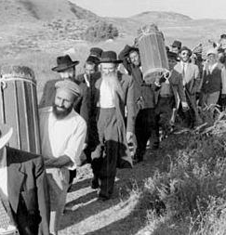
Spread of Judaism out of Palestine
Diaspora led to the spread of Judaism
Assyrian conquest and captivity of tribes living in northern Israel (722BCE)
Babylonian conquest and captivity of tribes living in southern Israel (597BCE)
In 539 BCE with Cyrus the Great’s conquest of Babylon, the Jews were freed to go back to Israel. Cyrus also rebuilt the Temple of Jerusalem the center of Jewish life.
How does this reflect Zoroastrian beliefs?
Greek conquest of Jerusalem
Roman conquest of Jerusalem- many Jews left Israel and settled in the Roman city of Alexandria (200-300 BCE)
Jews settled in countries such as Persia, Spain, France, Germany, Poland and Russia and adopted their language, and culture but always considered Palestine as the homeland.

Slide 7
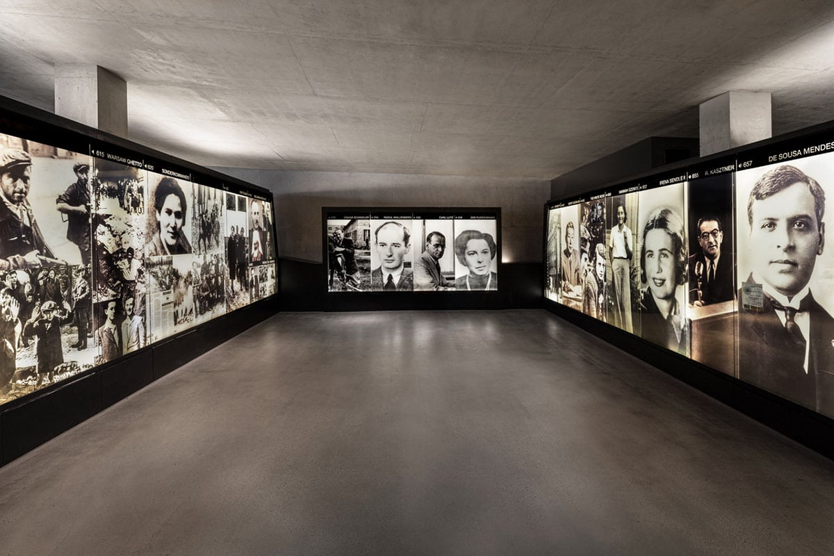
Major Force Against Jewish Community
Holocaust
Genocide of European Jews during WWII (1941-1945)
2/3 of Europe’s Jewish population was killed
Has Zoroastrian history witnessed a genocide?
How has the genocide in Judaism and Zoroastrianism affected them to this day?
How have the people of each religion dealt with the historical event?

Slide 8
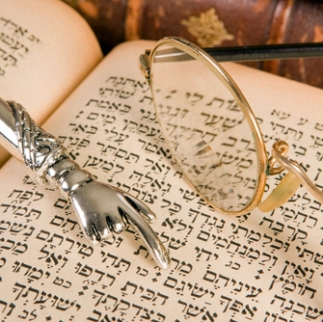
Religious Book of the Jews
The divine message of God to the people is gathered in 5 books, together known as the Torah written in Hebrew.
Torah in Hebrew means “teaching or learning”
Contains the fundamental Laws of physical and moral conduct
The Torah begins with the origin of the universe and ends with the name Israel in Hebrew meaning “triumph with God”.
Oral tradition which later was put into writing
What do you remember about Zoroastrian religious book/s?
How are our scriptures similar or different?

Slide 9
Belief in One God
Today, central to the religion is the belief in one God which is named Jehovah
What do we call God in Zoroastrianism?
Most scholars believe that Judaism
started as polytheism (belief in many gods)
Then henotheism (belief in one God but not denying the existence of others)
Finally, monotheism (belief in only one God)
What do scholars consider Zoroastrianism to be?

Slide 10
Nature of God in Judaism
Lord of the universe
Significantly different from all His creatures
Compassionate toward His creation and in turn humans are to love and fear (stand in awe of) Him
Because God is holy, He demands humans to be holy, righteous, and just to fulfil his design for the mankind and the world.
How does the nature of God in Judaism compare to the nature of God in Zoroastrianism?

Slide 11
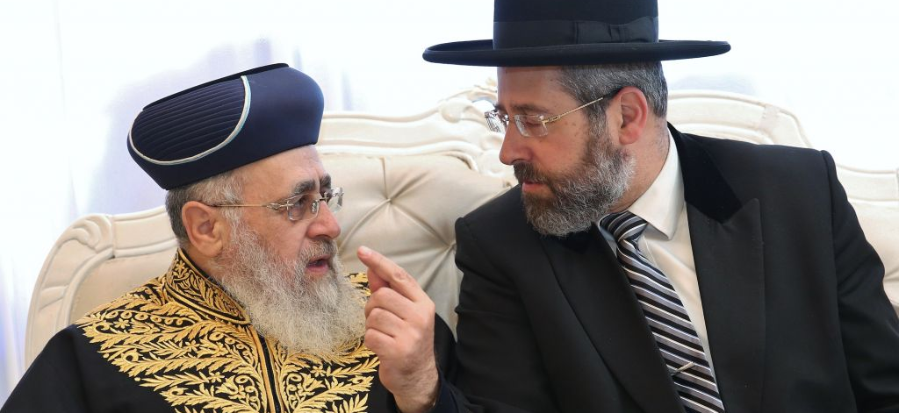
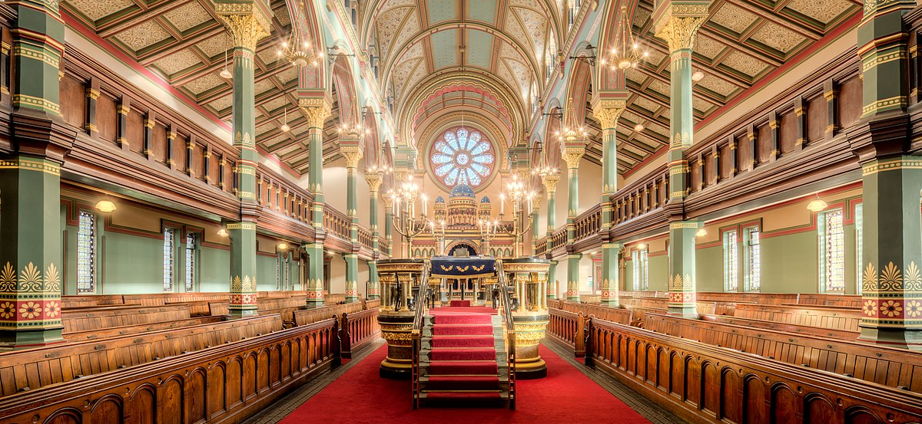
Place of Worship
Synagogue
Place of worship, education and communal affairs
Rabbi
Jewish priest/ leader/teacher
Traditionally only males could be Rabbi
Women recently accepted in some Jewish movements
Do you remember the place of worship in Zoroastrianism?
Can women be Mobeds?

Slide 12
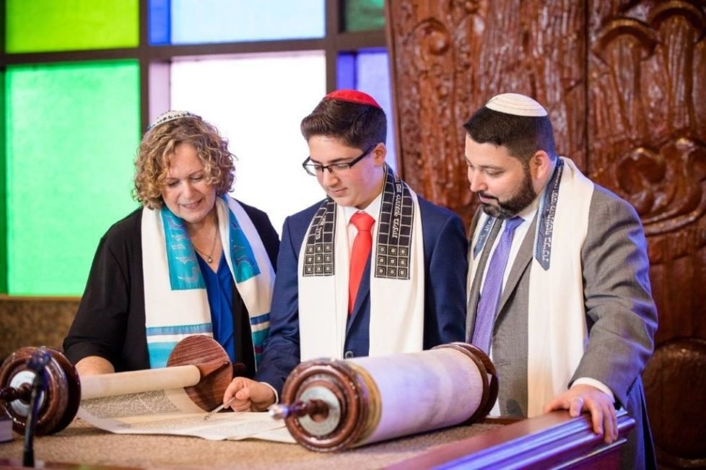
Bar Mitzvah
Initiation ceremony of a Jewish male into the community
Traditionally it is performed when the child is 13 years of age and a day
Performs his act as an adult in saying a portion of the Torah
Today it is usually followed by a social celebration
In 20th century a similar ceremony is performed for the female called Bat Mitzvah
How does this compare to Sedreh Pooshi/Navjote for Zoroastrians?
Gender
Age
Purpose and celebration

Slide 13
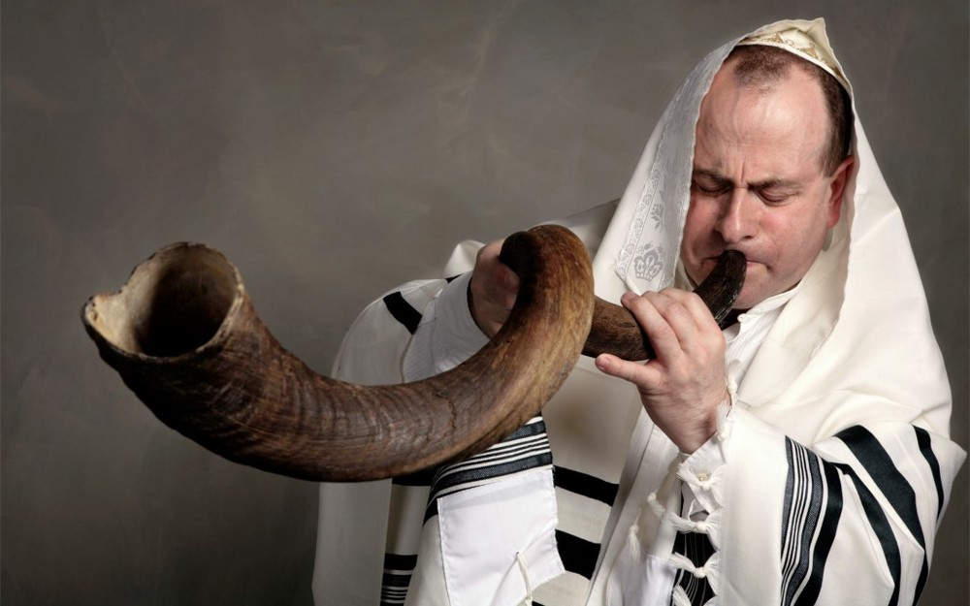
Holy days in Judaism
Shabbat
Story of creation in Torah indicates that God rested on the 7th day so Sundown on Friday to Sundown on Saturday, Jews rest.
https://www.youtube.com/watch?v=vjmjZWHXKFY
Rosh Hashanah
Jewish New Year commemorating the creation of the world
Ends in Yom Kippur, when Jews fast, gather in synagogues to pray, confess, and ask for forgiveness for the sins of the past year
https://www.youtube.com/watch?v=HkdPGmoeEOQ
Passover
A seven-day event in Israel, eight-day event outside Israel
A time of telling the story of Jew captivity in Egypt and being led out of Egypt by God through Mosses.
It is a time to remember the importance of freedom for all as they knew the hardship of slavery
What are the central theme of Jewish holidays? How does it compare to Zoroastrian celebrations?

Slide 14
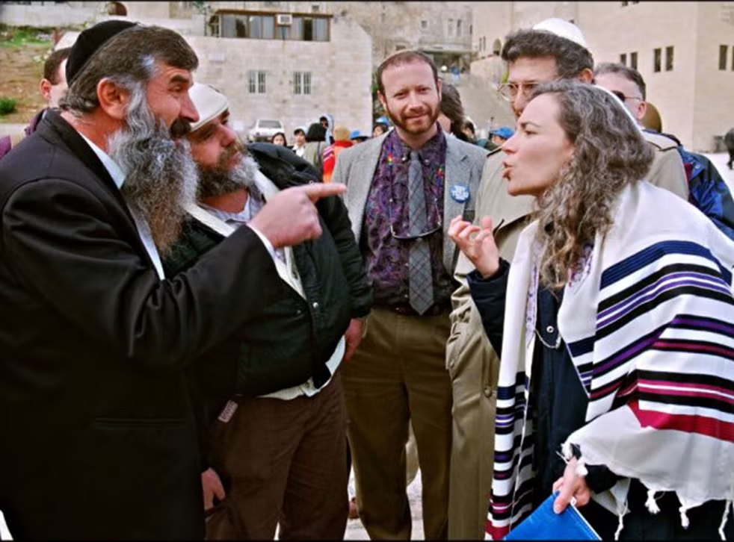
Movements in the US
Three major Jewish movements in US today
Reform (liberal)
Do not believe that the Torah was written by God but by different people at different times.
Do not believe in rigid following of the commandments but follow the ethical and value of Judaism
Men and women sit together
Conservative
Developed from the tension between Reformist and Orthodox Jews
Believe that the Torah is the word of God, transmitted to us by humans and it has a human component
Orthodox (traditional)
Believe that the whole Torah was given to Mosses, and it is unchanged since delivered to Moses.
They believe that the laws in Torah are to be followed by Jews
Men and women sit separately
35% of Jews consider themselves as just Jewish and not connected to any movement
Do Zoroastrians have different denominations?

Slide 15
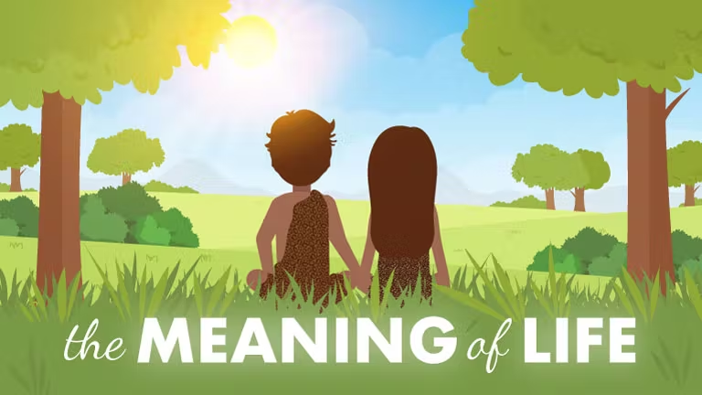
Purpose of Life in Judaism
It was the Creator’s will for the soul which is truly a part of the divine to be put into a physical body and a physical world.
This is because the soul has a mission to purify the physical body and the physical world and make it a place for God.
This can only be done by living a life according to the Torah and the commandments (mitzvot). This way one can connect his entire being with God and therefore making him a place in the Physical world.
Mitzvot examples include:
Having children
Declare God’s oneness
Resting on the 7th day
Not eating pork
Building the temple in Jerusalem,…
What is purpose of life in Zoroastrianism?

Slide 16
Can one be initiated into Judaism?
Historically being Jewish is part of a race of people but today certain movements within Judaism do accept converts.
How is one way of being initiated into Judaism?
Study and learn the scripture
Circumcision
Bait Din (Rabbinic Court)
Three-member court who vote on the initiate’s knowledge and intent
Mikveh (immersion in a body of water)
Hebrew name
Can one be initiated into Zoroastrianism? If yes how?

Slide 17
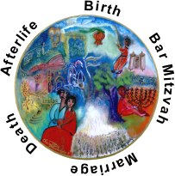
Life After Death in Judaism
Life doesn’t begin with birth and doesn’t end with death.
Major sections in the soul’s journey
Soul before entering physical body
Physical life
Post physical life- Garden of Eden or a state of suffering
Soul passes judgment upon itself
Soul stays connected with family and loved ones and watch over them
Reincarnation- the soul must master all the mitzvot
The world to come- resurrection
World will be filled with knowledge of God
How does it compare to Zoroastrian belief?

Slide 18
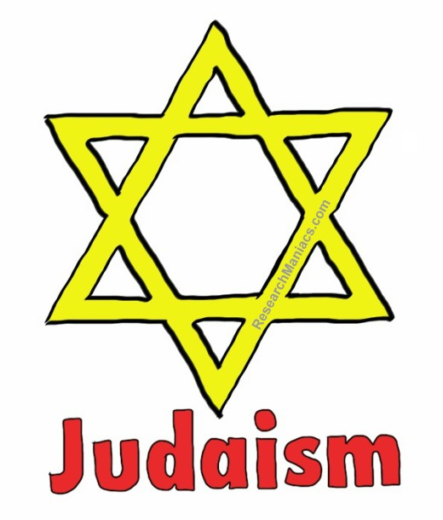
Most Common Symbol of Judaism today
Star of David
In the Torah it says that a six-pointed star protected and made King David’s shield sturdier than his opponent’s.
What is the symbol of Zoroastrian religion? Why?

Slide 19
Let’s go over our chart
Name of Religion | Messenger | Area and year it was first founded | God in the religion | Purpose of Life and our role as the follower of the faith | Religious text | What are the celebrations centered around? | Belief after death
Zoroastrianism
Judasim

Slide 20
My answers. Let’s compare.
Name of Religion | Messenger | Area and year it was first founded | God in the religion | Purpose of Life | Religious text | What are the celebrations centered around? | Belief after death
Zoroastrianism | Zarathushtra Spitama | Northeastern Iran 1500-1700 BCE | Ahura Mazda | Move the world toward Asha | Gatha-Zarathushtra’s hymns Avesta- Zoroastrian cannon | Nature | A good and a bad state of being. House of Songs and House of Druj
Judaism | Many messengers Most important Moses | 1300 BCE Middle East | Yahweh | Live a life according to Torah and mitzvot to be complete connection to God in order to make a pure physical abode for God | Torah | Jewish history and law | Garden of Eden or place of suffering. Notion of reincarnation until mastered at mitzvot

Slide 21
Solve the Puzzle
1
2
3
4
5
6
7
8
9
10
…….. is the major Jewish prophet.
Their prophet led the captive Jews out of ……. to the promise land or
……..
The Jewish religious book is the ….
Purpose of life in Judaism is to live a live of Torah and mitzvot in order to completely connect with God and therefore make him a place in the …….. world
The major Jewish holidays are centered around their ……….
Jewish temple is called…..
Jewish priest is called a ….
Star of ….. is the most recognized Jewish symbol.
Most Jews live in …..
Mystery word: Zoroastrian Seasonal celebrations (green)

Slide 22
Solve the Puzzle
1 | M | o | s | e | s
2 | E | g | y | p | t
3 | P | a | l | e | s | t | i | n | e
4 | T | o | r | a | h
5 | p | h | y | s | i | c | a | l
6 | p | r | o | p | h | e | t
7 | s | y | n | o | g | a | g | u | e
8 | r | a | b | b | i
9 | D | a | v | i | d | l
10 | I | s | r | a | e | l
…….. is the major Jewish prophet.
Their prophet led the captive Jews out of ……. to the promise land or
……..
The Jewish religious book is the ….
Purpose of life in Judaism is to live a live of Torah and mitzvot in order to completely connect with God and therefore make him a place in the …….. world
The major Jewish holidays are centered around their ……….
Jewish temple is called…..
Jewish priest is called a ….
Star of ….. is the most recognized Jewish symbol.
Most Jews live in …..
Mystery word: Zoroastrian Seasonal celebration (green)

