Slide 1
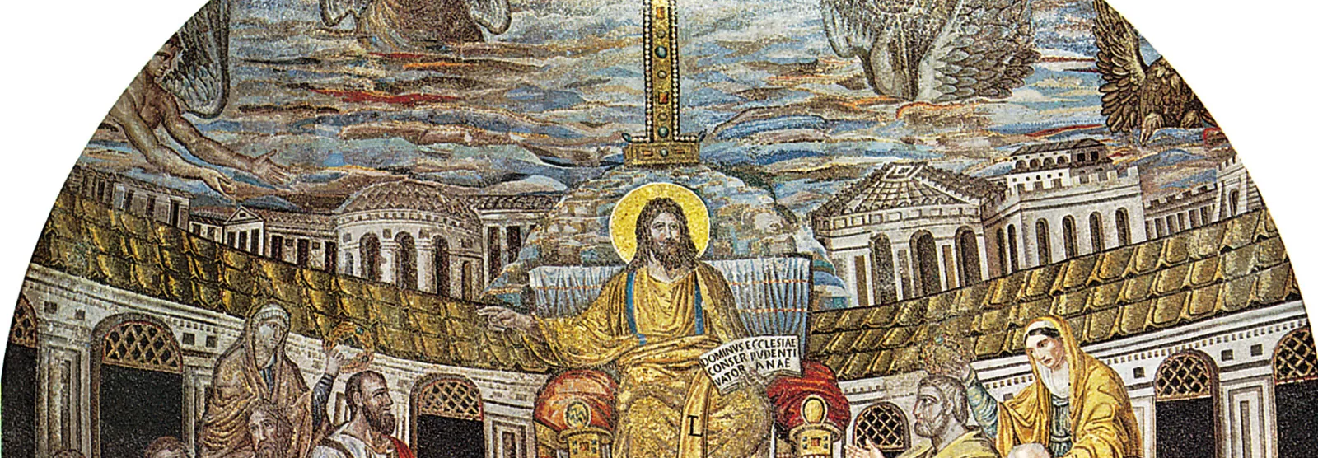
Christianity
Comparative Religion

Slide 2
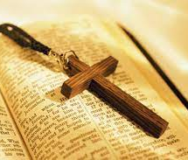
What do you know about Christianity?
Who was the messenger of the faith?
When and where was he born?
What was his message?
Do you have Christian friends?
What do they celebrate?
How do they worship?

Slide 3
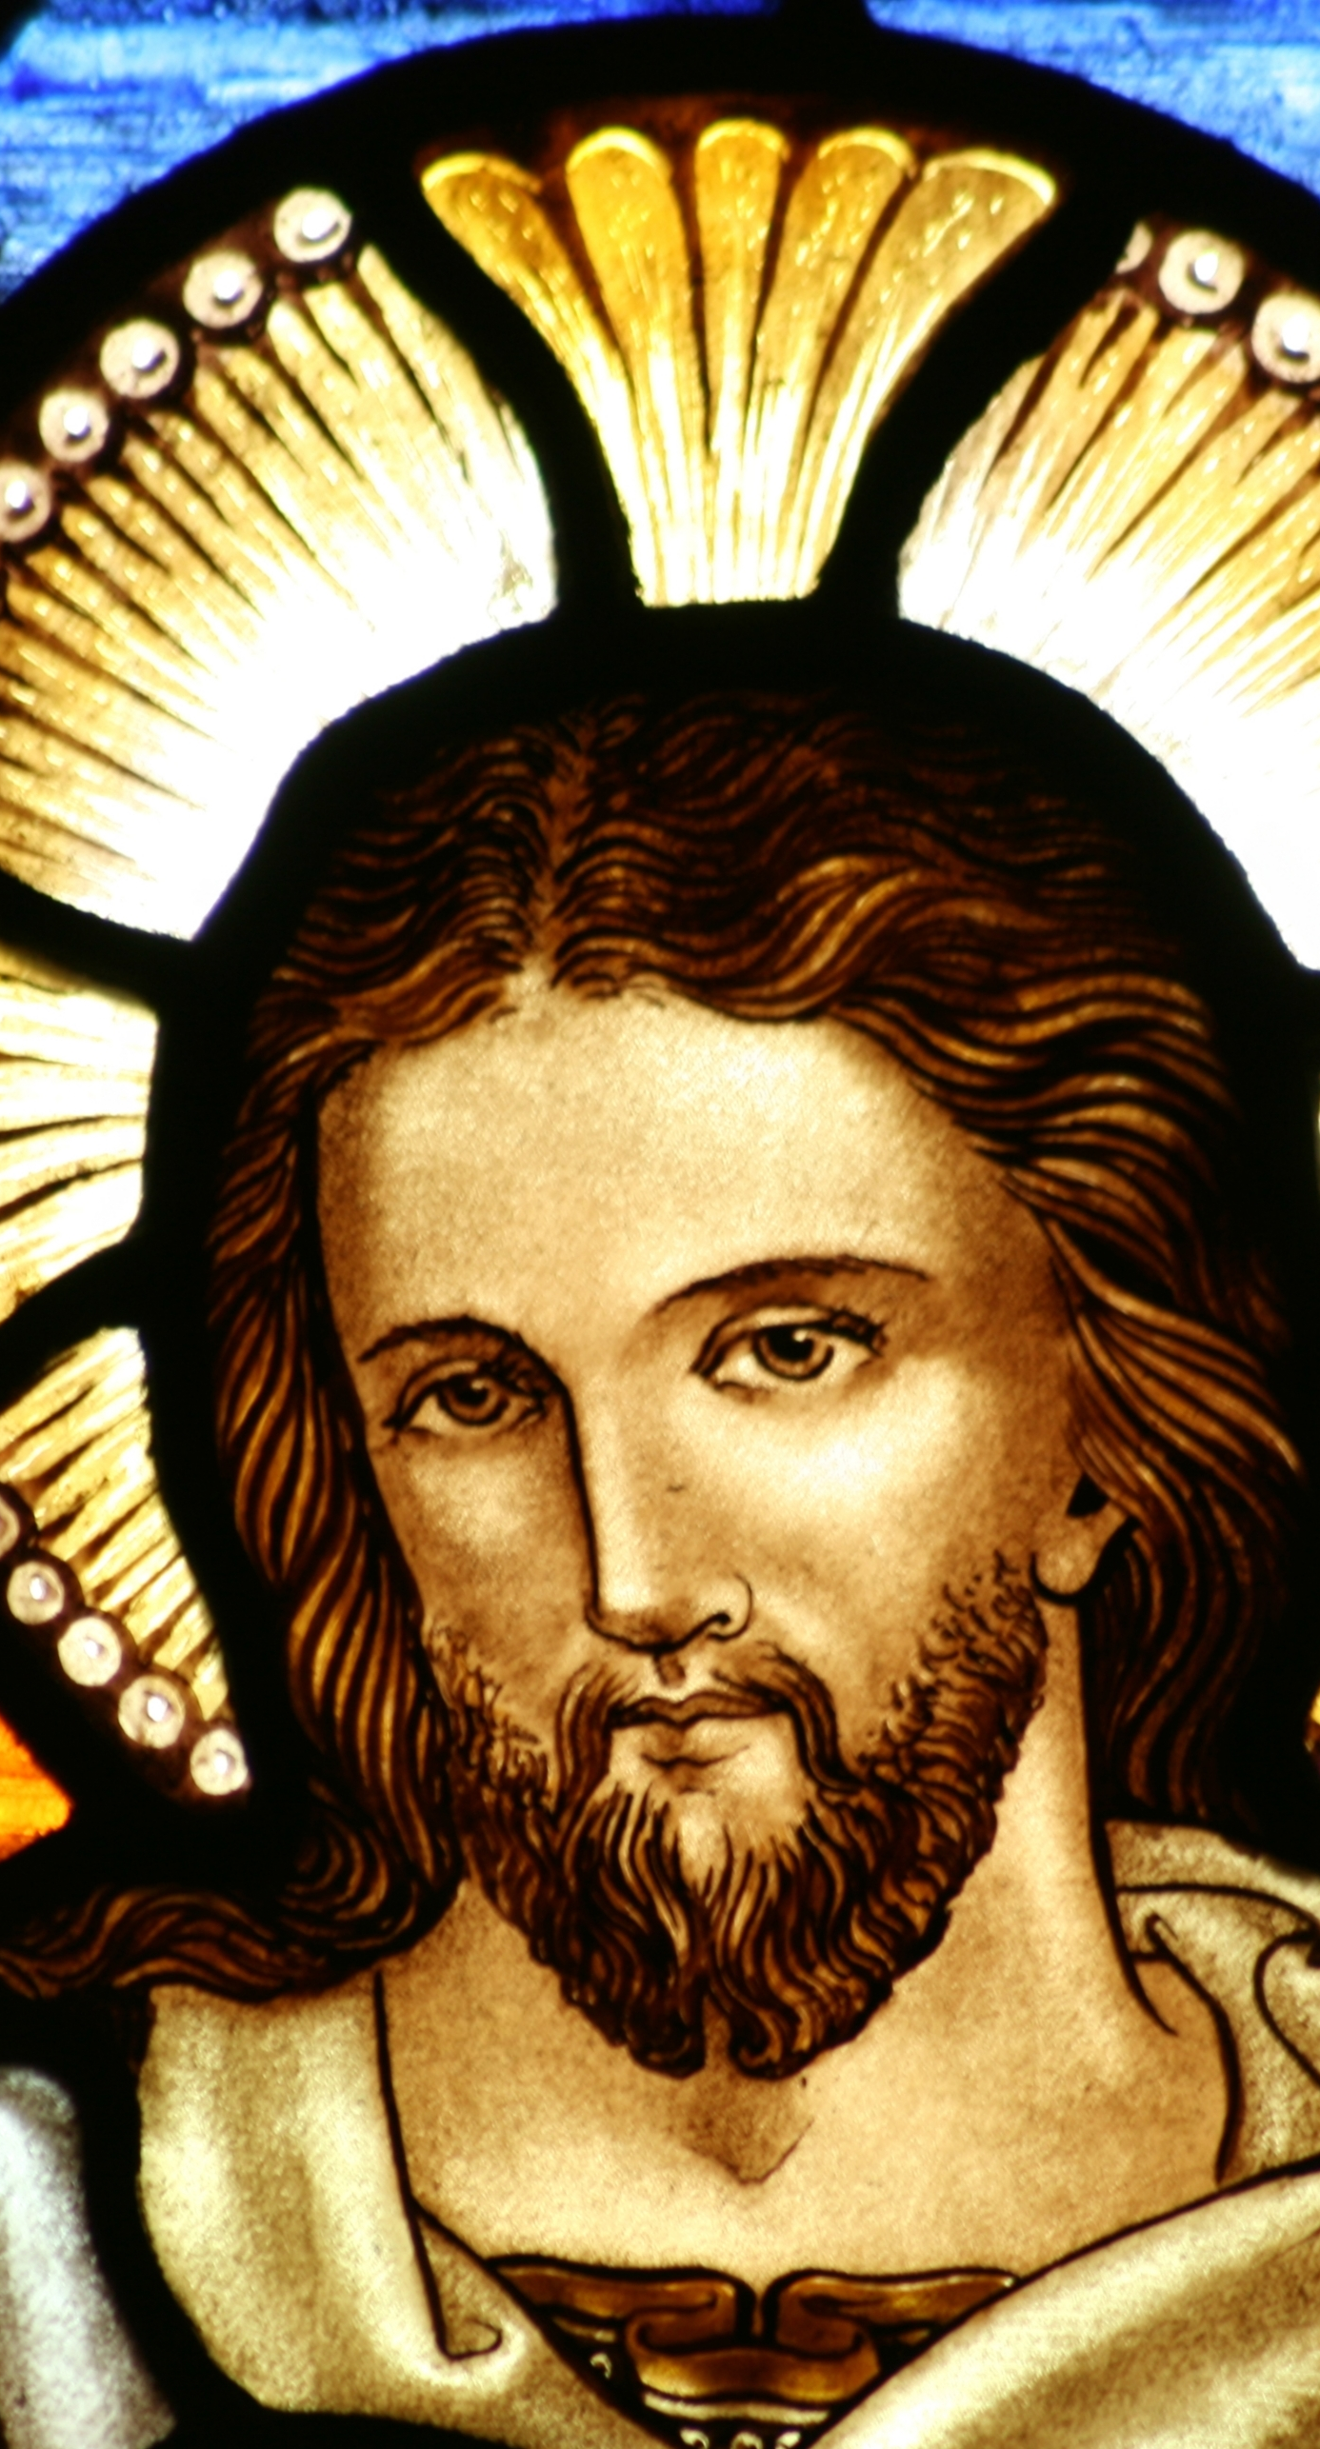
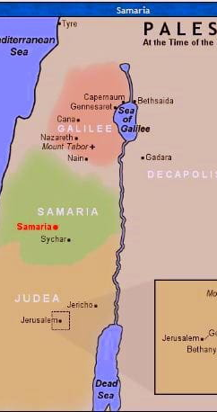
Who was the founder of Christianity and when was it founded?
Founder= Jesus of Nazareth
Christians believe Jesus to be the Messiah or the anointed one
His arrival was predicted in the Old Testament
Who else is named Messiah in the Bible? Why?
The word Christ is the Greek word for Messiah
It is a title rather than a name-Jesus Christ
Does Zarathushtra have a title? If yes, what is it? Why?
Jesus started preaching when he was about 30 years old in Judea near the Jordan River
About 26 CE
When did Zarathushtra start preaching?

Slide 4
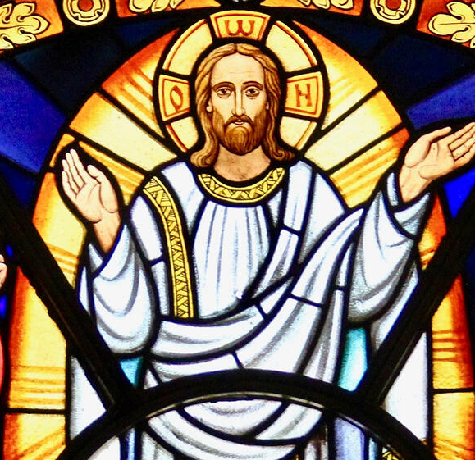
Jesus of Nazareth
He was born a Jew in Bethlehem about 4 BCE
When and where was Zarathushtra born?
His mother was Mary and his father Joseph, a carpenter of Nazareth
It is believed that three Magi visited Christ at time of his birth bringing gifts of gold, frankincense, and myrrh
Who were the three Magi?
He died about 28-30 CE
Who ruled Persia at this time?
What political implications would this bring for Persia?
How could it effect Zoroastrianism?

Slide 5
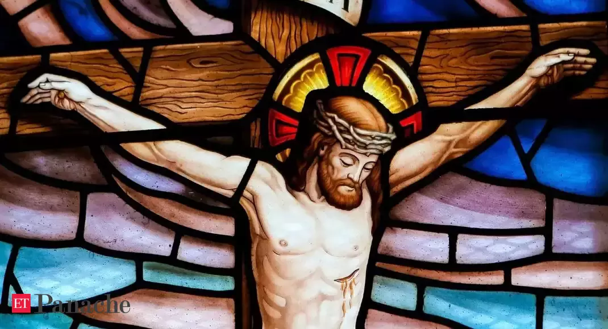
Last Days of Jesus on Earth
On Passover, he entered Jerusalem on a donkey, where he shared the Last Supper with his disciples
He was betrayed to the Roman authorities by Judas
He was arrested, tried, and condemned to death as a political agitator
He was crucified and buried
Three days after he was buried, visitors found his tomb empty
According to the Gospel, he appeared several times to his disciples before ascending to heaven.

Slide 6
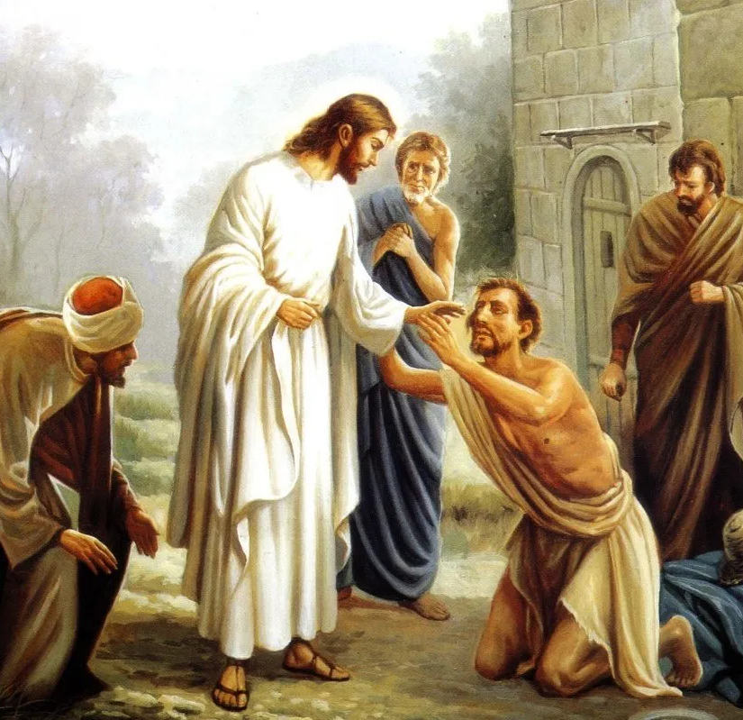
Nature of Jesus
Jesus was believed by his followers to be the son of God
He was a preacher, teacher and healer
He gathered disciples in the region of Galilee which was the center of his ministry (North of Israel)
His reported miracles won him a growing number of followers who believed he was the promised savior (messiah)
What is the nature of Zarathusthra?

Slide 7
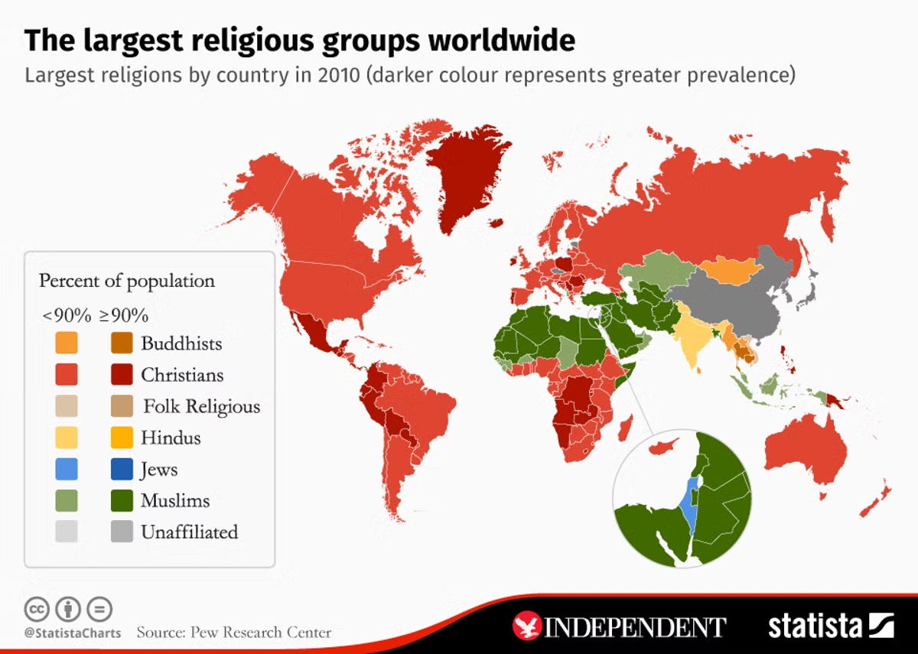
Followers of Christianity
There are about 2 billion Christians, it has the largest following
Most of the followers reside in the United States (253 Million)
Where do most Zoroastrians live?

Slide 8
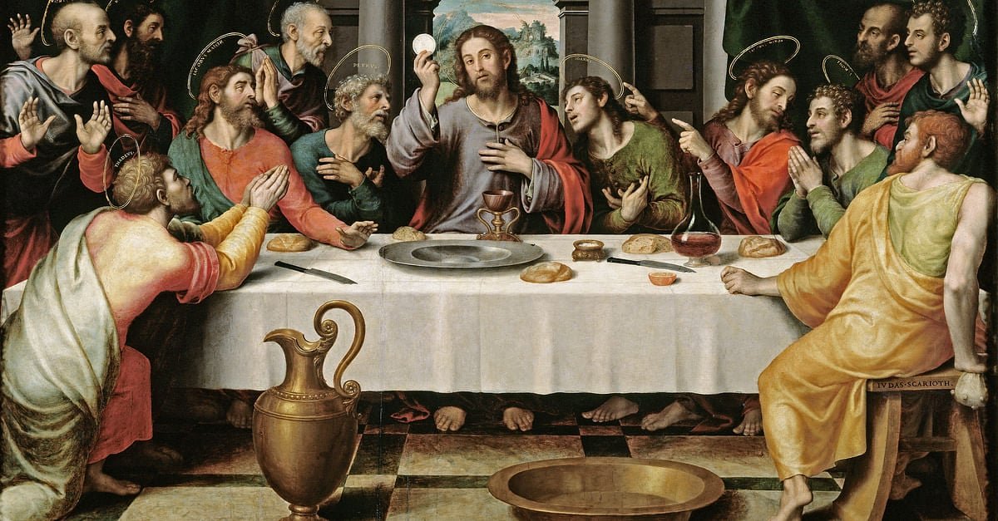
12 Apostles
The 12 Apostles are 12 individuals chosen by Jesus to preach the gospel (Jesus’s life and teaching)
Did Zarathushtra have close followers? If yes, who were they? How do you know?

Slide 9
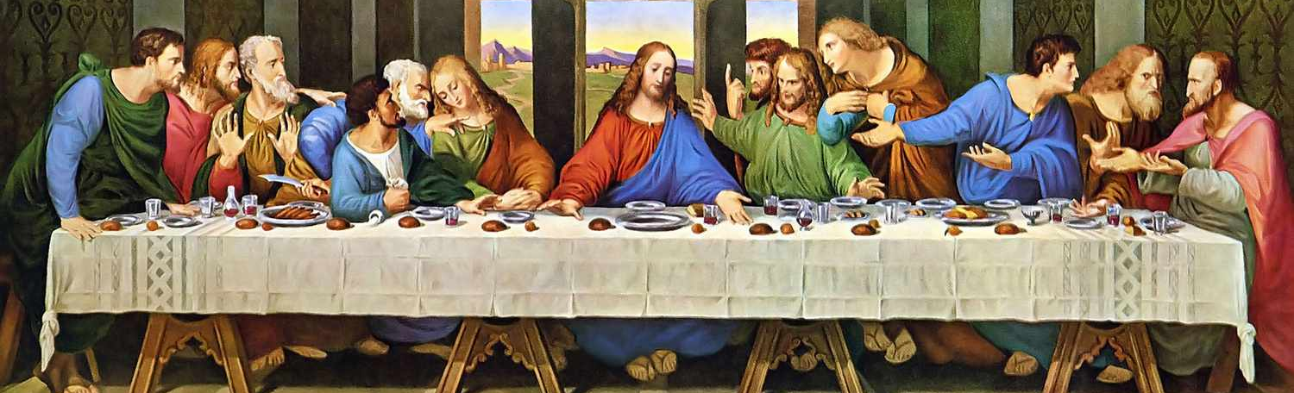
Jesus’s teaching
End of time will occur resulting in the reign or Kingdom of God
To prepare for this event, all must repent and live according to an ethic of love
He asked his followers to be meek and merciful peacemakers.
He also asked them to love one another, even one’s enemies
How does this compare to Zarathusthra’s teaching?

Slide 10
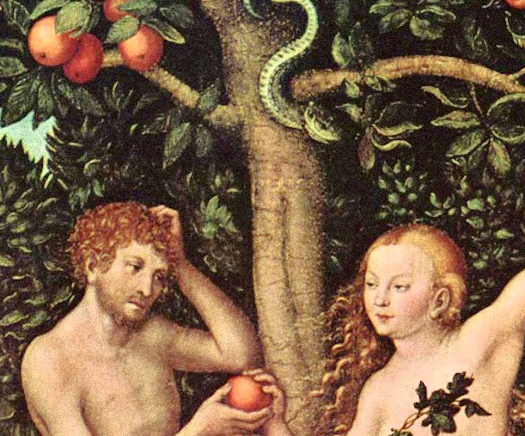
Jesus’s Gift to Humanity
By dying and rising from the dead, Jesus made up for the sin of Adam and redeemed the world, allowing all who believe in Him to enter heaven.
What was Zarathushtra’s gift to humanity?
Do we have the above concept in Zoroastrianism?

Slide 11
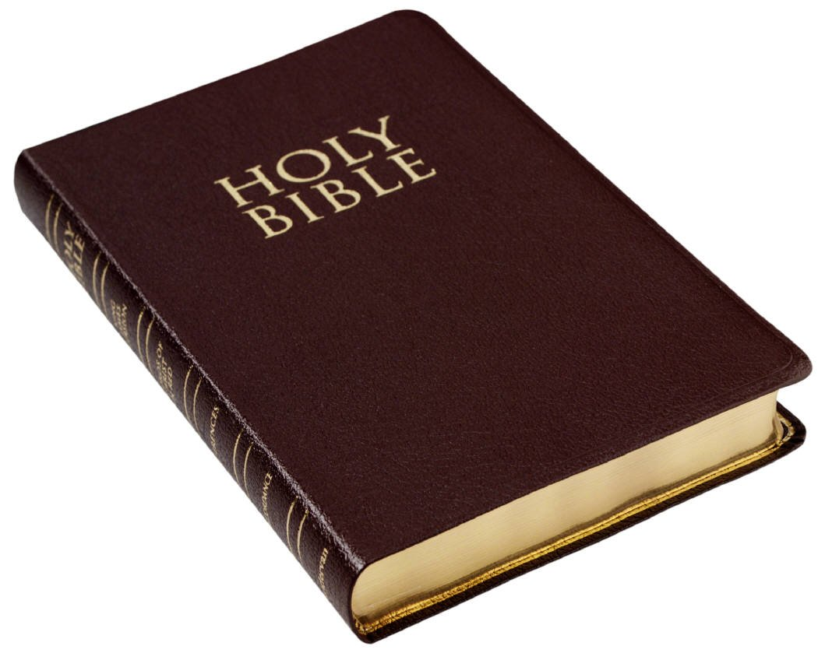
Christians’ Religious Book
Bible is the inspired word of God and is made of
the Old Testament-written in Hebrew with a few chapters written in Aramaic
the New Testament (written in 50-100 CE) -written in Greek
Gospels of the New Testament are four books
give a record of Jesus Christ’s life and teaching
What is Zoroastrian’s religious book?

Slide 12
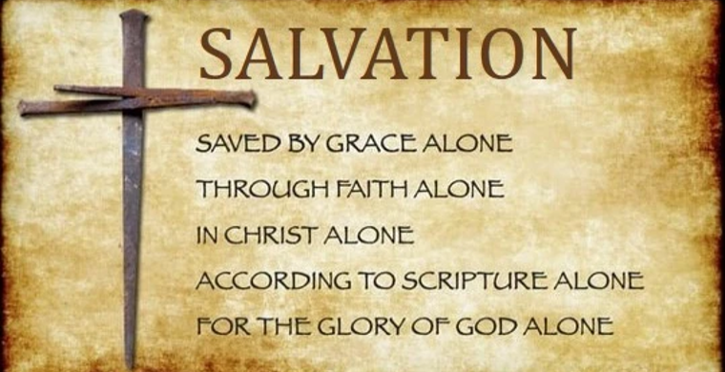
Central Teachings of Traditional Christianity
Jesus is the Son of God
Jesus’ life on earth, his crucifixion, resurrection and ascension into heaven are proof of God’s love for humanity and God’s forgiveness of human sins
Jesus sacrificed himself thus paid for the sins of mankind.
What does this notion of sacrifice remind you of?
By having faith in Jesus, one may receive salvation and eternal life.
Christians consider salvation through Jesus unearned but rather a gift from God
How does the above compare to Zarathushtra’s teachings?

Slide 13
God in Christianity
Most Christians believe that God is one single eternal being who exists in three distinct, eternal, and invisible persons
God the Father
God the Son (Jesus)
God the Holy Spirit (or Holy Ghost)
Compare this to God in Zoroastrianism.

Slide 14
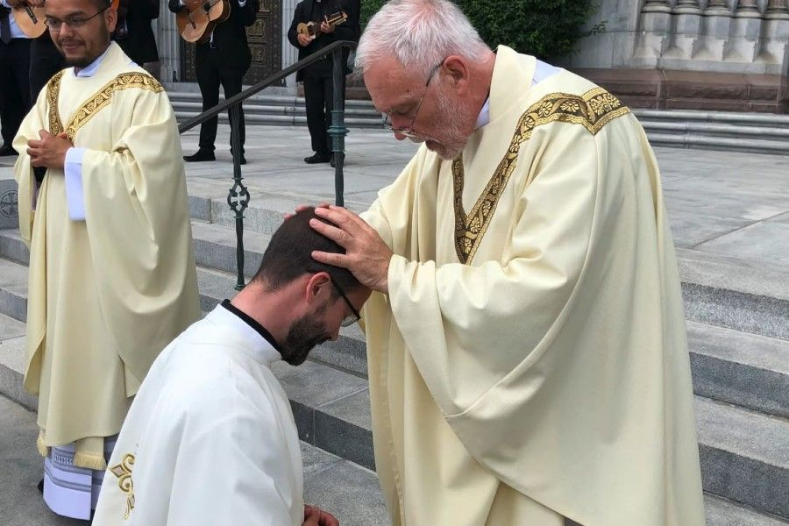
Worship in Christianity
Christian worship includes the following sacraments:
Baptism
Confirmation or Chrismation
Communion (Eucharist)
Penance
Christian worship also includes:
Acts of personal piety such as prayer, and Bible reading
Living a moral lifestyle.
Obedience to the Ten Commandments
Love thy neighbor
Feed the hungry/shelter the homeless
How do we worship in Zoroastrianism?

Slide 15
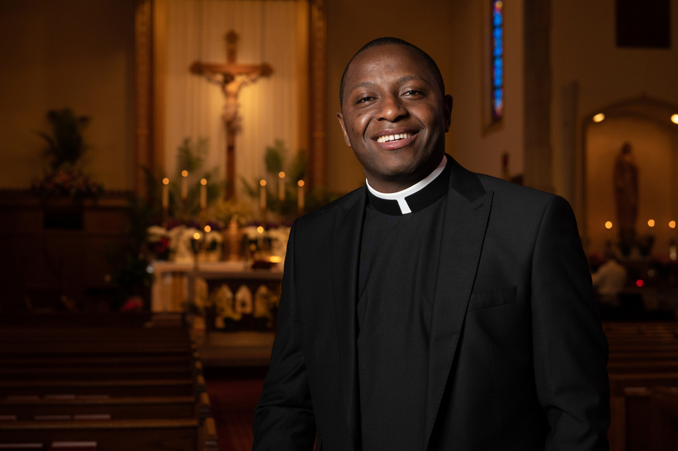
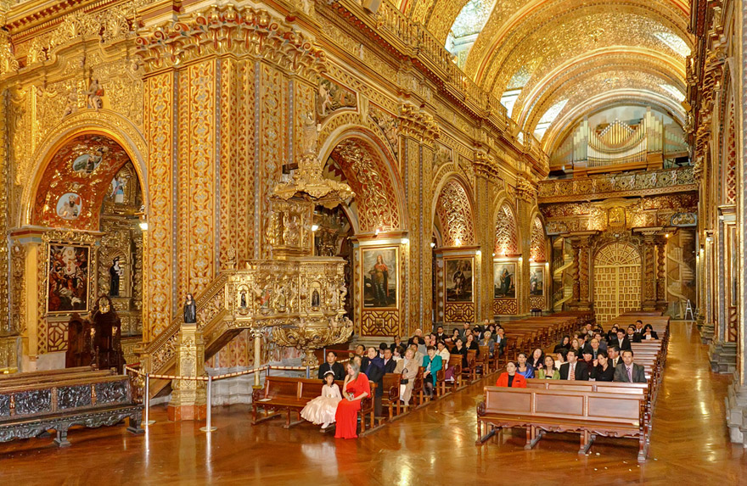
Place of Worship
Church
The religious service is led by a priest, minister, preacher, or pastor
What is Zoroastrian place of worship and priest called?

Slide 16
Purpose of Life in Christianity
Love and respect God and follow his instructions
Choose to follow Jesus Christ for a better life
Have a close relationship with God to
overcome difficult times
find joy in life
be forgiven for wrong doings
Be a good influence on the world
Love and value one another
Be hospitable
Live in peace with others
Put the needs of others before your own needs
Rule over Earth to help it flourish
What is the purpose of life in Zoroastrianism?

Slide 17
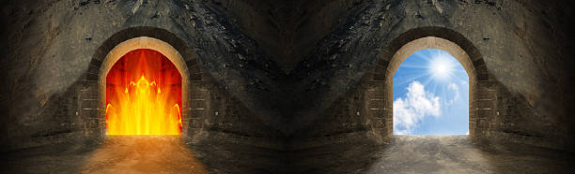
After Life and Resurrection in Christianity
Christians believe in heaven and hell
An “in between” realm is added by Catholicism in which the souls of Christians stay there for a time, repent their sins and then enter heaven.
Most Christians believe that at the end of time all the dead will rise again and will be judged by Jesus at which time the Kingdom of God will come into existence.
What is Zoroastrian belief of after life?

Slide 18
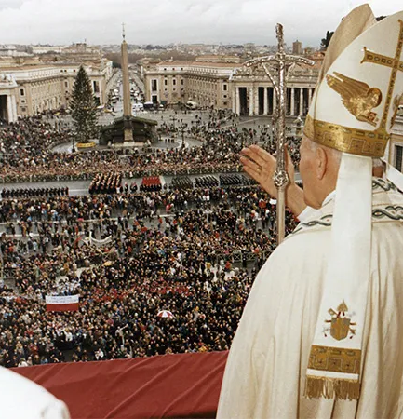
Different Sects of Christianity
Between 0-1000 CE, Christianity was divided by opinion and belief
Roman Catholic
Believe that the Bible and Catholic tradition (praying to the saints for example) are the source of salvation
Pope is the head of the church
Having faith in Christ and doing good will save the faithful
Orthodox Eastern
Believe that the meaning in the Bible does not change with times
Pope is not the leader of the entire church
Protestant (within Protestants there are subdivisions)
Believe that the Bible is the only source of salvation
No human is the head of the church only Christ
Having faith in Christ will save the faithful
Are there different sects in Zoroastrianism?

Slide 19
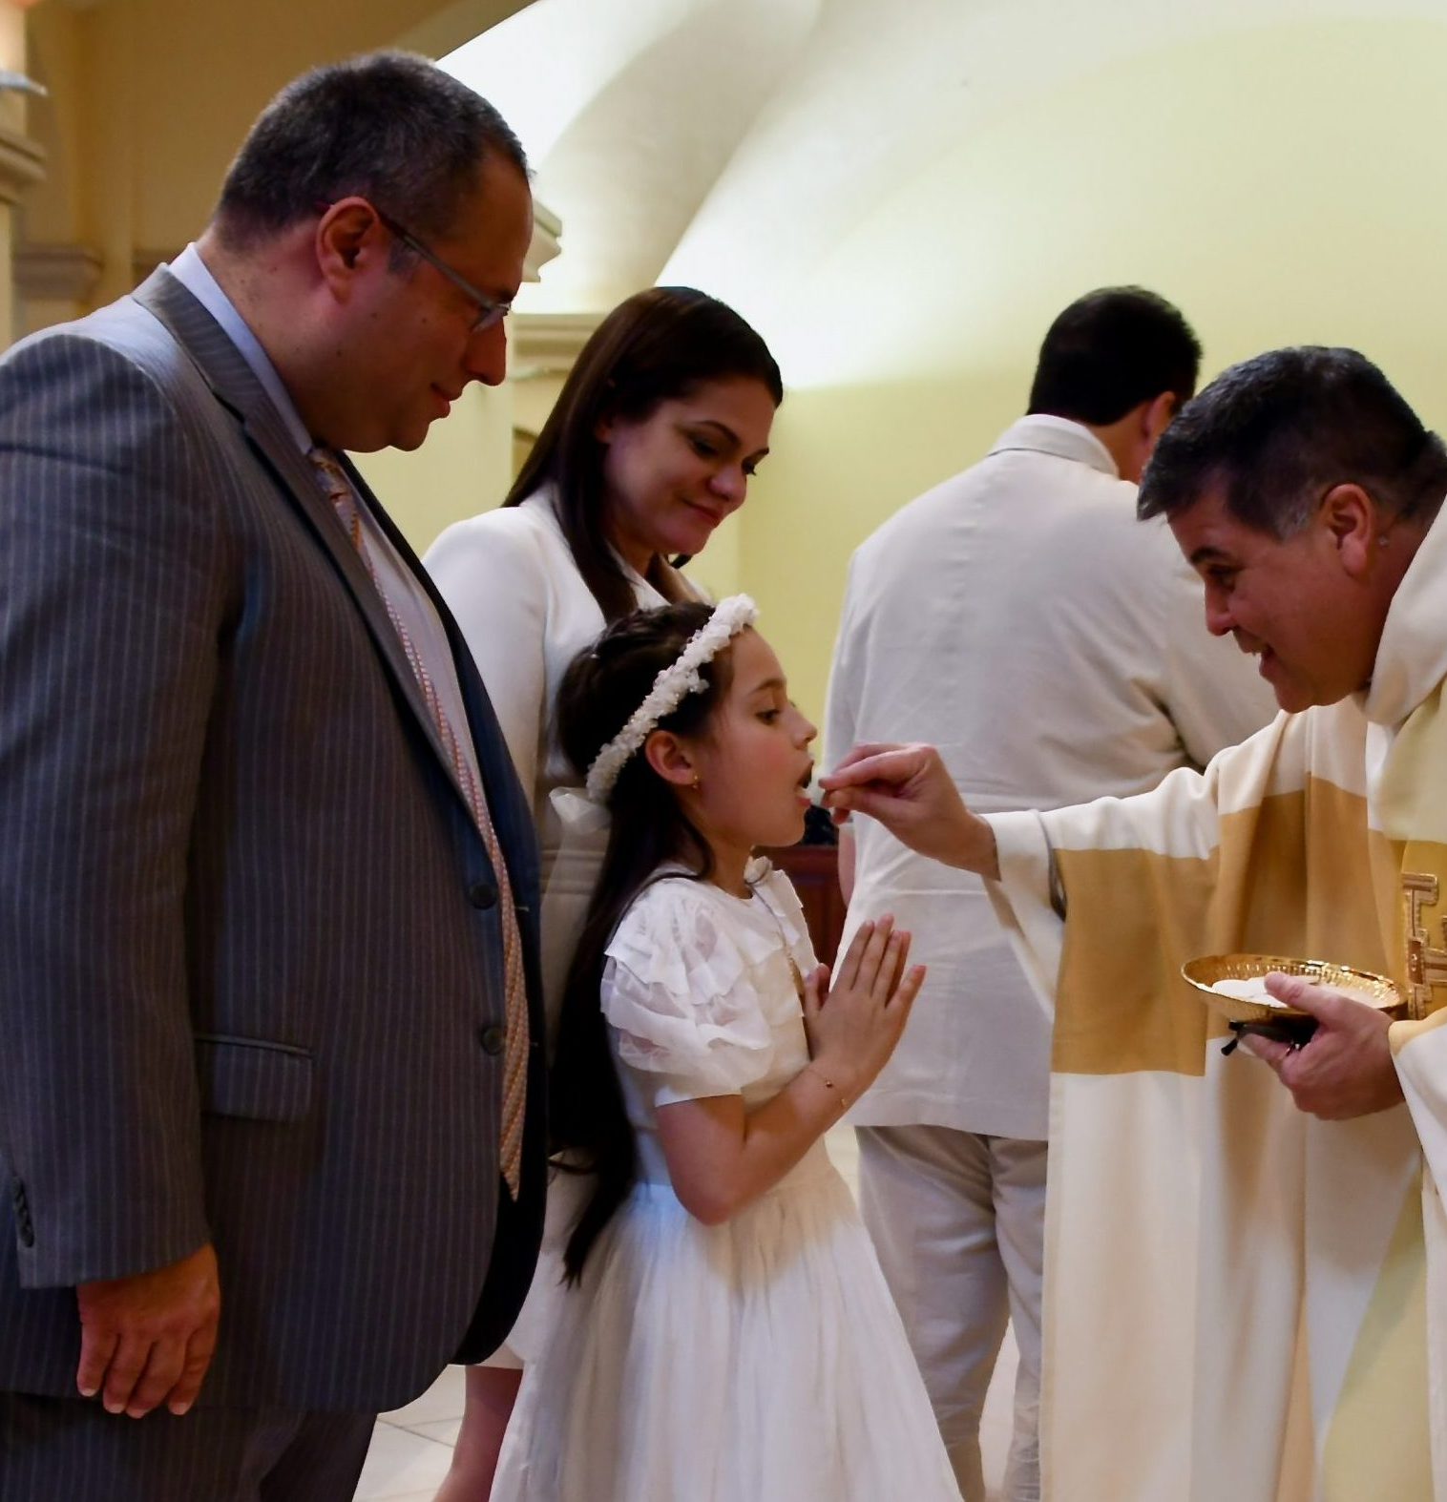
Initiation into Christianity
Inquiry (Pre-Catechumenate)
Share your story, hear the stories of Catholic faith, ask your questions, and be introduced into Christian life.
Catechumenate
Period to deepen faith within the community
Baptism-Sprinkling of holy water
Cleansed of original sin and receive God
Sacrament of Confirmation- Sins are forgiven and the gift of the Holy Spirit guides and strengthens the initiate in the faith
Sacrament of Holy Communion
Symbolically receive the body and blood of Christ which unites the Christian more closely to him
What is the process of initiation into Zoroastrianism?

Slide 20
Christian Celebrations
Christmas- Jesus’s birth
Most Christians celebrate Christmas on Dec. 25th but Orthodox Christians celebrate it on January 7th.
Epiphany- visit of the three wise men to Jesus
Lent- Commemorating the 40 days Jesus spent in the desert fasting and praying
A time to fast, pray and study
Holy Week -last week of Jesus’ life
Good Friday- Jesus’s crucifixion
Easter- His resurrection
What are some Zoroastrian celebrations?

Slide 21
Symbol of Christianity
The Cross= most common
Recalling the crucifixion of Christ
The fish
Oldest symbol of Christianity (about 2000 years ago)
Used under the rule of the Romans when it was life-threatening for Christians to openly identify themselves as such
What is the symbol of Zoroastrianism?

Slide 22
Let’s go over our chart
Name of Religion | Messenger | Area and year it was first founded | God in the religion | Purpose of Life and our role as the follower of the faith | Religious text | What are the celebrations centered around? | Belief after death
Zoroastrianism | Zarathushtra | 1500-1700 BCE Northeastern Iran | Ahura Mazda | Lead the world to perfection or Asha | Gathas Avesta | nature | State of joy and suffering
Christianity | Jesus | Judea near Jordan River in 26 CE | One God that exists in three persons Jesus the Son God the Father Holy Spirit | To believe in Jesus, love one another, do God’s work | Bible | Life and death of Jesus | Heaven and hell Resurrection

