Slide 1
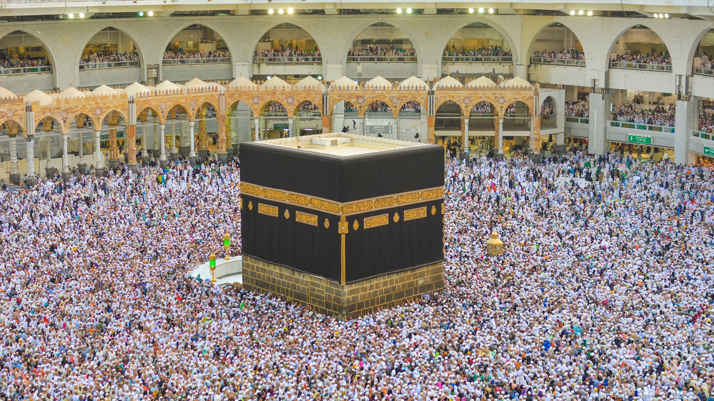
Islam
Comparative Religion

Slide 2
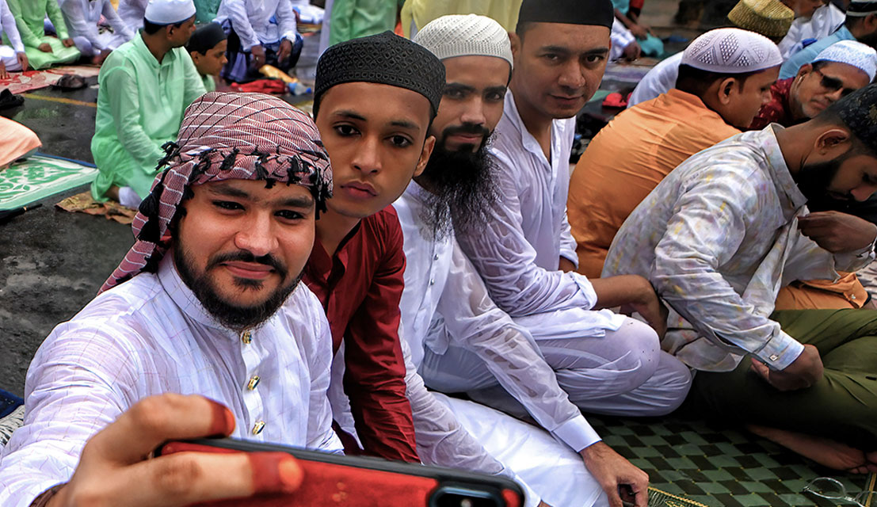
What do you know about Islam?
Who was the messenger of the faith?
When and where was he born?
What was his message?
Do you have Muslim friends?
What do they celebrate?
How do they worship?

Slide 3
Who was the founder of Islam and when was it founded?
The founder of Islam is Prophet Mohammad
Islam was founded in the 7th Century CE (about 610 CE)
Islam is an Arabic word meaning “submission to God”
The followers of Islam are called Muslims
Muslim is an Arabic word meaning “One who submits”
Zarathushtra called his religion Daena Vanguhi meaning “Good Conscience”
The followers of Zoroastrianism have been called Mazadayasnis meaning deep respect for wisdom.
What does this comparison mean to you?
Name of Religion | Meaning | Name of the followers of the religion | Meaning
Islam | Submission to God | Muslim | One who submits
Daena Vanguhi | Good Conscience | Mazdayasni | Deep respect for wisdom

Slide 4
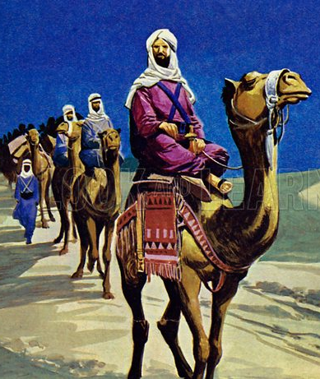
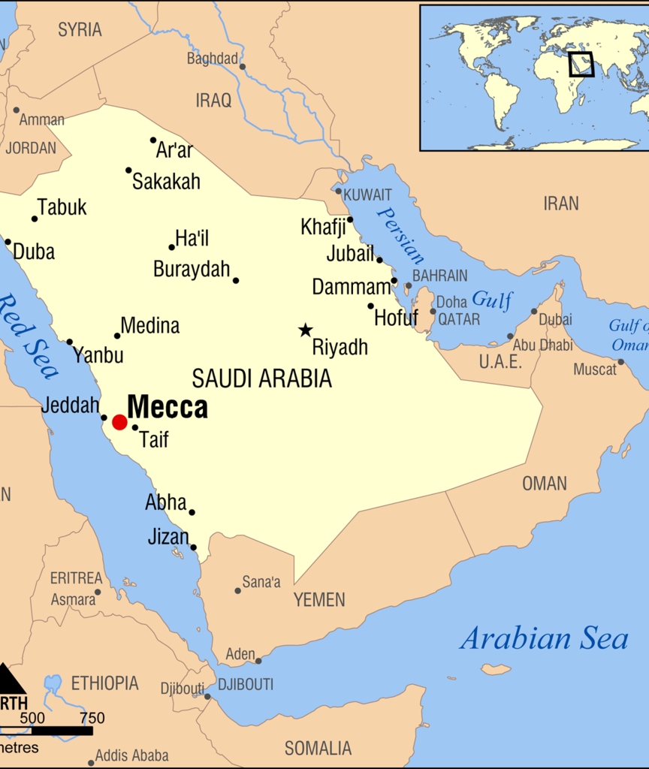
Muhammad
Born about 570CE in Mecca, Saudi Arabia
Mecca was the base of pilgrimage for many gods= Ka'ba
Believed to have been founded by Abraham
Lost his father, and mother before the age of 6
His care was given to his uncle who was a merchant and with whom he would travel to nearby countries
What kind of advantages these travels gave him?
When and where was Zarathushtra born? What do we know of his childhood?

Slide 5
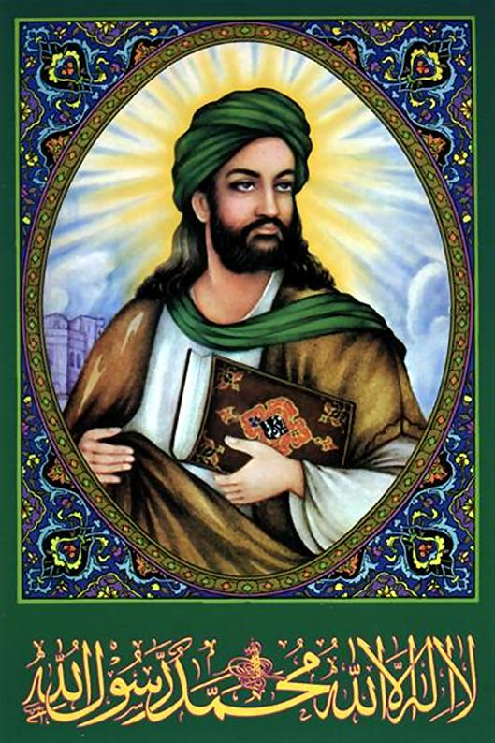
Young Muhammad
At 25 years of age, he was employed by a rich woman named Khadijeh
Khadijeh offered Muhammad marriage and they had 4 daughters, the most famous of which is Fatimah
Fatimah became the future wife of Muhammad’s cousin, Ali regarded by Shiite Muslims as the true successor after Muhammad.

Slide 6
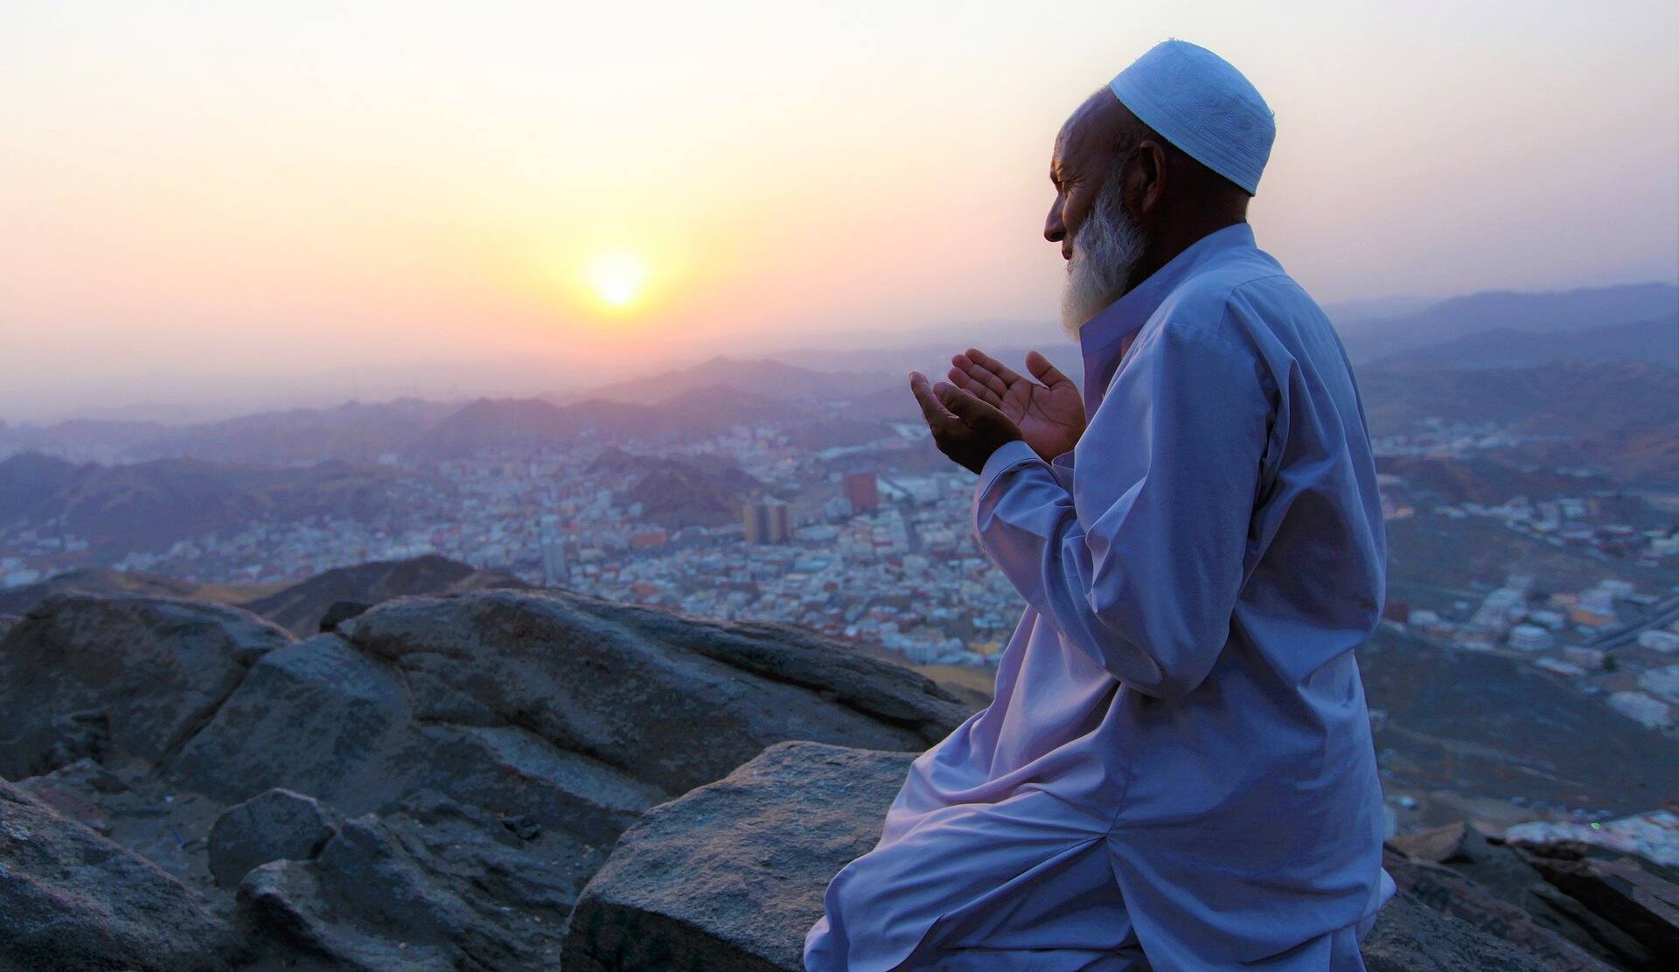
Muhammad the Prophet
At age 40 during a spiritual time on top of a mountain near Mecca, the angel Gabriel appeared to him and taught him to read and recite the opening verses of Surah 96 of Quran
How did Zarathushtra become a prophet?
Muhammad continued to receive revelations
For three years he talked about these revelations in private until God commanded him to preach publicly.
He encountered opposition for contradicting the beliefs of the Quraysh tribe who controlled Mecca and the Ka’ba.
Did Zarathushtra encounter opposition? Were the reasons for the oppositions similar or different to that of Muhammad?

Slide 7
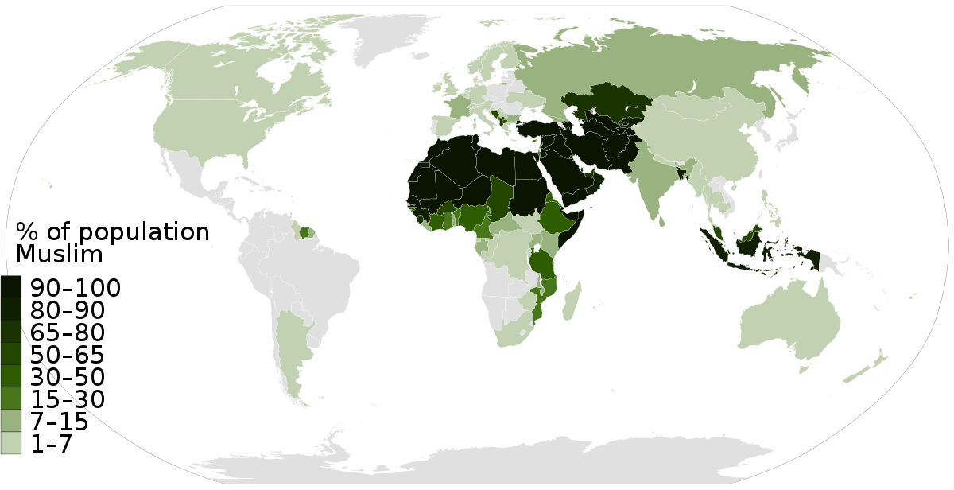
Followers of Islam
Indonesia-12.7% (percentage of world’s Muslims)
Pakistan-11.1%
India- 10.9%
Bangladesh- 9.2%
Where do most Zoroastrians live?

Slide 8
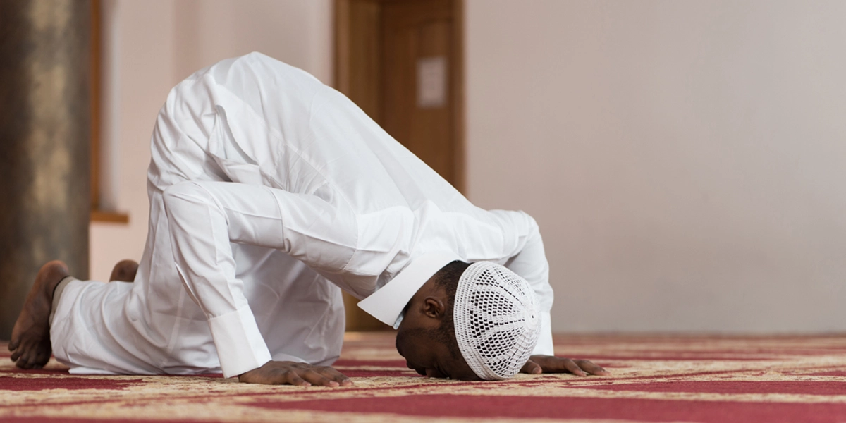
Ethos of Islam
Characteristic of Islam is in its attitude toward Allah (God)
To His will Muslims submit
Him they praise and glorify
In Him alone they hope
What is the characteristic of Zoroastrianism?

Slide 9
Quran
Quran is the Muslim’s holy book.
It contains the core of the Islamic religion
They believe it to be the final word of God revealed to Muhammad
It is in Arabic
Therefore, Arabic is used in religious practices worldwide
Sunna is a complementary book to the Quran
It includes what Muslims saw Muhammad do and say and was passed on to the next generation
How do the Quran and Sunna compare to the Avesta?

Slide 10
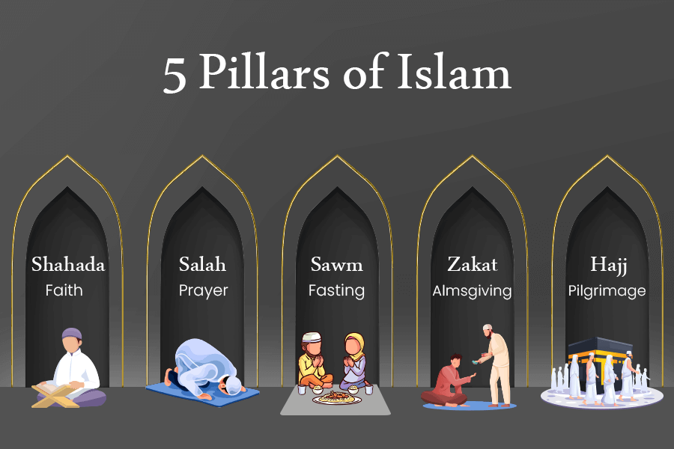
Arkan ad-din
Muslims submit to Allah by following 5 requirements
Affirmation that there is no god, but God (Allah) and Muhammad is the messenger of God=Shahadah
The five daily ritual prayers-Salah
Giving religious tax=Zakat
Dawn to sunset fast during the month of Ramadan=Sawm
Pilgrimage to Mecca=Hajj
Do Zoroastrians submit to Ahura Mazda?
How do Zoroastrians show their commitment to their faith?

Slide 11
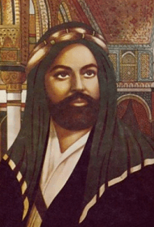
How does Islam view Muhammad?
Islam sees Muhammad as the continuation and the final prophet in the line of prophets in the Old and the New Testament
Adam, Noah, Abraham, Mosses, David, Jesus
What does this mean for the prophets who have come or may come after Muhammad? What about those prophets who are not mentioned in the Old and New Testament?
What does it mean when we say a religion is an Abrahamic religions? Is Islam an Abrahamic religion? Is Zoroastrianism an Abrahamic religion?

Slide 12
People of the Book
Gives communal status to “People of the Book”
Jews
Christians
Some of the other religions that follow other religious texts
Unity of umma or world of Islam
What does this mean for the other religions in the world?

Slide 13
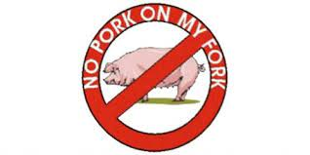
More about Islam
Do good and avoid evil
Avoid gambling
Don’t drink alcohol
Don’t eat pork
Other meat can be eaten if the animal is ritually slaughtered=halal
What are the dos and don’ts about food and other daily living aspects in Zoroastrianism?
Does the animal need to be killed a certain way in Zoroastrian belief?

Slide 14
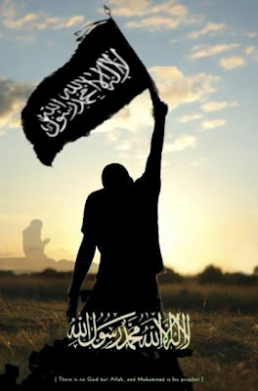
Jihad=Effort for the Cause of God is a Duty
Personal level
To be righteous and follow the path ordered by God
Communal level
Encouraging what is good and correcting what is not
Waging war against enemies of Islam
Do we have the concept of Jihad in Zoroastrianism?

Slide 15
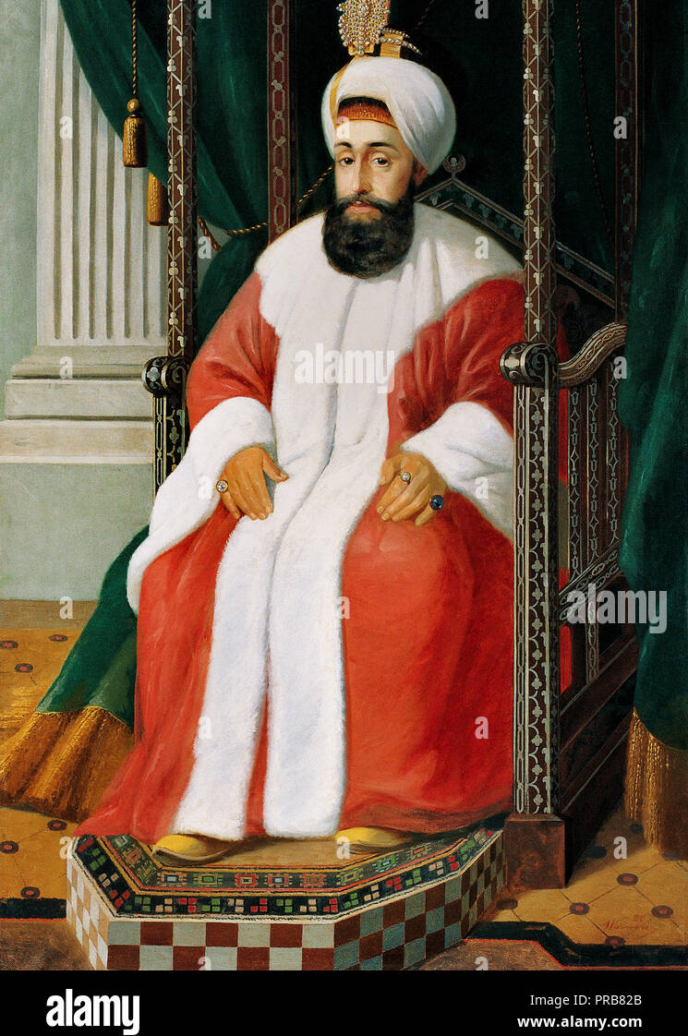
Ruler of Islam
Calipha= Ruler of community
Has both religious and political power
Is the Zoroastrian religious ruler the same as the political ruler?
Yatha Ahu prayer
How are most countries today governed in relation to the above rule of Islam?

Slide 16
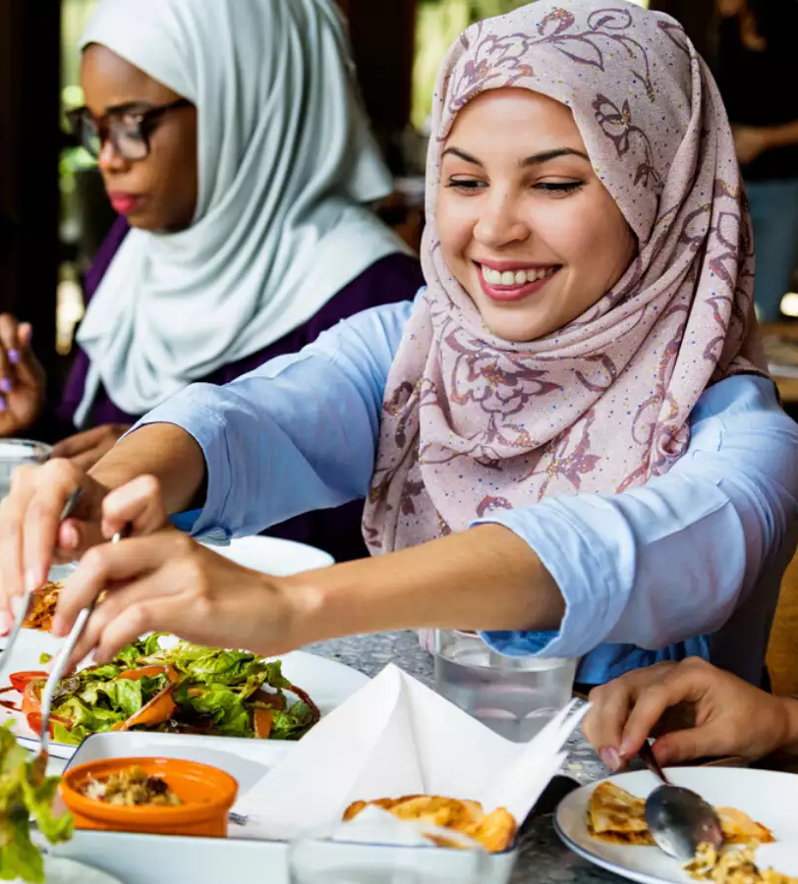
Celebrations
Id-al-fitr
Breaking of fast during Ramadan
Id-al-adha
Coinciding with the pilgrimage of Mecca
Id-al-ghadir-celebrated by Sh’ai Muslims
Anniversary of Muhammad’s declaration of Ali as his successor
Muhammad’s birthday
Muhammad’s miraculous journey to Jerusalem to pray with other Abrahamic prophets and going to heaven where God imposes on him the 5 daily prayers in Islam
What are these celebrations centered around? What are Zoroastrian celebrations centered around?

Slide 17
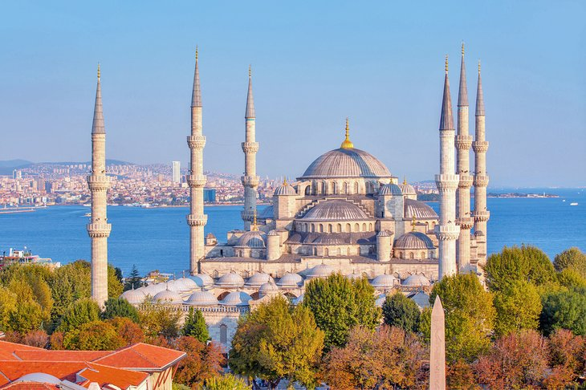
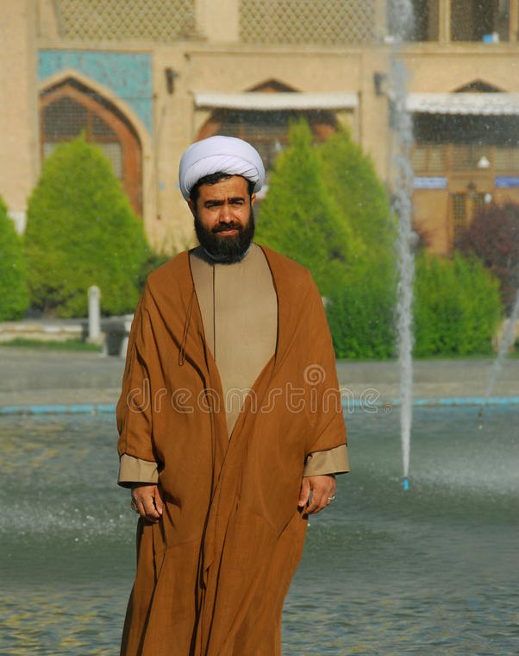
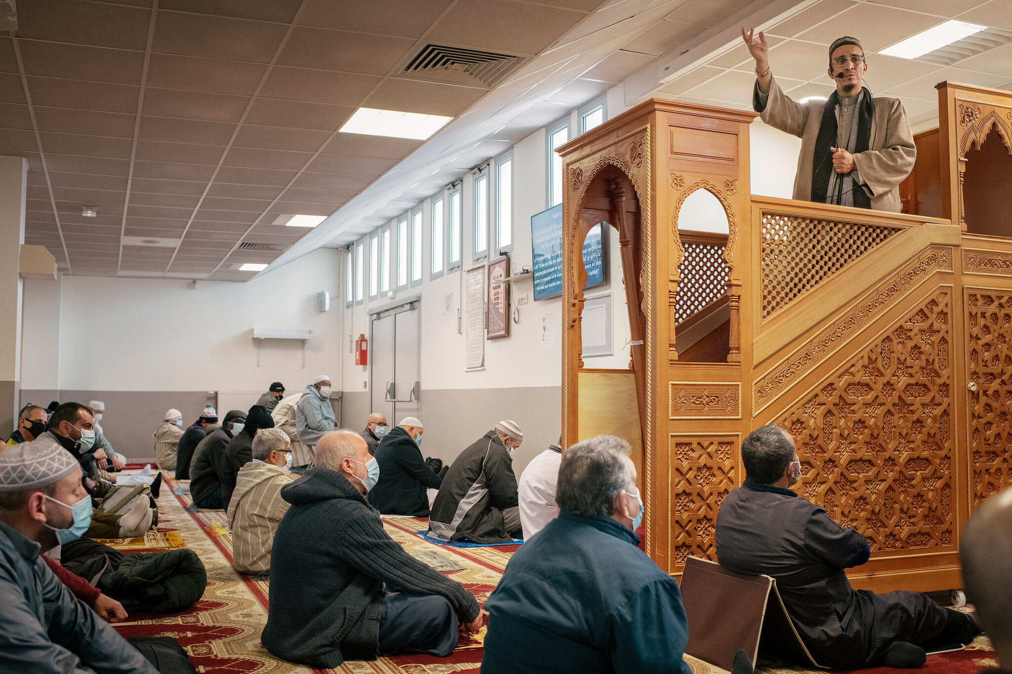
Place of Worship
Muslims worship in mosques
Their religious teacher is called Shaykh or Mullah (In Persian speaking countries)
Where do Zoroastrians pray and what do they call their religious teacher?

Slide 18
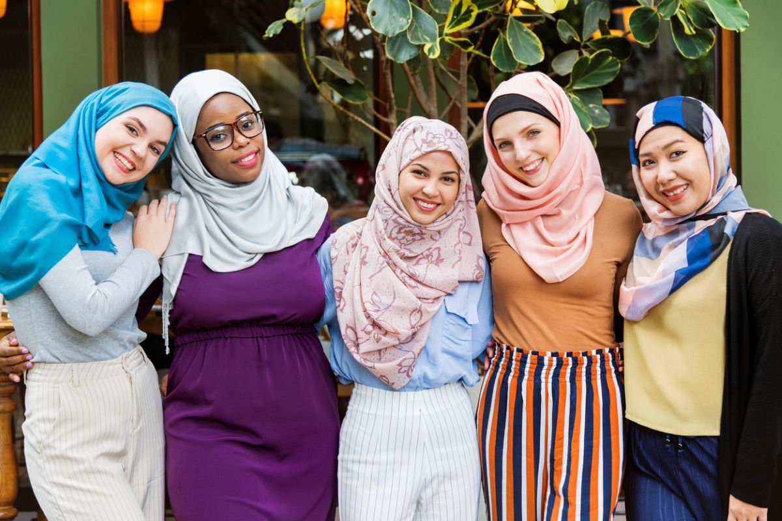
Gender Equality in Islam
Women and men are equal in Islam except in certain areas such as:
Inheritance
Witness Law
Family Law
How is gender equality described in Zoroastrianism? What about human equality in Zoroastrianism?

Slide 19
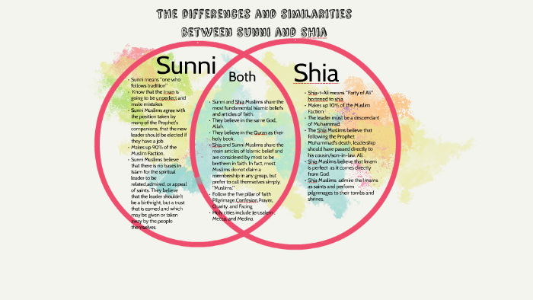
Different sects in Islam
There are different sects in Islam the predominant of which are Sunni and Shiite
The main difference between the two is the disagreement about who should have succeeded Muhammad
The Shiite’s believe that Ali should have been Muhammad’s successor and after Ali, his dependents.
12 Imams
Are there different sects in Zoroastrianism?

Slide 20
Life after Death in Islam
After death, the soul is in a state of waiting until the day of resurrection
All deeds are written in the “Book of Deeds” by which God judges each person
Depending on the person’s deeds he/she will end up in hell or heaven
The most common punishment in hell is burning in fire
In heaven there is no sickness, the weather is not too cold or hot,..
At one point those with sins can ask scholars or prophets to beg Allah for forgiveness
Is there heaven and hell in Zoroastrianism?
Do we have the concept of Ahura Mazda forgiving us for our wrong doings?
Personal responsibility and changing

Slide 21
Purpose of Life in Islam
Pray to Allah
Live the life that is shown by Allah
What happens in our life is an exam of how our afterlife will be like
Depending on an individual’s deeds in life one will go to heaven or hell
What is the purpose of life in Zoroastrianism?

Slide 22
Symbol of Islam
Crescent and Star:
The Crescent is the early phase of the moon and represents progress.
The star signifies illumination with the light of knowledge.

Slide 23
Let’s go over our chart
Name of Religion | Messenger | Area and year it was first founded | God in the religion | Purpose of Life and our role as the follower of the faith | Religious text | What are the celebrations centered around? | Belief after death
Zoroastrianism | Zarathushtra | 1500-1700 BCE Northeastern Iran | Ahura Mazda | Lead the world to perfection or Asha | Gathas Avesta | nature | State of joy and suffering
Islam | Muhammad | 610 CE Mecca | Allah | Pray Live a life that is shown by Allah Our life is an exam of how our afterlife will be like | Quran Sunna | The prophet and religious duties such as fasting | Heaven and hell Resurrection

