Slide 1
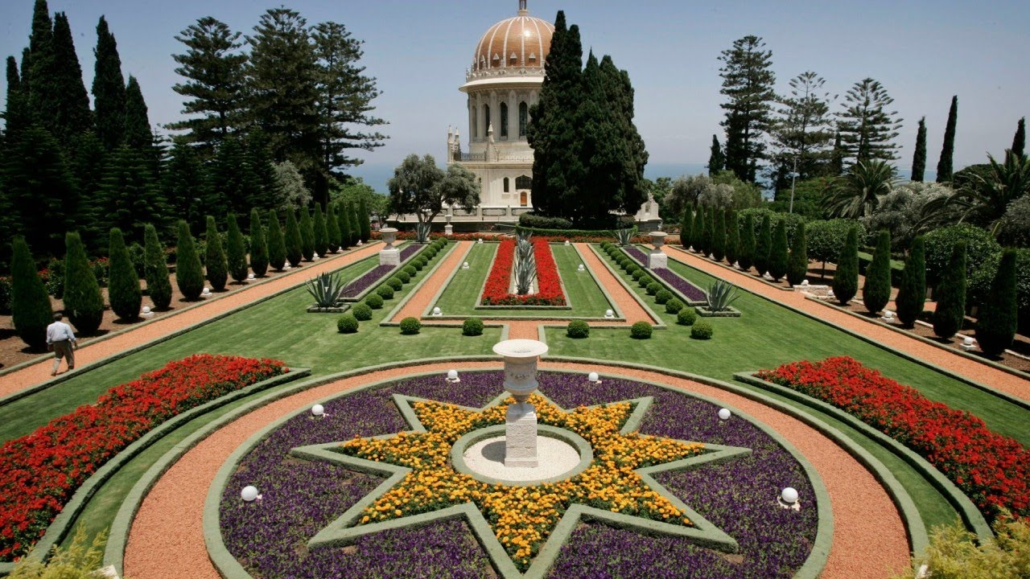
Bahaism
Comparative Religion

Slide 2
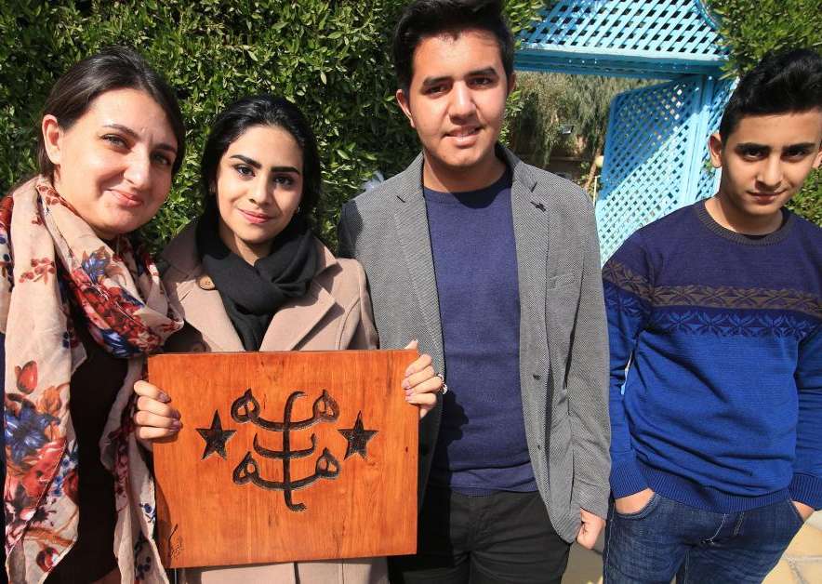
What do you know about Bahaism?
Who was the messenger of the faith?
When and where was he born?
What was his message?
Do you have Baha’i friends?
What do they celebrate?
How do they worship?

Slide 3
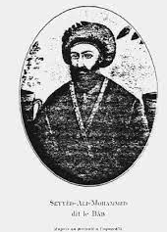
Who was the founder of the Baha’i faith and when was it founded?
The first messenger was an Iranian named Sayyid Ali Muhammad who called himself “Bab”
He was considered a prophet of God
He brought forth his message in 1844
He introduced his message in present-day Iran
Bab declared that a second messenger of God will soon arrive.
Bab was killed by a firing squad and many of his followers were martyred in 1850
What was the main religion of Iran in 1844?
What do you know from his real name?

Slide 4
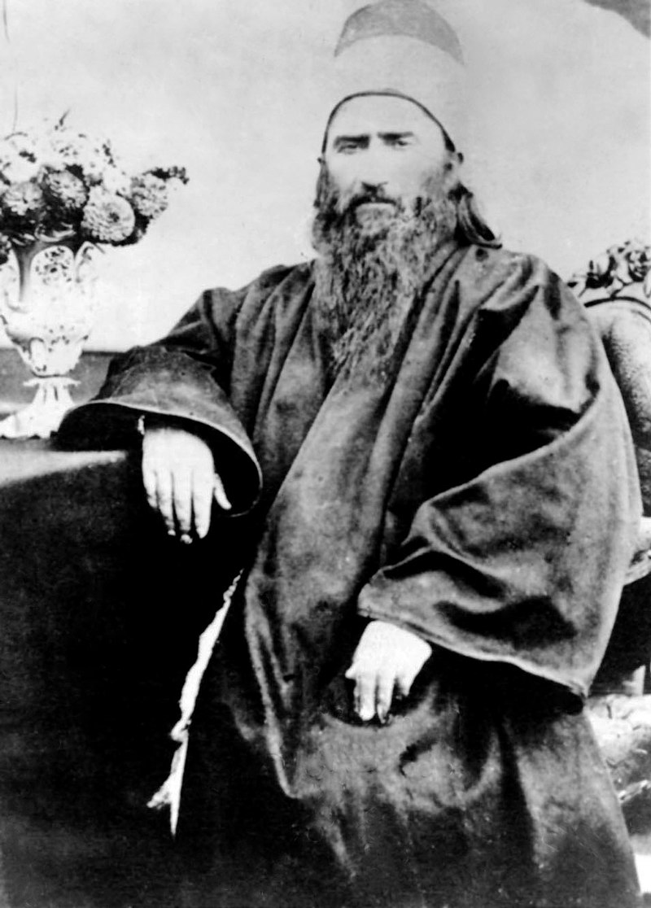
The Second Messenger
Mirza Husayn Ali was born in a wealthy family in 1817
He called himself Baha’u’llah
The Bahais believe him to be the most recent manifestation of God
In 1863 he declared himself as an independent messenger of God
He said that he is not the final messenger of God
Bab and Baha’u’llah never met
Bahais consider both the Twin Manifestations of God
https://www.youtube.com/watch?v=RmAC7PYiK_k
What does the second messenger’s name tell you?
Who was the messenger of Zoroastrianism? When and where did he live?

Slide 5
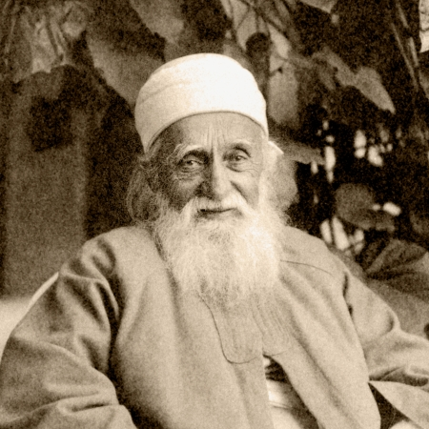
What influenced Bahaism?
Bahaism was influenced by Shi'a Islam.
Bab claimed to be the gate to the twelfth imam Mahdi.
Baha’u’llah claimed to be the promised savior.
How did this effect the Zoroastrian community?
Later Baha’i Faith adopted other beliefs and is still changing.
https://www.youtube.com/watch?v=bc7AvTq1FGY
https://www.britannica.com/topic/Bahai-Faith

Slide 6
Human Essence and Heaven and Hell in Baha’i Faith
All humans have a soul that lives forever
After death, the soul continues to progress in the spiritual world toward perfection and God.
An evolved soul will have influence on progress in this world and the advancement of its people.
Heaven and Hell are spiritual places that are closer to God or further away from God.
What does Zoroastrianism teach you about human essence and heaven and hell?
How does it compare to the Baha’i belief?
https://www.bahai.org/beliefs/life-spirit/human-soul/life-death
https://www.bahai.org/beliefs/life-spirit/human-soul/heaven-hell

Slide 7
God in Bahaism.
God can not be known directly
We get to know God through the lives and spiritual teachings of all the prophets, the most recent of whom was Baha’u’llah and the world that God has created.
All creation belongs to God.
God is all powerful, perfect, and has complete knowledge of life.
There is only one God that is called by different names by different religions.
Humans can never understand God because our mental abilities do not allow us to do so as he is too great
We get to know God through his attributes
In order to see the attributes of God we need to become humble
We can experience God through attributes such as love, compassion, justice,..
How does this compare to Zoroastrian belief in God?
https://bahaiteachings.org/knowing-the-many-names-of-god/

Slide 8
Why do different religions describe God differently?
The description of God is limited by the views of the people and their cultural background.
Therefore, each religion describes God differently according to their culture and time.
The Baha’i religion accepts all religions as true and valid.
How does the Zoroastrian religion regard other religions?

Slide 9
Equality in Bahaism
The baha’i religion believes that all humans are of the same race.
We should be united as one community.
All humans are different but equal (all races and sexes are equal).
Fun fact: Women are not allowed to serve on the Universal House of Justice, the supreme governing institution of the Baha’i faith.
They believe all religions are from God and each one further reveals God.
What is Zoroastrian belief in human equality?

Slide 10
Purpose of Life in Bahaism.
To acquire divine attributes that will serve us in the life beyond the physical plane.
What is the life purpose in Zoroastrianism?

Slide 11
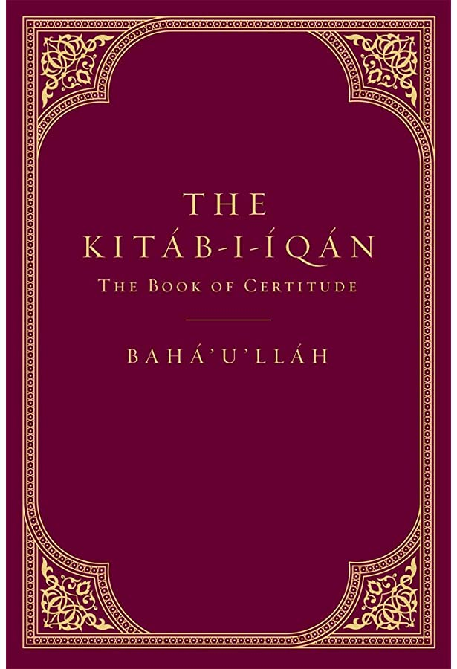
Main Sacred Text of Bahaism
The Kitab-i-Aqdas (meaning the Book of Laws) is the central Book of the faith.
It was written in Arabic by Baha’u’llah in 1873
The Kitab-i-Igan (the Book of Certitude) is the second important book.
It was also written by Baha’u’llah
What is Zoroastrian sacred text?

Slide 12
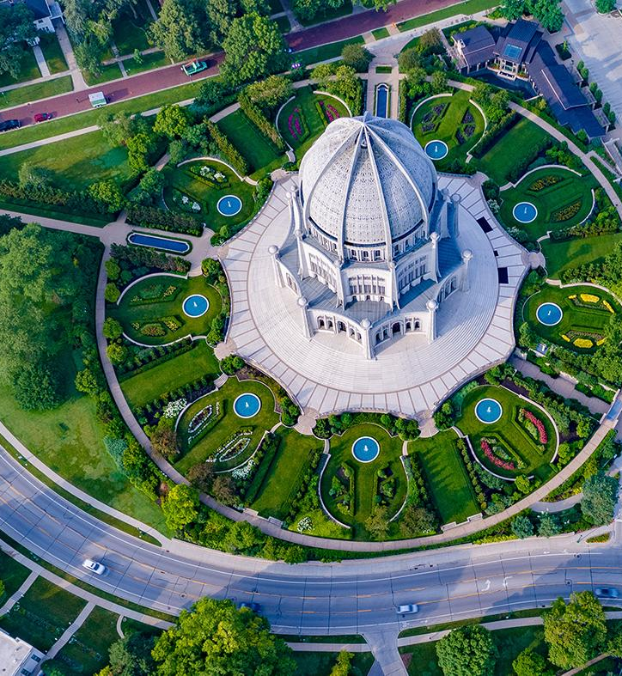
Place of Worship and Religious Leaders
There is only one house of worship in each continent
The one in North America is in the Chicago area
Local Baha’i gatherings are in private homes, rental or bought community centers depending on the needs of the community.
Baha’is do not have clergy
What is the place of worship called for Zoroastrians and what do we call the clergy?

Slide 13
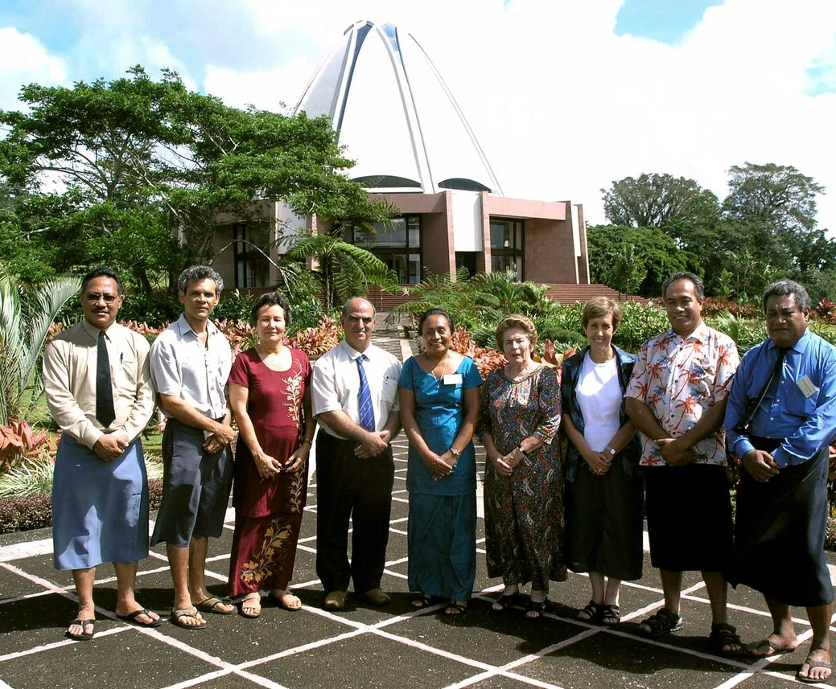
Governing Infrastructure of the Baha’i Faith
They elect local and national assemblies of nine individuals
The world assembly of nine individuals is elected by the members of all national assemblies.
Elections are done in an atmosphere of prayer by Baha’is 21 years and older
Elections are conducted without any campaigning.
Do Zoroastrians have a leadership body?

Slide 14
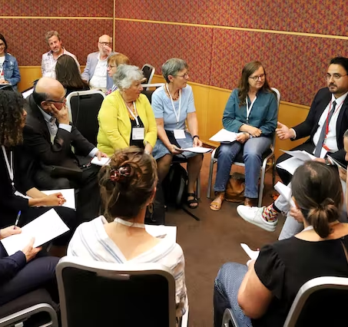
Baha’i meetings
Baha’i meetings are called Feasts
They occur once every Baha’i month
It includes
A spiritual portion with prayer and reading of the scriptures
Followed by a business portion where community members consult with one another
A fellowship portion which includes socializing and enjoying food
How do Zoroastrians conduct their meetings?

Slide 15
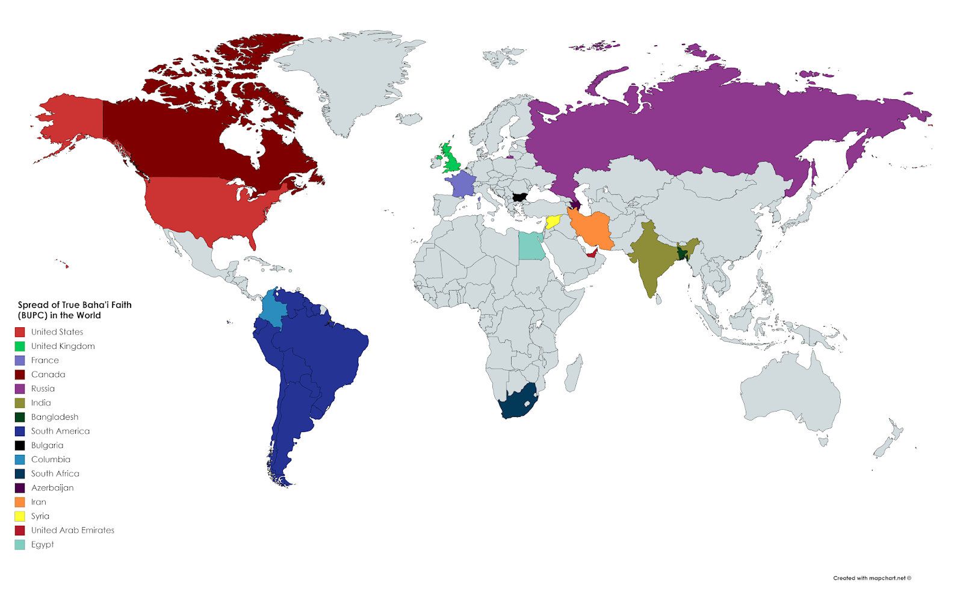
Where do most Baha'is live?
There are about 6 million Baha’is in the world.
Location of most Baha’is
The largest population live in India (1.9million)
United States (introduced around 1845) (500K)
Kenya (introduced in 1945) (400K)
https://www.worldatlas.com/articles/countries-with-the-largest-baha-i-populations.html

Slide 16
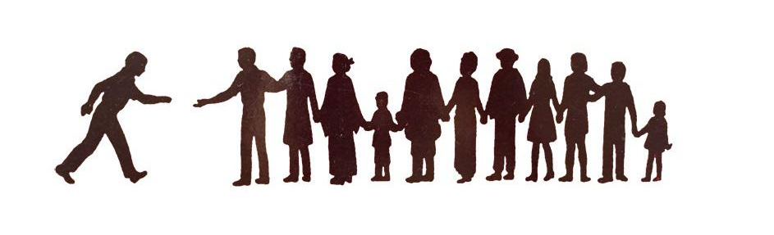
Initiation to Bahaism
There is no ceremony.
You become a Baha’i once you begin believing in Baha’u’llah and in Baha’i teachings.
Sign a Baha’i declaration card which usually states:
I wish to become a member of the Baha’i community. I accept Baha’u’llah as the Bearer of God’s Message for this Day and will endeavor to follow His teachings and the Baha’i way of life. I also accept the authority of the institutions which administer the affairs of the Baha’i community.
How does someone initiate into the Zoroastrian Faith?
https://bahaiteachings.org/how-do-i-become-a-bahai/

Slide 17
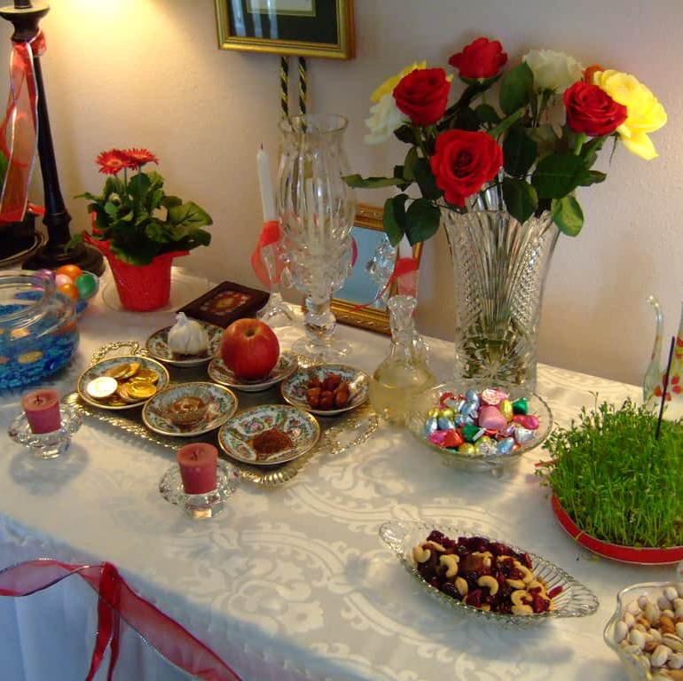
Main Celebrations in Bahaism
Centered around events in Bab and Baha’u’llah’s lives such as their birthdays, travels, announcement of their mission, and death.
Nowruz- Baha’i New Year
They fast for a month before Nowruz
How do Baha’i celebrations compare to Zoroastrian celebrations?

Slide 18
Symbol of Bahaism
Nine-point start
Signifying the nine great religions.
https://bahai-library.com/uhj_nine_pointed_star

Slide 19
Let’s go over our chaLLrt
Name of Religion | Messenger | Area and year it was first founded | God in the religion | Purpose of Life and our role as the follower of the faith | Religious text | What are the celebrations centered around? | Belief after death
Zoroastrianism | Zarathushtra | 1500-1700 BCE Northeastern Iran | Ahura Mazda | Lead the world to perfection or Asha | Gathas Avesta | nature | State of joy and suffering
Bahaism | Bab and Baha’u’llah | 1844-Bab 1863-Baha’u’llah | Many names-Names of God are divine attributes of God | To acquire divine attributes to serve us in the life beyond physical plain | Kitab-i-Aqdas And Kitab-i-Igan | The prophets’ births, deaths, and journeys. | After death soul will progress toward perfection. Heaven is being close to God and hell is being far from God.

