Slide 1
Places of Worship
Comparative Religion
Grades 1-5
Slides by: Shiraz Antia and Temi Mehta

Slide 2
Places of Worship
A place of worship is a building or other place where people gather to carry out honor and religious praise. According to varying beliefs, the style of religious buildings have changed over many, many years.

Slide 3
Not Just A Temple
The word ‘temple’ is frequently used as a broad term for a house of worship. Synagogues and churches, however, are not usually referred to as temples.
Places of worship include Buddhist and Hindu temples, mosques, synagogues, and churches.

Slide 4
What is the Zoroastrian Place of Worship?
The followers of Zoroastrianism have several names for their place of worship including:
Fire Temple
Agiary
Atashkadeh
Atashgah
Dar-e Mehr

Slide 5
Zoroastrians in different parts of the world
Zoroastrians living in different parts of the world have slightly different practices of worship but all of them pray in front of the fire or a source of light.
They all have a common core belief.

Slide 6
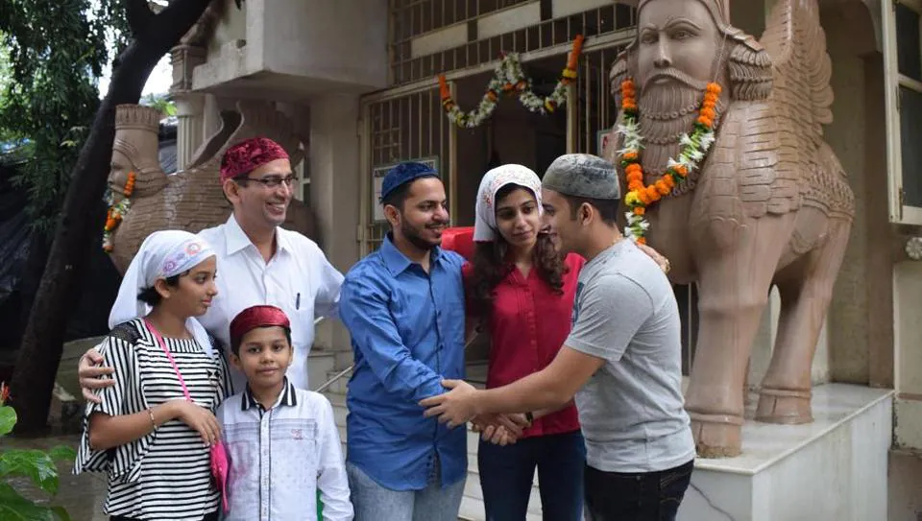
Zoroastrians in India or Parsis

Slide 7
The Zoroastrian Fire Temple
Fire, together with clean water, are agents of ritual purity for Zoroastrians.
Clean, white "ash for the purification ceremonies is regarded as the basis of ritual life", which "are essentially the rites proper to the tending of a domestic fire, for the temple [fire] is that of the hearth fire raised to a new solemnity". For one "who sacrifices unto fire with fuel in his hand ..., is given happiness".

Slide 8
Fire Temples in the World
As of 2019, there were 177 fire temples in the world, of which 45 were in Mumbai, 105 in the rest of India, and 27 in other countries.
There was a religious custom in India of not allowing Zoroastrian women to enter the Fire Temple and the Tower of Silence if they marry a non-Zoroastrian person. This custom has been challenged before the Supreme Court of India after a Zoroastrian woman was denied entry into Zoroastrian institutions.

Slide 9
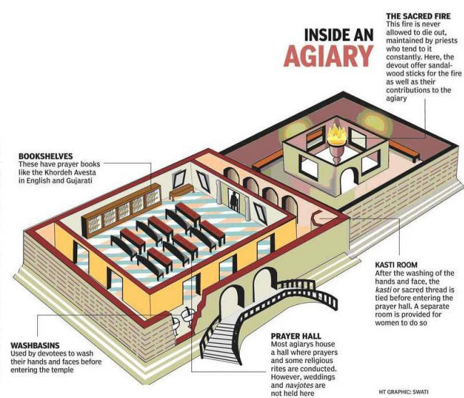

Slide 10
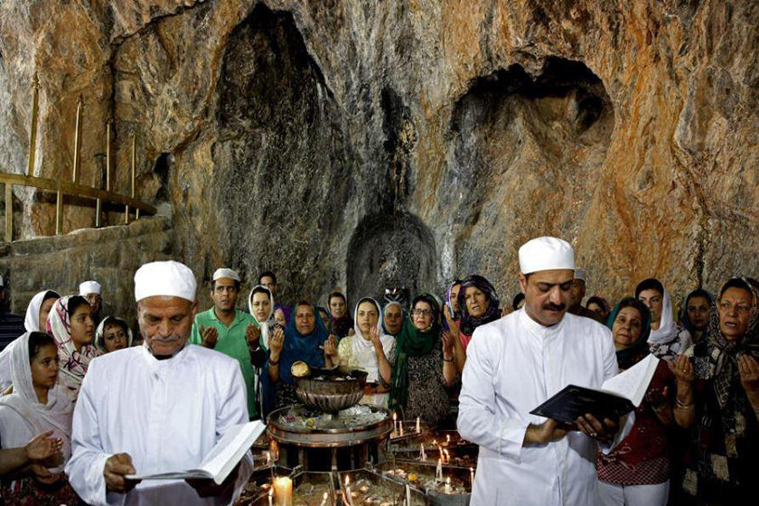
Zoroastrians in Iran

Slide 11
Places of worship in Iran
Atashgah (Atashkadeh)
Shrines
Shah Verahram Izad
Alters at homes

Slide 12
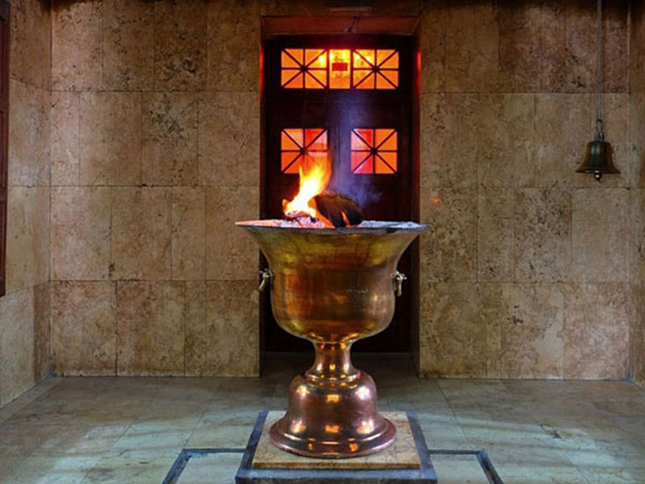
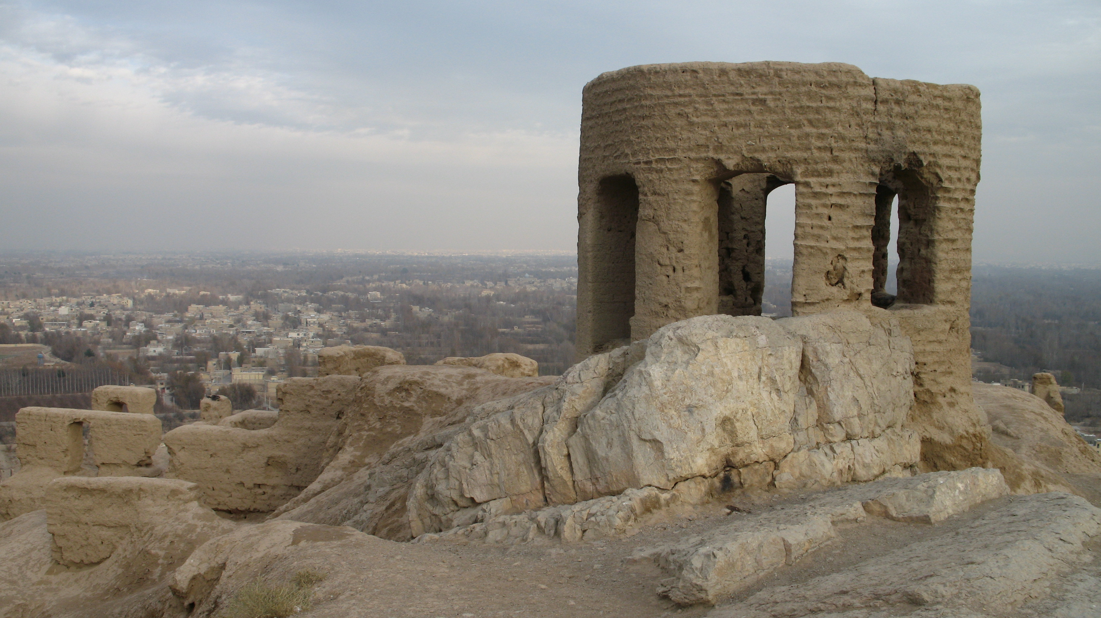
Atashgah (Atashkadeh)
Until the end of Sassanid Empire (224-651CE) Atashgahs were outdoors.
After the Arab invasion of Iran, the fire was kept indoors.

Slide 13
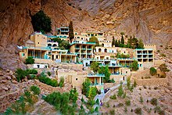
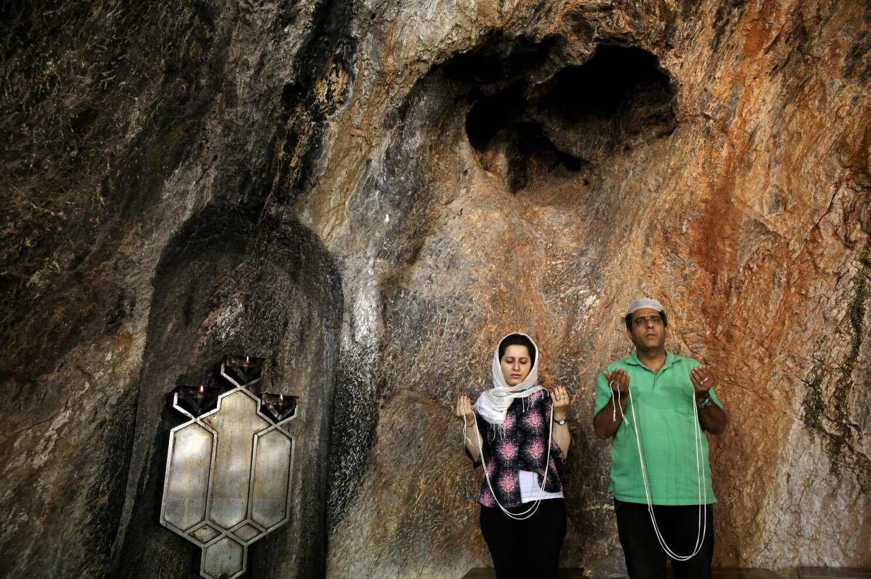
Shrines
It is said that after the Arab invasion of Iran, daughters of Yazdegard III escaped and found refuge in the deserts of Yazd. These places have become Zoroastrian shrines and places of worship.
The most famous of these shrines is Pir e Sabz in Yazd province where Zoroastrians gather in Summer to pray, celebrate and spend communal time with one another.
Another one of these shrines is Pir e Herisht, a place of pilgrimage during Nowruz.

Slide 14
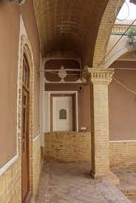
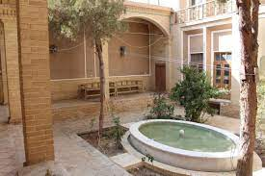
Shah Vehrahram Izad (Izad of Victory)
Smaller than Atash Gah and situated in cities.
People go to Shah Verahram Izad to pray, donate, eat aash, sirog and enjoy communal time.

Slide 15
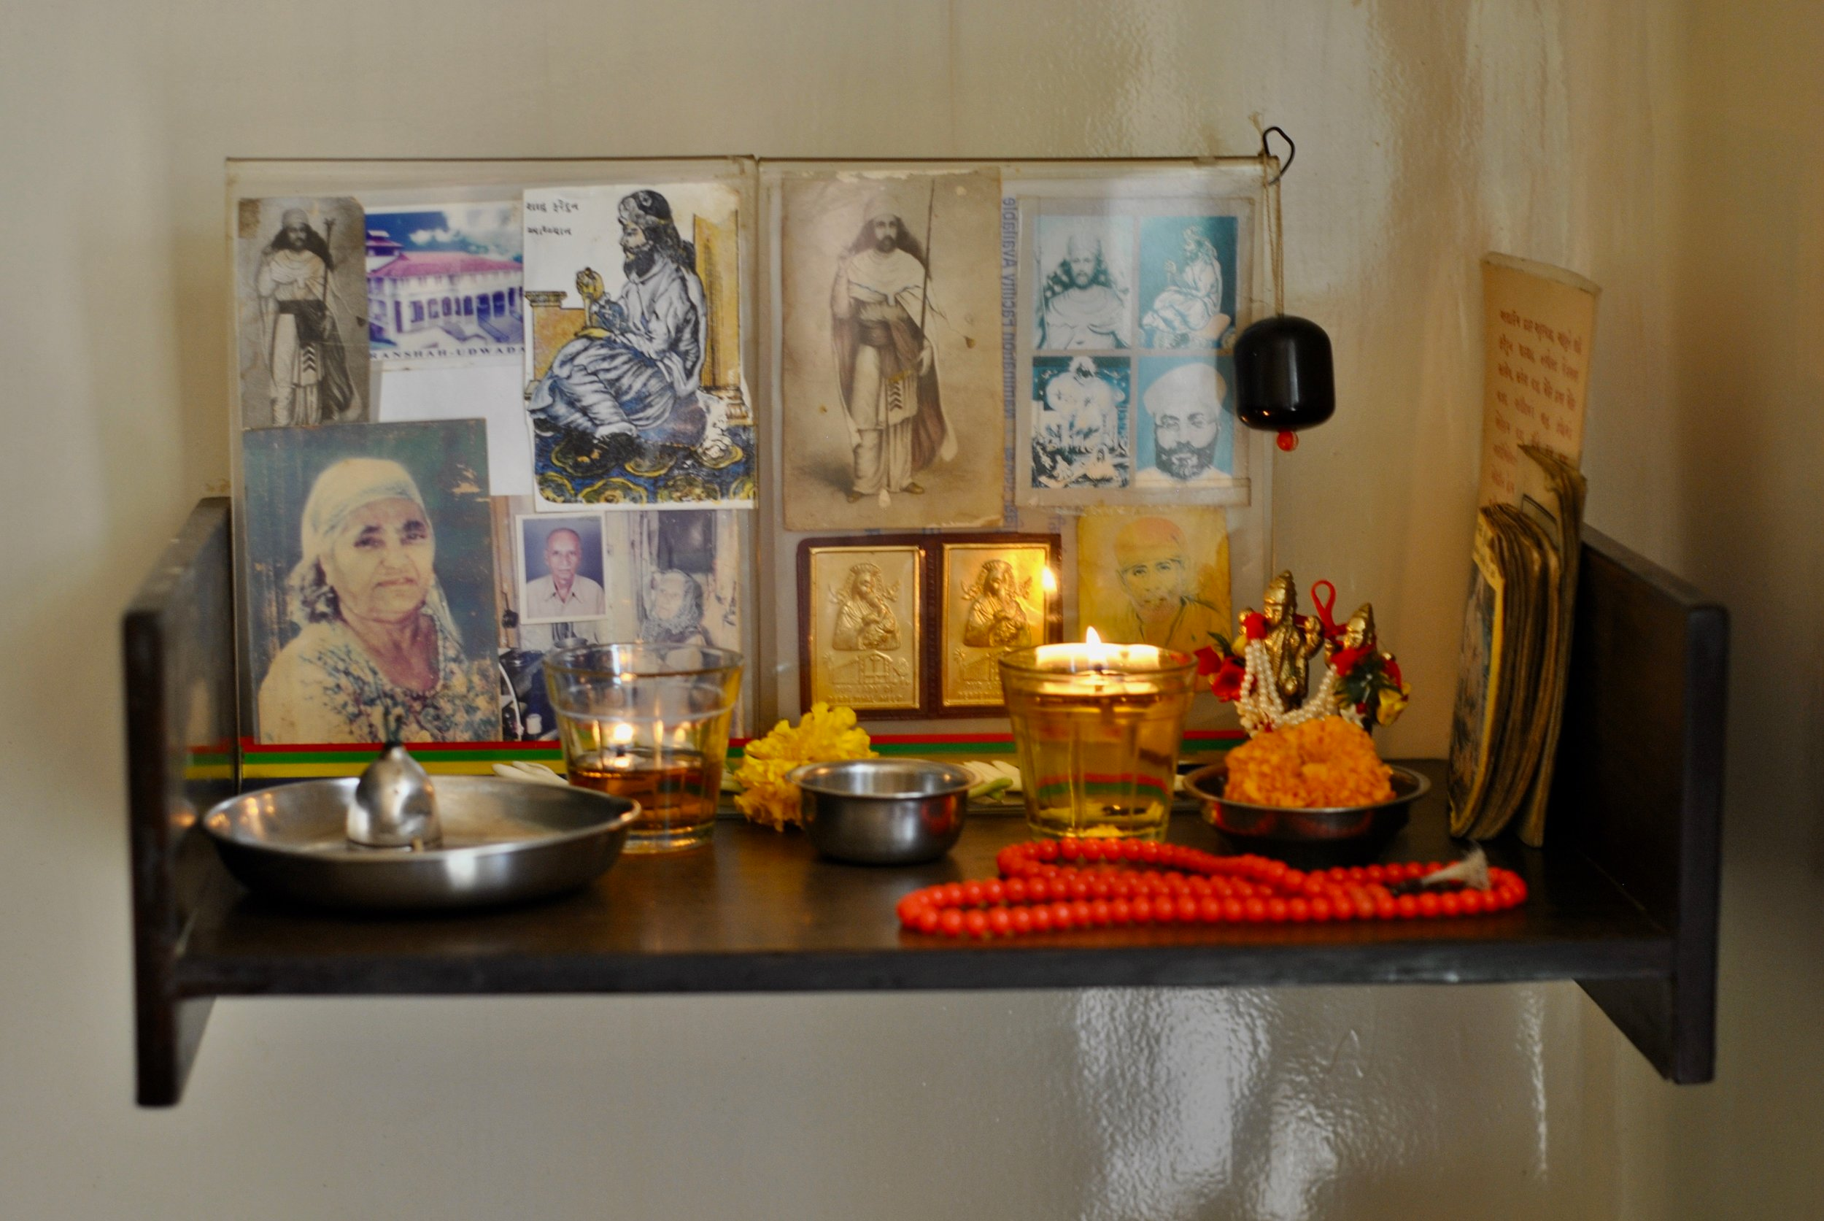
Alters at homes
Zoroastrians used to dedicate a section of their home as an alter.
Khordeh Avesta, Zarathushtra’s photo, candle, incense, esfand and condor was kept there for pray.
These days most homes don’t have an alter and Zoroastrians either go to their local Atashkadeh or light a candle to pray.

Slide 16
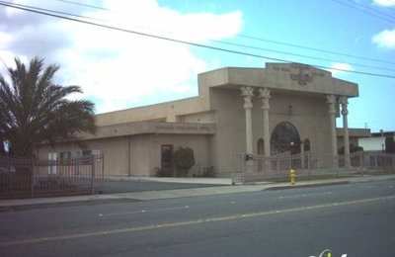
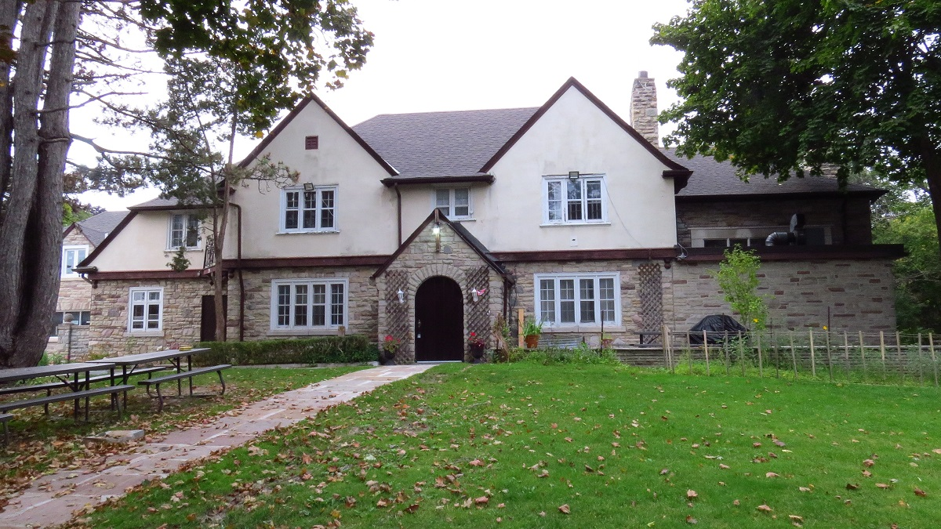
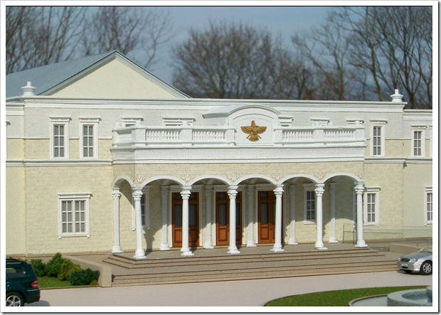
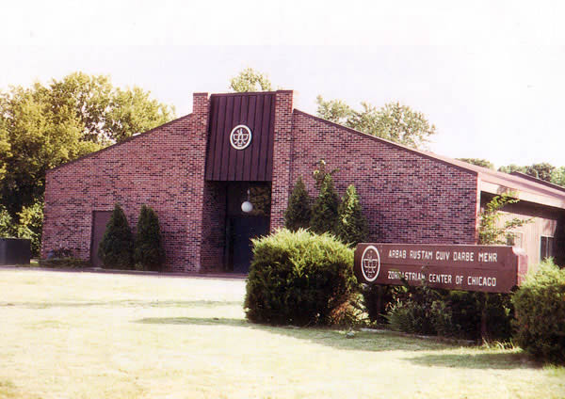
Zoroastrians living in North America
There are Atashkadehs all over North America where Zoroastrians go for communal time or pray.

Slide 17
Other Religions Have Places of Worship
Islam: Mosque
Christianity: Church
Judaism: Synagogue
Hinduism: Shrine Temple

Slide 18
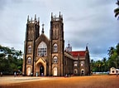
The Christian Church
A church is a place where Christians assemble to worship God. Some are very old while others are very modern—any type of building can be used as a church. Areas in the church include the sanctuary, the most holy area; the nave, the main area where people sit; the alter, which is used for the ritual known as the Eucharist or Holy Communion. The pulpit is where the minister gives his/her sermon, and s/he uses the lecturn to read the Bible out loud during services.

Slide 19
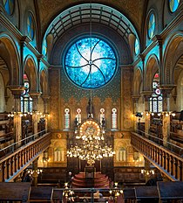
The Jewish Synagogue
A Jewish place of worship goes by several names: shul, beit, congregation and Temple. Synagogue is the most general term and the most recognized. The most significant item in a synagogue is the ark, a cabinet or container that holds the Torah scroll. The ark symbolizes the Holy of Holies, and it is the most sacred place in a synagogue and the prime focus of prayer. During particular prayers, the ark's doors or curtain can remain open or closed.

Slide 20
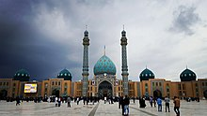
The Islamic Mosque
Since their beginnings, mosques have served many purposes. The main purpose of a mosque is to worship and praise Allah. It can be a community building or an open area deemed as sacred. Several mosques have domed roofs with the symbol of Islam, and many of them in Muslim countries have a tower called a minaret. Mosques don't have furniture, statues, or pictures.

Slide 21
The Hindu Shrine
In the Hindu religion, everyday worship occurs in three places: in one's home, in a temple, or on a street side shrine.
Most households have a small shrine dedicated to the gods that are significant to that house. If there is a guru, a photo is present to remind the individual of the guru's teachings.

Slide 22
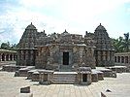
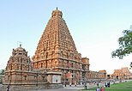
The Hindu Temple
In the Hindu temple, the god or goddess are regarded as royalty. The statue is bathed and dressed, and meals and other gifts are frequently provided. Small shrines to Hindu gods and goddesses can be found on roadsides and on streets. They can stay there permanently and untended or be put on a cart and moved around.

