Slide 1
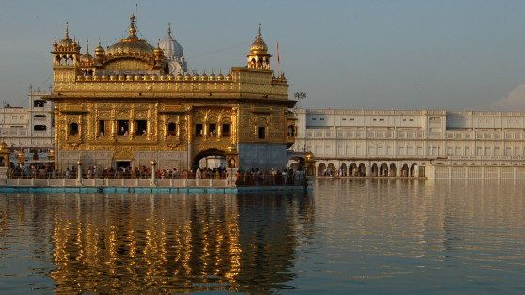
Sikhism
Comparative Relgioin

Slide 2
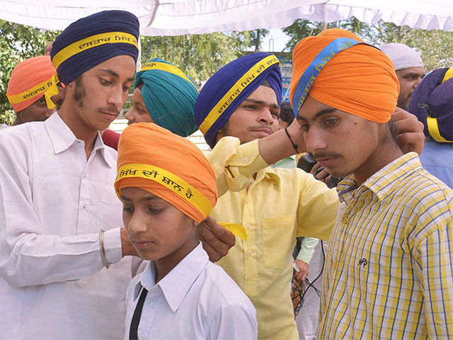
What do you know about Sikhism?
Who was the messenger of the faith?
When and where was he born?
What was his message?
Do you have Sikh friends?
What do they celebrate?
How do they worship?

Slide 3
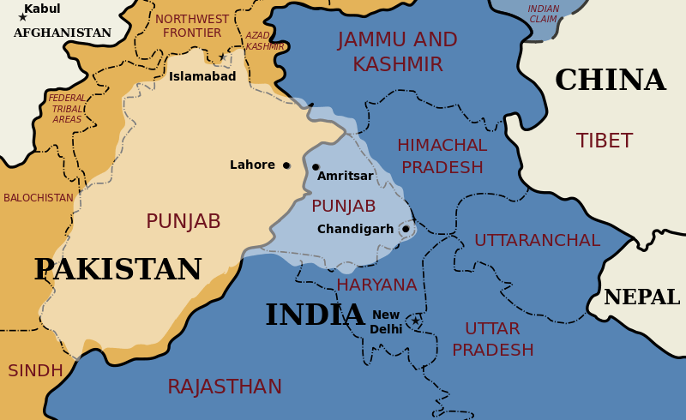
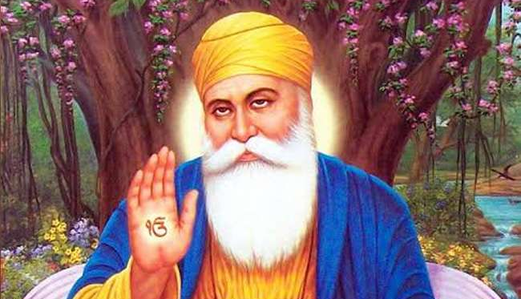
Who was the founder of Sikhism and when was it founded?
Sikhism has 10 Gurus or mediators of divine grace.
The last of the 10 Gurus lived at the end of the 17th century.
The first was Guru Nanak (1469-1539) the founder of Sikhism
The term Sikh in Sanskrit means “disciple” or “learner”
Sikhs are the followers of the Gurus
Sikhism originated in the Punjab region of northwest India (current day Pakistan)
Who was the founder of Zoroastrianism and when did he introduce his message?

Slide 4
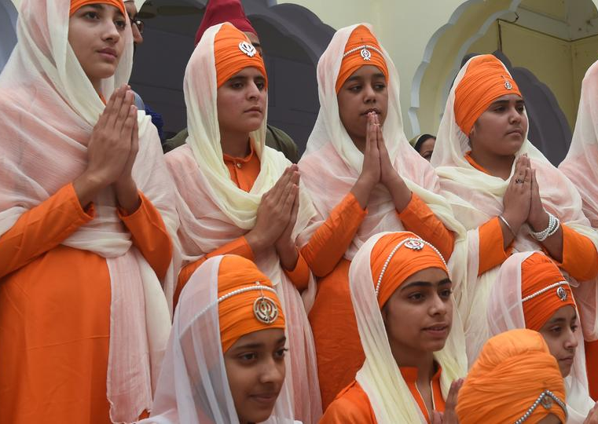
What influenced Sikhism?
Sikhism drew on elements from Bhakti Hinduism and Islamic Sufism to develop into a distinctive religious tradition of its own.
Has Zoroastrianism been influenced by other cultures, religions, and beliefs?

Slide 5
Name of God in Sikhism
God is known by several names:
Sat (truth)
Sat Guru (true Guru)
Akal Purakh (timeless being)
Kartar (creator)
Wahi-Guru (“praise to the Guru)
Sikh religious worship involves deep thinking and reflection of the divine Name.
What does Zoroastrian worship involve?
What is the name of God in Zoroastrianism and what does it mean?

Slide 6
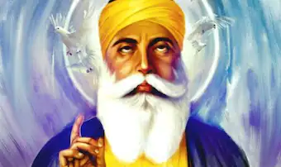
Life purpose in Sikhism
Sikhism believe that release from the karmic cycle of birth and rebirth occurs when the human spirit becomes one with the spirit of God (Mukti).
By concentrating on God's Name (or many titles), one conquers one’s ego and unites with God.
What is the purpose of life in Zoroastrianism?

Slide 7
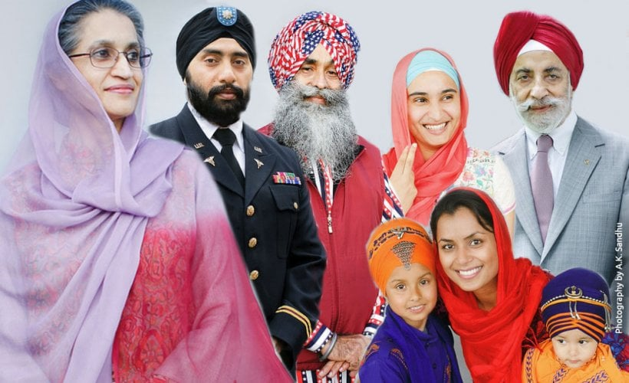
“Religion of Household”
Sikhism puts a strong emphasis on family
Believes in living in the world without concentrating on material aspect of life.
Moral purity is essential
How does Zarathushtra’s view of the family unit?

Slide 8
Khalsa Brotherhood
Established by Guru Gobind Singh, the 10th Guru
Anyone initiated into this brotherhood is required to wear 5 symbols:
Uncut hair
A comb
A steel wrist bangle
A sword
A pair of short underpants
Guru Gobind Singh also required all men to take the name Singh (lion) and all females to take the name Kaur (princess).
The outward symbols provide a communal unity.
What is the sign of unity among Zoroastrians?
https://www.youtube.com/watch?v=PhLer0OWtmk

Slide 9
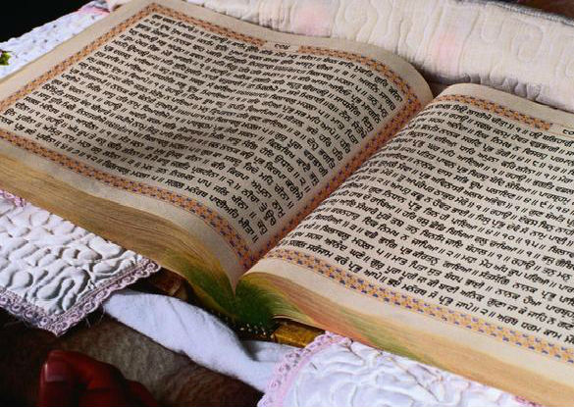
Main Sacred Text of Sikhism
Adi Granth is the compilation of Sikh scriptures.
The compilation was begun in 1604 by the 5th Guru
The 10th Guru named himself the last Guru and named Adi Granth as the teacher of all Gurus (Guru Granth Sahib)
Guru Granth Sahib became the embodiment of all 10 Gurus and the focus of Sikh worship
Adi Granth is written in Gurmukhi (script of the Punjabi language)
What is the Zoroastrian religious book and what language is it written in?

Slide 10
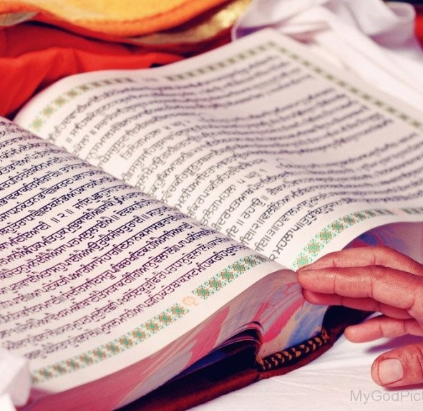
Parts of Adi Granth
Adi Granth is made of three parts
A long poem that sums up the elements of Sikhism
Songs by the first 5 Gurus
Commentaries about the songs of the Gurus, and hymns by Hindu saints and Sufi mystics.
What does Zoroastrian religious scriptures include?

Slide 11
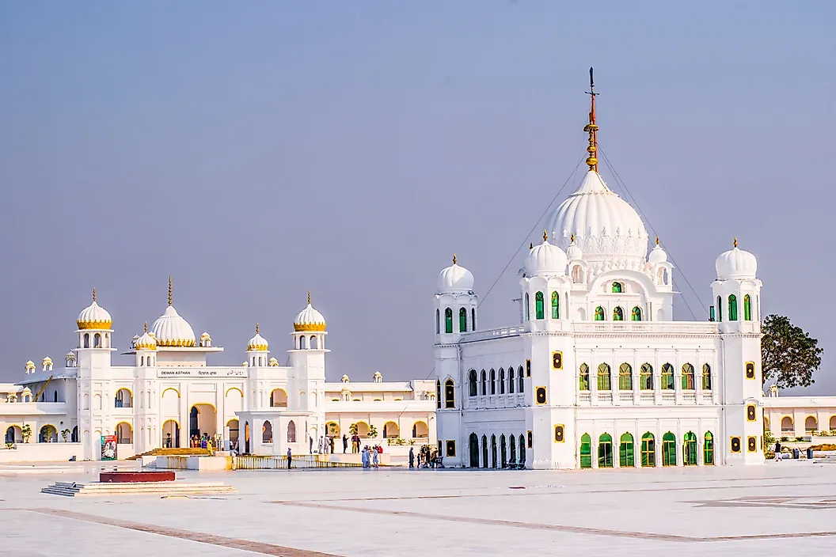
Place of Worship
Any temple that has the sacred book Guru Granth Sahib is considered a Sikh temple or Gurudwara.
There is no priesthood per se but there are official readers of the scripture.
What do Zoroastrians call their place of worship and what do they call the religious priest?

Slide 12
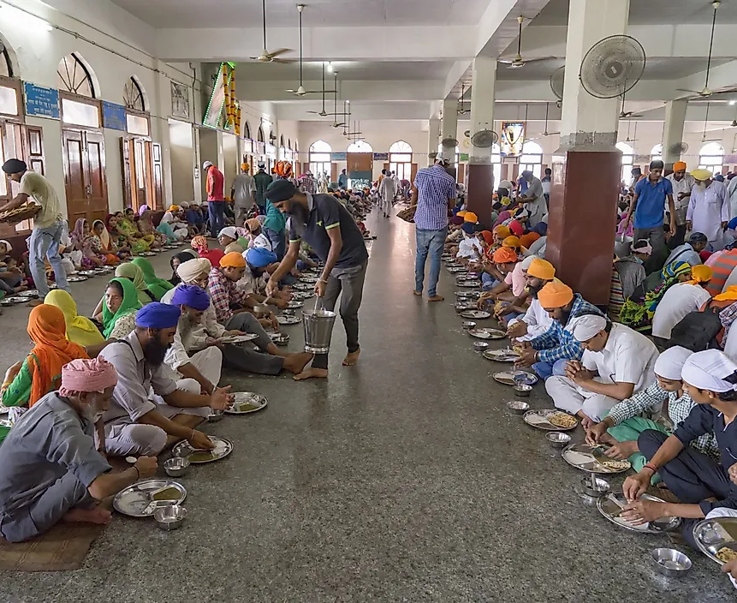
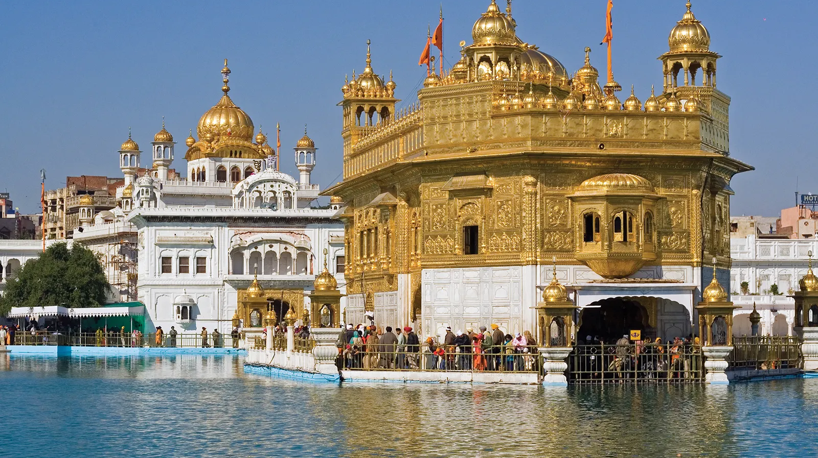
Main Place of Pilgrimage
Golden Temple of Amritsar, in India.
Do Zoroastrians have a place of pilgrimage?

Slide 13
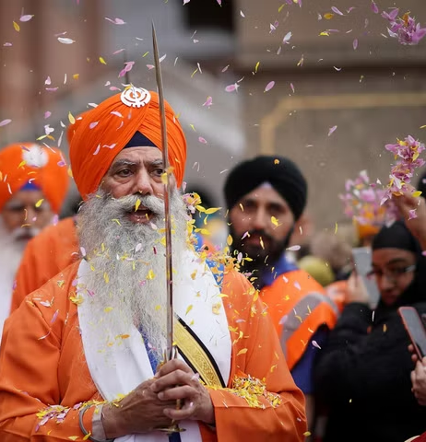
Sikh Celebrations
Sikh celebrations are centered around the Gurus of Sikhism or Hindu cultural celebrations
Gurpubs festivals- birthday or martyrdom of a Guru
Gurpubs starts with a “Akhand Path” continuous reading of the Adi Granth which lasts for 48 hours and finishes on the day of the festival
Hola Maholla- celebrated on the Indian holiday of Holi
Initiated by the 10th Guru is a day for military exercises and mock battles followed by music and poetry
Vaisakhi- Is on the Hindu festival of thanksgiving but for the Sikhs it marks the founding of the Khalsa in 1699. Those interested in being baptized into the Sikh religion find this an appropriate day to do so.
Diwali- For Sikhs it is celebrated as the release of the 6th Guru from prison.
What do Zoroastrian celebrations center around?

Slide 14
Where do most Sikhs live?
Sikhism currently has more than 25 million followers all over the world.
90.2% of the world’s Sikh population is found in India in the east Punjab region.
Besides India, Sikhs are found in countries such as United States, Canada, United Kingdom, Australia, Malaysia and East Africa.
https://www.worldatlas.com/articles/sikhism.html

Slide 15
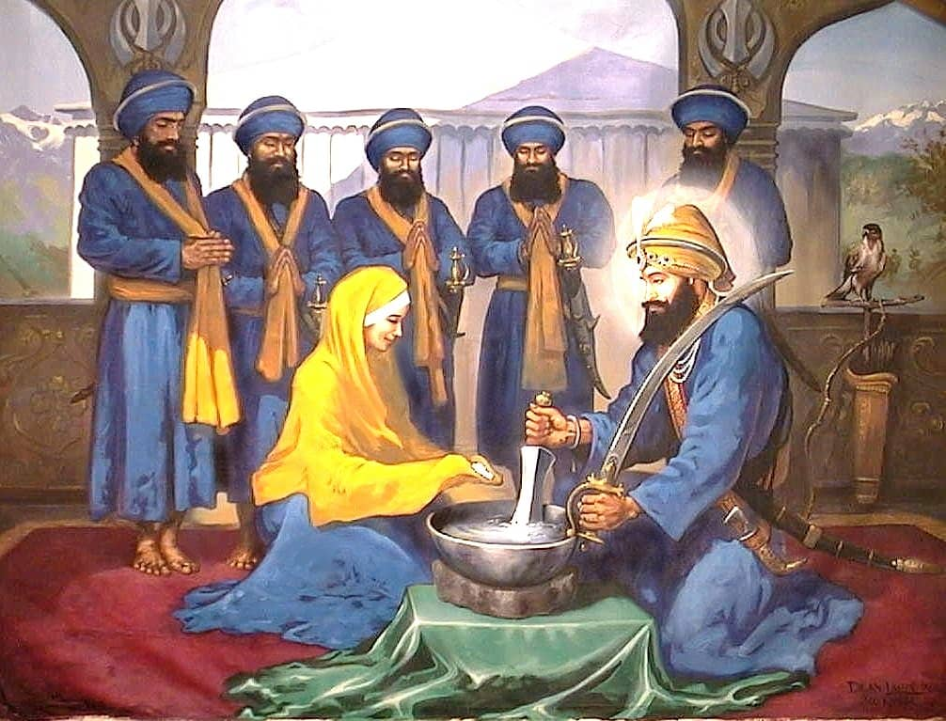
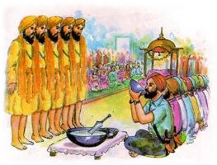
Initiation into Sikhism
Amrit is a mixture of sugar and water that has been stirred with a double-edged sword.
The candidates for initiation drink some of the Amrit, and have it sprinkled on their eyes and hair.
Each then recites the Mool Mantra (the fundamentals of Sikhism).
Worship one God.
Read the Guru Granth.
Join the Sikh congregation.
Serve others.
Refrain from worshiping any created object or living thing.
What is the Zoroastrian initiation ceremony called?
How is it performed and what does the initiate decides to follow by doing the initiation?
https://www.learnreligions.com/amrit-the-sikh-baptism-ceremony-2993263

Slide 16
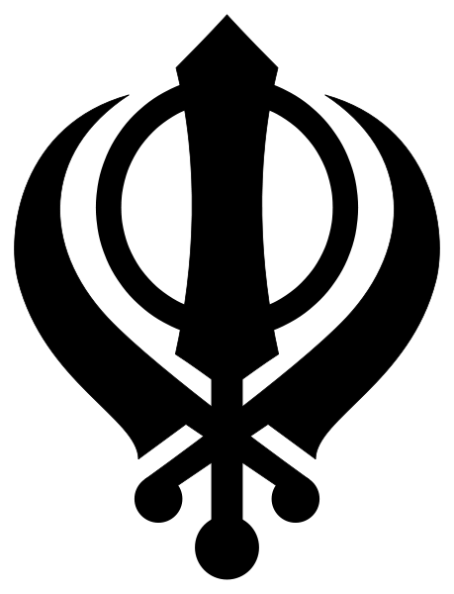
Symbol of Sikhism
They symbol of Sikhism is Kanda
Kanda meaning double edge sword (in the middle) metaphor of Divine Knowledge
Separating Truth from Falsehood
Circle around the Kanda (Chakar) symbolizing perfection of God who is eternal
Two curved swords outside the Kanda (Kirpans) symbolizing Sikhs spiritual aspiration as well as obligation to society
What is the symbol of Zoroastrian religion?
https://www.sikhs.org/khanda.htm

Slide 17
YouTube video on Sikhism
https://www.youtube.com/watch?v=L-1UAORcX4c

Slide 18
Let’s go over our chaLLrt
Name of Religion | Messenger | Area and year it was first founded | God in the religion | Purpose of Life and our role as the follower of the faith | Religious text | What are the celebrations centered around? | Belief after death
Zoroastrianism | Zarathushtra | 1500-1700 BCE Northeastern Iran | Ahura Mazda | Lead the world to perfection or Asha | Gathas Avesta | nature | State of joy and suffering
Sikhism | Guru Nanak | Around 1500 CE Punjab, India | 5 names of God: 1. Sat (truth) 2. Sat Guru (true Guru) 3. Akal Purakh (timeless being) 4. Kartar (creator) 5. Wahi-Guru (“praise to the Guru) | Mukti- becoming one with God | Adi Granth | The Gurus and Hindu cultural celebrations | Reincarnation until Mukti

