Slide 1
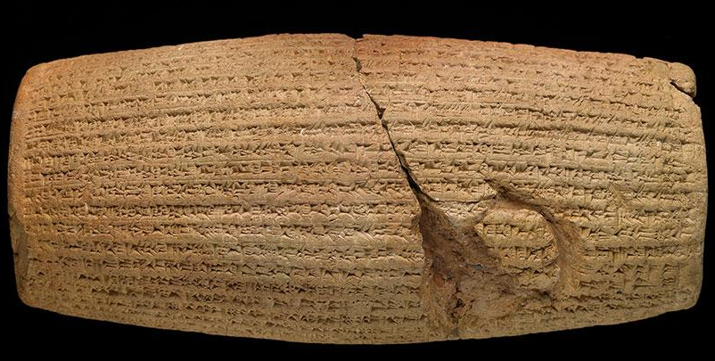
The Cyrus Cylinder
A Brief Overview
Xerxes Kotval & Daulat Kotval

Slide 2
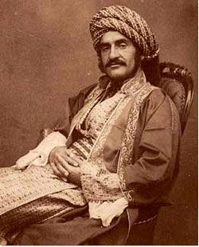
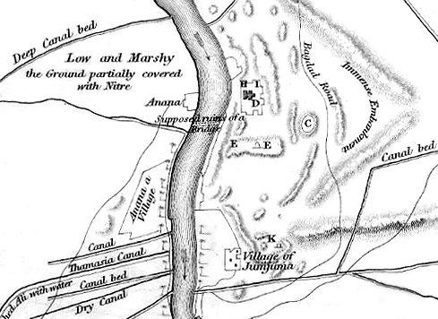
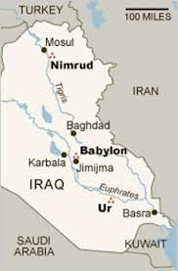
Discovery!
Hormuzd Rassam (1826-1910), an Assyrian-born British diplomat and archaeologist, oversaw extensive excavations throughout Mesopotamia
In Feb/March 1879, during the excavation of the foundations of the city’s main temple, Esagila, in Babylon fragments of a clay cylinder were found
Circa 1854
Notes:
Detailed biography of Hormuzd Rassam at http://zoroastrianheritage.blogspot.com/2013/03/cyrus-cylinder-its-discoverer-hormuzd.html

Slide 3
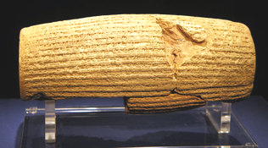
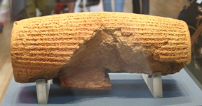
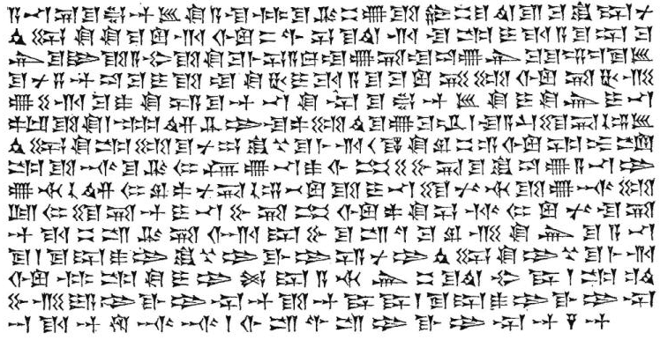
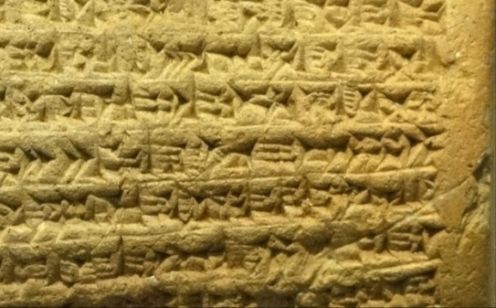
What does it look like?
Barrel-shaped cylinder of multi-layered baked clay
Originally constructed between 539BC – 530BC
Comprised of two main fragments ("A" and "B“), reunited in 1972
45 lines of text written in Akkadian cuneiform script
35 lines on fragment "A" | 10 lines on fragment "B“
A number of lines at the start and end of the text are too badly damaged for more than a few words to be legible
22.5cm / 8.9in
10cm / 3.9 in
Lines 15 – 21
Extracted from the Cyrus Cylinder

Slide 4
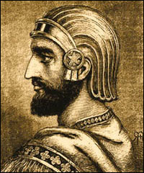
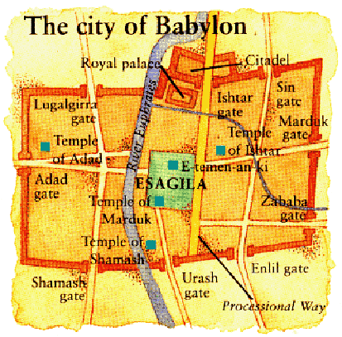
Who was Cyrus?
Cyrus II was the son of Cambyses I, a King of the small Persian city of Anshan. Cyrus was also the grandson of Astyages, King of the great Median empire.
Cyrus united all the Persian tribes, marched on Media and became King of Persia and the Medes. He then went on to expand his empire into Lydia and Babylon.
Cyrus the Great
Babylon relied heavily on the Euphrates River as a barrier to an army crossing.
Cyrus diverted the rivers around Babylon, lowering the water levels, allowing his army to cross.
The Babylonians were so sure they were secure that they were feasting and dancing when the Persian army walked through the Gate of Ishtar.

Slide 5
What does it say?
The text can be divided into distinct parts:
The reviling of Nabonidus, the previous king, and associating Cyrus with the god Marduk (1-19)
Detailing Cyrus’ royal titles and genealogy, and his peaceful entry into Babylon (20–28)
Returning of peoples to their homelands and restoring their sanctuaries (29-35)
Declaration that Cyrus had enabled the people to live in peace and has increased the offerings made to the gods (36–37)
Details of the building activities ordered by Cyrus in Babylon (38-45)

Slide 6
What does it say?
Excerpted from lines 28-36
“…that we might live happily in his presence, in well-being. … I sent back to their places… the sanctuaries across the river Tigris - whose shrines had earlier become dilapidated,
the gods who lived therein, and made permanent sanctuaries for them.
I collected together all of their people and returned them to their settlements, and the gods …which Nabonidus … had brought into Shuanna …I returned them unharmed to their cells, in the sanctuaries that make them happy.
May all the gods that I returned to their sanctuaries… mention my good deeds, and say to Marduk …“Cyrus, the king who fears you, and Cambyses his son, may they be the provisioners of our shrines until distant days, and the population of Babylon call blessings on my kingship. I have enabled all the lands to live in peace.”

Slide 7
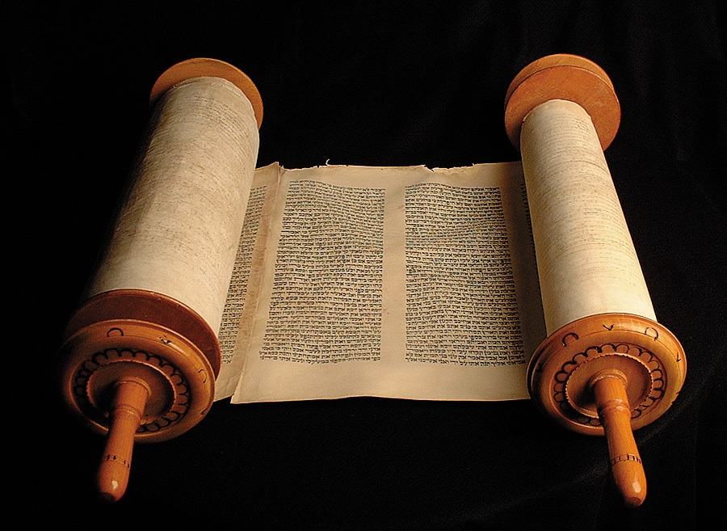
Biblical Corroboration
The Cylinder's text has t been seen by biblical scholars as corroborative evidence of Cyrus’ policy of the repatriation of the Jewish people following their Babylonian captivity.
"Now in the first year of Cyrus king of Persia … the Lord stirred up the spirit of Cyrus king of Persia, so that he made a proclamation throughout all his kingdom, and also put it in writing, saying, Thus says Cyrus king of Persia: All the kingdoms of the earth the Lord God of heaven has given me. And He has commanded me to build Him a house at Jerusalem which is in Judah. Who is among you of all His people? May the Lord his God be with him, and let him go up!" - 2 Chronicles 36:22-23

Slide 8
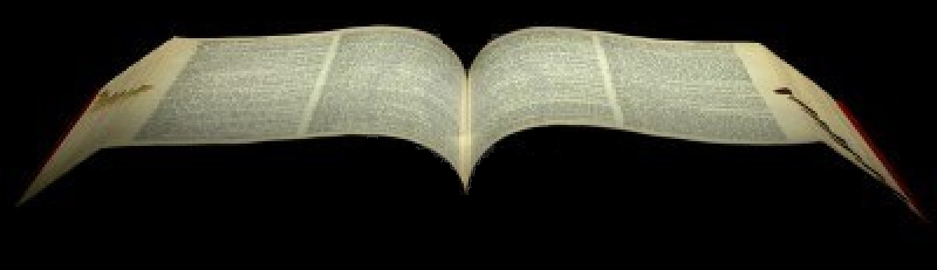
Biblical Corroboration
"Who says of Cyrus, 'He is My shepherd, And he shall perform all My pleasure, Saying to Jerusalem, "You shall be built," And to the temple, "Your foundation shall be laid." ' - Isaiah 44:28
"King Cyrus also brought out the articles of the house of the Lord, which Nebuchadnezzar had taken from Jerusalem and put in the temple of his gods; and Cyrus king of Persia brought them out by the hand of Mithredath the treasurer, and counted them out to Sheshbazzar the prince of Judah. …All the articles of gold and silver were five thousand four hundred. All these Sheshbazzar took with the captives who were brought from Babylon to Jerusalem." - Ezra 1:7-11

Slide 9
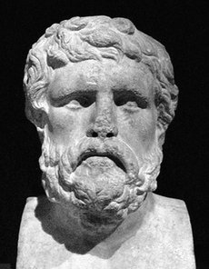
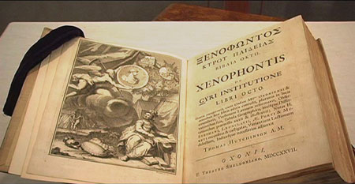
Xenophon's Cyropaedia
The Cyropaedia meaning "The Education of Cyrus“ was written in the early 4th century BC by Xenophon of Athens.
It describes the education of an ideal ruler, trained to rule as a benevolent despot over his admiring and willing subjects.
Xenophon's portrait of Cyrus as "the Ideal Ruler and the best form of Government", "could not have been painted had there not been a credible memory of such a Cyrus”.
One of Thomas Jefferson's two personal copies of Xenophon's 'Cyropaedia.'
Cyropaedia
influenced the thinking of many European leaders and our Founding Fathers.

Slide 10
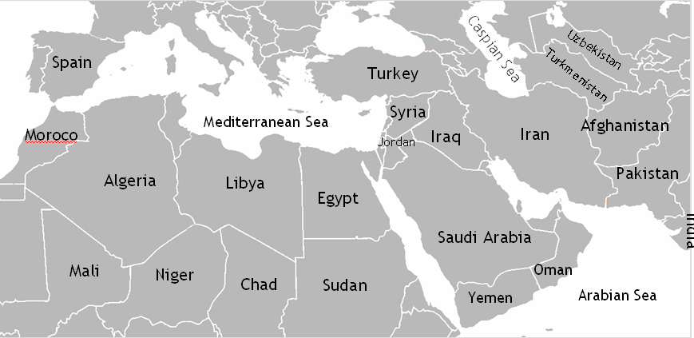
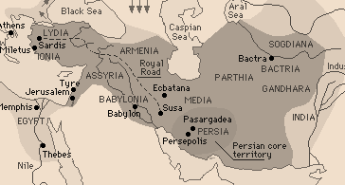
Why does it matter today?
A 2600-year-old “blueprint” for religious tolerance and freedom
Today
A region larger than Turkey, Jordan, Israel , Palestine. Syria, Iraq, Iran, Afghanistan and Pakistan combined.
Empire of Cyrus the Great

