Slide 1
In today’s Class, Let’s talk about:
Fravahar

Slide 2
What is the Image below called?
Fravahar

Slide 3
In the picture below who is older? Who do you think has had more experience in life.
With Age comes Wisdom

Slide 4
The head of the Fravahar is an older man reminding us wisdom comes with age.

Slide 5
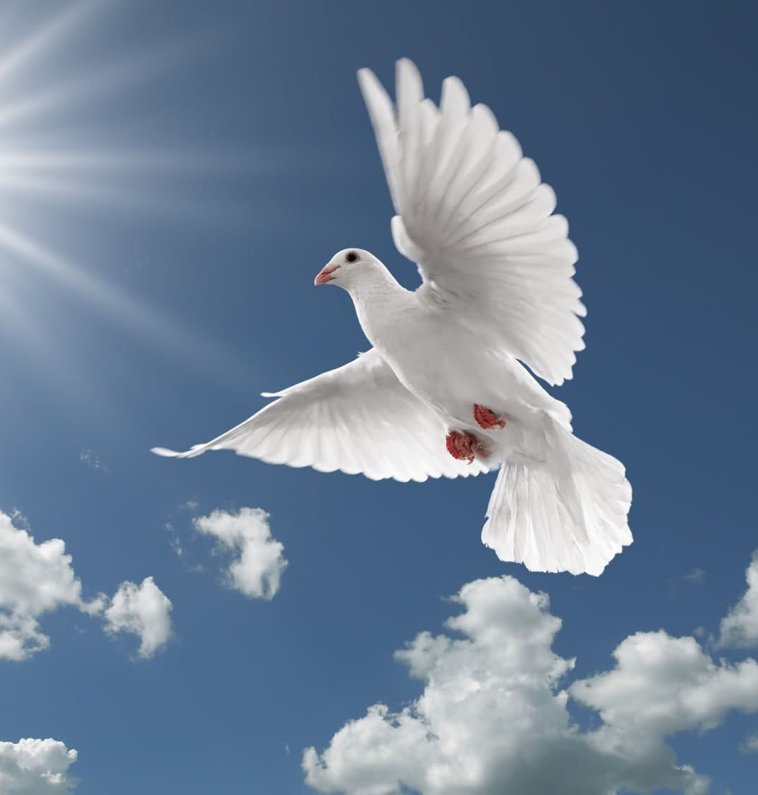
What do these images remind you of? What does soar into the sky represent? Progress or Regress (decline)?

Slide 6
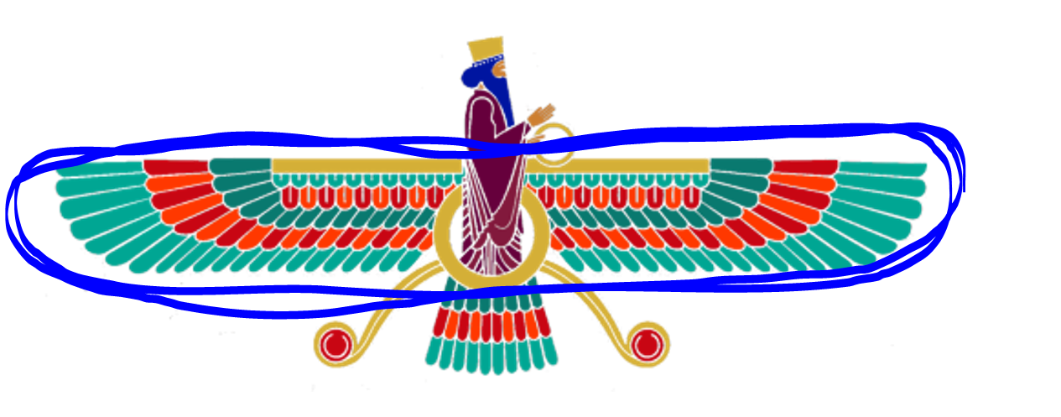
The wings of the Faravahar remind us to progress and advance in life with good thoughts, good words and good deeds.

Slide 7
What does the rings in the picture below remind you of?

Slide 8
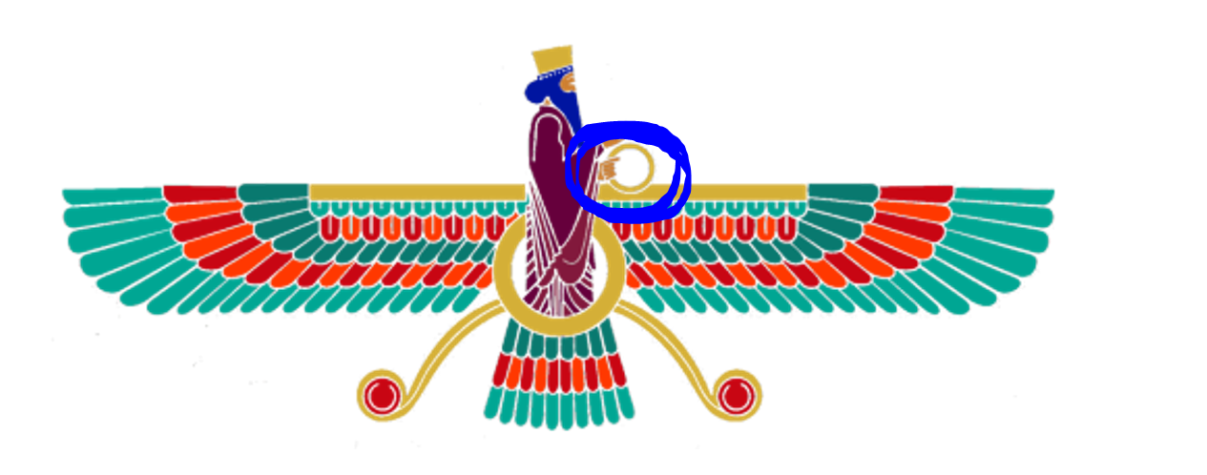
The ring held by the Fravahar reminds us to keep our promise and commit to it wholeheartedly.

Slide 9
What does circle of life mean to you?
We are all connected in the universe. Cycle of life goes on. What goes around, comes around. It means do good to receive good. When one sways away from good deeds, things will not go well for them.

Slide 10
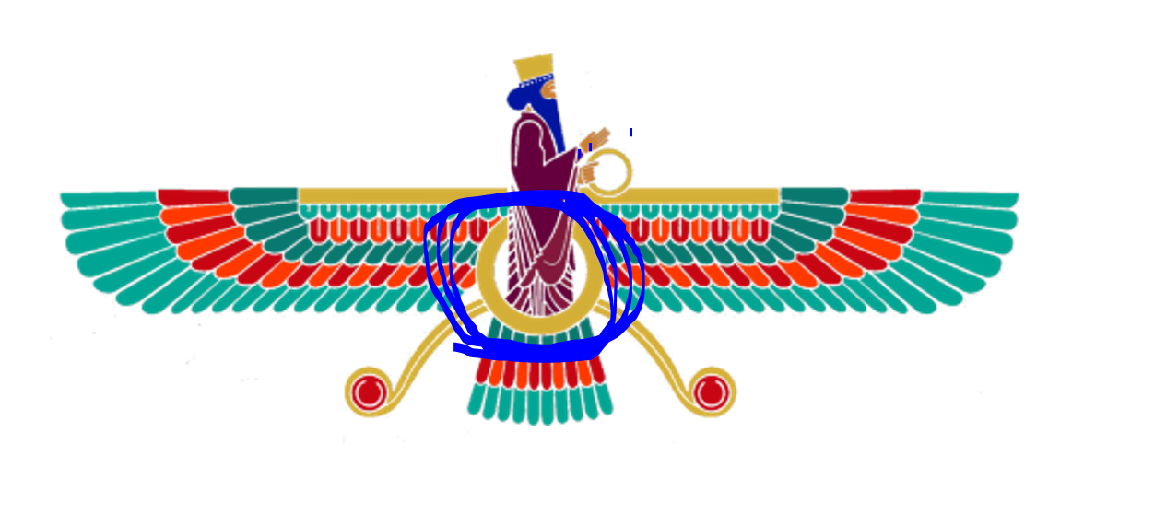
The Mid circle in Faravahar reminds us to do good to receive good. It represents Circle of life. “What goes around comes around.”

Slide 11
Decisions, Decisions! Do I tell the truth, or do I not? We should make the right choice. But this is not that easy because there are always 2 opposing forces. The wrong choice may be more attractive swaying us from doing the right thing. Can you think of the section of Fravahar that represents this?

Slide 12
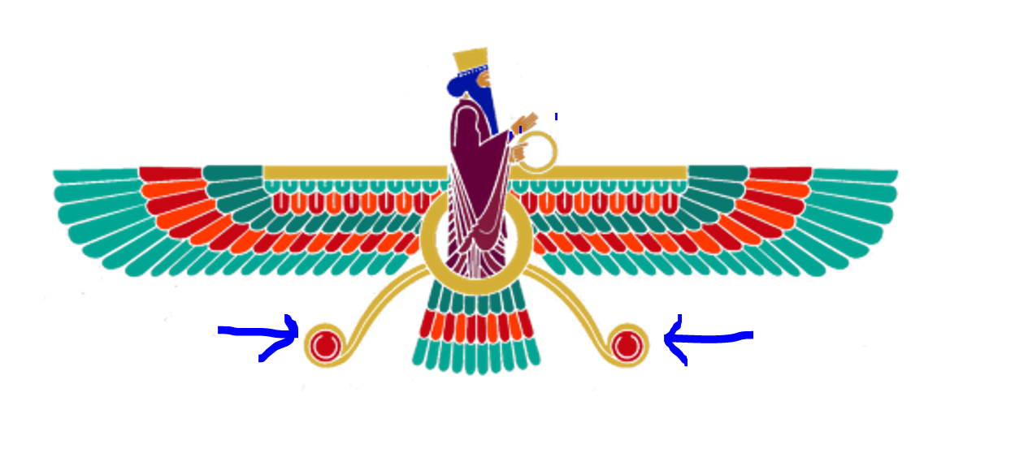
Here they are! These 2 antennas at the bottom remind us that there are always 2 opposing forces in the Universe. They are called Spenta Mainyu & Angra Mainyu

