Slide 1
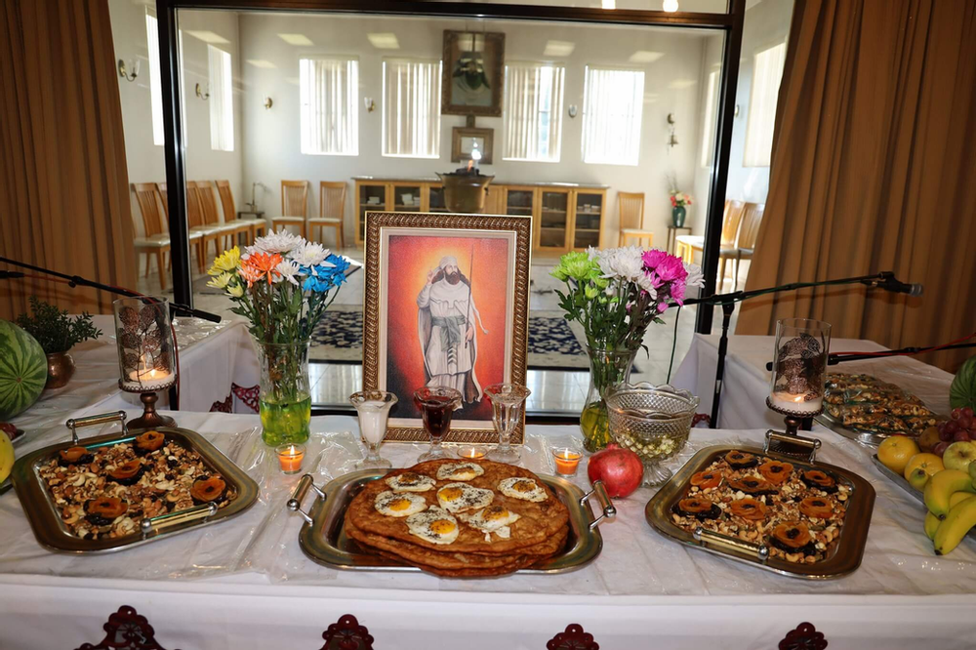
Gahanbar

Slide 2
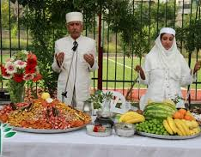
Gahanbar
Gahanbar is a ceremony held 6 times each year where anyone can come eat and is a community gathering. In these occasions , we gather, we enjoy, we pray to Ahura Mazda , we offer donations, and we cherish the memories of great people.

Slide 3
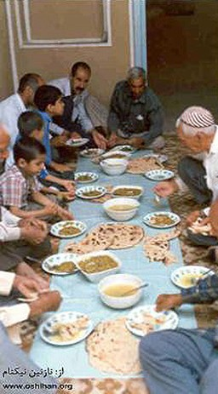
Gahanbars are six seasonal thanksgiving festivals when Zoroastrians assemble to eat and share food communally. They are joyous occasions at which rich and poor meet, new friendships are formed, and old disputes resolved.

Slide 4
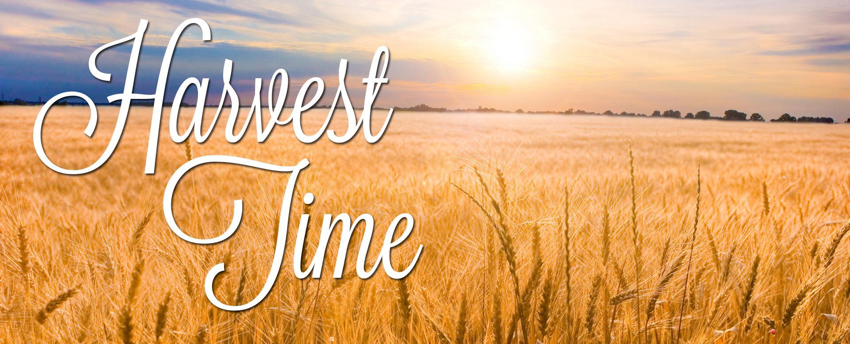
Some derive Gahanbar from gah-anbar meaning time-gathering, the time for gathering (food and people) or assembly-time.

Slide 5
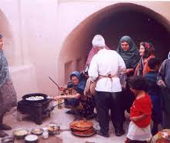
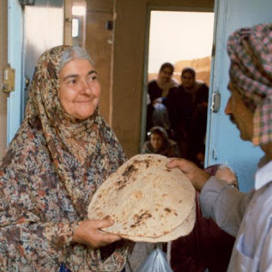
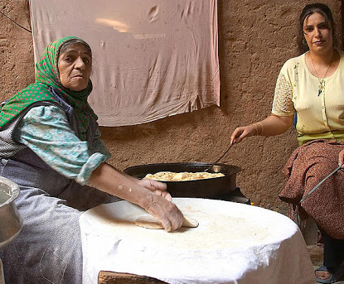
Many community members volunteer to prepare the food, prepare for the occasion and serve the meals - without regard to status.

Slide 6
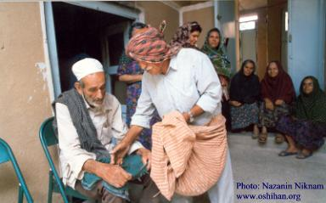
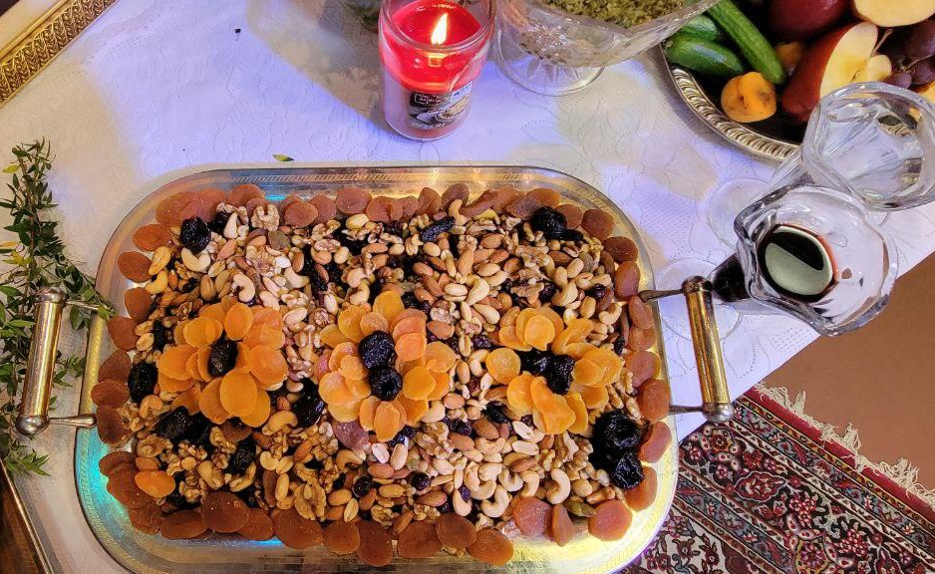
Lork in Gahanbar
Lork, a mixture of nuts and dried fruits is essential part of each Gahanbar. Lork will be distributed equally among all who are present, whether they are kings, peasants, or children, all have equal shares.

Slide 7
The last gahanbar celebrated during the five days before Nowruz, is the most significant. This sixth gahanbar, the Hamaspathmaidyem Gahanbar is devoted to remembering the fravashis (guardian angels/souls) of those who have passed away.

Slide 8
Fire, a Religious Symbol
Gahanbar’s Purpose
Fire represents the energy of the creator
Represents purity
Sustains life
Signifies inner warmth
Is natural source of light
Prayer
Remembrance of the souls of the righteous and one's ancestors
Sharing
Donation
Help the needy

Slide 9
Name of Gahanbar | In Honor of Ahura Mazda’s Creation | Days of celebration
Maidyuzaramgah (Mid Spring) | sky | Day of Khur to Day of Daybemehr from month of Ordibehesht
Maidyushahemgah (Mid-Summer) | water | Day of Khur to Day of Daybemehr from month of Tir
Paytehshahemgah (End of Summer) | Earth | Day of Ashtad to Day of Anaram from month of Shahrivar
Ayautharemgah (Beginning of Winter) | Plants | Day of Ashtad to day of Anaram from month of Mehr
Maydyauremgah (Mid-Winter) | Animals | Day of Mehr to day of Varahram from month of Day
Hamaspatmaydeemgah (Equinox) | Human | Last five days of the year

Slide 10
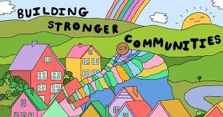
The free and equal sharing of food with everyone, the environment of togetherness, goodwill and sharing - all serve to help build and strengthen the community.

