Slide 1
Story of Sara nickname
Aya-threm-gah
Story by: Artemis Javanshir

Slide 2
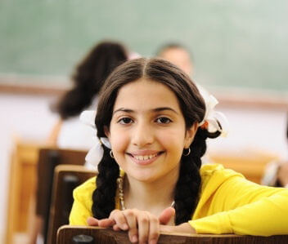
Sara was 12 years old.
She lived with her father, Jamshid and her mother, Mandana in Los Angeles.
Sara didn’t have any siblings but hoped for a little sister.
She attended Portola Middle School and was the only Zoroastrian in her class.

Slide 3
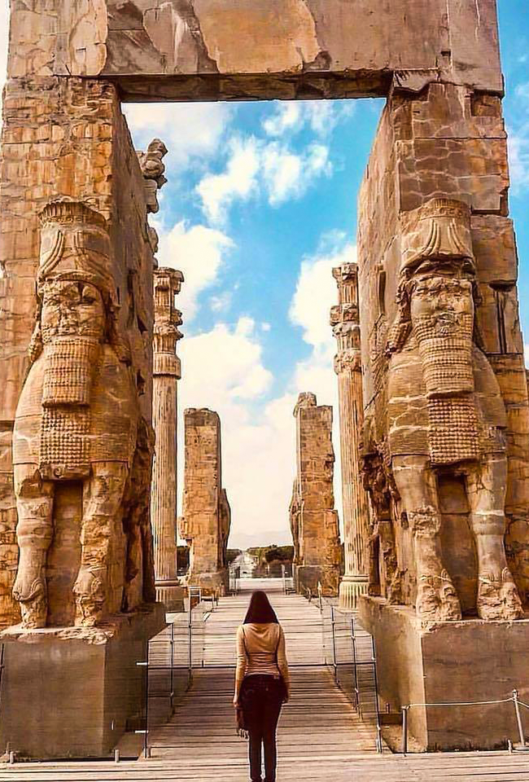
Her family paid close attention to Zoroastrian holidays. They took her to the Zoroastrian center on De Soto Ave, for classes and other programs.
She had a whole different community of friends outside the center. She enjoyed spending time and talking on the phone with them.
She may have complained at times coming to the center but deep down she knew that she shared an ancient and important culture with the community at center.

Slide 4
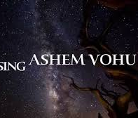
People at the center would understand the prayer “Ashem Vohu”
She could talk about Nowruz or Mehregan with them, and they would relate to it.
Thinking about her friends in school, it felt good to have a different side in her life. A side that was unique and special to her and those who shared her ancestorial culture.

Slide 5
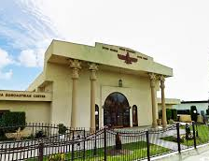
One of her favorite times of the year was the beginning of Fall.
This was because of Halloween, pumpkin pie, and cinnamon tea but also because of Aya-threm-gah Gahanbar, the beginning of Fall.
This was a time when she would go to the center and have a communal feast with her community.
This was the time when her Maman and Baba would start calling her Aya-threm-gah instead of Sara joon their usual endearing way of calling her.

Slide 6
Sara herself would sing:
Aya-threm-gah,
Aya-threm-gah, gah, gah,
six gahs, Aya-threm-gah
Aya-threm-gah,
Aya-threm-gah, gah, gah,
six gahs, Aya-threm-gah

Slide 7
During this time, her religion teacher would always plan a planting project for class. Sara loved planting and spending some of the class time outside in the center’s small garden rather than in the classroom.
This was because of Aya-threm-gah Gahanbar.
This Gahanbar is at the beginning of Fall, and it is dedicated to celebrating plants, one of Ahura Mazda’s creations.
Her teacher would say that Zoroastrians have 6 seasonal celebrations called 6 Gahanbars.

Slide 8
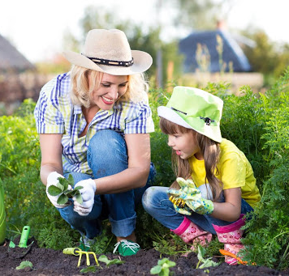
Gahanbars are celebrated at different times in a year important to our agriculturalist and pastoralist ancestors.
Sara’s teacher says “gah” in the old language means “time of”
Sara wished for Aya-threm-gah to be called Sara-gah “time of Sara” instead.

Slide 9
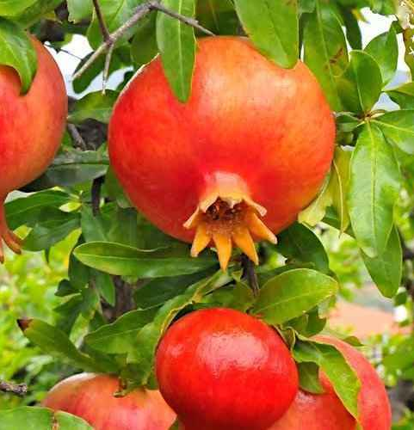
Today, Aya-threm-gah’s teacher asked all the students to help set up the table for the Gahanbar.
Shawdi put a white tablecloth on the table.
Nikan put all the dried fruit and nuts, “lork” on a big serving dish and placed it on the table.
Manucher and Ariana set the fresh fruits of the season on a big dish on the table.
Pomegranates were Aya-threm-gah’s favorite fruit on the table.

Slide 10
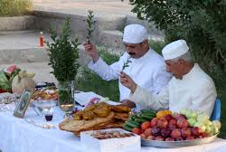
Sohrab and Tehmina, knew something was missing.
They ran outside and brought back a small branch of the “sarv”, an evergreen tree and placed it in water and on the table.
The Aya-threm-gah, Gahanbar table was ready.

Slide 11
Aya-threm-gah could hear sound of laughter and dishes clattering from the kitchen.
Parmis was going towards the kitchen. Aya-threm-gah thought to join her just in case she could get a piece of “sirog” sweet fried bread while it was hot.
In the kitchen, there was hardly any room to move around. Ariana’s Baba was adding greens to the big pot of “aash”
Sohrab was adding some lentils that he had brought from home.
This aash was starting to smell really good.

Slide 12
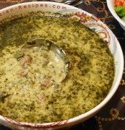
Lately, Fereydoun’s family were having a hard time.
Aya-threm-gah had heard her Baba and Fereydoun’s Dad talking on the phone one night.
Fereydoun’d Dad had lost his job because the company he was working for went bankrupt.
Aya-threm-gah noticed that Fereydoun had not brought anything to add to the feast, but he was sitting by the big pot of aash and making sure it was stirred often.

Slide 13
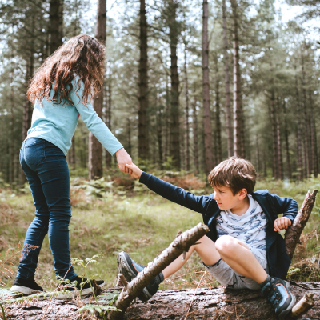
Zaal’s family on the other hand had opened another restaurant in the Woodland Hills areas in addition to the one in Sherman Oaks.
Aya-threm-gah peaked Zaal’s Dad going to the donation box and slipping in a check through the slot.
As Zaal moved away, she noticed, Anahita’s mom donating.
She remembered her teacher talking about the importance of donating during Gahanbars.
Her teacher said that during this time community members made donations. She said this donation can be monetary or through non-monetary means.

Slide 14
Rastin, walked over to Aya-threm-gah and told her that it was time for everyone to sit by the Gahanbar table.
The whole community were sitting down.
Rastin and Aya-threm-gah found a spot by Nikan.
Mobed was wearing all white sitting by the Gahanbar table singing a special section of the Avesta specific to the Aya-threm-gah Gahanbar.
The smell of “esfand o kondor” was one of love and community. It mingled with the “Ashem Vohu” prayer sung by the Mobed.

Slide 15
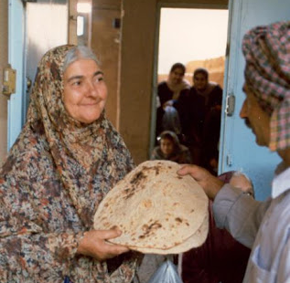
After the prayer, Jamshid, Aya-threm-gah’s father helped pass the “lork” to each member of the community to enjoy.
The potluck Gahanbar table looked delicious, specially the aash that the whole community prepared together.
She couldn’t wait to grab a big piece of the “sirog” and a dish of aash.
She looked forward to sit with her Zarathushti friends younger and older than herself and share the common news of the community.

Slide 16
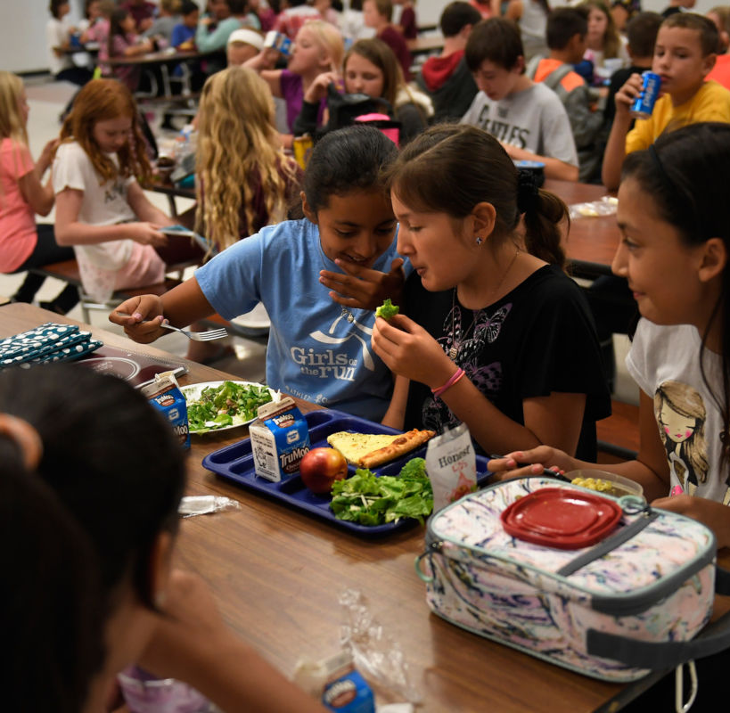
Shirin was saying that the Orange County center needed help cleaning the weeds out of their garden and that her family was going to help that Saturday.
Aya-threm-gah was happy to be at the communal gathering so she could find out about the opportunity to help the Orange County center.

Slide 17
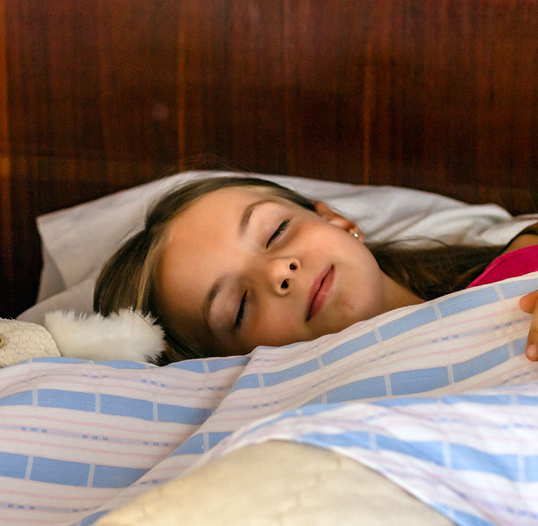
That night, laying in bed, Aya-threm-gah felt very peaceful.
Why? … She thought.
What has brought such peace to her mind?

Slide 18
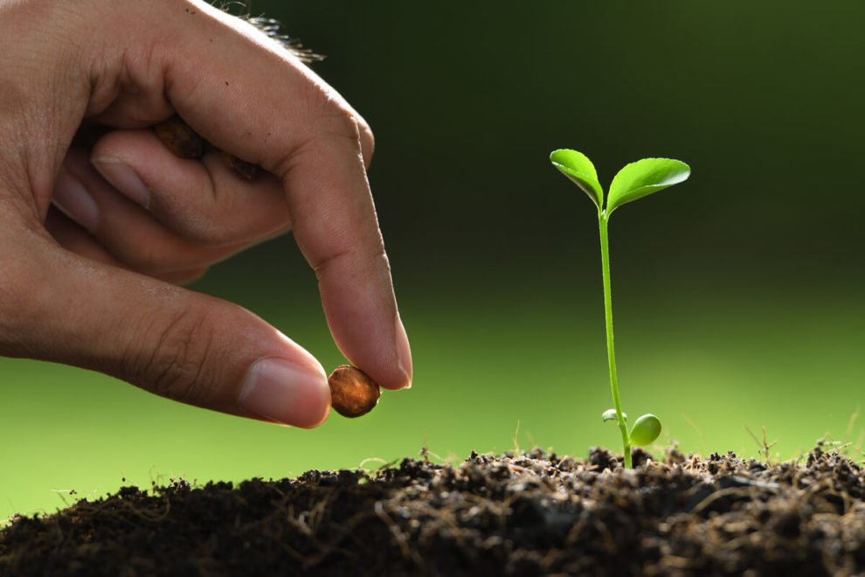
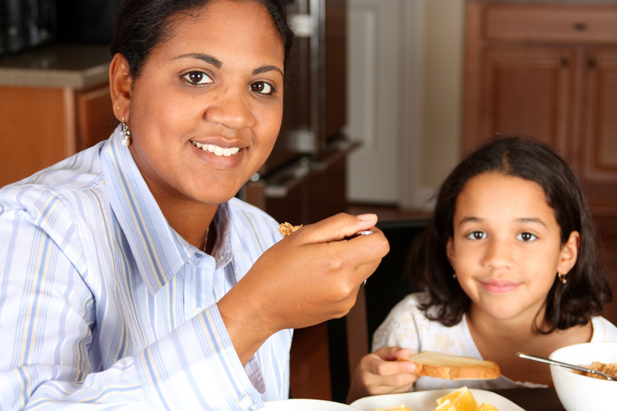
Was it celebrating Ahura Mazda’s creation of plants by planting during religion class?
Was it donating her time by helping set up the Gahanbar table?
Or was it spending quality time with her Zoroastrian friends and the opportunity to help a neighboring center?
She figured it is the “Hamazoori” in all the above.
She smiled.

Slide 19
No wonder she liked this time of the year.
She had the best nickname, she thought,
Aya-threm-gah, Aya-threm-gah, gah, gah, 6 gahs, Aya-threm-gah

Slide 20
When are Gahanbars?
Spring Mid Spring-Sky
Summer Mid summer-water End of Summer-Earth
Fall (Beginning of big winter) Start of Fall-Plants
Winter Mid Winter-beneficial animals Last 5 days of the year-mankind

Slide 21
When are the Gahanbars
Mid Spring (Maidyo-zarem-gah)
Day Khoor - Day be-mehr of month of Ordibehesht
Mid Summer (Maidyo-shahem-gah)
Day Khoor-Day be-mehr of month of Tir
End of Summer (Paiti-shahem-gah)
Day Ashtad-Day Anaram of month of Shahrivar
Start of Winter (Fall) (Aya-threm-gah)
Day Ashtad-Day Anaram of month of Mehr
Mid Winter (Maid-yarem-gah)
Day of Mehr-Day of Verahram of month of Day
Equinox (Hamas-path-maidyem-gah)
Last five days of the year

Slide 22
How would you celebrate Gahanbar?

