Slide 1
Sassanid Empire Lesson 1 224-651 CE
Ardeshir I
Shapur I

Slide 2
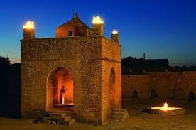
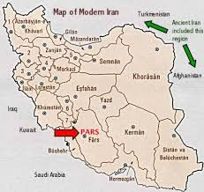
Ardeshir
During the Parthian Empire, each section of the country had a ruler who paid taxes to the Parthian king and supplied the king with men at time of war. (241BCE-224CE)
Pars was one of these provinces who had a ruler of its own.
Sassan (tended fire at Atash-gah). He married the ruler’s daughter in Pars.
They had a son named Babak (Papak).
Babak had a few children one of which was Ardeshir.

Slide 3
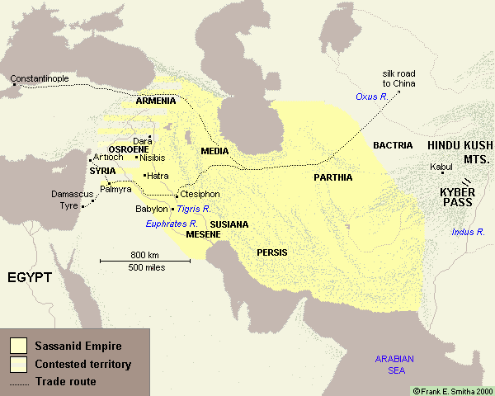
Ardeshir Establishes Sassanid Empire
Ardeshir was assigned to manage one of the cities in Pars, however, he started taking control of the nearby cities and provinces one by one.
In 224 BCE, Ardeshir fought Ardavan III, Ashkanian king at Ctesiphon and won.
In remembrance of his grandfather, he named his newly found empire, Sassanid Empire
He is known as Ardeshir e Babakan (Papakan) because his father was named Babak (Papak).

Slide 4
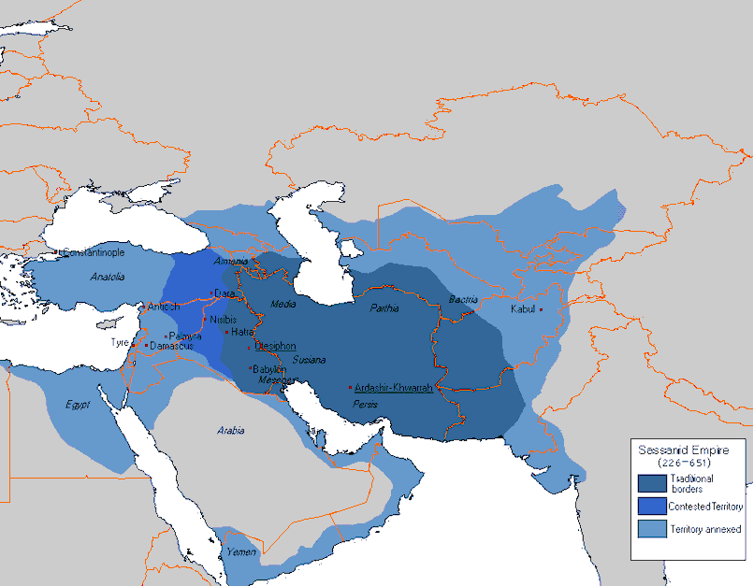
Bringing Back Iran to its Former Glory of Achaemenid Era
He wanted to bring back Iran under a centralized government.
He marched to the East and regained the territory to the west all the way to parts of India
Then he marched and took back land to the west, including Armenia

Slide 5
Centralization
During Ashkanian, each province had its own king. These kings were at times cruel to the citizens.
Ashkanians did not meddle in the provinces’ affairs, these citizens had no protection from the King of kings.
Ardeshir ended this affair and brought all the provinces under the rule of one government.

Slide 6
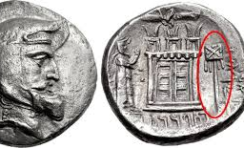
Religion
Ardeshir’s family were Zoroastrians, as his grandfather tended the Atash-gah
For the first time in Iranian history, he announced Zoroastrianism as the official religion of the country
He ordered the re-building of the ruined Atash-gahs
He gave high religious positions to the Mobeds
Started gathering the religious texts which were lost or scattered

Slide 7
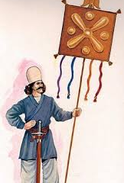
Cultural Organization
He divided the society into specific social orders

Slide 8
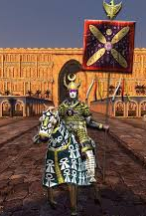
Law and order
He illegalized some of the harsh existing punishments

Slide 9
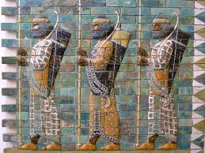
Immortals and Iranian Army
Parthians unlike the Achaemenids lacked a standing army, ready for battle at any given time, and the Immortals (the King’s personal guard)
Ardeshir reinstated the Immortals and a standing army

Slide 10
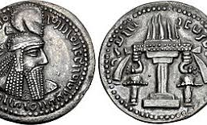
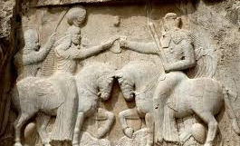
Wisdom
Ardeshir was known as a wise leader
His wisdom and advice were used by the preceding kings many years after his death

Slide 11
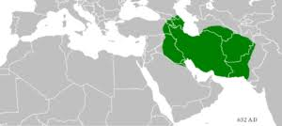
Iranianization
Ardeshir was proud of the Iranian race and country
He considered his lineage to have been traced back to the Achaemenid kings
He wanted to instill high moral standards
He made Zoroastrianism the official religion of the country
He envisioned his empire with Iranian and Zoroastrian morals
The Sassanid Kings gave themselves the title of:
Mazda worshiper, king of Iran and outside Iran
This shows that they made a distinction between Iran/Iranians and others

Slide 12
Iran Under Aredeshir I 224-240 CE
Centralization
Religion
Cultural organization
Law and order
Immortals
Wisdom
Iranization

Slide 13
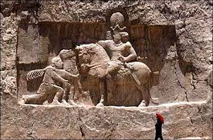
Shapur I (240-270 CE)
Born 215 CE
Reaffirmed Sassanid power and military power against Rome
Took back Armenia who had revolted

Slide 14
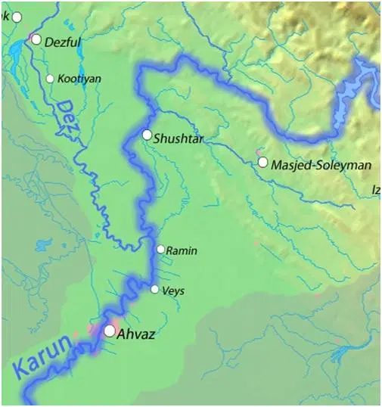
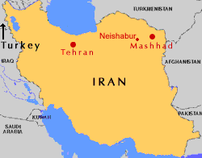
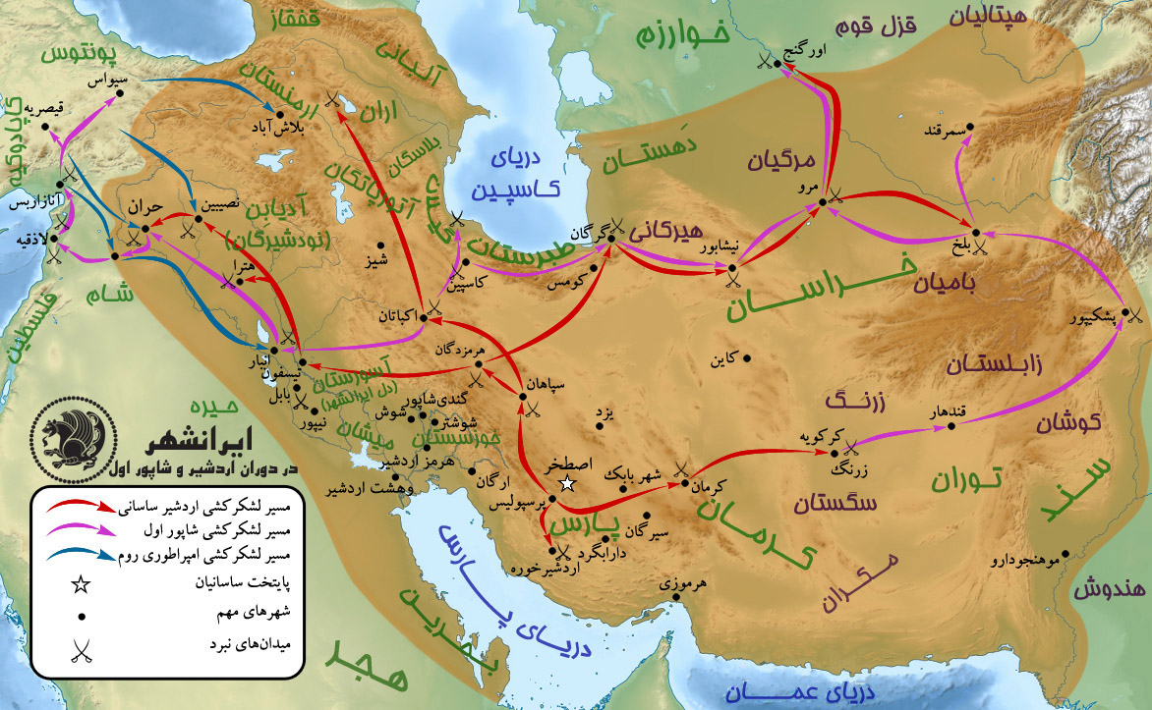
Putting the enemies at bay, Shapur concentrated on improving the country.
A huge dam on Karoon River
Built big and small cities
City of Shapur near Kazerun in Pars
Jandy-Shapur in Khoozestan between Shushtar and Dezful. This city became the center of medicine and the major hospital built in the city was famous in the world
City of Naishabur in Khorasan

Slide 15
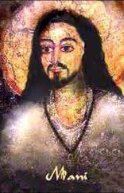
Mani
During the reign of Shapur I, a man named Mani came to court introducing a new religion
In order for people to understand his religion better he drew pictures
Shapur I was fond of Mani but later , for the new religion not cause any chaos in the country, he made him leave Iran.
Mani’s religion gained followers from China to Europe, however, with spread of Islam and Christianity it disappeared

Slide 16
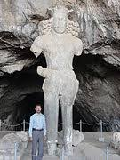
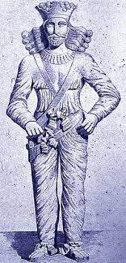
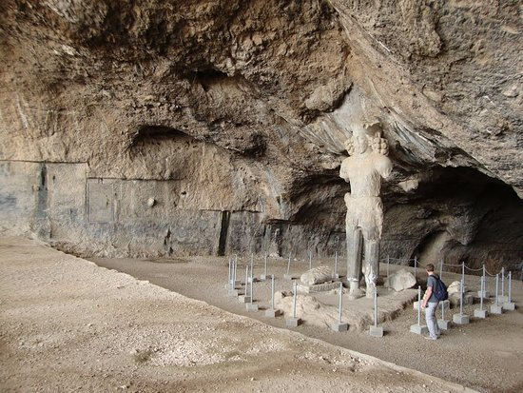
Shapur I’s Statue
His 7-foot statue is in a cave near Kazerun

