Slide 1
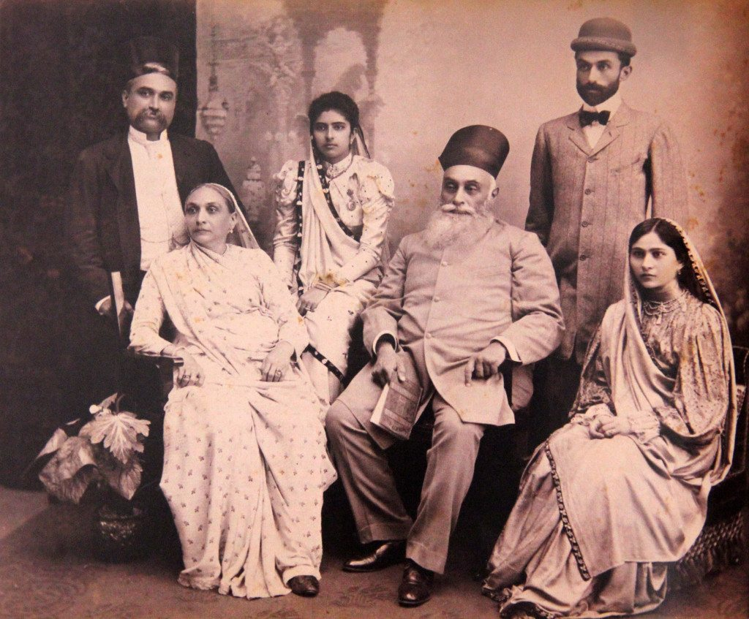
Migration to India and the Sacred Fire
The Journey of Zoroastrians to India

Slide 2
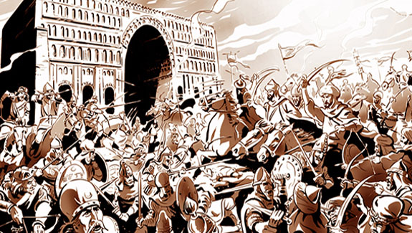
Arabs Conquered Iran
Arabs invaded Iran in 636CE
In 651 CE, Yazdgerd III was killed in Merv, Khorasan so the Sassanid Dynasty ended
Iranians actively fought the Arabs for 300 years

Slide 3
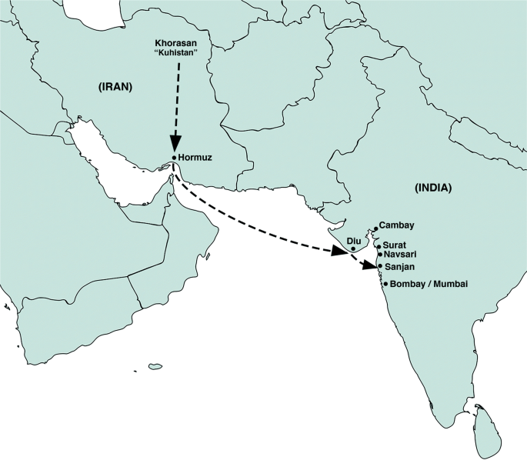
In Pursuit of Peace
Zoroastrians lived under extreme pressures:
Heavy taxes
Forceful conversion to Islam and loss of lives
Persecution-Social and Economical
Confiscation of properties and homes
Destruction of fire temples and religious/cultural books
What would you do? Would you decide to stay in Iran or leave?
A group of Zoroastrians decided to leave Iran
18 ships left Iran traveling the routes to China, Russia, Africa and India
A group set sail from Hormuz to Diu, Gujarat
They lived in Diu for 19 years and then sailed to Sanjan in 936 CE

Slide 4
The Shores of Sanjan

Slide 5
Return to Roots In the Shores of Sanjan

Slide 6
Sanjan
Zoroastrians arrived in Sanjan and were taken to King Jadav Rana
Sugar and milk story
King Jadav Rana asked Zoroastrians to make 5 promises so that they could stay in Sanjan
To explain our religion
To learn their language-Gujarati
The women would learn to wear an Indian dress-the Sari
To lay down any weapons
To have marriage ceremonies take place after sunset
King Jadav Rana gave Zoroastrians land to build a fire temple and to keep Atash Bahram
Zoroastrians lived in Sanjan for 500 years
They are called Parsis. Why?

Slide 7
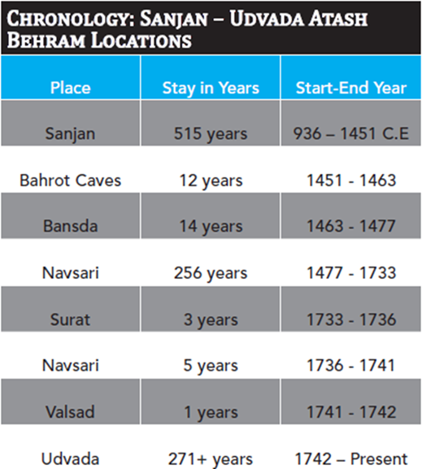
Arabs Invade Again
Sultan Mahmud Bagada attacks Sanjan with his army
The Zoroastrians (Parsis) take Atash Bahram fire and take refuge in the Bahrot Caves
What is Atash Bahram?
Later, the Atash Bahram fire was taken to Bansda (80 Km east of Bahrot Caves) and kept there for 14 years, then was taken to Navsari, and later to Surat, Valsad, and in 1742, to Udvada where it has remained until today.

Slide 8
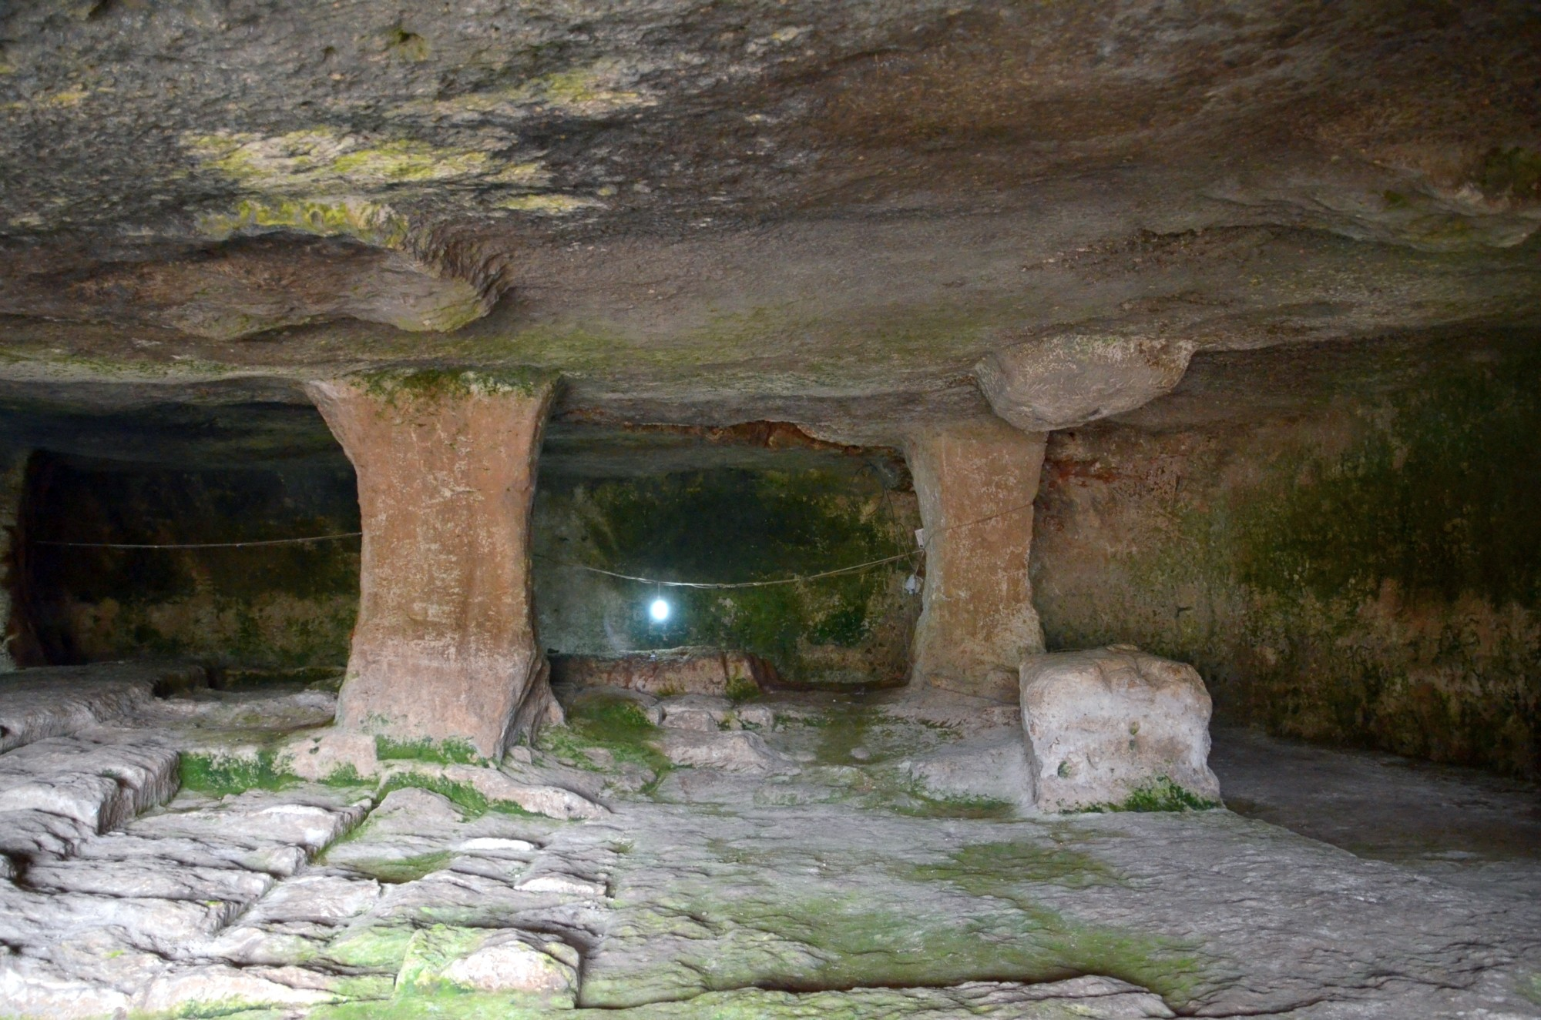
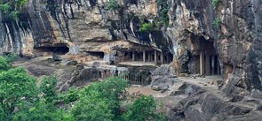
Bahrot Caves

Slide 9
View From the Top of Bahrot Mountain Caves

Slide 10
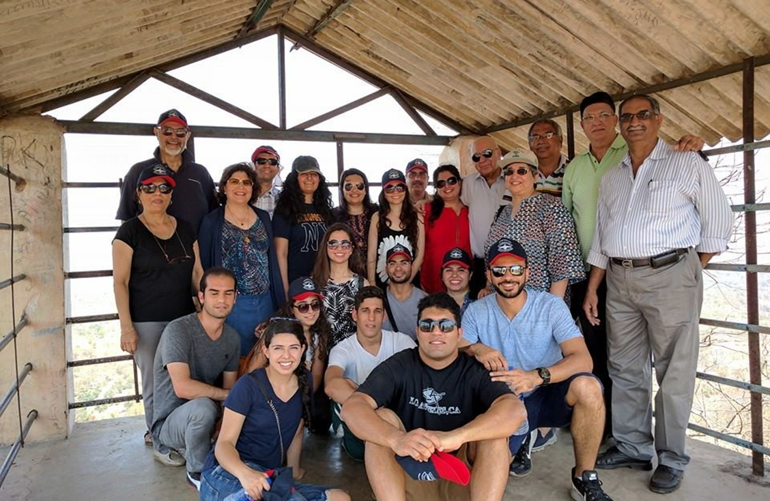
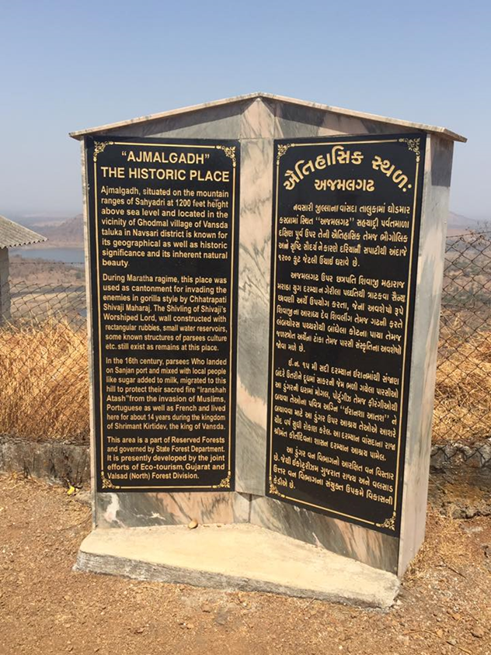
Return to Roots 3 Group posing on the Structure built on top of the Bahrot Caves
Commemorative Plaque standing above the Bahrot Caves, where the Parsis hid Atash Bahram Fire

Slide 11
Navsari Atash Bahram

Slide 12
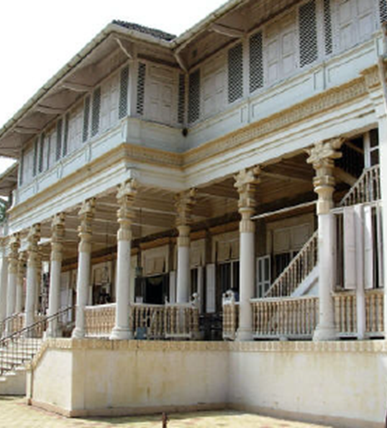
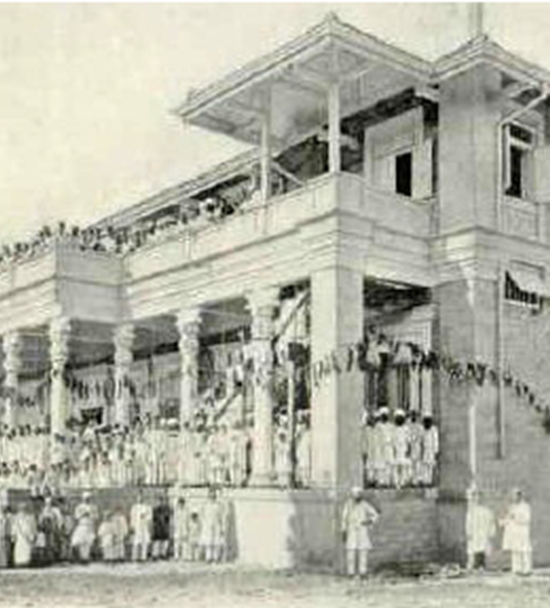
Udvada Atash Bahram

