Slide 1
The Parthian Empire Lesson 1
241 BCE-224 CE
(452 years)

Slide 2
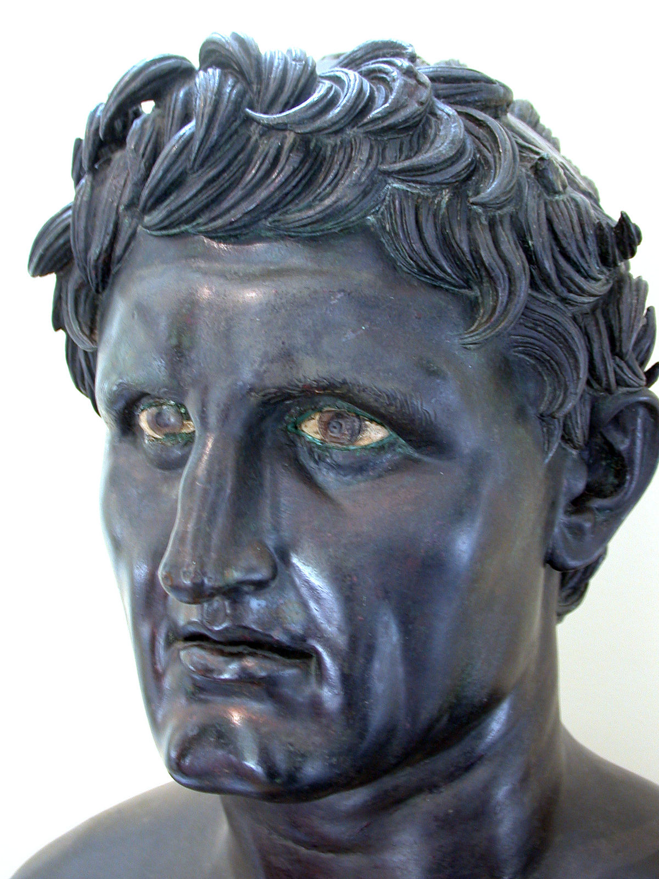
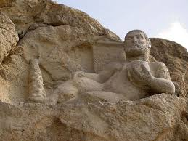
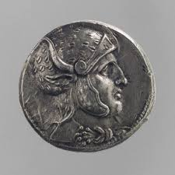
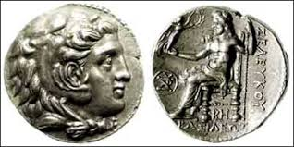
Seleucid Rule
The Seleucids ruled over Iran from 320-250 BCE
The Seleucids tried to make their language, art and culture dominant
Their language was adopted by those in commerce and the natives who married the Greeks
Their language and culture did not deeply affect Iranians both those living in cities and rural areas

Slide 3
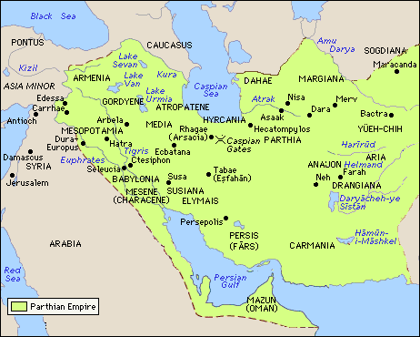
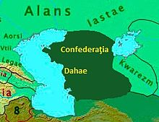
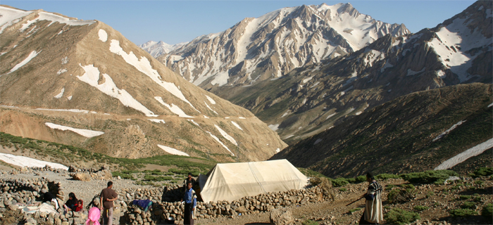
Around 250 BCE
A group of Aryan tribes from Dahae, who had settled in northeastern part of Iran named Parni, moved south
They entered the Iranian plateau through Atrak Valley
In the ancient city of Iran named Asaak, they established their capital

Slide 4
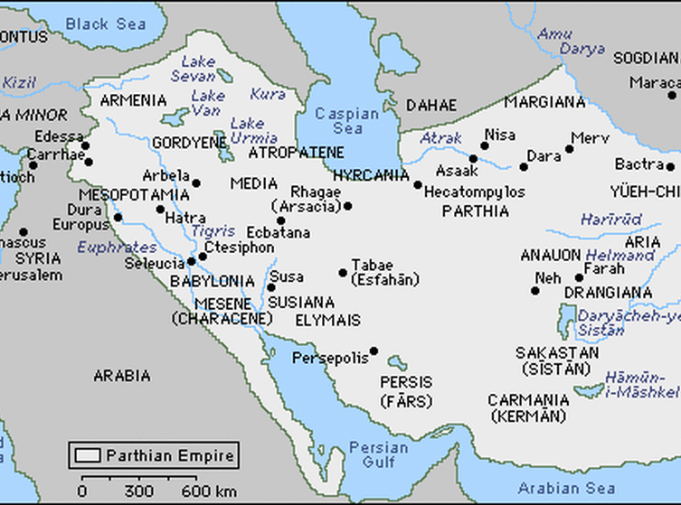
Seleucid Rule
Seleucids adapted the Persian use of satrapies (provinces)
Parthia was one of the satrapy ruled by a Greek satrap
In 245 BCE, Andragoras the satrap of Parthia revolted from the new Seleucid king Seleucid II who had just ascended the throne
The Parni tribe used the situation to their advantage
In 247 BCE in the city of Asaak, they crowned Arsaces (Ashk in Persian) as their king

Slide 5
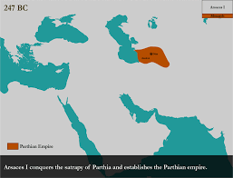
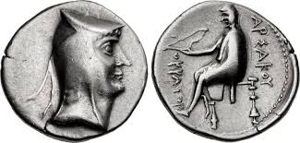
Arsaces I (Ashk in Old Persian-Ashkan in Modern Persian) 247-217 BCE
Arsaces first occupied the small region of Asaak but under the leadership of Parthian kings the region grew
The empire that later came to be known as Parthian Empire got its name from the satrapy or land that Parni tribe under kingship of Arsaces I occupied

Slide 6
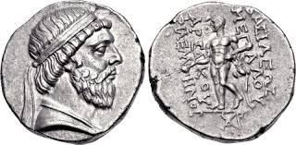
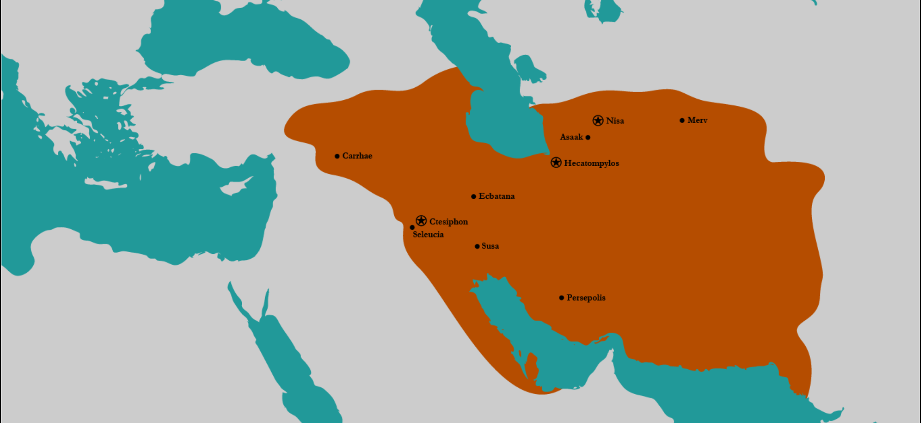
Mithridates (Mehrdad in Persian) 171-132 BCE
Under his kingship, Parthia reached its greatest extent
He conquered Bactria (India and China’s neighbor) in 168 BCE
After a 9-year war, Media was added to Parthia in 151 BCE
After a 4-year rest and re-booting his military at Hyrcania, he marched to Mesopotamia and captured Seleucid’s capital in 144 BCE
141 BCE he took Babylon
He marched to Elamite and to city of Susa

Slide 7
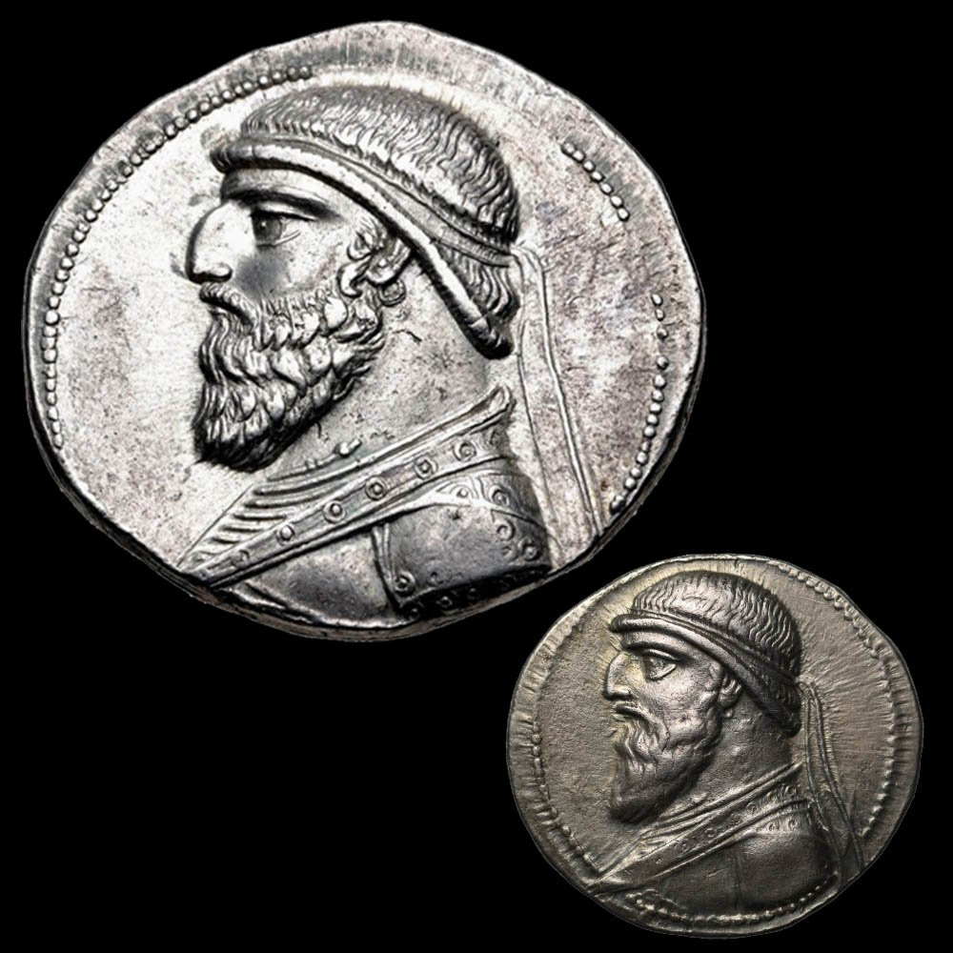
Mithridates II (ca. 124-88 BCE)
Mithridates II was known as “the Great” and assumed the title “King of Kings” around 109 BCE
Around 115 BCE, he was visited by an embassy from the Chinese emperor, Wu-ti, and the two rulers reached an agreement on the opening of the trade route later known as the “Silk Road”
Another meeting took place with Rome in 96 BCE and although the outcome of the meeting is unclear but the agreements with China and Rome proved Parthia’s rise to world status
Mithridates II faced an internal problem between the nobility who frequently opposed the monarch, marking this time as a “time of internal disorder”

Slide 8
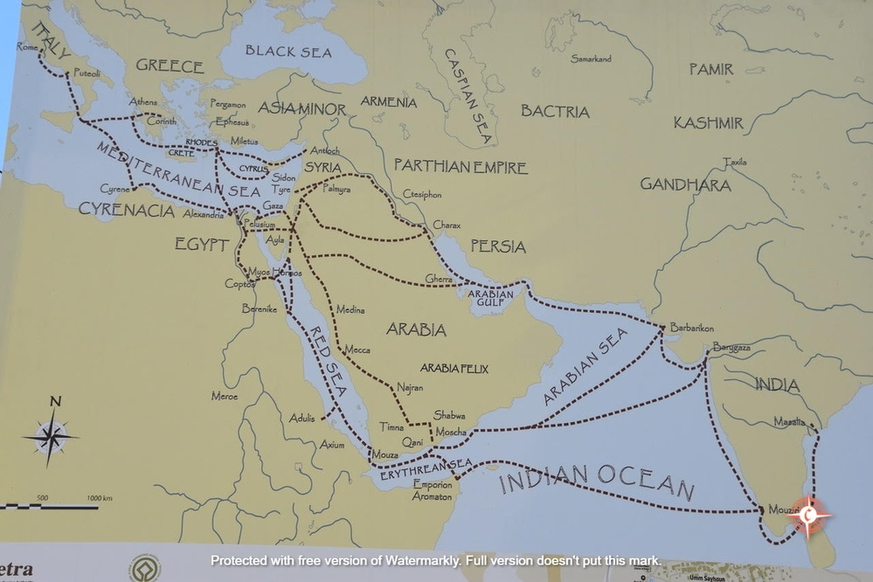
Roman and Parthian Empires
Romans and Parthians were in constant battle
Most of their battles were over the control of Armenia
Armenia was situated by the Black Sea which provided a strong trade route for the empire that controlled the area

Slide 9
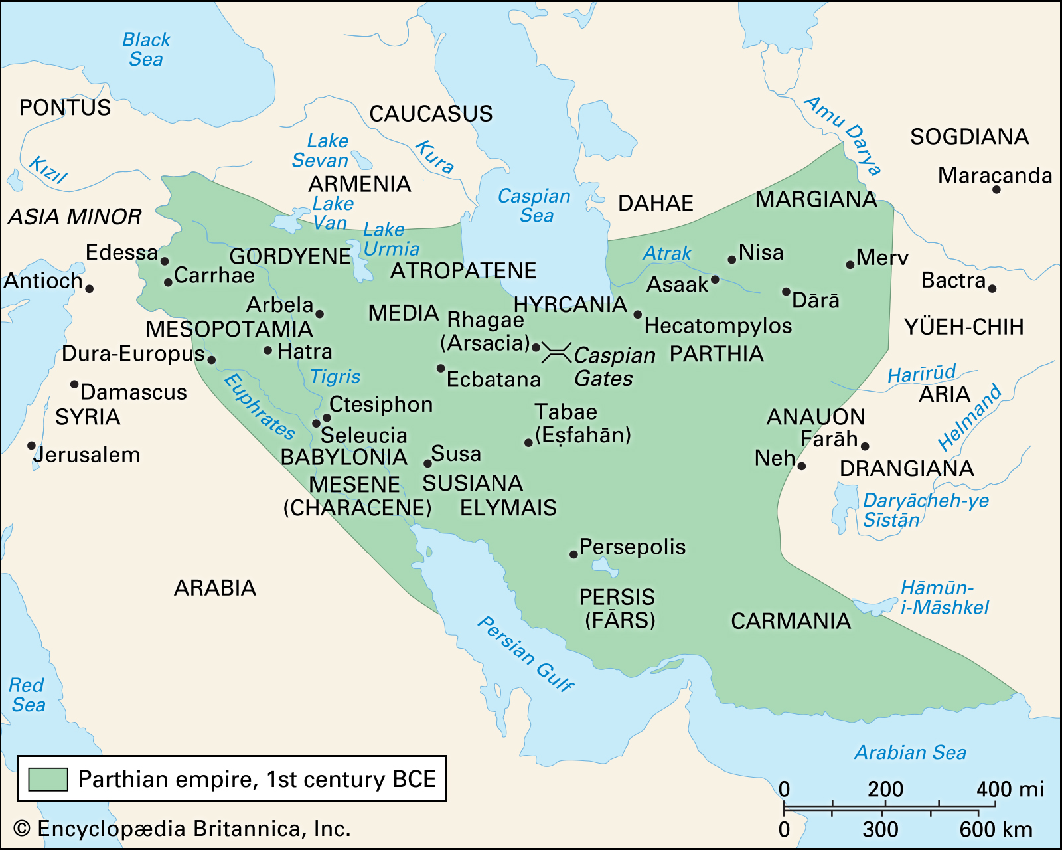
Decline and Fall of Parthian Empire
As the Parthian nobles gained economic riches, they denied paying their taxes and following the call to arms by the government
Internal disagreement about the succession of power made the government weak and gave advantage to Romans and other invaders
Loss of key commercial areas and plundering of government riches made the Parthian rule weak
In 224 CE, Parthia severely weakened and was overthrown by Ardeshir, founder of Sassanid Empire

