Slide 1
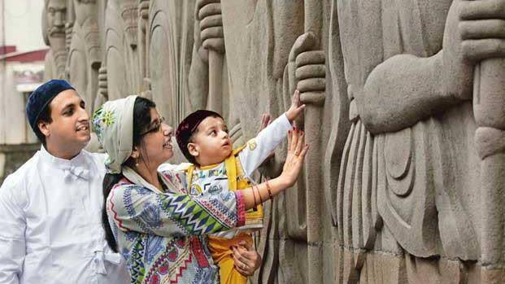
Parsis in India 1700-2023
Post-Sassanid Empire
Lesson 2

Slide 2
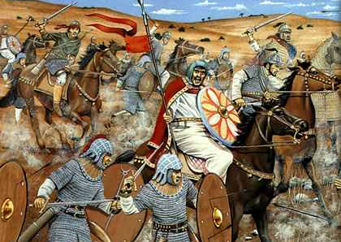
The Fall of the Sassanid Empire
The Sassanid Empire fell in 651 CE by the Islamic Arab invasion of Iran
Iranians actively fought the Arabs for 300 years
Many Iranians were killed, sold to slavery or converted to Islam

Slide 3
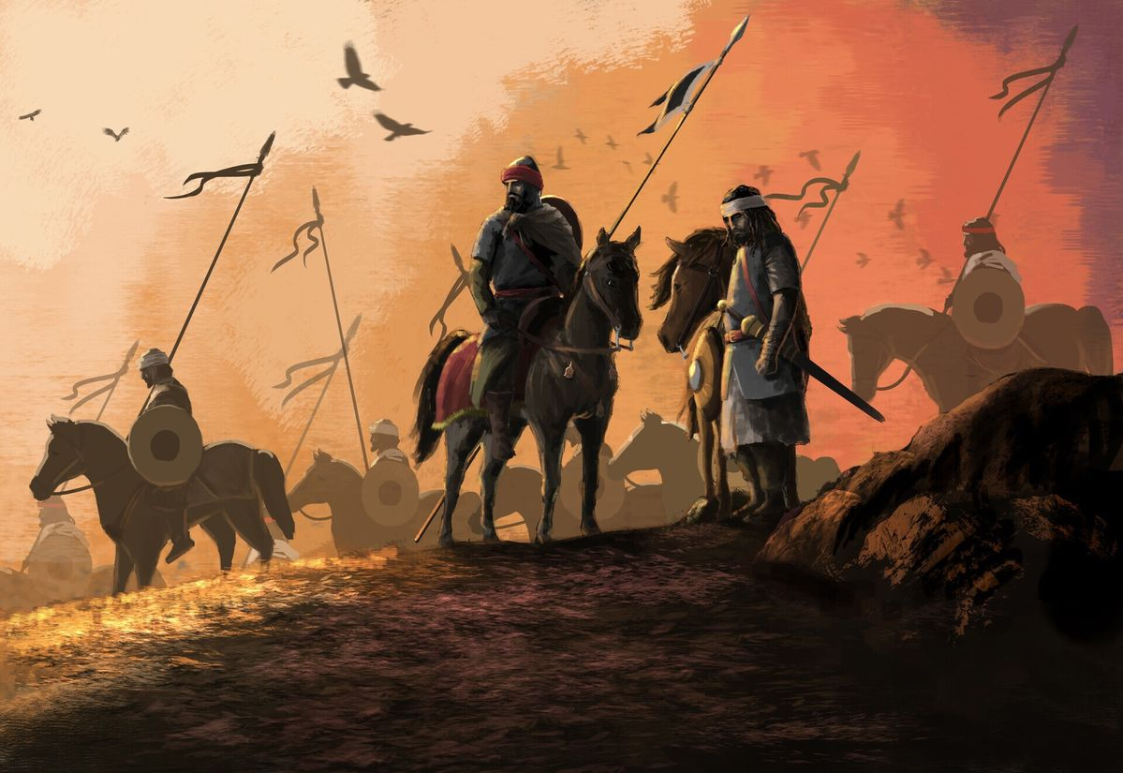
Social and Economical Persecutions by Muslim Arabs
Jizya- extra tax for non-Muslims
Confiscation of property
Burning of the fire temples and religious and cultural books
Social degradation of non-Muslims specially Zoroastrians

Slide 4
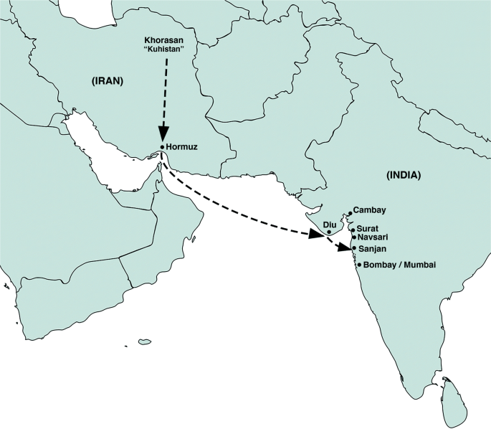
Leaving Homeland
Many Zoroastrians decided to leave Iran to escape persecution
A large group migrated to India and are called Parsis
The Parsis took Atash Bahram with them and preserved it until today
Parsis lived as an agricultural community for about 800 years
With the establishment of the British trading posts at Surat in the 17th century Parsis got involved in commerce and their economic status improved

Slide 5
East India Company
Bombay came under the East India Company in 1668 and Parsis began to settle in Bombay
The expansion of the city of Bombay in the 18th century was largely due to the Parsis’ success in industry and commerce
From about 1850 onward they became a wealthy community successful in heavy industry specifically railways and shipbuilding

Slide 6
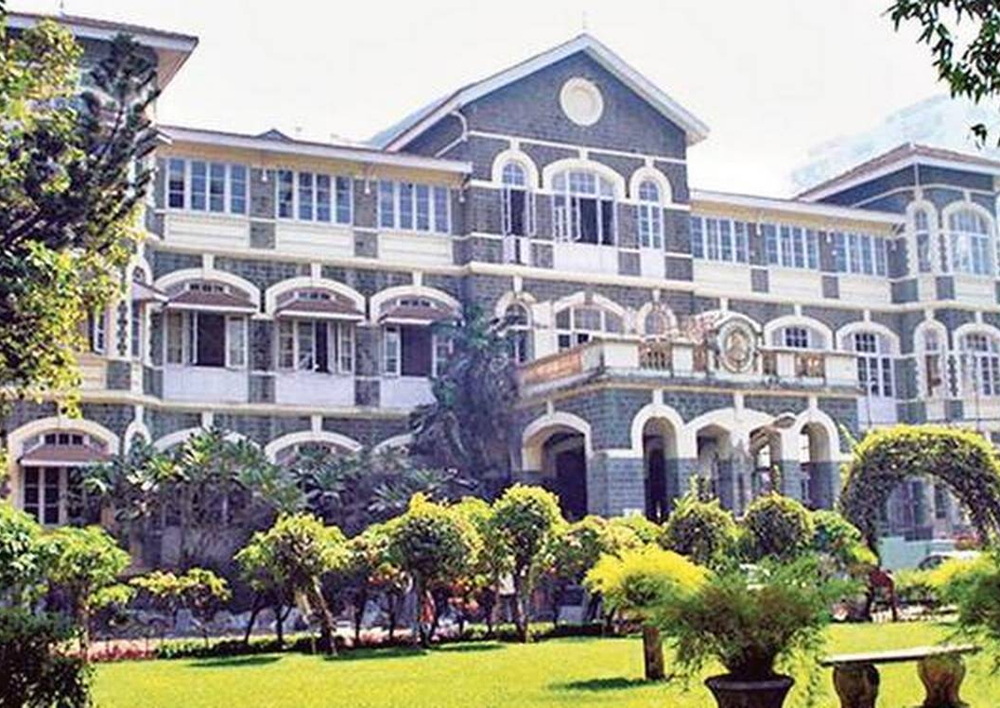
Parsis and Charity
Zoroastrian religion
encourages wealth creation as well as charity
Emphasizes education
Successful Parsis have donated to hospitals, schools, and libraries.
In 1800’s they owned more companies that either the Hindus or the Europeans.

Slide 7
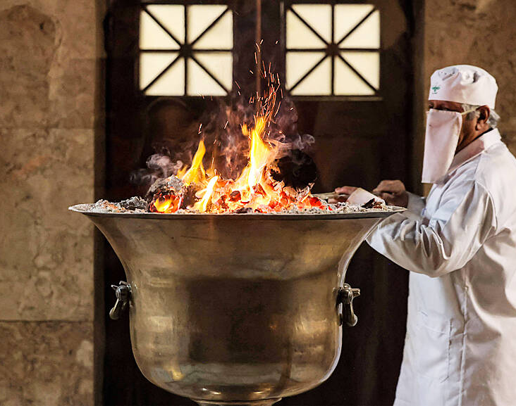
Iranian Zoroastrians in the 1700-1800’s
While the Parsis were flourishing under British rule, building fire temples, schools, hospitals, etc., Zoroastrians in Iran were under extreme social and economic pressure with their fire temples converted into mosques

Slide 8
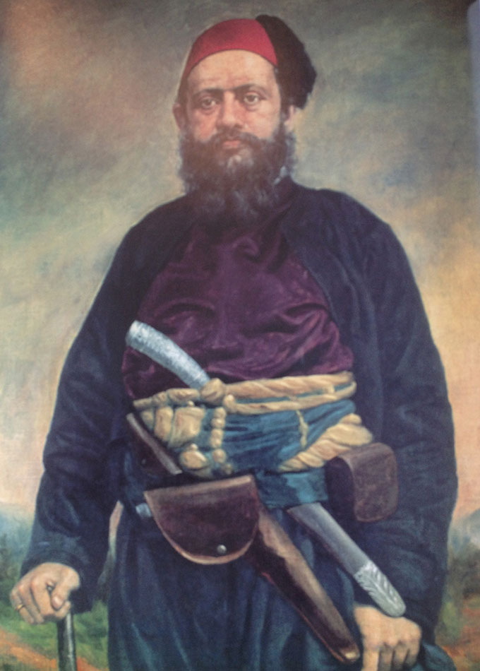
News of Extreme Discrimination in Iran
As more Iranian Zoroastrians to India, news of poor conditions of Zoroastrians in Iran was spread among Parsi community.
In 1834 Parsis initiated a fund that became the Society of Amelioration of the Condition of Zoroastrians in Persia
Maneckji Limji Hataria was commissioned to Iran to evaluate the condition of Zoroastrians in Iran
This expedition, led to a 30 year stay of Hataria in Iran greatly improving the lives of Iranian Zoroastrians

Slide 9
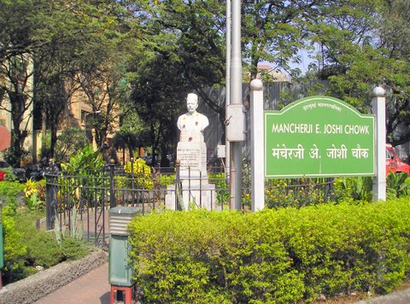
Zoroastrian Colonies in Bombay
Parsis established housing communities exclusively for Zoroastrians in Bombay. One such community is Dadar Parsi Colony
It was established in 1890’s
Mancherji Edulji Joshi, an engineer, persuaded British authorities to set aside plots for lower middle-class Parsis and was given a 999-year lease for 103 plots
The Dadar colony has a library, functional hall, sports grounds, seminary, school, and a temple.
It maintains a low rent for those living in the same apartments since 1947
Despite long waiting lists for these houses, one quarter of the flats remain empty because the owners live outside India but continue to pay the rent to ensure they won’t lose the flat

Slide 10
Small Community-Huge Impact
2016 Wall Street Journal printed:
India’s Parsis are one of the most successful minority and migrant groups in the world. They make up less than 0.005% of India’s population but three out of the country’s top 10 billionaires

Slide 11
A Few Examples of Successful Parsis
Ardeshir Godrej- 1868-1936
His company manufactured surgical instruments but branched off into home and office equipment. Today they have entered the housing industry and are known for their honesty and reliability
Sir Byramjee Jeejeebhoy- 1822-1890
A businessman and philanthropist who founded two colleges and several educational institutions
Homi Jehangir Bhabha- 1909-1966
Nuclear physicist who played a key role in creating the country’s nuclear program
Cyrus Poonawalla-Born in 1941
Founded the Serum Institute of India and world’s largest vaccine manufacturere

Slide 12
Decline in Parsi Population in India
Low fertility
About 1/3 of Parsis don’t marry
The average Parsi woman has only one child
Exclusion of children born to non-Zoroastrian fathers
There still exists a struggle in accepting children born to non-Zoroastrian fathers which is slowly changing
Struggles with accepting non-Zoroastrians into the Zoroastrian religion and community

Slide 13
1908 Petit vs Jijabhai Case
Suzanne Briere, a French woman, and wife of the Parsi industrialist Ratanji Dadabhoy Tata was initiated to Zoroastrian religion by a Mobed. This initiation was up for dispute among the orthodox Parsis who believe one can only be a Zoroastrian if born into a Zoroastrian community. Suzanne wished for her body to be left in Bombay’s dakhme (Towers of Silence) per traditional Zoroastrian death rites but was not allowed. She took her case to the Bombay High Court
What do you think was the verdict?

Slide 14
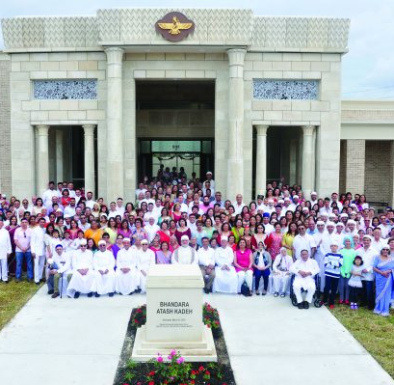
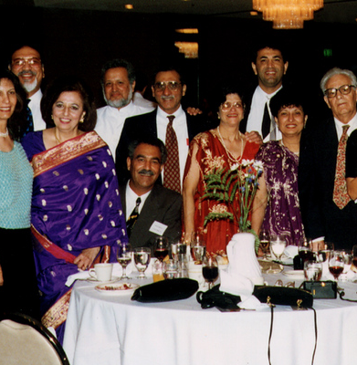
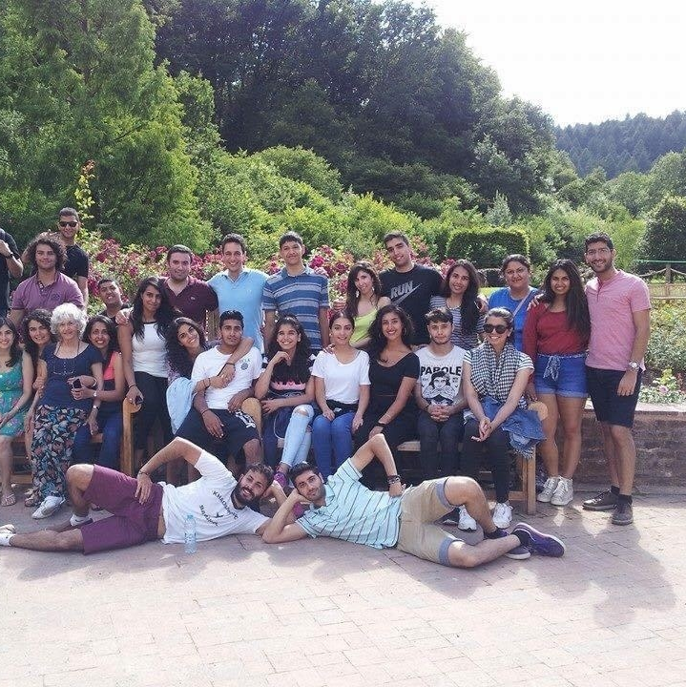
Parsis in 2023
Today Parsis live in many countries with a large population in North America where they are thriving and building communities.

