Slide 1
Sassanid Empire Lesson 2 224 -651 CE
Shapur II
Yazdgerd I

Slide 2
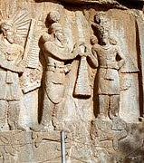
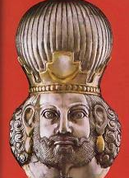
Shapur II (309-379 CE)
Took the empire to its greatest height
Ordered writing of Zoroastrian scripture
Expanded territory by taking advantage of weakened Rome

Slide 3
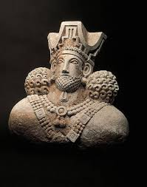
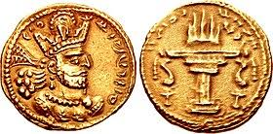
King Before Birth
Shapur II is one of the great men in Iranian history
He was the 10th king of Sassanid Empire
When his father, Hormoz II died, Shapur was still not born
He was crowned king before birth
When he reached the age of 16, he took control of country’s affairs

Slide 4
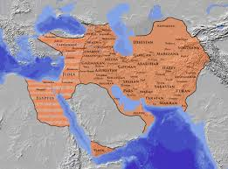
Arabs Invading Iran
Before his control of the kingship, Arabs were invading Iranian cities along the borders, looting and invading territory
At one time, even threatened the capital of Iran, Ctesiphon
When Shapur II, became king, he ordered the building and remedy of ships
Then used his naval fleet to attack the Arabs through Persian Gulf
His pursue of this matter was so strong, effective, and swift that the Arabs did not bother Iranian borders for a few centuries.

Slide 5
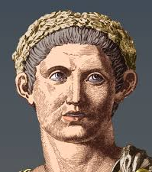
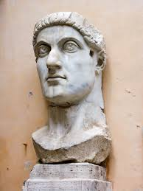
Rome Turns to Christianity
Romans were mostly, idol worshippers.
At this time, 300 years had passed since Christ’s birth and his message was spreading throughout Rome.
The emperor of Rome, who was not Christian, persecuted, tortured, and killed Christians
When Constantine (Ghostantin in Persian) became the emperor of Rome, he became Christian and ordered all Romans to become Christian too
As part of his campaign, he supported the Christians in Europe, and within Iran

Slide 6
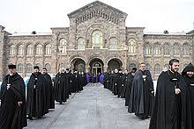
Armenia Becomes Christian
Tirdad , the ruler of Armenia at the time, started off his reign being cruel to all Christians.
Suddenly, Tirdad fell ill and the only way he was cured was by a prayer from a Christian.
His miraculous recovery, led Tirdad to not only accepting Christianity, but also making it the official religion in Armenia.
https://usflibexhibits.omeka.net/exhibits/show/armenianstudies/language-culture/religion

Slide 7
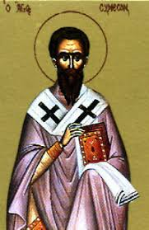
Iran’s Conflict with Rome Changes Shape
From this point on, Iranian and Roman conflicts, were beyond just politics, they became religious as well.
Shapur II believed that the Christians living inside Iran were helping the Romans. This escalated the conflict between Persia and Rome.
Shapur started double taxing the Christians, as a means for them to take part in funding the war
Simeon or Shemon, a Christian leader refused to pay the tax. The refusal of Simeon and others started the killing of Christians within the country.

Slide 8
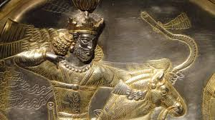
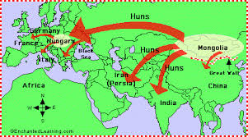
War with the Hephthalites (part of Hunnic tribe) “Hoons or Khiyoonan in Persian) of the East
Huns were from Central Asia, nomadic tribe who were invading, killing and looting the people in eastern borders of Iran
The same tribe, 100 years prior, had invaded Europe and had killed and looted the land. Europe remembers their invasion as most barbaric
Shapur II, marched to the East of Iran and battled the Huns for 7 years and defeated them. Later, the Huns that were held captive became part of Shapur II’s army.

Slide 9
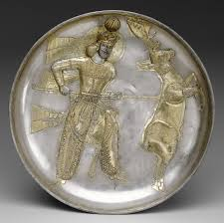
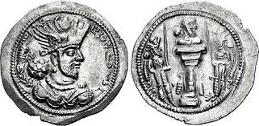
Yazdgerd I (399-420)
He was Shapur III’s son and Shapur II’s grandson.
Yazdgerd I tried to limit the clergy’s power
Rome had become very weak during his reign; he could have easily taken all the territory and added it to Iran, but he decided to build a good relationship with Rome

Slide 10
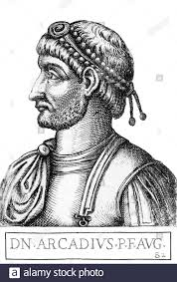
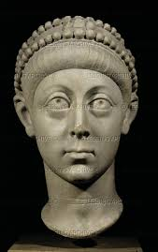
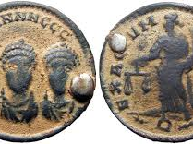
An Example of His Good Will
One of Rome’s dying emperors, Aracadius, asked Yazdgerd I to be his son’s guardian.
Yazdgerd I not only accepted this role but ensured the son, Theodosius, had an excellent education, and protected him.
During Theodosius and Yazdgerd I’s reign, Iran and Rome had a good relationship.

Slide 11
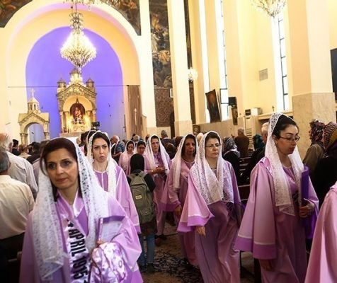
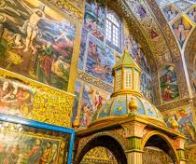
Religious Tolerance
During Yazdgerd I’s reign, all the people living in Iran, regardless of their religion were regarded as the king’s children and were supported by the king
Yazdged ordered that Christians be left free to build their temples and follow their faith
Convened a religious council in Seleucia in 410 to organize church affairs.

Slide 12
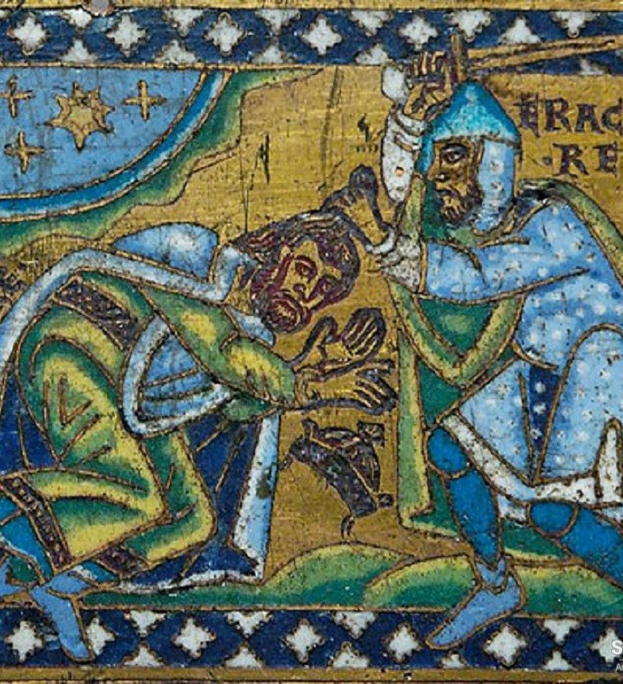
End of Religious Tolerance for Christians
In the last year of his reign, he changed his mind against Christians and ordered their persecution.
Reasons for this change of mind:
Destruction of fire temples by some of the Christians
Theft of property deeds
Slandering of the Mazdaean faith
Disobedience of royal orders

Slide 13
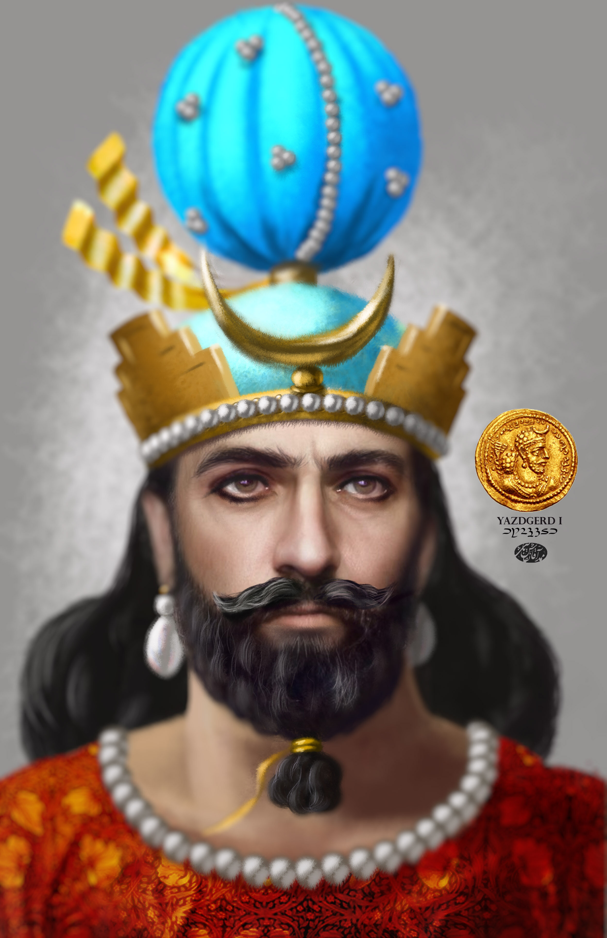
How is Yazdgerd I Viewed in Sassanid-based Records
He was given the title “the sinner”
Following are some of the reasons stated in Sassanid-based records:
Tyrant who inflicts harsh punishments
Listens to the advice of foreigners
Doesn’t allow those who surround him to form close friendships

Slide 14
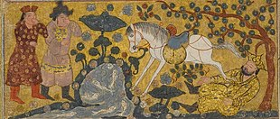
Yazdgerd’s Death in 420CE
The details of his death are not known.
He either died of illness or was assassinated by the nobility
The story of his death is that he was mysteriously killed by a white horse
After his death a quarrel broke over his succession.
He has three sons, Shapur, Bahram, and Narse
Shapur the king of Armenia was assassinated on his way to Iran to take the throne.
Bahram marched to the capital of Iran and the throne with an Arab Army.
Narse was made the governor of Khorasan

