Slide 1
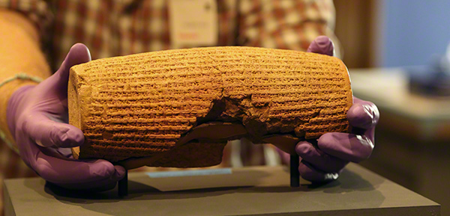
Cyrus Cylinder
First Known Charter of Human Rights

Slide 2
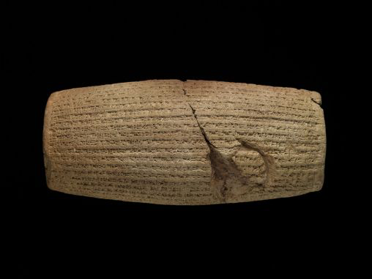
What do I know about this?

Slide 3
My Learning Guide
First Column | Second Column | Third Column
Things I know about the Cyrus Cylinder | Things I would like to know about the Cyrus Cylinder | Things I have learned about the Cyrus Cylinder
Fill out the first and second columns

Slide 4
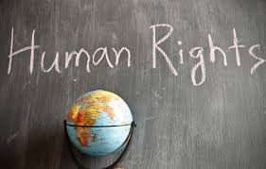
What are Human Rights?
https://www.humanrights.com/what-are-human-rights/brief-history/

Slide 5
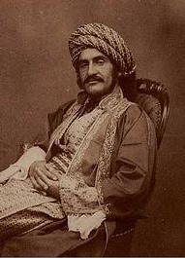
What is the Cyrus Cylinder
Recognized as the first charter of human rights.
Some freedom declarations were directly or indirectly influenced by Cyrus Cylinder.
Freedom of religion,
racial equality,
no slavery-
parallel to the first four articles of UN Human Bill of Rights
Cyrus Cylinder is a historical record of Cyrus’ conquest of Babylon and his deeds following the conquest.
It was found in March 1879 as a foundation under the wall of Esagila Marduk Temple in Babylon (today’s Iraq) during Assyro-British archaeologist Hormuz Rassam’s excavation.
It is written in Cuneiform script and Akkadian language.
One third of the cylinder is still missing.
It is translated to all 6 official languages of the United Nations.

Slide 6
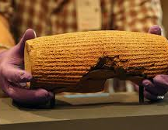
Translation of Cyrus Cylinder:
http://www.iranchamber.com/history/cyrus/cyrus_charter.php

Slide 7
Key Components
Marduk chooses and gives Cyrus the right to rule, and Cyrus asks for his blessings.
Enters the city without bloodshed
Cyrus names his lineage
He frees the slaves
Rebuilds and returns the gods to their appropriate temples
People are free to return to their original land
Brings peace
Restores the great wall of Babylon
Improves the buildings and the city

Slide 8
October 29, 539 BCE
Day honoring Cyrus
(How are his actions parallel to Zoroastrian beliefs?)
Liberator: Freed slaves to return to their homeland or anywhere they wished. Freedom to choose
Tolerance: Showed great respect to Babylonian god, Marduk. Built temples for different gods important to the people of the areas so everyone could worship as they wished. Freedom of belief and religious practices
Spenta Mainyu: Improved the conquered city instead of destroying. Did not kill noble captives but at times gave them important posts. Improving the living world for all

Slide 9
Both links show the same video.
https://www.khanacademy.org/humanities/ancient-art-civilizations/ancient-near-east1/persian/v/cyrus-cylinder
https://www.youtube.com/watch?v=iokGgmrOj4Q

Slide 10
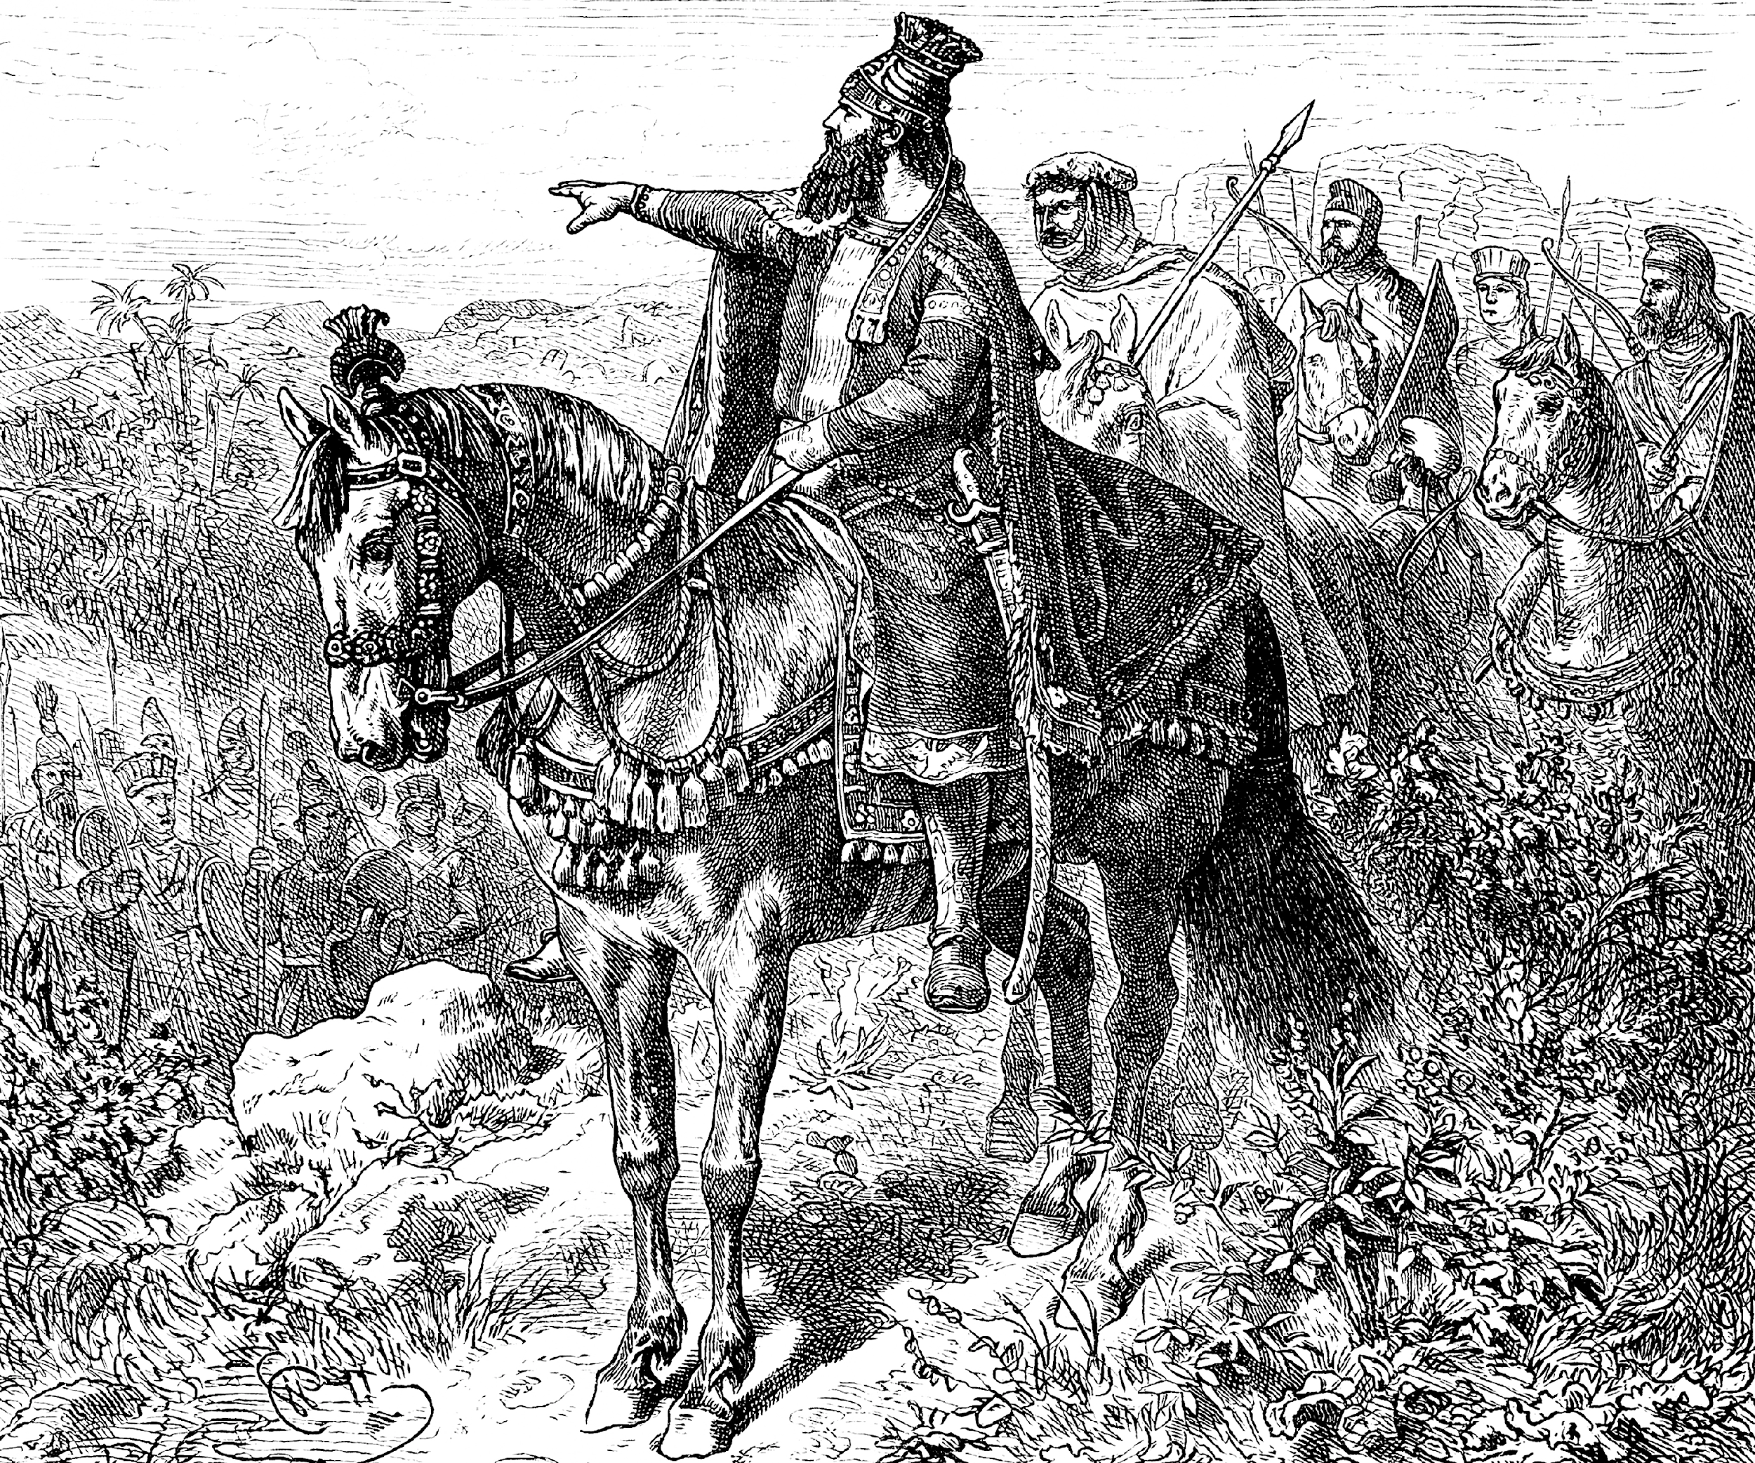
Cyrus the Great gets A+ in Everything
Babylonians- The liberator
Bible- Messiah (the anointed one) Isaiah 45
Xenophon- ideal leader

Slide 11
Complete the third column
The activity has been adopted from https://education.asianart.org
First Column | Second Column | Third Column
Things I know about the Cyrus Cylinder | Things I would like to know about the Cyrus Cylinder | Things I have learned about the Cyrus Cylinder

Slide 12
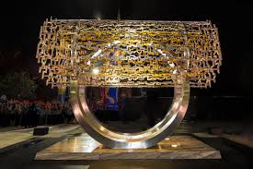
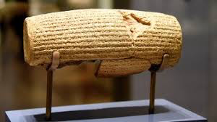
Pick a partner and write down three important things you learned from the Cyrus Cylinder.
 | Three things We’ve learned from the Cyrus Cylinder
1
2
3

Slide 13
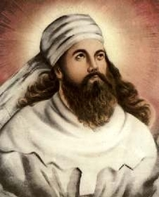
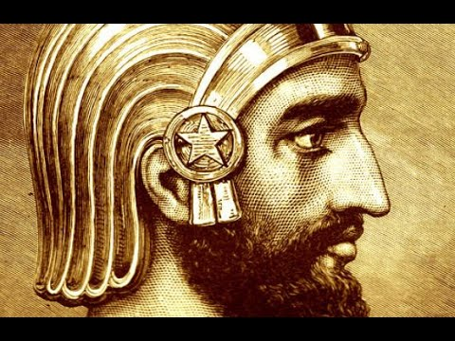
Cyrus and Zarathushtra
Taking into account what we have learned from Cyrus, write three things that associate Cyrus’ deeds with Zarathushtra’s teachings. Are they the same as the three most important things you learned from the Cyrus Cylinder?
Glue them on the poster.
1.
2.
3.

Slide 14
In your opinion what are the qualities of a good leader?
If we had a class leader, what qualities would he/she have?
Do we have benevolent leaders today?
What can our leaders learn from Cyrus?

Slide 15
Song 16-16
(Yasna 44-16)
Oh Mazda, show me the wise and soul healing leader who is brave and victorious and can protect your teachings.
Please give the gift of good mind and clear insight to this leader and other good people.

