Slide 1
The Parthian Empire Lesson 2 The Parthian Infrastructure and Art
241 BCE-224 CE
(452 years)

Slide 2
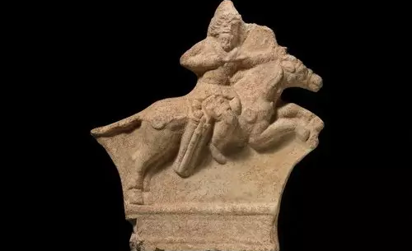
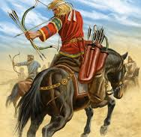
Parthian Military Tactics
Unique use of horse and bow
‘Parthian shot’- were able to shoot backward from horseback in full gallop thus they could come at enemy from all directions
Use of camels in providing steady supply of arrows
Enemy infantry turned into sitting ducts and could not engage unless at close range
Hit and run fighting style
Pretending retreat

Slide 3
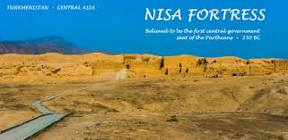
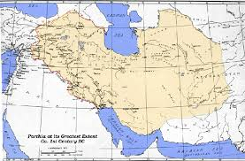
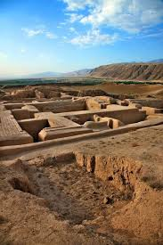
Parthian Government
The king demanded absolute royalty
Mithridates I kept Greek nobles in position of leadership to ensure continuance economic and bureaucratic affairs
Greek settlements were left alone as long as they paid tribute to king
Divided their provinces into smaller satrapies called eparchies in order to avoid rebellion- decreased regional power of the governor
Allowed conquered powers in their empire to have their own kings- providing Parthia with tribute and military aid when needed

Slide 4
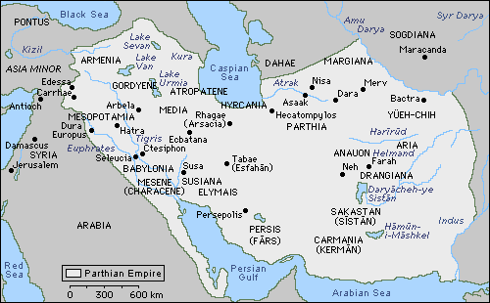
Economy and Trade
Preserved the cities and roads they conquered
Possession of Armenia gave them access to Black Sea
Hyrcania and Caspian Sea gave them access to Central Asian markets
Persis, and cities like Antioch, had access to Indian Markets via the Persian Gulf.
Susa ,a politically important city, the fertile lands of Media and Ecbatana- enriched Parthians culturally and materially
Royal Roads provided access to long reaches of land- solidifying Parthia’s position as an international trader
Trade with China- Chinese envoys visited Parthia in 115 BCE

Slide 5
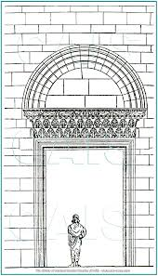
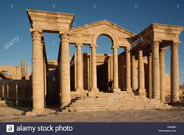
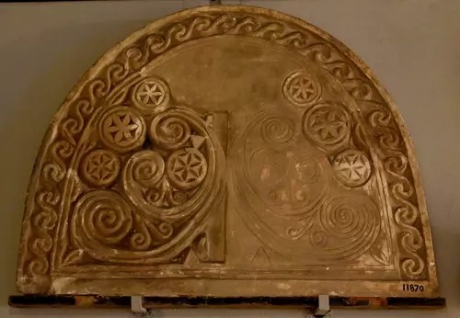
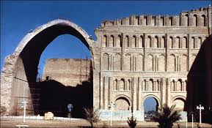
Parthian Architecture and Art
Developed their own unique artistic and architectural style- circular and frontal motifs (Hellenic architecture was rectangular/triangular style)
Developed graceful arches (Hatra temple)
Built domes that ran to the ground rather than sitting on top of supporting structures as in Roman style

Slide 6
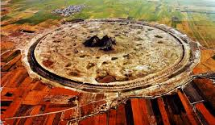
Parthian cities
Cities and towns made in circular pattern
(ex. Nisa- their original capital, and re-foundation of Ctesiphon)

Slide 7
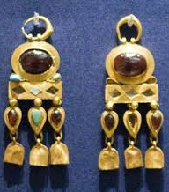
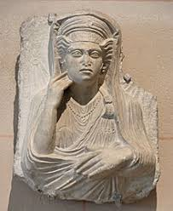
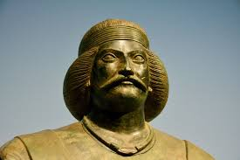
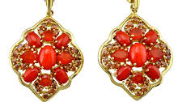
Parthian Art
Great source of influences due to their origin and vastness of the Empire
Parthian art has been discovered from borders of China and Central Asia to Mesopotamia and Syria
Their art used the motif of frontality (connection between art and viewer-later adopted by Byzantines)
Creative use of precious metal jewelry, bronze, terracotta, and stone figures

Slide 8
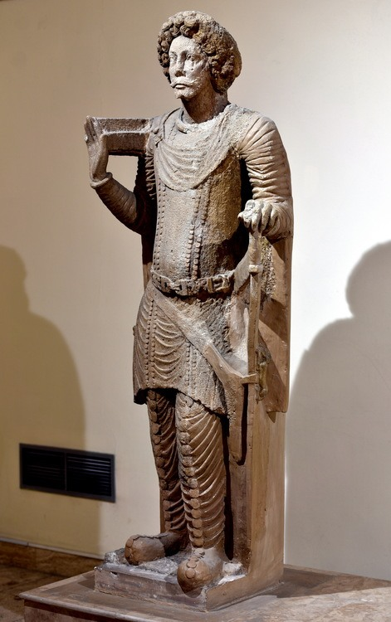
Clothing and Style
Particular clothing worn among the ruling class
End of 1st century BCE: belted tunic and trouser-suit throughout the Empire
Loose fitting clothing with multiple horizontal pleats
Lengthy mustaches with closely groomed beards
Puffed hairstyle of moderate length secured with a headband

Slide 9
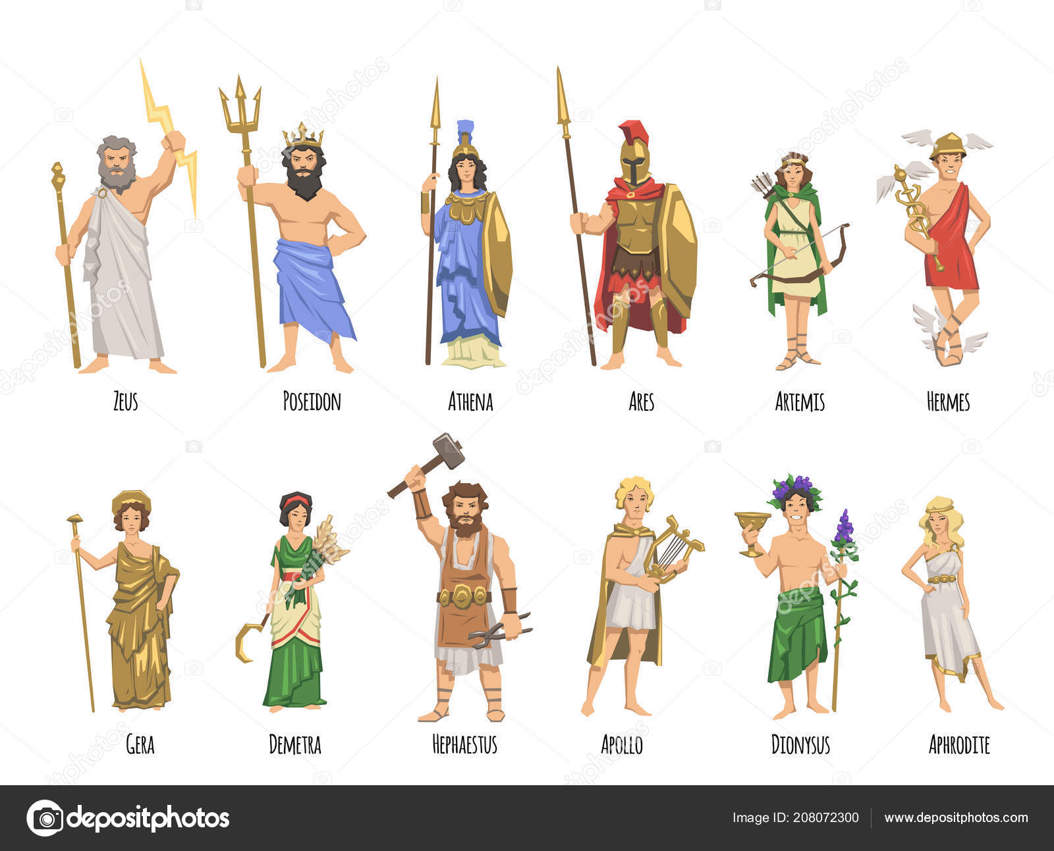
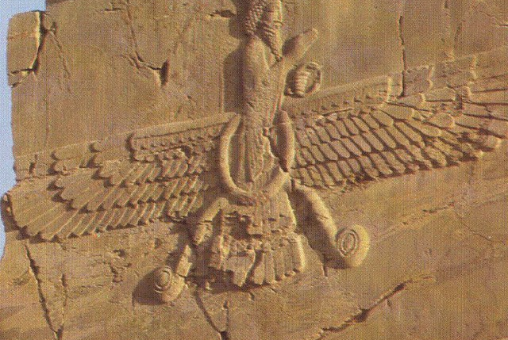
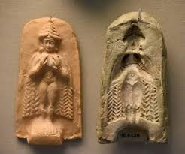
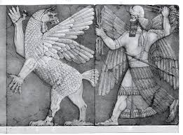
Religion
Parthians were tolerant of different beliefs
Zoroastrianism was widespread
Compiling of the Avesta began during Parthian Empire
Deep respect for the elements such as water and fire, etc. existed in western areas
Seleucids had pantheon of gods
Babylonians respected fertility gods, Ishtar and Bel
Jews in Mesopotamia worshipped Yahweh
In Hatra, sun and moon gods
Christians, east of Tigris, gained footing toward the end of the Parthian period

Slide 10
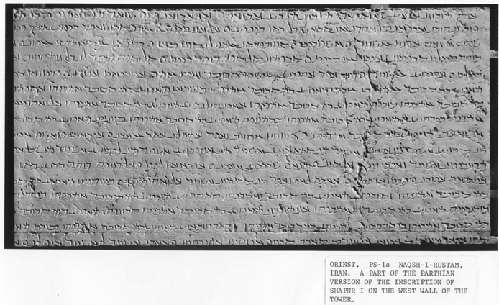
Parthian Language
Parthians spoke a northwestern Iranian language called northwestern Pahlavi
It was spoken in a small region but with the extent of the Parthian Empire it became widely spoken
Parthian language was very close to Middle Persian which was the official language during Sassanid Empire

