Slide 1
Sassanid Empire lesson 3 (224-651 CE)
Bahram V
Yazdgerd II

Slide 2
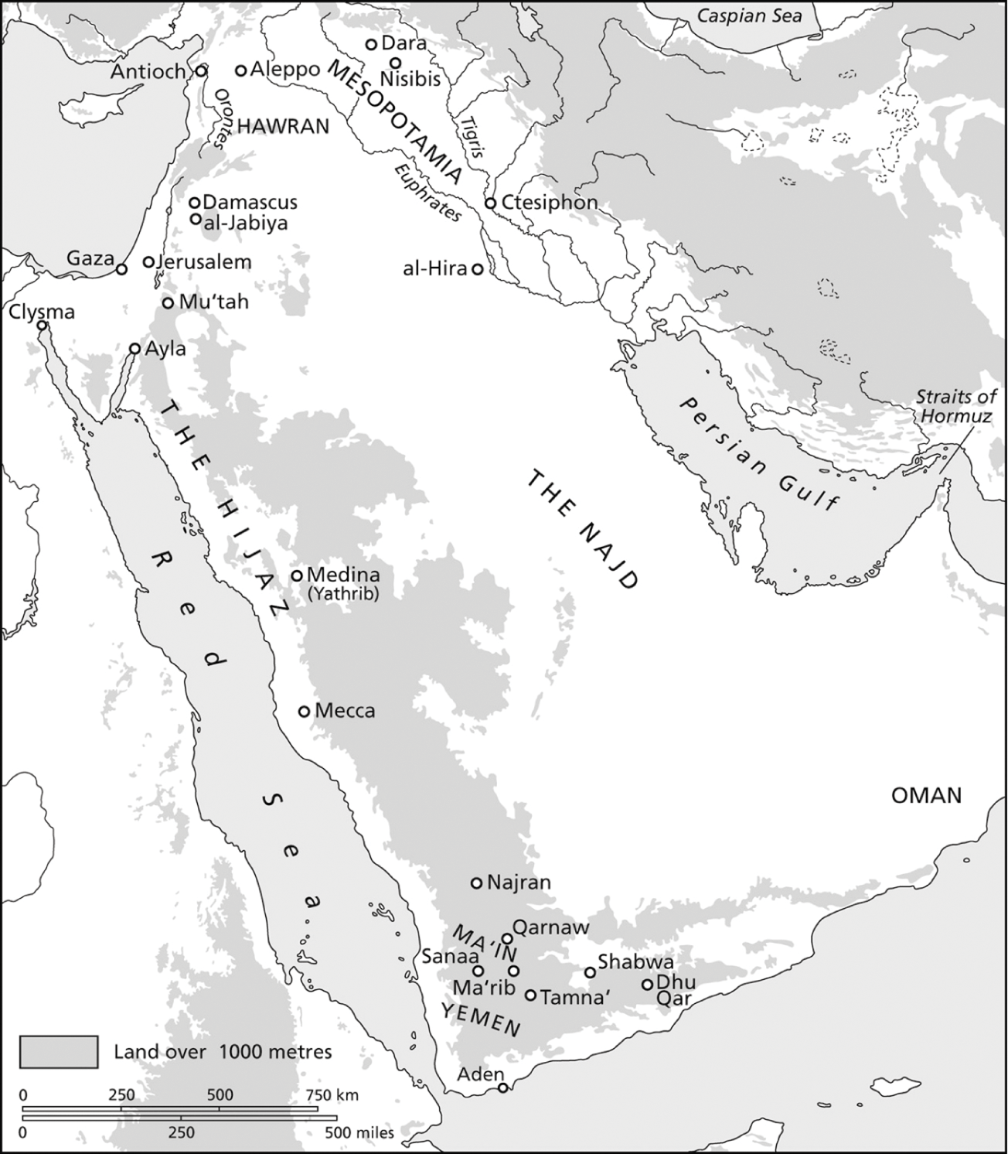
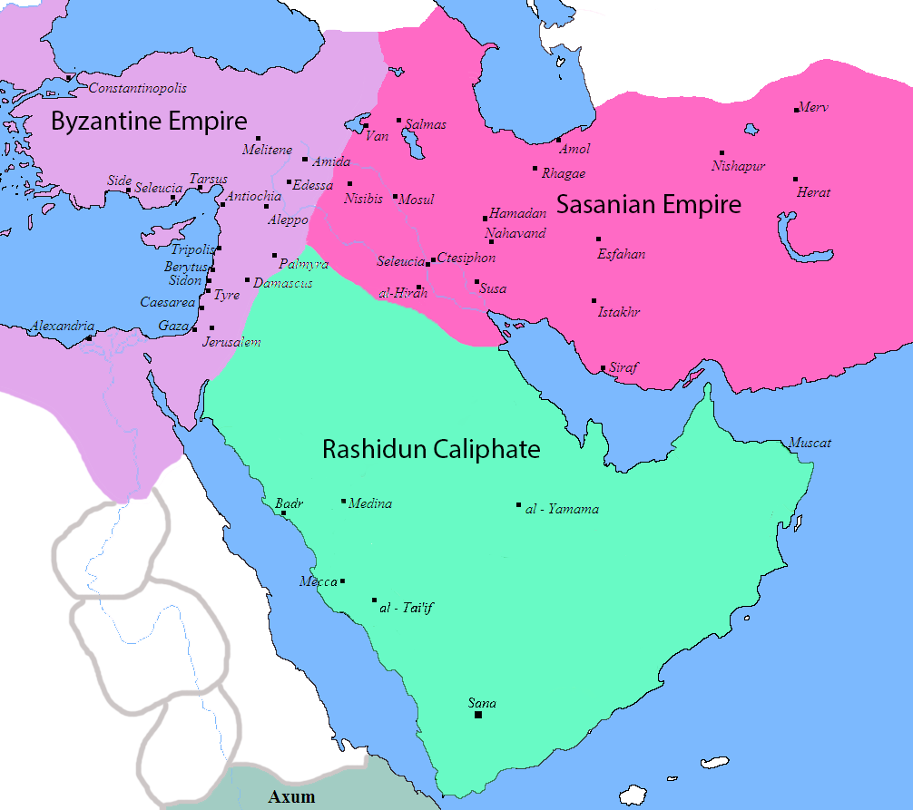
Bahram e Gur (420-438) (Bahram V)
Yazdgerd I had a son named Bahram
He sent Bahram to al-Hira to be raised by King of Lakhmid Arabs, named Mundhir.
Al-Hira is a city in the Arab region under Iran’s rule.

Slide 3
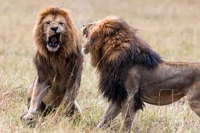
Kingship Between Two Lions
It is said in the Shahnameh, that once Yazdgerd I dies, the noblemen want to have Khosro, a distant relative of Yazdgerd, to take the throne
Bahram marches with an army to claim his kingship
It is said that the nobles put the throne between two lions and said whoever gets the throne will be king.
Khosro does not approach the lions, but Bahram courageously fights the lions with his sword and claims the throne

Slide 4
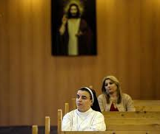
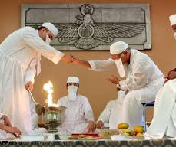
Again….War with Rome
Christians in Iran and in Rome, Zoroastrians in Rome were being persecuted.
The two countries went to war, but neither one proved to be better than the other.
Finally, the two countries sat and discussed peace.
The peace treaty was for Romans to stop persecuting Zoroastrians and for Iran to stop persecuting Christians .

Slide 5
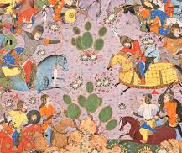
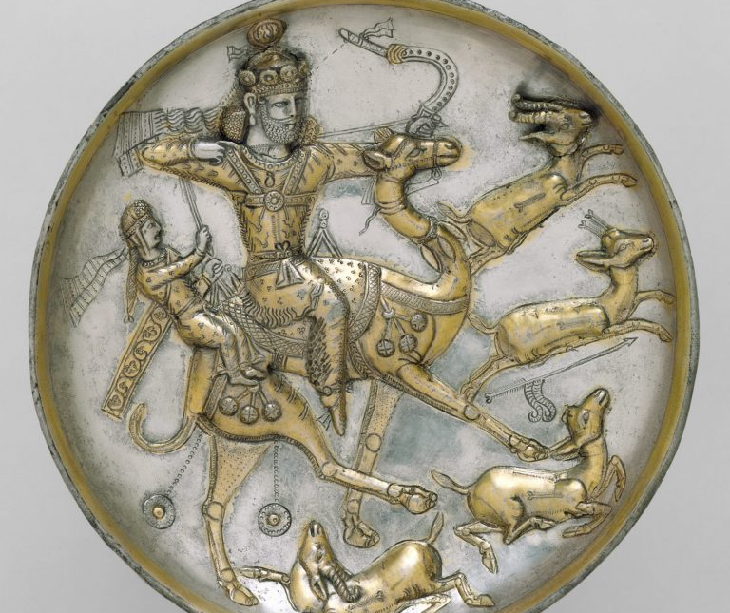
Troubles on the Northeastern Boarders of Iran….Again
A Central Asian race named Hephthalites, started invading the southeastern borders of Iran instilling fear in the hearts of the citizens
Bahram pretended to go hunting in Northern part of Iran, but instead of marching to the east through night and day.
He arrived on the eastern border sooner than anyone could imagine.
This gave him the advantage of surprise.
He fought the Hephthalites and won; as a result, they never attacked Iran’s borders in retaliation while Bahram was head of the throne.

Slide 6
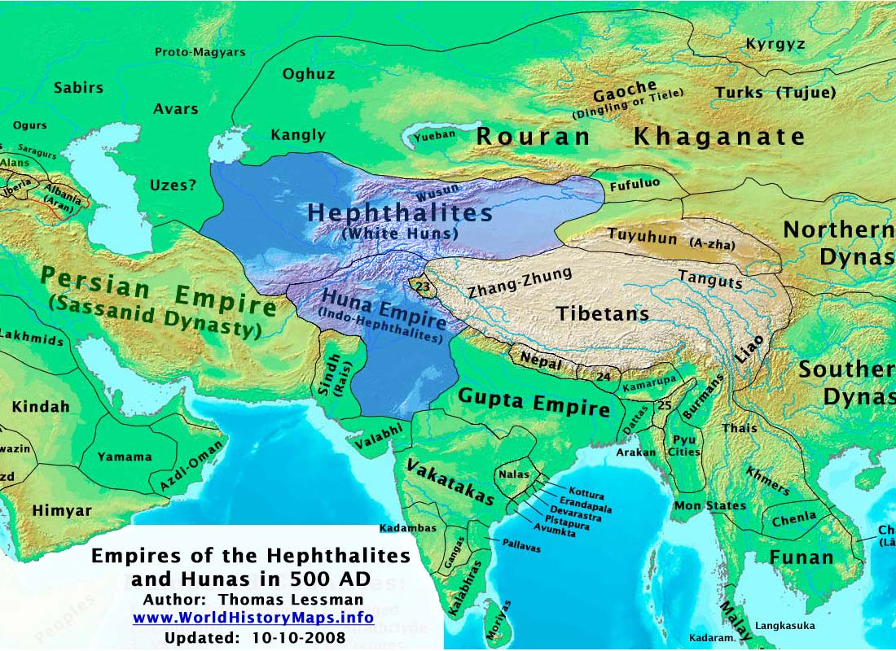
Addition of Sand and Mekran to Iran
After defeating Hephthalites, Bahram marched to India
The Indian king who had suffered at the hands of Hephthalites, gave Iran, the regions of Sand and Morkan for defeating them

Slide 7
Bahram V’s (Bahram e Gur) Accomplishments
He kept Iran’s borders safe from enemies both on the east and west side
Famous for enjoying hunting and being a swift hunter
Liked to hunt gazelle and onager (gur in Persian), a favorite game animal in ancient Iran, and that’s how he was given the nickname “Bahram e Gur”
Bahram encouraged literature, the arts, crafters, and the pursue of knowledge.
He is known as a just man and did his best to have equal rights for all
Iranian people loved Bahram V and for many years after his death told stories of him; Shahnameh has stories of Bahram in addition to “Haft Paykar” by Manzoom e Nezami.
It is said that when he returned from India, he brought 12,000 musicians with him and scattered them around Iran to bring the people of Iran happiness.

Slide 8
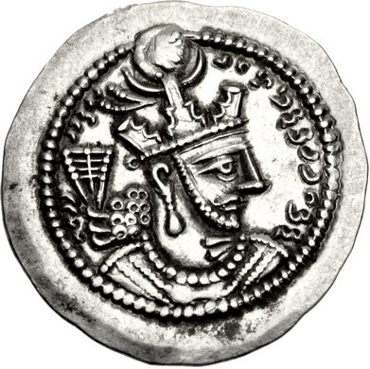
Yazdgerd II
He was Bahram V (Bahram e Gur)’s son and reigned from 421-439CE
Just like his reign was marked by continuous wars between the Eastern Roman Empire to the west and the Hephthalites to the east.
He was an astute and well-read ruler with the motto, “Question, examine, see. Let us choose and hold that which is best”.

Slide 9
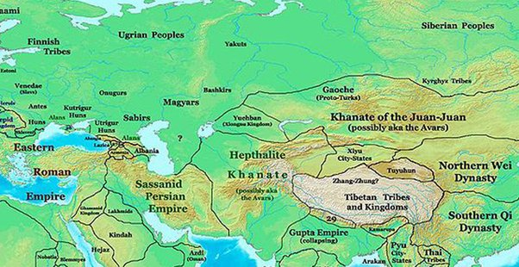
War with the Eastern Roman Empire and Armenia
In 440 CE, he waged a war with the Eastern Roman Empire, but none could defeat the other and they made a treaty:
No new fortresses will be built in Mesopotamia
Yazdgerd II marched to and conquered Armenia
He took the surviving Armenian nobility, priests, and others to the east to fight the Hephthalites.
In 440 CE he constructed a defense system to fend off the Cole tribe of Hun from the north.
A found inscription at the walls of Derbent indicates that the tribute paid by the Romans was used for the renewal of the fortress.

Slide 10
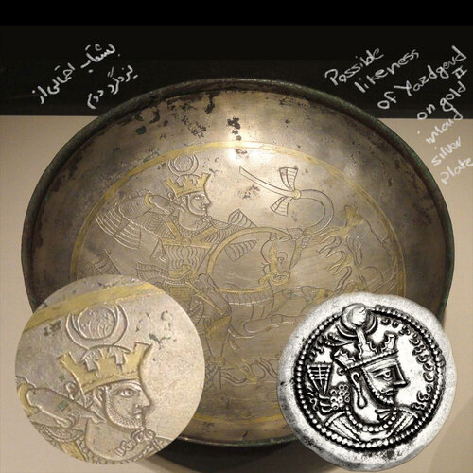
How do Sassanid Based Sources Remember Yazdgerd II?
He is remembered fondly for:
his interest in the wellbeing of the country
His goals to bring justice for all
His gentler temper (unlike that of his grandfather’s)
His dislike for hunting, feasting, and holding long audience sessions (unlike that of his father’s).
He tended to the masses and organized the army.
He was known as Gentle Yazdgerd.

Slide 11
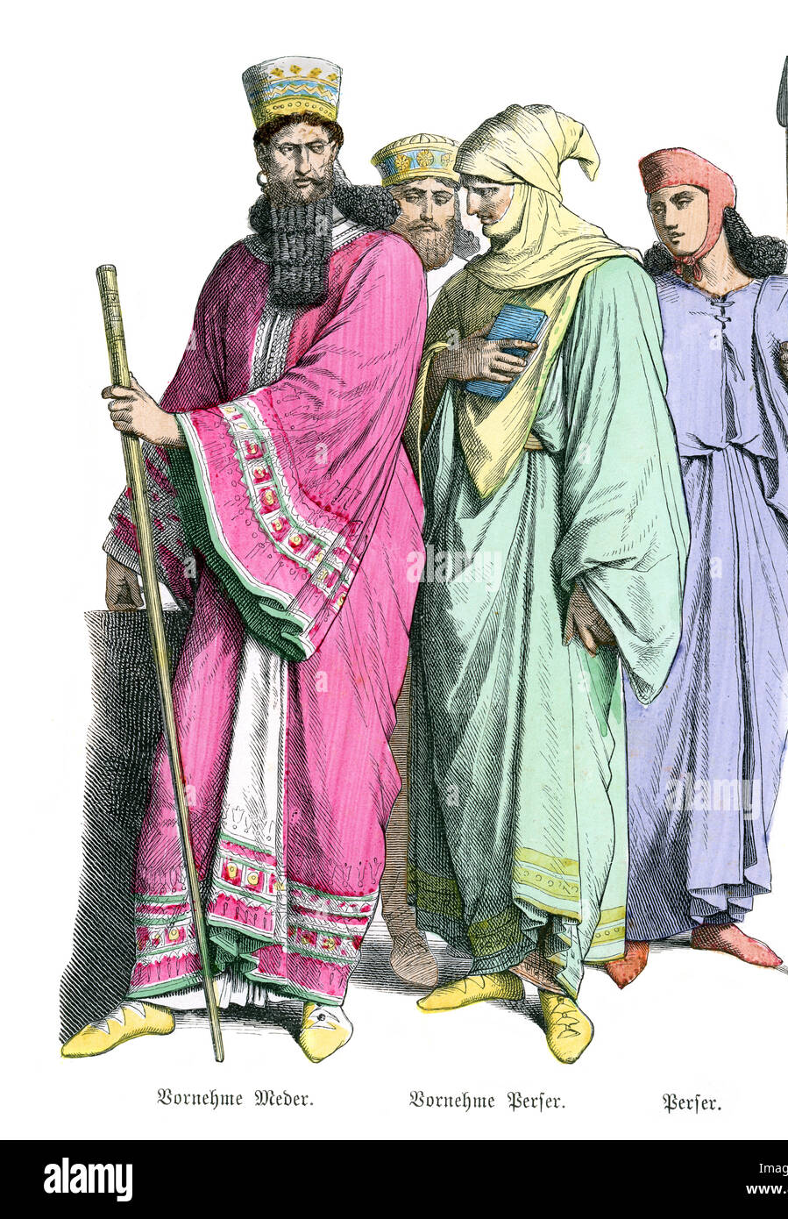
Christian and Jewish persecution during the reign of Yazdgerd II
In 445-46, repressive measures were enacted against the Christians.
For example: expulsion from the army
Yazdgerd II sent Mehr Narseh to Armenia to impose Zoroastrianism on the members of the Armenian noble houses .
This resulted in an uprising by a group of Armenian nobility which resulted in killing of Persian officials and the Zoroastrian priests.
The Sassanids sent an army to Armenia and the confrontations resulted in the destruction of the Armenian forces, death and capture of Christian priests and the exile of the remainder to Khorasan in 454 CE.
In 455 CE, a Jewish persecution was initiated in Persia
Jews were forbidden to celebrate the Sabbath openly and publicly
by 467 CE, Jewish schools were closed and some of the leaders were executed.
The Jewish population reacted by peeling the skin off two Zoroastrian priests alive in Isfahan resulting in further persecution and revolts.

Slide 12
More About Yazdgerd II
He was devoted to Zoroastrianism
Wanted to form a uniform religious identity among his subjects
He was the first Persian king to adopt the title “kay” meaning king associating himself with the Shahnameh’s Kianian Dynasty
“The Mazda-worshipping majesty, the Kayanid” was minted on the coins
During his reign, a style was introduced where the attendants face the fire altar in a posture of reverence

Slide 13
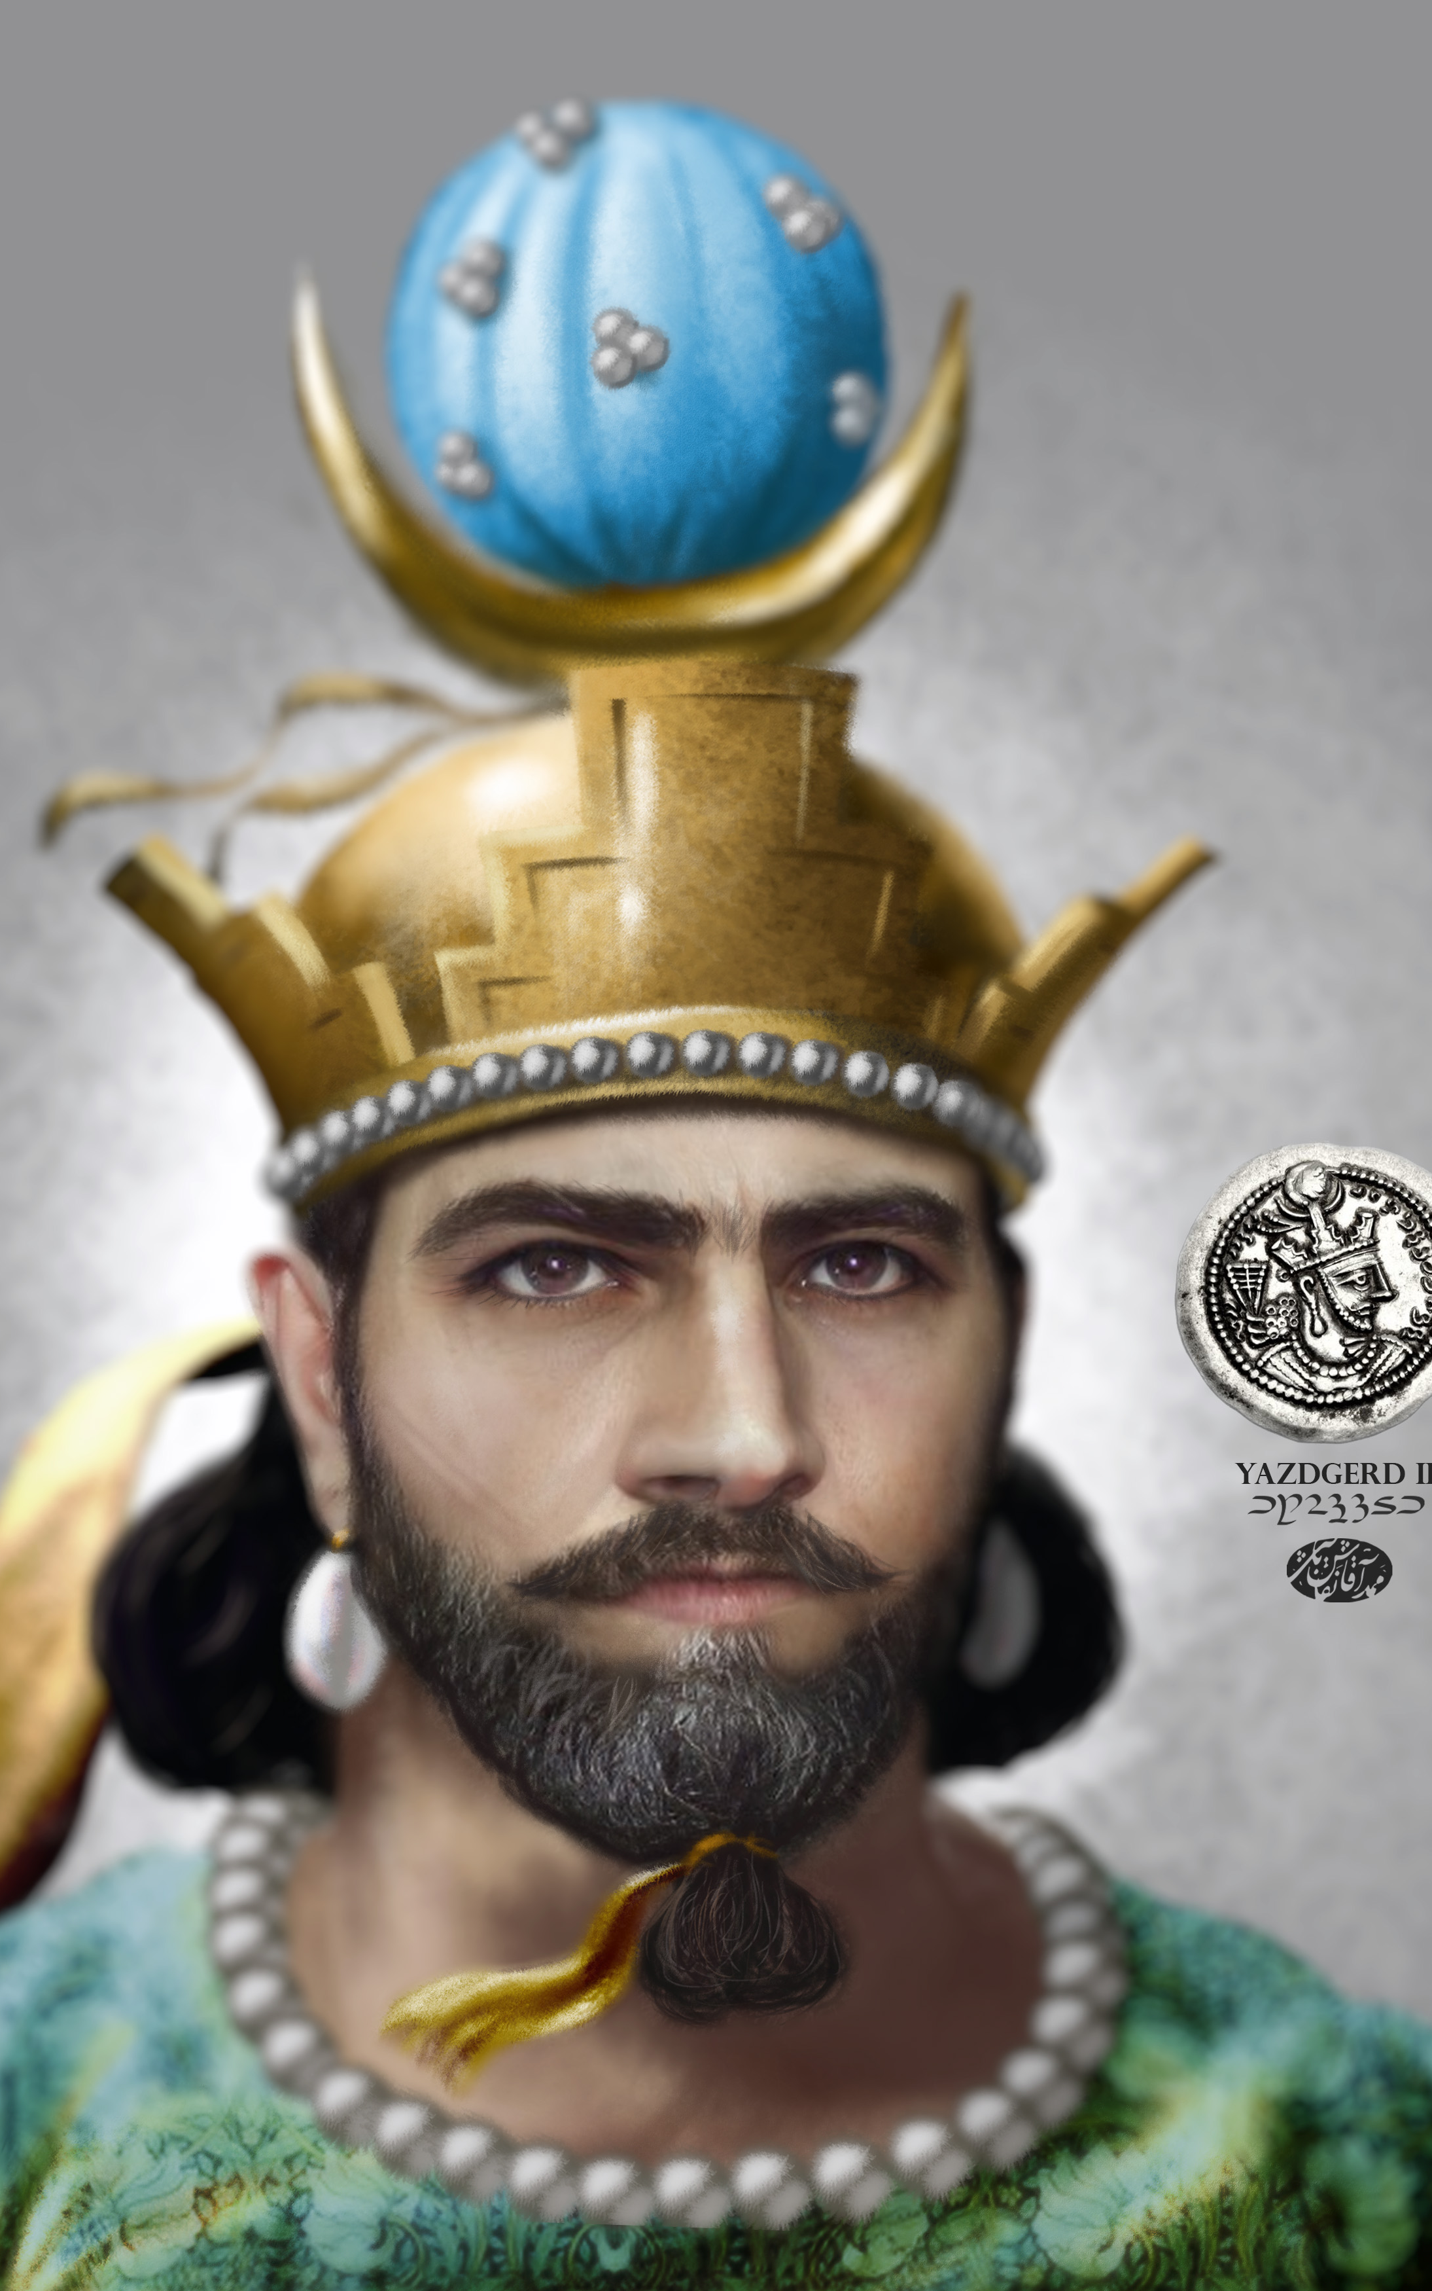
Yazdgerd II’s Death
He died in 457 CE leaving the decision of his succession to the elite
His eldest son, Hormozd III (Yazdgerd II’s eldest son), took the throne
Peroz, his youngest son, fled to the northeast to raise an army and claim the throne
Country fell into a power struggle and became divided

