Slide 1
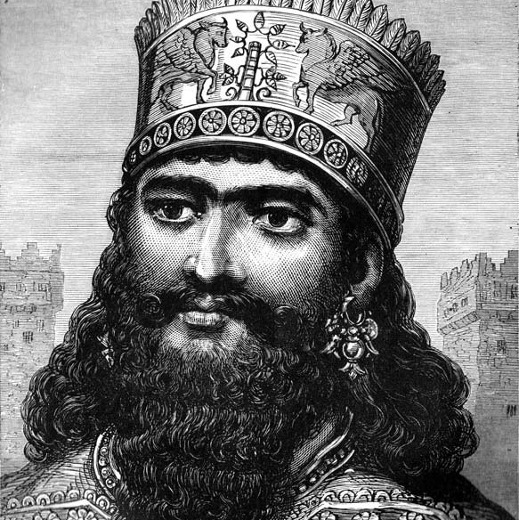

Cambyses II
Lesson 3
Grades 9-12
Slides by: Mr. Xerxes Kotval

Slide 2
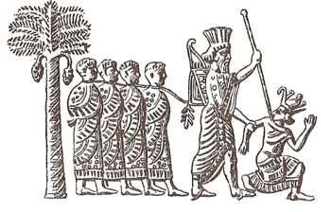
Cambyses II
CAMBYSES II – 529–521 BC
Cambyses II was the eldest son of Cyrus the Great (Cyrus II) and became king after Cyrus’ death.
Cambyses II of Persia capturing pharaoh Psamtik III
Before becoming king in 529 B.C., Cambyses II was appointed coregent over Babylon and officially appointed King of Babylon in 530 B.C. by this father, Cyrus II.
As the eldest son, Cambyses was heir to the throne. After Cyrus’ death, Cambyses’ younger brother, Bardiya (“Smerdis” in Greek), challenged Cambyses' right to the throne.
Cambyses is reported to have murdered Bardiya, concealing his death order to gain unchallenged rule.

Slide 3

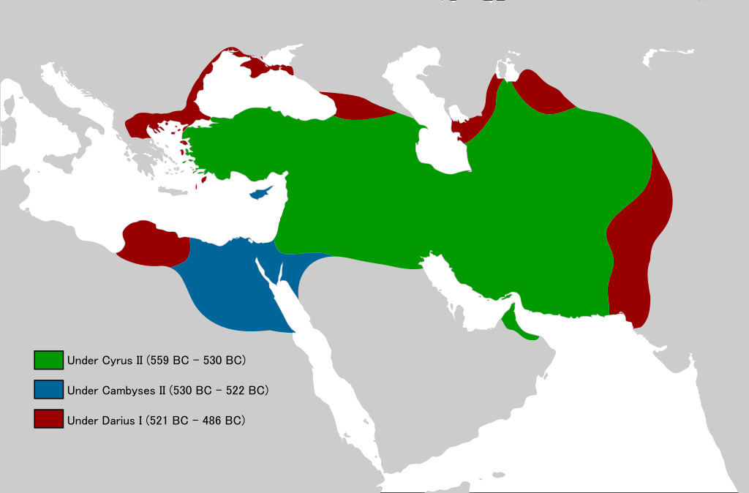
Cambyses’ main achievement was the conquest of Egypt in 525 BC, which established Persian rule there for two centuries.
The campaign to conquer Egypt had already been planned by Cyrus II. In 525 B.C. Cambyses II executed the plan and laid siege to Memphis (in Egypt) where Psamtik III, ruler of Egypt, and the Egyptians had barricaded themselves. After Cambyses II took Memphis, Egypt became a satrapy and Cambyses became Pharaoh.
Cambyses II had intended to extend the Persian Empire into Northern Africa, but logistics presented a problem shortly after he annexed the northern part of Ethiopia.
An account by the Egyptian admiral of the royal fleet and priest shows that Cambyses followed Cyrus’ religious policy of tolerance.
Cambyses II

Slide 4
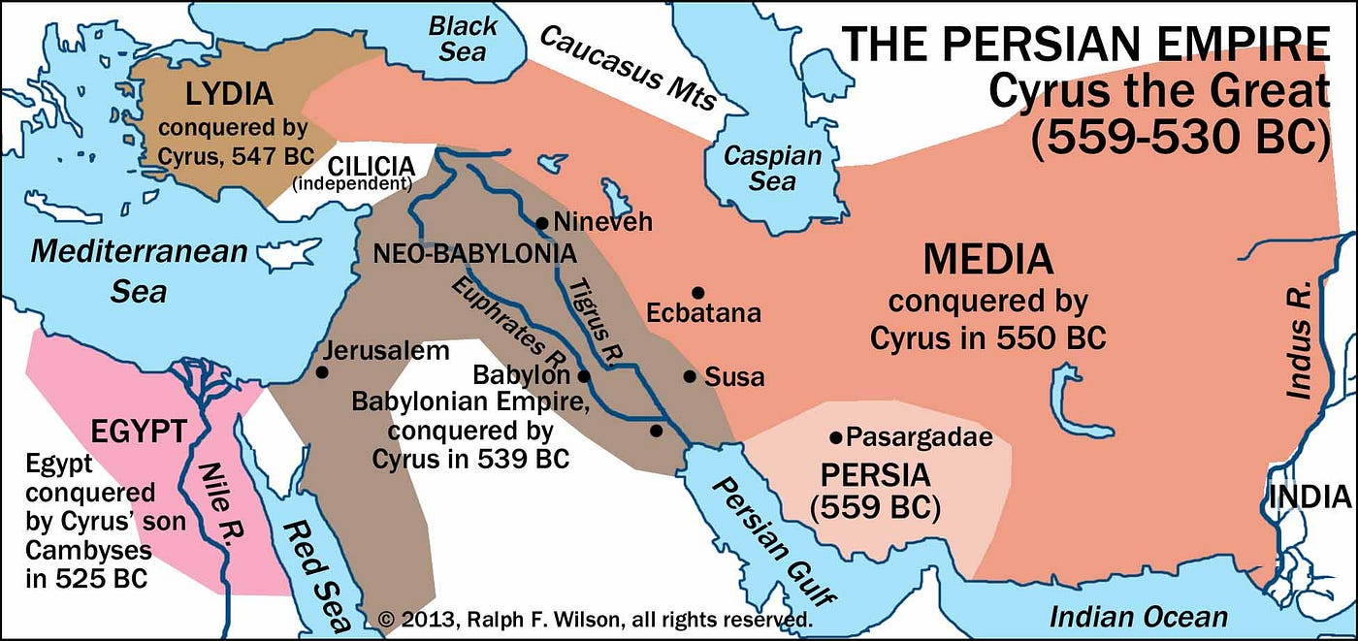
Persian Navy
Cambyses, in addition to conquering Egypt, is credited for creating the first Persian naval fleet
His navy supplied his army while marching through the barren lands to Egypt
Later, Darius and Xerxes used the naval fleet to conquer part of Europe and Athens

Slide 5
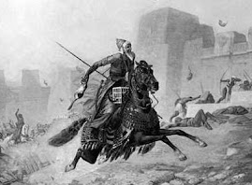
Cambyses II
CAMBYSES II – 529–521 BC
While in Egypt, Cambyses heard that his throne was occupied by a pretender, Gaumâta, who had assumed the name of this younger brother, Bardiya.
This new ruler was accepted by nearly all the provinces of the empire. Gaumata tried to win the favor of the people by remitting (suspending) taxes for three years and attempting religious reform.
Cambyses tried to rush back to Persia, but according to one story, while mounting his horse, the sheath of his sword broke, and the blade pierced his thigh. Cambyses died in Syria, childless.

Slide 6
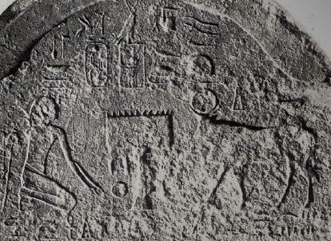
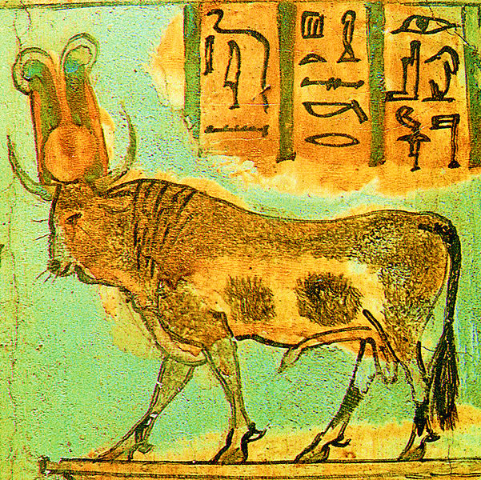
Cambyses II
CAMBYSES II – 529–521 BC
Historical Bias?
⧫ Apis stele dated to the regnal year 6 of Cambyses (524 BCE), and depicting the king (kneeling, left) as an Egyptian pharaoh, while worshiping a dead Apis bull (right).^{[1]}
The Apis Bull, important and highly regarded bull deity of many ancient Egyptians. 
Later Greek writers, perhaps influenced by hostile Egyptian priests that resented losing power during Persian rule, represented Cambyses as impious and tyrannical.
Greek writers (e.g., Herodotus) accused Cambyses of acts of cruelty and madness during his conquest of Egypt, including the murder of the Apis Bull.
In fact, Darius, Cambyses and later Xerxes all demonstrated great respect for the practices associated with the Apis bull and its full burial honors.
https://egyptianaemporium.wordpress.com/2012/07/11/dispelling-the-myth-herodotus-cambyses-and-egyptian-religion-2/

