Slide 1
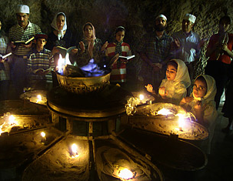
Persecution of Zoroastrians in Iran
Lesson 4
Post-Sassanid Empire

Slide 2
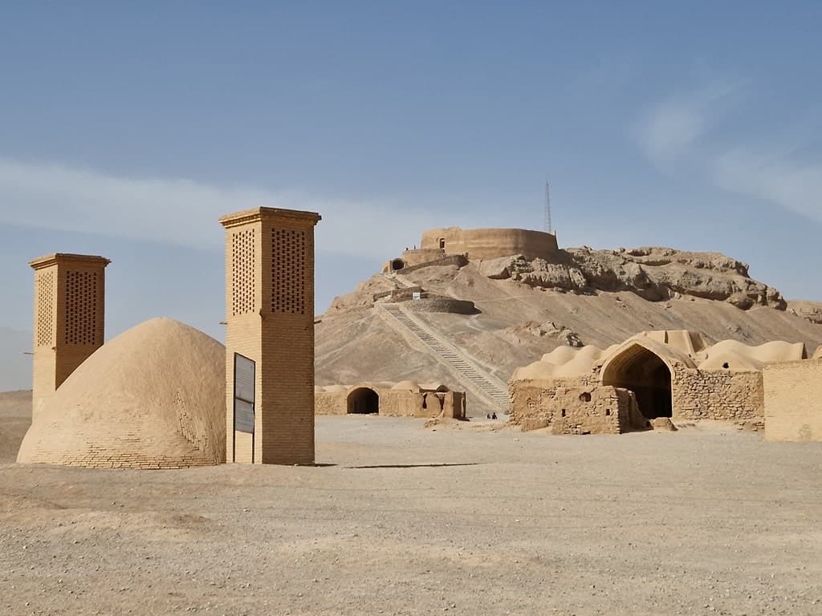
Background
Following the Islamic Arab conquest of Iran, many Zoroastrians migrated to countries to escape persecution
Those who remained took refuge in desert cities of Yazd and kerman

Slide 3
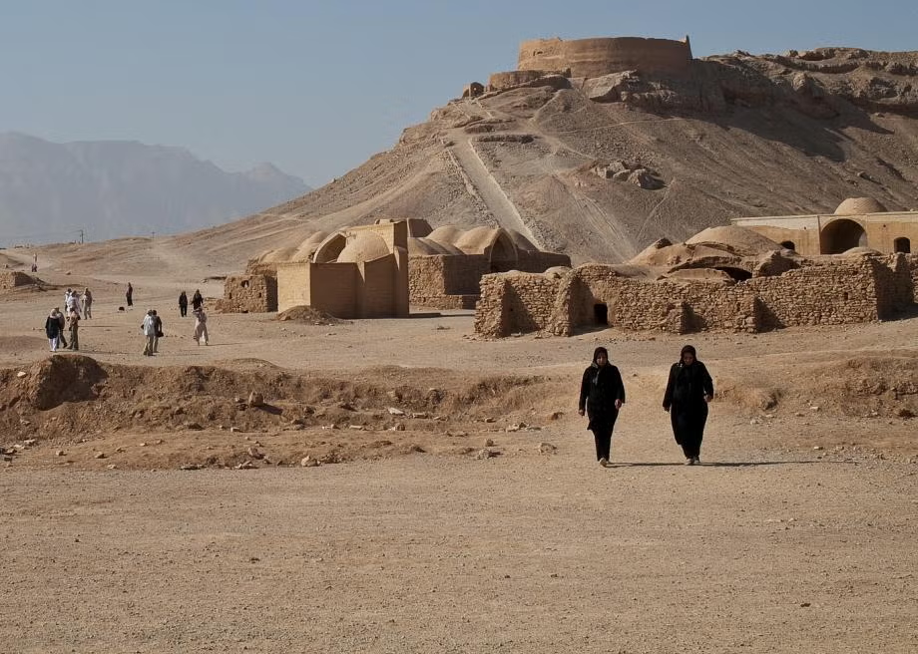
Zoroastrians in Iran
In 1850 the population of Zoroastrians in Iran once in millions declined to about 7000
The French Ambassador to Persia at the time wrote,
“Only a miracle may save them (Iranian Zoroastrians) from extinction.”

Slide 4
People of the Book
The Abrahamic faiths were considered “People of the Book” and could practice their faith within limits
Zoroastrians initially were categorized as “People of the Book” but with an inferior status because Zoroastrians lacked a shared history with Islam
Under Abbasid rule (9Th century), Zoroastrians lost the “People of the Book” status and were considered as “heretics”
They were considered impure
Banned from royal court, many public places, bathhouses, mosques, and bazaars
Many of their institutions were destroyed or confiscated

Slide 5
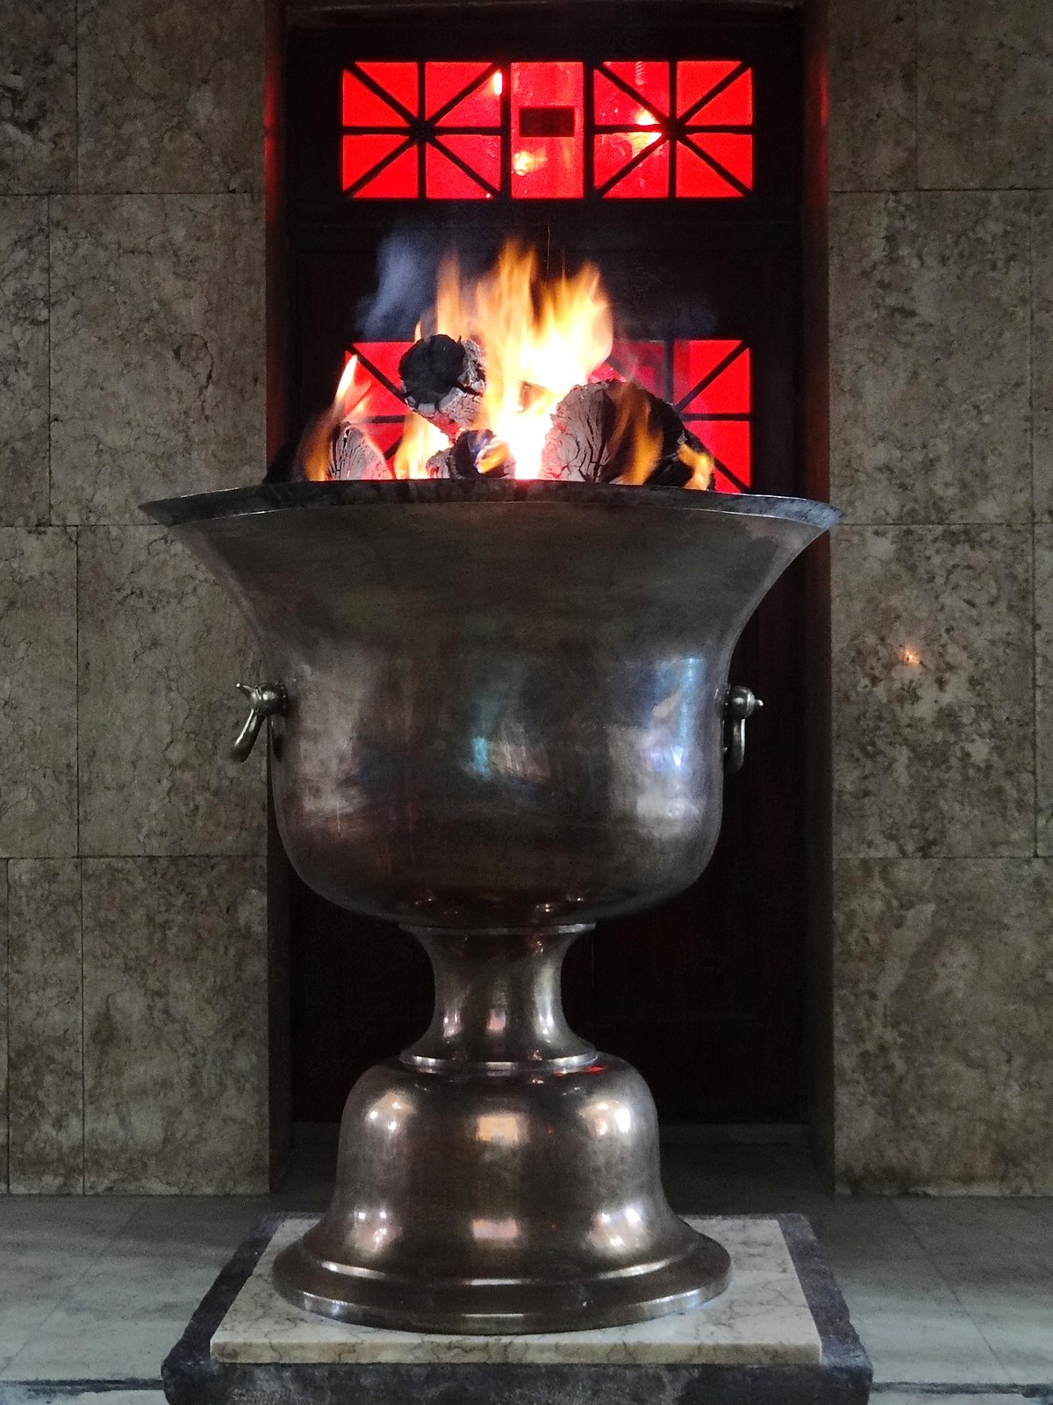
Rise of Shi’ite Islam
During Safavid Dynasty (16-18th century) and rise of the Shi’ite Islam the freedom of minorities were further diminished
Zoroastrians in Iran were among the most harshly treated minority group
During Shah Abbas and Sultan Husayn the forcible conversion of the Zoroastrians to Shi’ite Islam escalated
Those who resisted conversion were either severely punished or killed

Slide 6
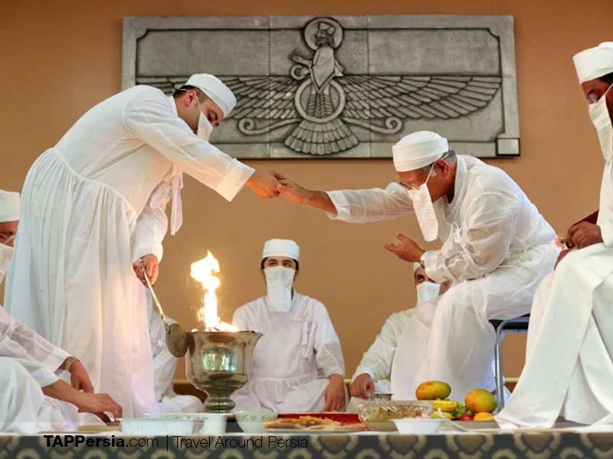
Iranian Mobeds Send a Message to the Mobeds in India
“No period, not even that of Alexander, had been more grievous or troublesome for the faithful.”
The injustice on Zoroastrians included
Destruction of knowledge (Books) and institutions
Assault
Abductions
Economic discrimination
Systemic extermination

Slide 7
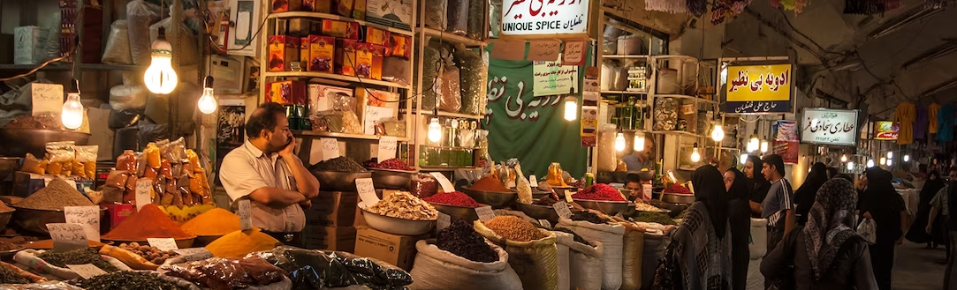
Economic Hardships
Zoroastrians could not hold any professions other than low-paying manual labor such as farming or weaving
Merchants were not allowed to trade in bazaars
Zoroastrian goods were considered unclean making it hard for them to sell
To encourage conversion, any family member who converted to Islam would receive all the inheritance of their Zoroastrian siblings

Slide 8
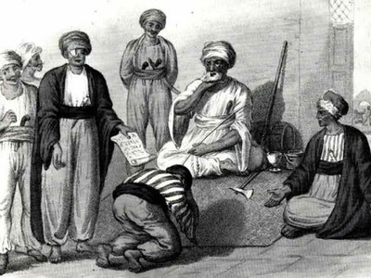
Jizyeh- A religious tax that had to be paid by all minorities
Jizyeh was first implemented during Umayyads (661-750) and continued until the Qajar rule (19th century)
To humiliate Zoroastrians, the tax could be requested by the tax collector at any time and those who could not pay would be severely beaten

Slide 9
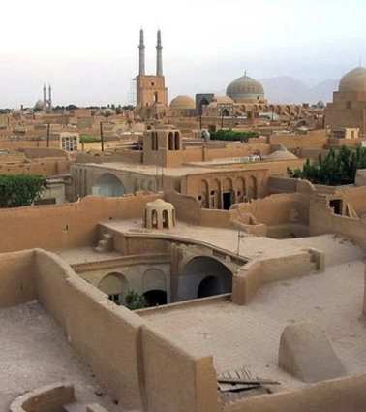
Restriction on Travel and Area of Residence
During Safavid Dynasty, Zoroastrians were forced out of the urban centers to live in religious ghettos
This limited their economic prospects even further
Their homes were outside the of city wall making them the first to lose their lives during an attack
The roof of a Zoroastrian’s house had to be low enough for a Muslim to touch its roof with his stretched hands with a maximum of two windows per room
As late as 1900s they were not allowed to have air-cooling towers in their homes

Slide 10
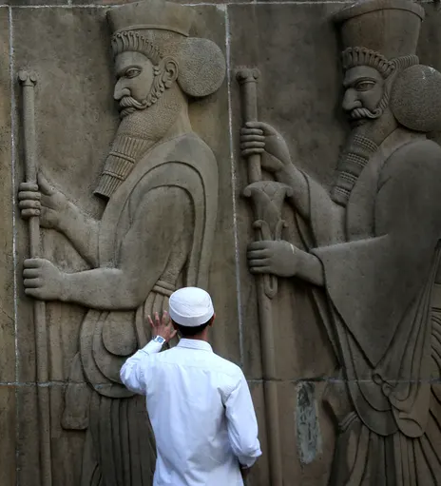
Travel Ban
During Nadir Shah (18th century0 Zoroastrians were forbidden to travel
This cut the ties between Iranian and Indian Zoroastrians

Slide 11
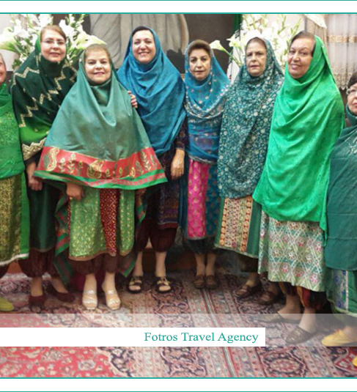
Social Restriction
Restriction on how Zoroastrians could dress
Women could not buy full length cloth
They had to buy scraps and sew them together
Men had to wear unbleached garments of brown, grey, and yellow woven at home by women
They had to wear a patch on their shoulders to show they were Zoroastrian
Their footwear was broad with a turned-up toe
They had to wear a head gear that was meant to cause discomfort

Slide 12
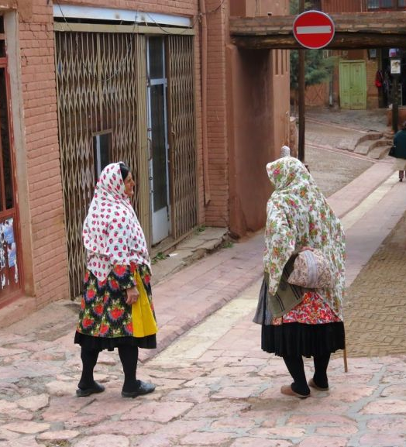
Interactions with Muslim
Zoroastrians were forbidden from traveling by horse
They had to dismount their donkey when passing a Muslim
They were not allowed outdoors when it rained as not to pollute the water
They had to carry a cloth to sit on when entering a Muslim’s house so not to dirty their floor

Slide 13
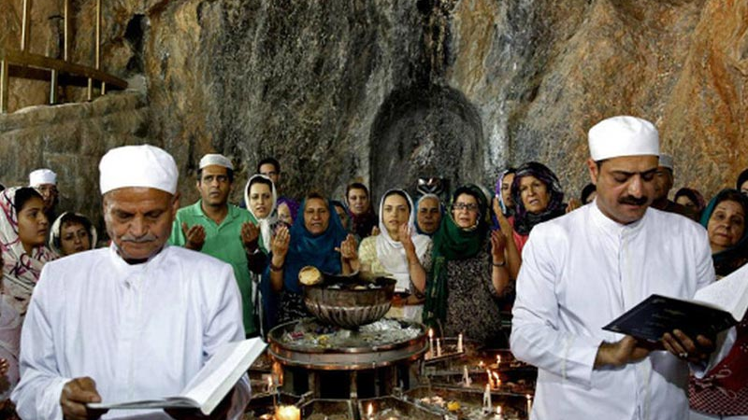
Education
Zoroastrian children were not allowed to receive formal education

Slide 14
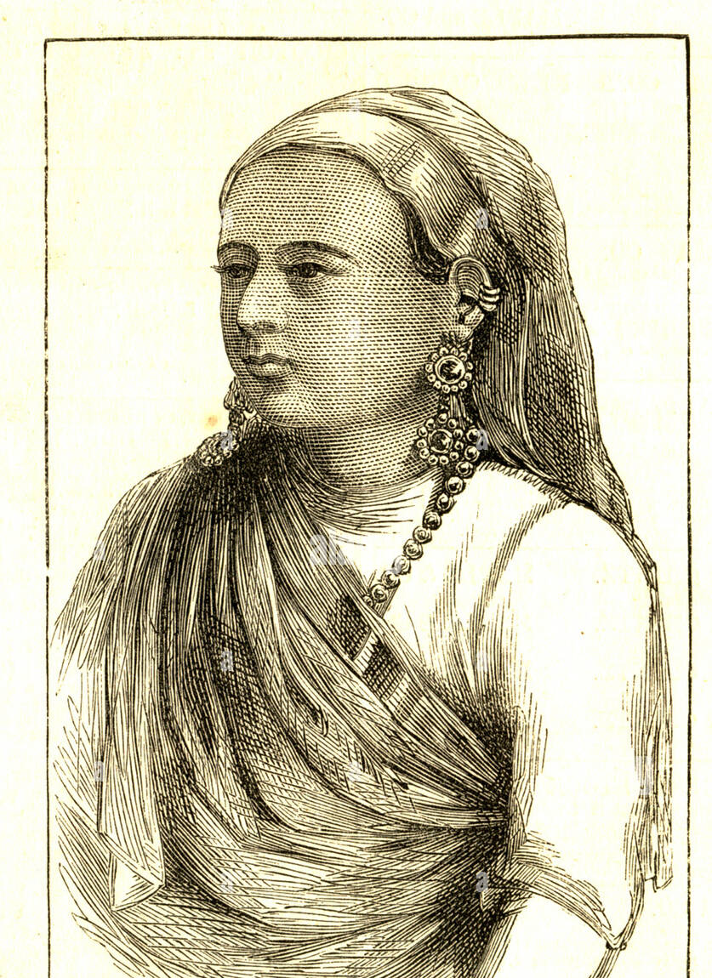
Gulistan Banu
Around 1779 Kai Khusrau Yazdyar, a Zoroastrian living in Yazd left Iran for India
This was because a wealthy Muslim became interested in his daughter Gulistan Banu
In Bombay, Gulistan Banu married a Parsi and became a well-loved member of the community
In 1834 her children initiated a fund that became the Society of Amelioration of the Condition of Zoroastrians in Persia.
This society funded Maneckji Limji Hataria to travel to Iran and evaluate the condition of Zoroastrians in Iran

