Slide 1
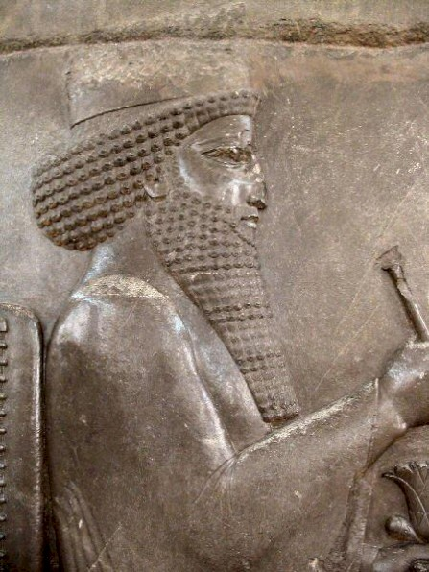
The Achaemenids- Darius the Great
Part 1 of 2
Prepared by: Xerxes Kotval
Shared with FEZANA Religion Education Committee
Notes:
*Material provided by Xerxes Kotval

Slide 2
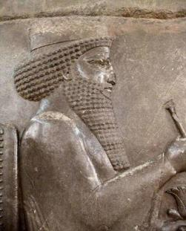
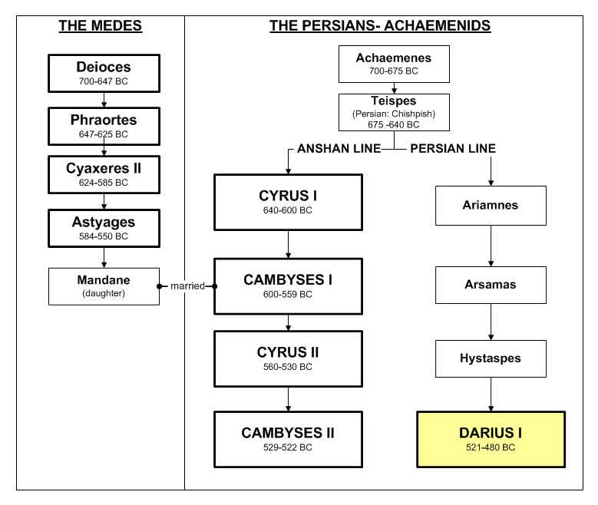
Darius I
Darius the Great - 521- 485 B.C.
Darius I (Darayavaush), also known as Darius the Great, held the Achaemenid empire at its peak, encompassing between 35-50 million people, representing ~70 distinct ethnic groups, stretching 2,600 miles from the Indus River in the east and the Aegean sea in the west, and 2,300 mile from Armenia in the north to the south of Egypt
Darius the Great
Ascension to the Throne
Darius, son of Hystaspes, belonged to a younger branch of the royal family of the Achaemenids. Darius had served as a warrior for Cambyses II. After the death of Cambyses, Darius, "with the help of Ahuramazda," and six other Persian noble families overthrew the alleged usurper Bardiya (some say it was Gaumata who pretended to be Cambyses II brother, Bardiya).
Darius justifies his ascension to the throne through his lineage to Achaemenes, even though he was distantly related. To establish and maintain his legitimacy, Darius married Atossa, daughter of Cyrus, with whom he had four sons, Xerxes, Achaimenes, Masistes and Hystaspes. He also married Artystone, another daughter of Cyrus, and Parmys, the daughter of Bardiya, and other another women of the nobility.

Slide 3
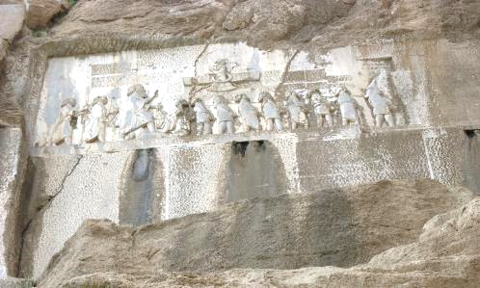
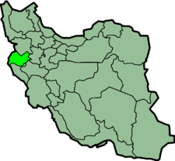
Darius I
THE BEHISTUN INSCRIPTIONS
What is it?
The Behistun complex is a rich archeological site, coverings an area of 116 hectares. There is evidence that humans have taken shelter is this area as far back as 40,000 years ago. There are 18 historical monuments from different points in history registered in the Iranian national list of historical sites. One of these is an inscription authored by Darius the Great sometime between his coronation as king of the Persian Empire in 522 BC and his death in 486 BC.
The inscription is approximately 15 meters high by 25 meters wide and 100 meters up a limestone cliff from an ancient road connecting the capital cities of Babylon and Ecbatana. The Old Persian text contains 414 lines in five columns; the Elamite text includes 593 lines in eight columns, and the Babylonian text is in 112 lines. The inscription was illustrated by a life-sized bas-relief of Darius the Great.
What does it say?
The inscription begins with a brief autobiography of Darius, including his ancestry and lineage. Later in the inscription, Darius provides a lengthy sequence of events following the deaths of Cyrus the Great and Cambyses II in which he fought nineteen battles in a period of one year (ending in December of 521 BC) to put down multiple rebellions throughout the Persian Empire.
The inscription states in detail that the rebellions, which had resulted from the deaths of Cyrus the Great and his son Cambyses II, were orchestrated by several impostors and their co-conspirators in various cities throughout the empire, each of whom falsely proclaimed kinghood during the upheaval following Cyrus's death.
Darius the Great proclaimed himself victorious in all battles during the period of upheaval, attributing his success to the "grace of Ahura Mazda".
Iran
Where: Behistun Mount is located near the village Besitun in Western Iran along the old carven road from Ecbatana to Babylon. It is the last peak (3,800 feet high) of a long, narrow range of mountains that skirt the Plains of Keneanshah.

Slide 4
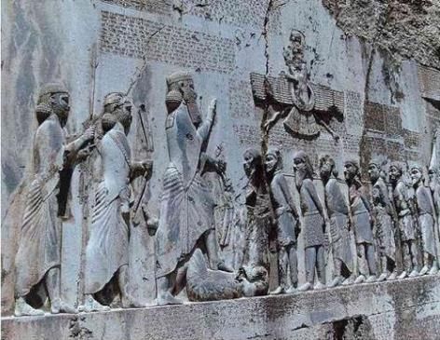
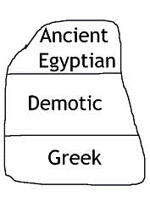
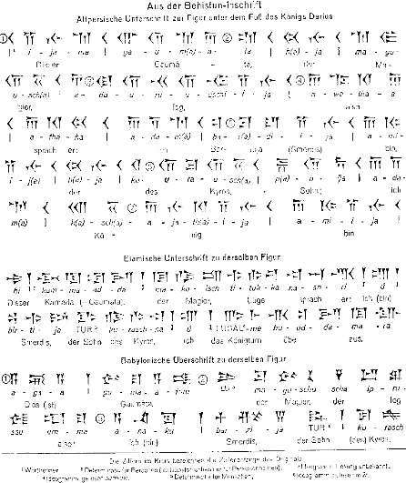
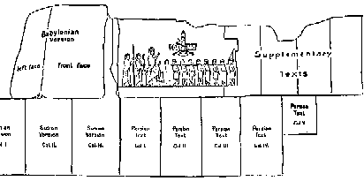
THE BEHISTUN INSCRIPTIONS
Darius I
Why is it important?
The inscription does more than provide the history of Darius’ reign. The inscription includes three versions of the same text, written in three different cuneiform script languages: Old Persian, Elamite, and Babylonian (a later form of Akkadian).
The Behistun Inscription is to cuneiform what the Rosetta Stone is to Egyptian hieroglyphs. It allowed preserved but previously undecipherable documents to be translated, revealing much about the most ancient civilizations of human history.
Rosetta Stone
The ledge below the inscription shows Darius I holding a bow as a sign of kingship, with his left foot on the chest of a figure lying on his back before him. The supine figure is reputed to be the pretender Gaumata.
Darius is attended to the left by two servants, and ten figures stand to the right, with hands tied and rope around their necks, representing conquered peoples.
A Faravahar floats above, giving his blessing to the king.
One figure appears to have been added after the others were completed, as was Darius's beard, which is a separate block of stone attached with iron pins and lead.
Babylonian
(Akkadian)
Elamite
(Susian)
Old
Persian
Behistun Inscription

Slide 5
Darius I

Slide 6
Darius I

Slide 7
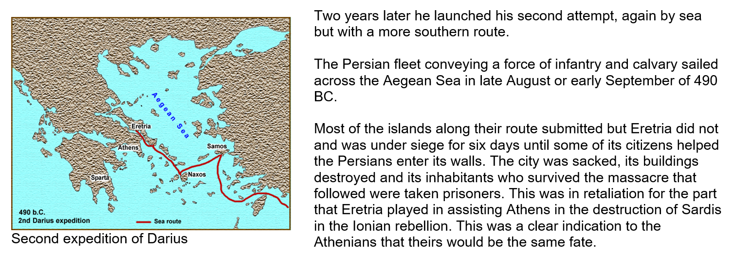
Darius I

Slide 8
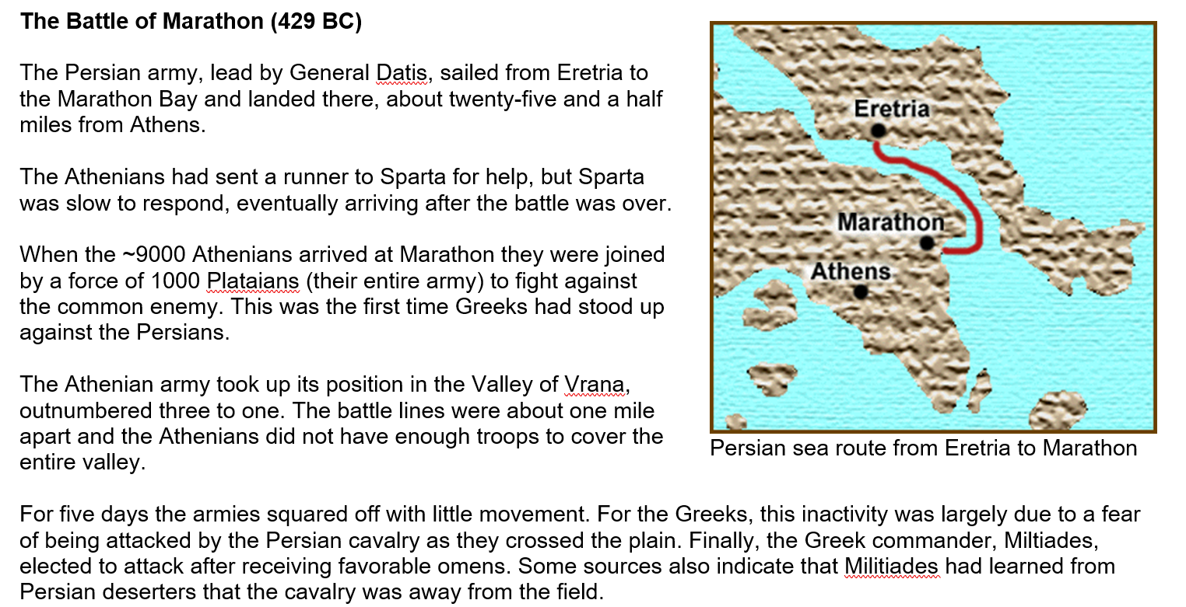
Darius I

Slide 9
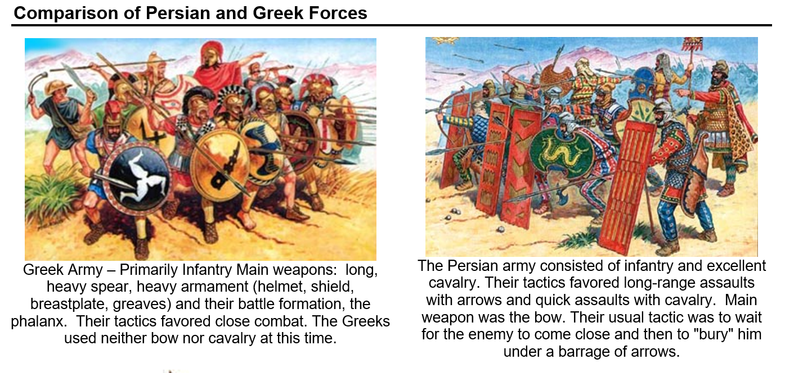
Darius I

Slide 10
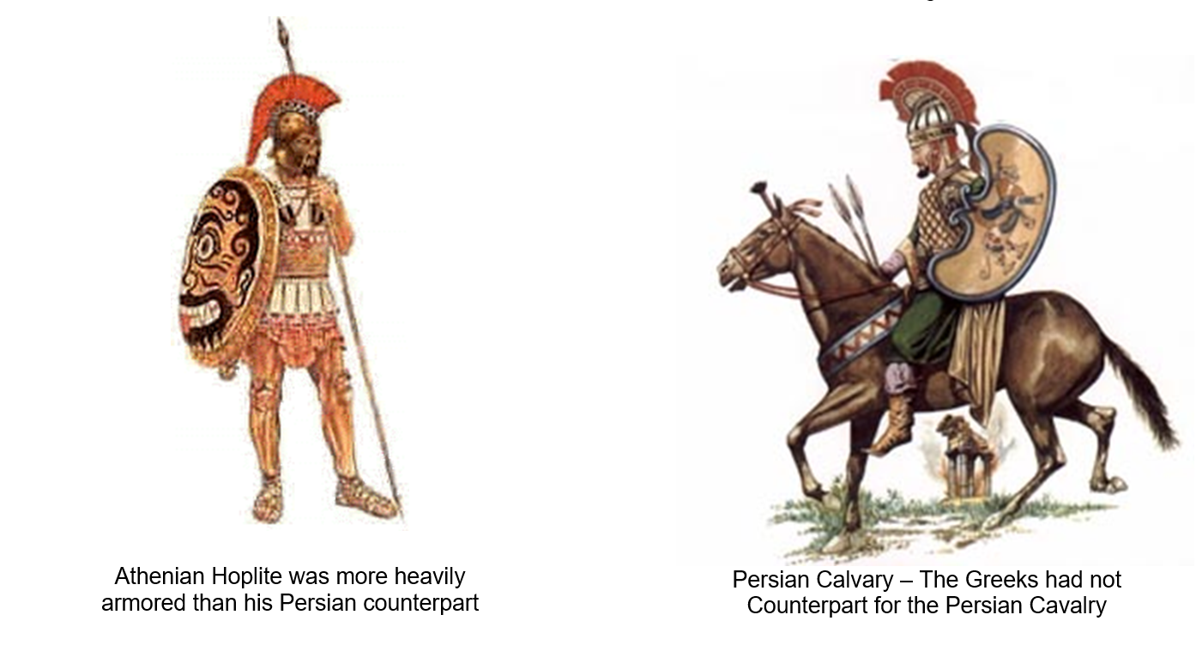
Darius I

Slide 11
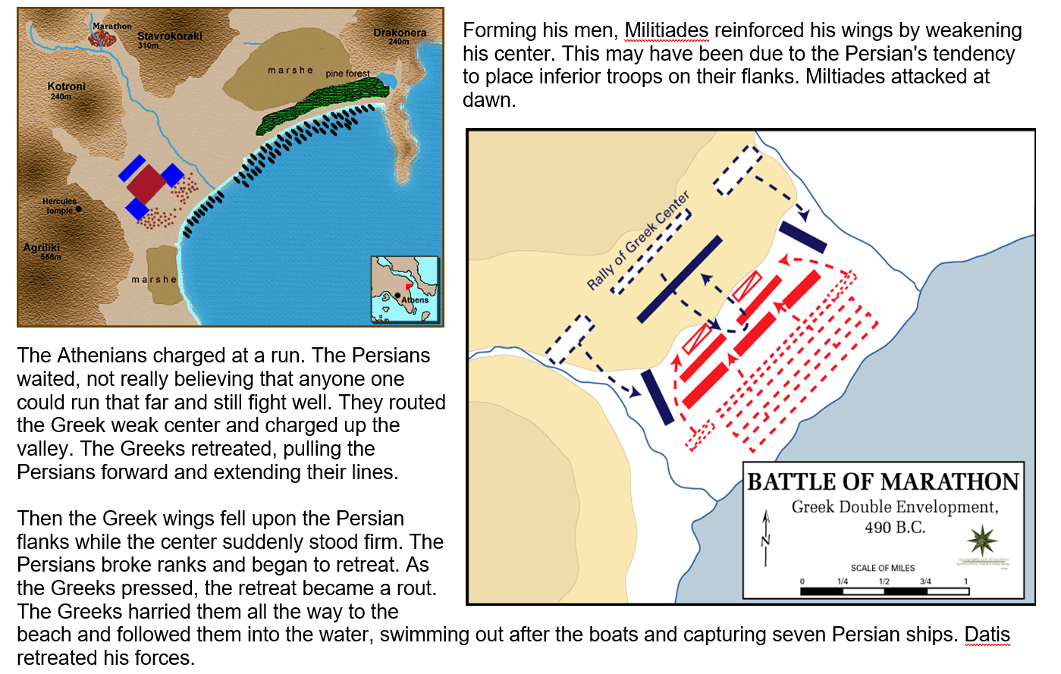
Darius I

Slide 12
The Athenians had won at Marathon, but they certainly had not destroyed the Persian army. They had made plans before the battle that if they won, they would return to Athens as soon as possible because they knew that the Persian fleet was sure to sail around Attica and attempt to take the city while it was undefended. The citizens were to man the walls and make it appear that Athens was strongly defended.
The Persians did indeed sail around Attica hoping to find the city helpless but when they met with resistance, they hesitated. Not long after, the Greek army arrived. The Persians decided they had enough of these Greeks and sailed home.
The Battle of Marathon is perhaps the single most important battle in Greek history. Had the Athenians lost, Greece would have eventually come under the control of the Persians and all the subsequent culture and accomplishments of the Greeks would probably not have taken the form they did.
However, the Persian were not finished. In 481 BC, Darius I's son, Xerxes, gathered an army of some one hundred fifty thousand men and a navy of six hundred ships. He was determined that the whole of Greece would be conquered by Persia.
Darius began preparations for a second force which he would command, instead of his generals; however, before the preparations were complete, Darius died, thus leaving the task to his son Xerxes.
Darius I

Slide 13
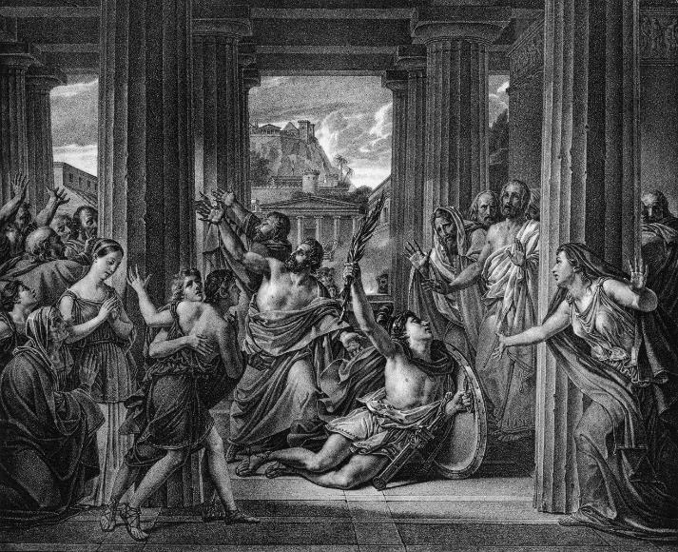
Darius I
The Real Story of Pheidippides and the Marathon
Pheidippides was a day runner - referred to as hemerodrome, in Ancient Greek, by the Athenian military. These ancient couriers were responsible for running for days at a time in order to give important messages. They were designed to move swiftly and to arrive with their messages in a timely manner. They trained extensively, and they could run great distances.
Pheidippides Runs to Sparta - Pheidippides was on duty the day of the fabled Battle of Marathon, which pitted the Athenian army against the Persian army. However, before the invasion, it was Pheidippides responsibility to run the 240 kilometer (150 mile) distance from Athens to Sparta to ask Sparta for their help. Sparta said they’d help but since they were in the middle of a religious festival, they were unable to leave right away. The journey from Athens to Sparta took about two days. After he gave his message to the Spartans requesting their help, he turned around and ran the distance from Sparta to Athens to let them know that the Spartans wouldn’t be able to fight right away.
Athens defeats Persia at Marathon - Athens won the battle, but now it was up to Pheidippides to make the run from Marathon to Athens, a distance of 40 kilometers or about 25 miles. He gave the message explaining that Athens was victorious and then he collapsed and died from the combined exertion of that run and the 300 miles that he ran from Athens to Sparta and back (see image).
Pheidippides story is immortalized in paintings, poetry, and every time someone runs a marathon. However, the marathon runs only tell part of the story. But to really understand what he went through, it is much more accurate to run the Spartathalon, which is actually a distance of 246 kilometers and closely resembles the route Pheidippides actually ran.
Here is an excerpt from a poem that Robert Browning wrote to commemorate that fated moment:
Unforeseeing one! Yes, he fought on the Marathon day: So, when Persia was dust, all cried “To Akropolis! Run, Pheidippides, one race more! the meed is thy due! ‘Athens is saved, thank Pan,’ go shout!” He flung down his shield, Ran like fire once more: and the space ‘twixt the Fennel-field And Athens was stubble again, a field which a fire runs through, Till in he broke: “Rejoice, we conquer!” Like wine thro’ clay, Joy in his blood bursting his heart, he died–the bliss!

