Slide 1
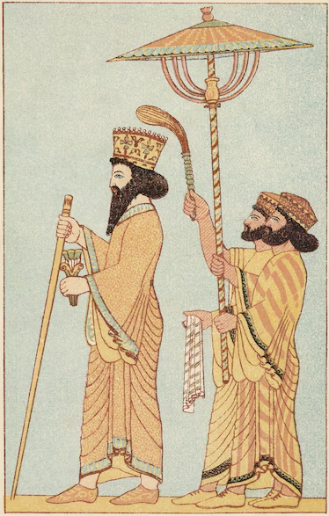
The Achaemenids- Darius the Great
Part 2 of 2
Prepared by: Xerxes Kotval
Shared with FEZANA Religion Education Committee
Notes:
*Material provided by Xerxes Kotval

Slide 2
Darius I
Darius the Great - Engineering and Administrative Accomplishments
 | Name 1 | Name 2 | Name 3
Coinage
Standardized Weights & Measures
The Persian Alphabet
The Royal Road
Darius’ Canals
Religion Tolerance
Bodies of Law
Building Projects – Persepolis
Building Projects – Susa

Slide 3
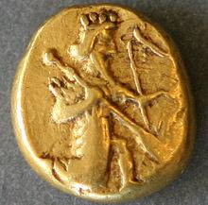
Darius I
Darius the Great - Engineering and Administrative Accomplishments
Coinage
Earlier satraps would mint their own coin. Darius considered right of coinage as an exclusively royal prerogative. He established the daric to be used throughout the Persian Empire.
It was a gold coin (purity of 95.83%) weighing ~8.4 grams. It bore the image of the Persian king, or a great warrior armed with a bow and arrow, but who is depicted is not known for sure. In the ancient times, it was nicknamed "the archer". For instance, Spartan King Agesilaus, said that he had been driven out of Asia by thirty thousand archers, referring to the bribes distributed by the Persian King.
The coin was used until Alexander the Great's invasion in 330 BC when they were melted down and re-coined for Alexander. This is believed to be the main reason for their rarity despite their widespread usage at the time.
Some, such as the Ancient Greeks, believed that this coin's name is derived from the name Darius. But, in reality, it appears to be derived from a Persian word meaning "gold"; in Middle Persian it is called zarig.
An Achaemenid daric
4th century BC.

Slide 4
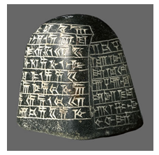
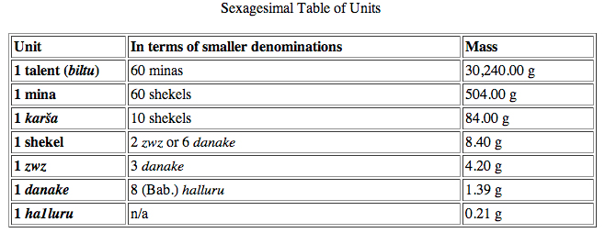
Darius I
Darius the Great - Engineering and Administrative Accomplishments
Standardized Weights and Measures
The shekel was a common unit of weight in the ancient Middle East before Darius I. However, Darius enforced strict standardization of the weights and measures throughout the empire to ensure fair and simplified commerce and trade.
Around 515 BC, Darius I established the Babylonian shekel as the standard and set the weight to 8.40 grams. This is in fact the key unit for understanding the ancient systems of weight, forming part of a sexagesimal table below.
Pyramidal weight
in polished diorite
Inscribed in Old Persian,
Elamite and Babylonian,
“2 karsha.
I am Darius, the great king, the son of Hystaspes, an Achaemenian.”

Slide 5
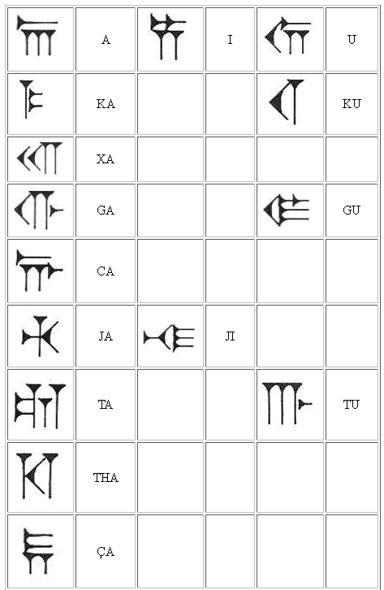
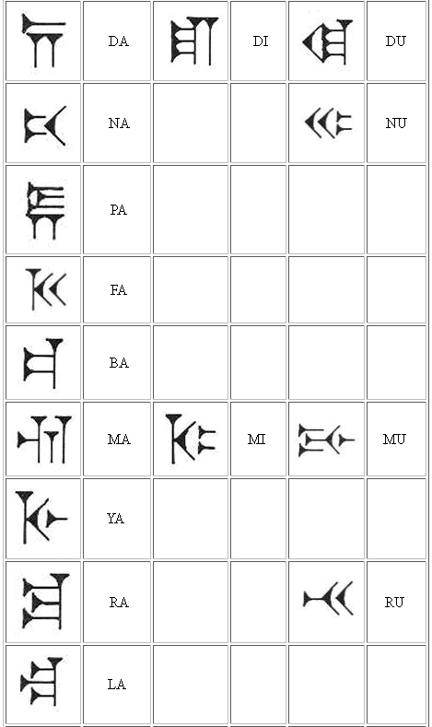
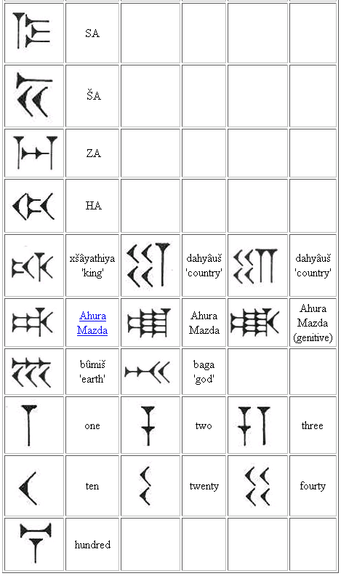
Darius I
Darius the Great - Engineering and Administrative Accomplishments
The Persian Alphabet
The Ancient Persian peoples spoke all types of languages. They originally spoke Old Persian. Old Persian was the language of the Achaemenid court. Old Persian was the administrative language of the early Achaemenian dynasty. Darius I ordered the making of the Persian Alphabet. which he called 'the Aryan script'. It consists of thirty-six signs indicating syllables and eight ideograms for the words 'king', 'country' (2x) 'good', 'god', 'earth', and 'Ahuramazda' (3x). A slanting wedge (\) is used as a word divider. The alphabet was mainly used for royal inscriptions.

Slide 6
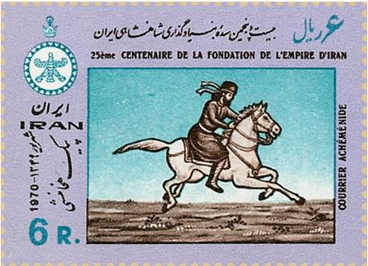
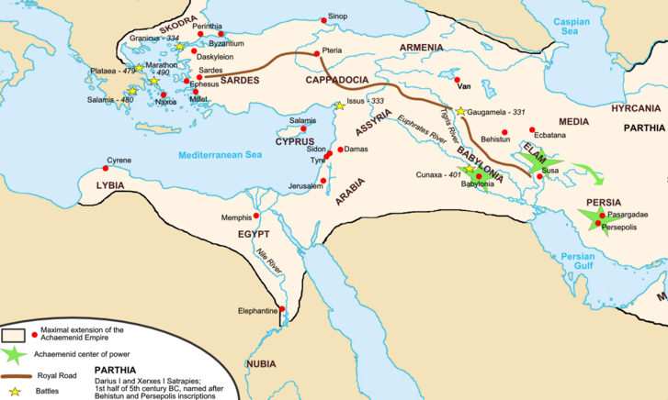
Darius I
Darius the Great - Engineering and Administrative Accomplishments
The Royal Road
The Persian Royal Road was an ancient highway reorganized and rebuilt by Darius I to facilitate rapid communication throughout his very large empire from Susa to Sardis.
Mounted couriers could travel 1,677 miles (2,699 km) in seven days; the journey from Susa to Sardis took ninety days on foot. It was highly organized with rest stations, guarded garrisons, inns and apparently no bandits.
The Greek historian Herodotus wrote, "There is nothing in the world that travels faster than these Persian couriers."
He also wrote that these messengers “…are stayed neither by snow nor rain nor heat nor darkness from accomplishing their appointed course with all speed. — Herodotus, Histories (8.98) (trans. A.D. Godley, 1924)
A similar inscription, "Neither snow, nor rain, nor heat, nor darkness of night prevents these couriers from completing their designated stages with utmost speed", is on the James Farley Post Office in New York and is associated unofficially with the United States Postal Service creed.

Slide 7
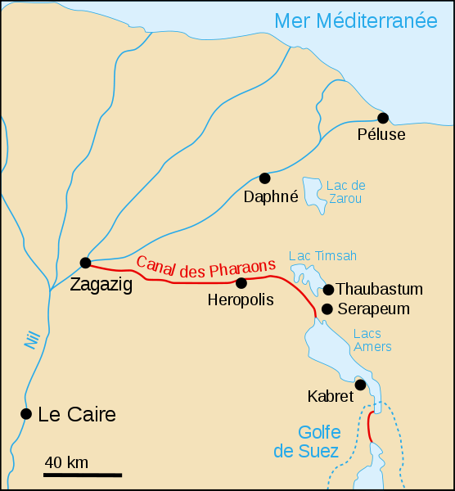
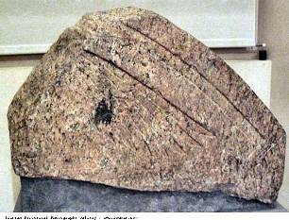
Darius I
Darius the Great - Engineering and Administrative Accomplishments
Darius’ Canals
Between about 520 and 510 BC, Darius I, invested heavily in the economy of his newly conquered province of Egypt. Darius built a number of canals and waterways to improve transportation and commerce. He spent 7 years making the 130 mile east to west connection between the Red Sea and the Nile by building a canal which ran from modern Zagazig to modern Suez.
According to Herodotus, Darius's canal was wide enough that two triremes could pass each other with oars extended and required four days to traverse.
Darius commemorated his achievement with a number of granite stelae that he set up on the Nile bank, including one near Kabret, and a further one a few miles north of Suez.
Darius’ Inscription reads:
“Saith King Darius: I am a Persian. Setting out from Persia, I conquered Egypt. I ordered this canal dug from the river called the Nile that flows in Egypt, to the sea that begins in Persia. When the canal had been dug as I ordered, ships went from Egypt through this canal to Persia, even as I intended.” —Darius Inscription

Slide 8
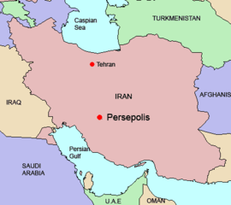
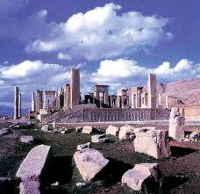
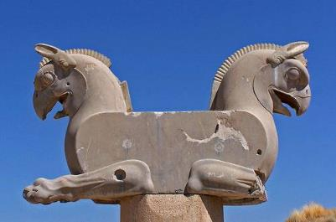
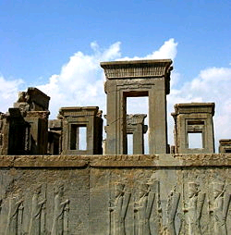
Darius I
Darius the Great - Engineering and Administrative Accomplishments
Building Projects
Many building projects were initiated during the reign of Darius, with the largest being the building of the new capital of Persepolis.
Pasargadae was too well associated with the previous dynasty of Cyrus and Cambyses and so Darius wanted a new capital. The city would have walls sixty feet high and thirty-three feet thick and would be an enormous engineering undertaking.

Slide 9
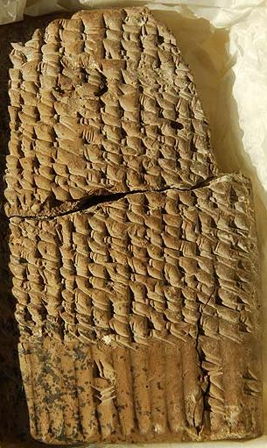
Darius I
Darius the Great - Engineering and Administrative Accomplishments
Religion Tolerance and Bodies of Law
In the lands that were conquered by his empire, Darius followed the same Achaemenid tolerance that Cyrus had shown and later Achaemenid emperors would show. He supported faiths and religions that were "alien" if the adherents were submissive and peaceable, sometimes giving them grants from his treasury for their purposes.
He had funded the restoration of the Jewish temple which had originally been decreed by Cyrus the Great, presented favor towards Greek cults and supported Elamite priests. He had also observed Egyptian religious rites related to kingship and had built the temple for the Egyptian God, Amun.
He established a legal code around the issues of laws of evidence, slave sales, deposits, bribery, and assault.

Slide 10
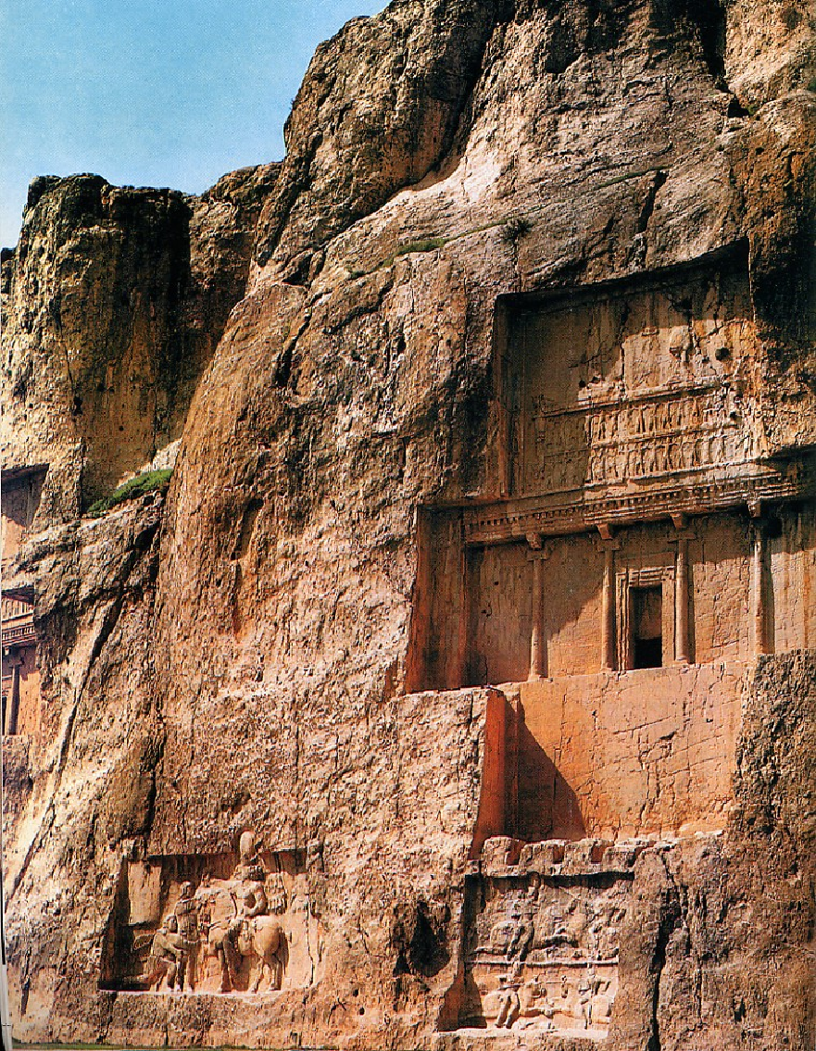
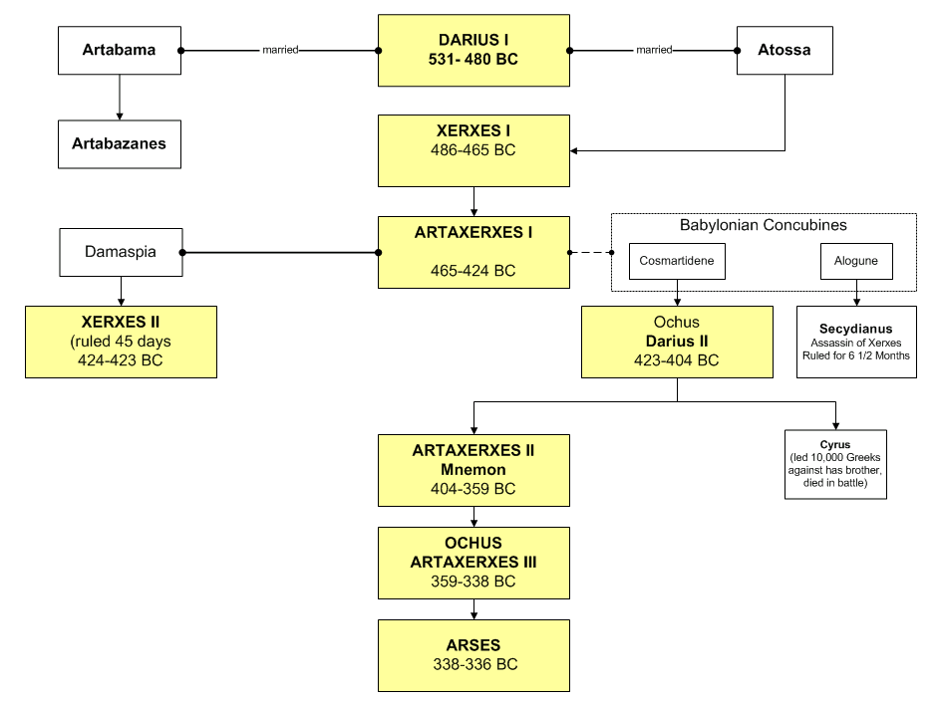
Darius’ Death
After becoming aware of the Persian defeat at the Battle of Marathon, Darius began planning another expedition against the Greek-city states; this time, he, not Datis, would command the imperial armies.
Darius had spent three years preparing men and ships for war, when a revolt broke out in Egypt. This revolt in Egypt worsened his failing health and prevented the possibility of leading another army himself. In 486, after a reign of 36 years, he died at age 64.
The body of Darius was embalmed and entombed in the rock-cut sepulcher which had been prepared for him several years earlier.
The tomb of Darius the Great (Darius I)
is one of the four tombs of Achaemenid kings at the historical site of Naqsh-e Rustam located about 12 km northwest of Persepolis, Iran.
Darius had been a great king, as even his Athenian enemies admitted. Thirteen years after his death, the tragic poet Aeschylus evoked the days of Darius as the golden age of Persia.
Xerxes, eldest son of Darius and Atossa, succeeded to the throne as Xerxes I
Darius I

