Slide 1
Sassanid Empire Lesson 4 (224-651 CE)
Kavad I
and
Mazdakism

Slide 2
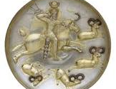
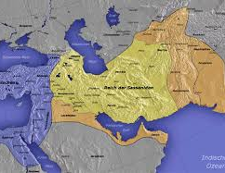
Kavad I (Qobad in Persian) (488-496 and 498-531 CE)
His reign was filled with fighting the Huns from east, Romans from west and Khazars (semi nomadic Turkic people living in northwestern Iran)
Rise of Mazdakism during his reign
Established tax reforms for a fair collection of taxes
Built cities

Slide 3
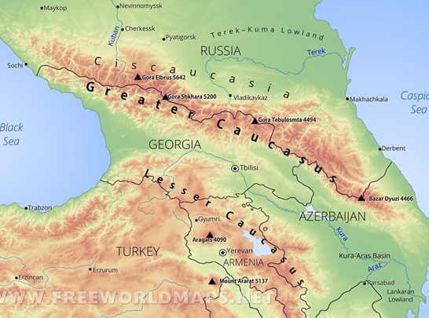
Khazars
He built towers in Caucasus (Ghafghaz in Persian) Mountains to guard Iran and, in part, Rome from the Khazars
Funded through the Roman tax treaty with Persia
He fought the Khazars and won

Slide 4
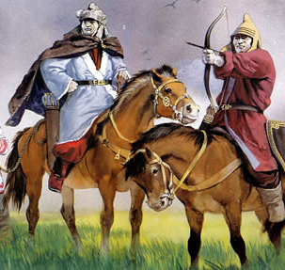
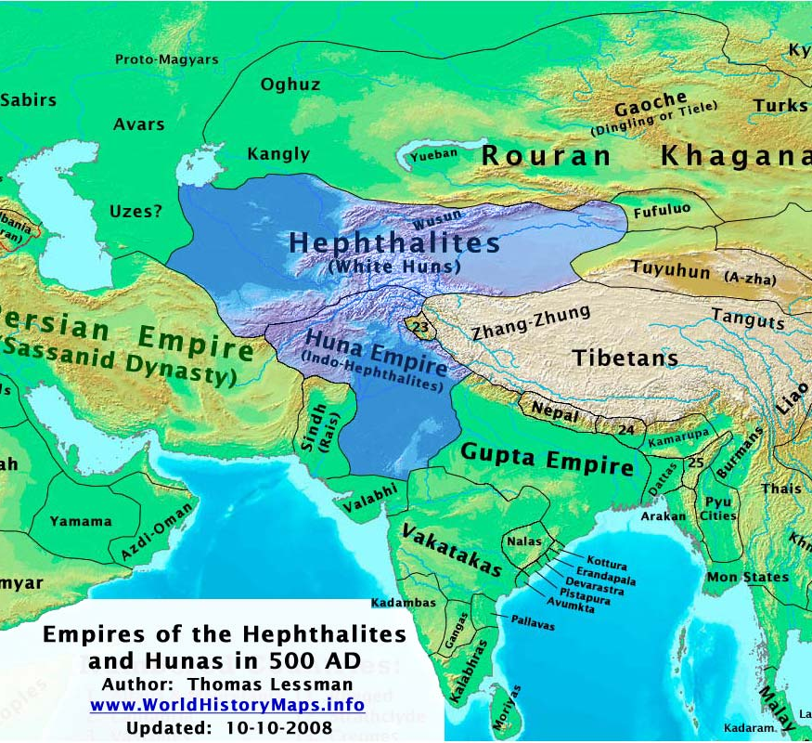
Romans and Huns
Rome attacked Iran
While fighting the Romans, Kavad heard that the Huns have attacked Khorasan
He made peace with Rome for 7 years and went to Khorasan, fought the Huns for 10 years and defeated them
Upon returning, the Romans and people from Caucasus region had joined forces against Persia.
Kavad fought them for many years and succeeded in defeating them

Slide 5
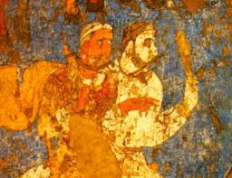
Mazdak
During the early reign of Kavad, a man named Mazdak, son of Bamdad, named himself as a prophet

Slide 6
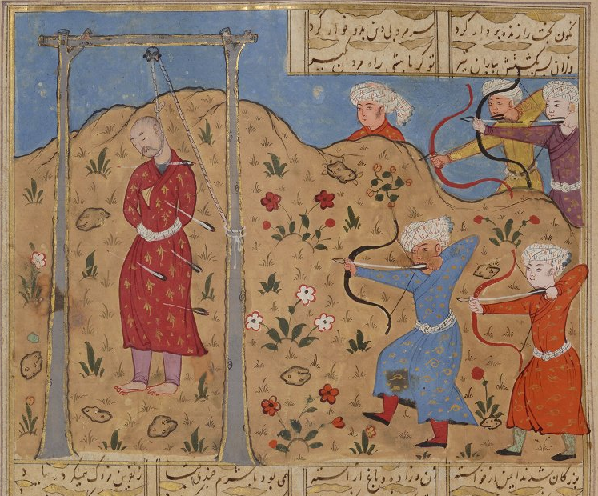
Persia’s Socio-Economic Condition During the Rise of Mazdakism
During the rise of Mazdakism, Persia was in dire state of socio-economic condition
Unsuccessful wars during Firuz I’s reign had damaged the economy and wealth of the country and people
Drought in Persia
Unfair taxes and corrupt governors
Unhappy and desperate citizens
Belief in Mazdakism became attractive to those desperate
Rich had to share their wealth and wives
This led to chaos, unruliness and violation of women and people’s rights

Slide 7
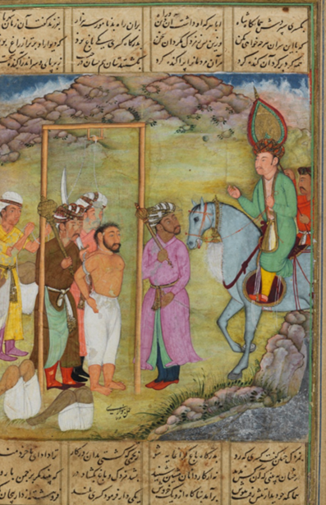
Kavad and Mazdakian Religion
Kavad supported the religion of Mazdak
Zoroastrian priests and noble men were unhappy of his decision, so imprisoned Kavad and made Jamasb (Kavad’s brother) king
Kavad escaped and sought refuge with the White Huns (Hephthalites)
There he married the daughter of the Hun’s leader
They had a son named Khosrow
Khosrow would later become Kavad’s successor and one of the most beloved of Sassanid Kings

Slide 8
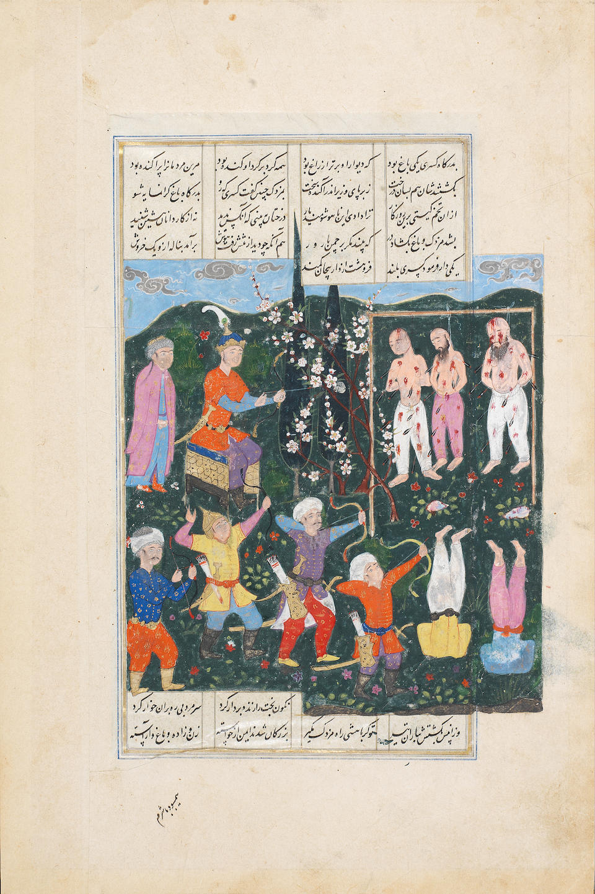
Kavad Regained Kingship
Kavad put an army together, and with help of the Hephthalites, they marched to Persia
He regained his kingship in 498 CE
He then abandoned the Mazdak religion and imprisoned the followers of Mazdakism

Slide 9
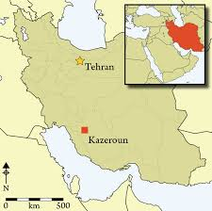
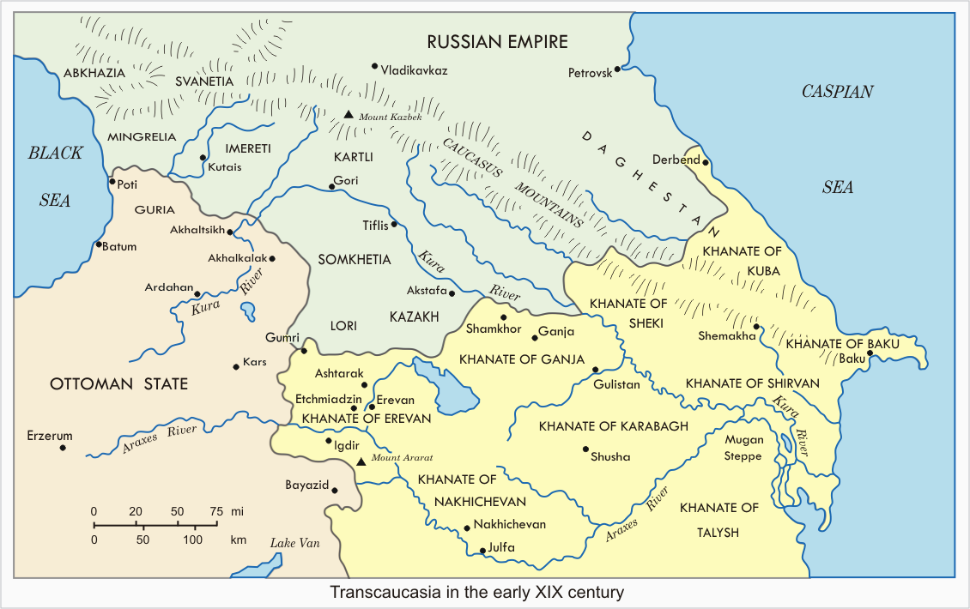
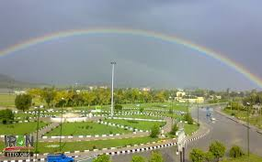
Kavad’s Accomplishments
Kavad secured Iran’s borders
He established many cities including, Kazeroon in Pars and Gangeh in Ghafghaz (currently part of Russia)
He began planning a tax system to ensure fair collection and minimize corruption
This system was put in use during his son’s reign, Khosrow I

