Slide 1
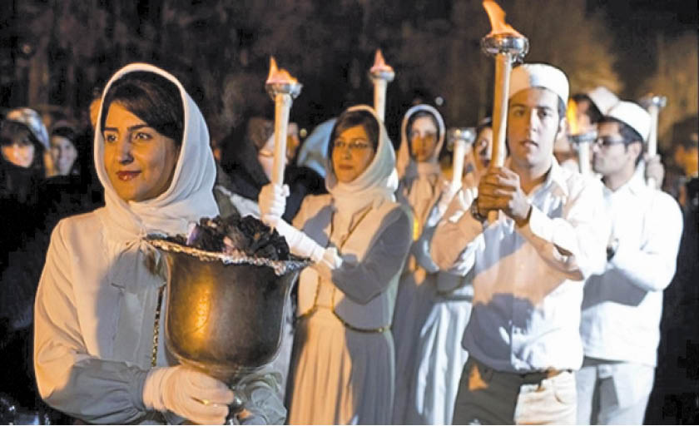
Zoroastrians in Iran 1800-2023
Post-Sassanid Empire
Lesson 5

Slide 2
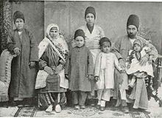
Background
After the Islamic Arab invasion of Iran in 636 CE, religion minorities in Iran specially Zoroastrians were severely persecuted.
A population of once millions fell to about 7000 by the 1800’s
The Zoroastrians in India (Parsis) established an organization and funded the expedition of Maneckji Limji Hataria to Iran
The purpose of this expedition was to evaluate the condition of Zoroastrians in Iran

Slide 3
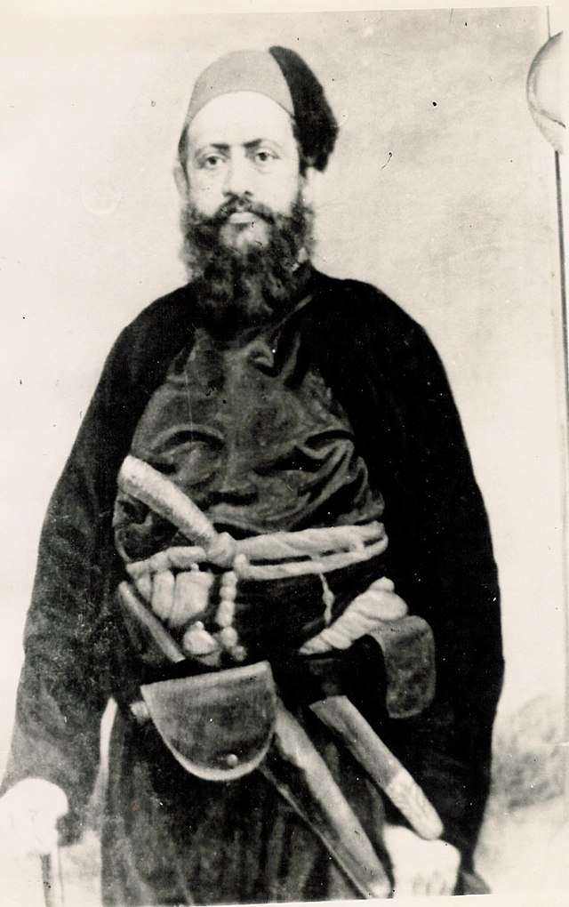
Seth Maneckji Limji Hatari (1813-1890)
Maneckji was born in a small village near Surat, India
He was brought up to take pride in his cultural heritage and history of ancient Iran
He was fluent in Gujarati, English, Urdu, and Farsi
The reports on the dire conditions of the Zoroastrians in Iran, initiated an expedition by Maneckji on behalf of the Society of Amelioration of the Condition of Zoroastrians in Persia

Slide 4
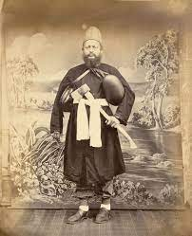
Maneckji’s Arrival
Maneckji arrived on the shores of Iran in Spring of 1854
Upon visiting Zoroastrians in Iran, he wrote:
I found [them] to be exhausted and trampled, so much that even no one in this world can be more miserable than them

Slide 5
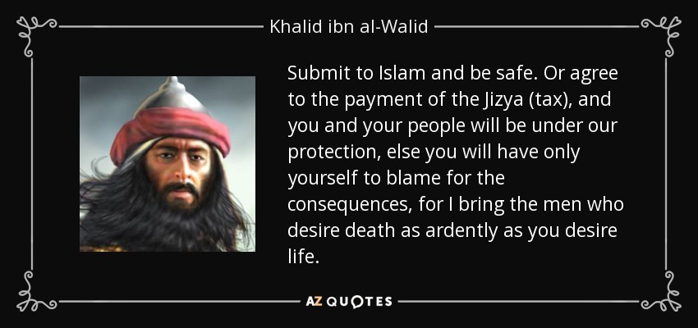
Maneckji’s Evaluation
Maneckji’s report indicated that the dire condition of Zoraostrians in Iran were mainly due to:
Jizya- extra tax enforced on Zoroastrians
Demeaning laws posed an inferior status of Zoroastrians
Lack of leadership in the community
Lack of community funds
Fear of persecution
Poor condition of places of worship and burial sites

Slide 6
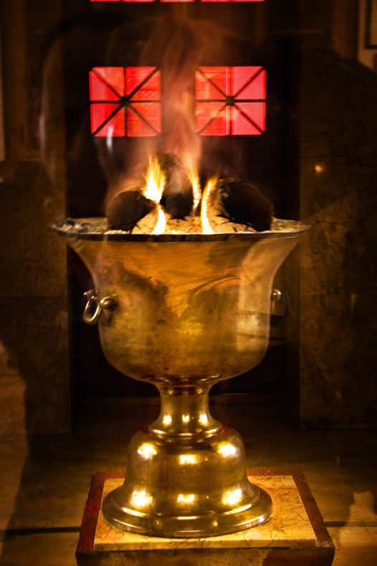
Plan of Action
A fund was provided by Parsis to revive the Zoroastrian community in Iran
Maneckji’s strategy was :
To end Jizya
To end Social and legal discriminations
Build educational institutions
Reform religious practices
Foster leadership in communities
Raise the status of the Zoroastrian religion and community in Iran

Slide 7
Maneckji’s Accomplishemnts
Maneckji spent 30 years in Iran and through diplomacy, gifts, political pressure through contacts in India, Iran, and Britain he accomplished the following
Restoration of Atash Bahram in Yazd to boost morale
New Dar-e-Mehrs and dakhmas were built
It took 26 years and hefty funds to abolish jizya for all minorities
Establishment of free schools for boys and girls
Religious reforms
Leadership and Anjumans
Raising the status of Zoroastrian religion

Slide 8
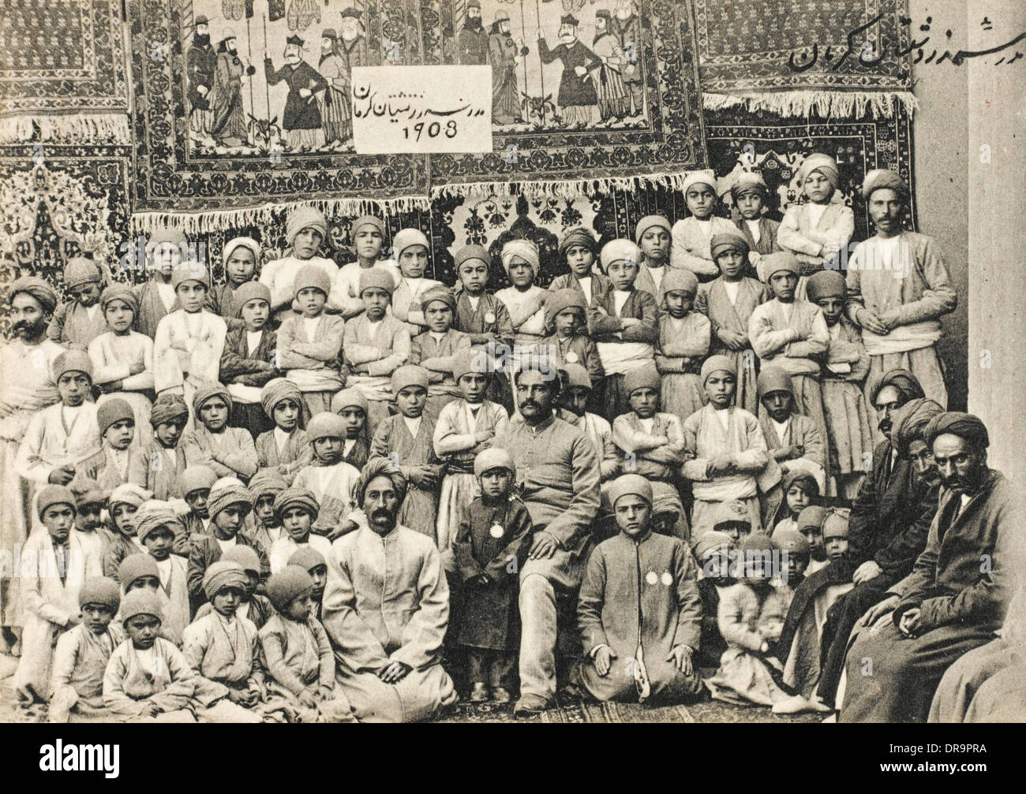
Between 1860-1882 free schools were set up for boys and girls
Parsi teachers came to Iran and Iranian teachers were sent to India for training
Focus of the curriculum was on science and English
Maneckji provided generous grants so boys could stay in school and later travel to India for further studies
This fund helped the families who needed their boys to work to help support the family

Slide 9
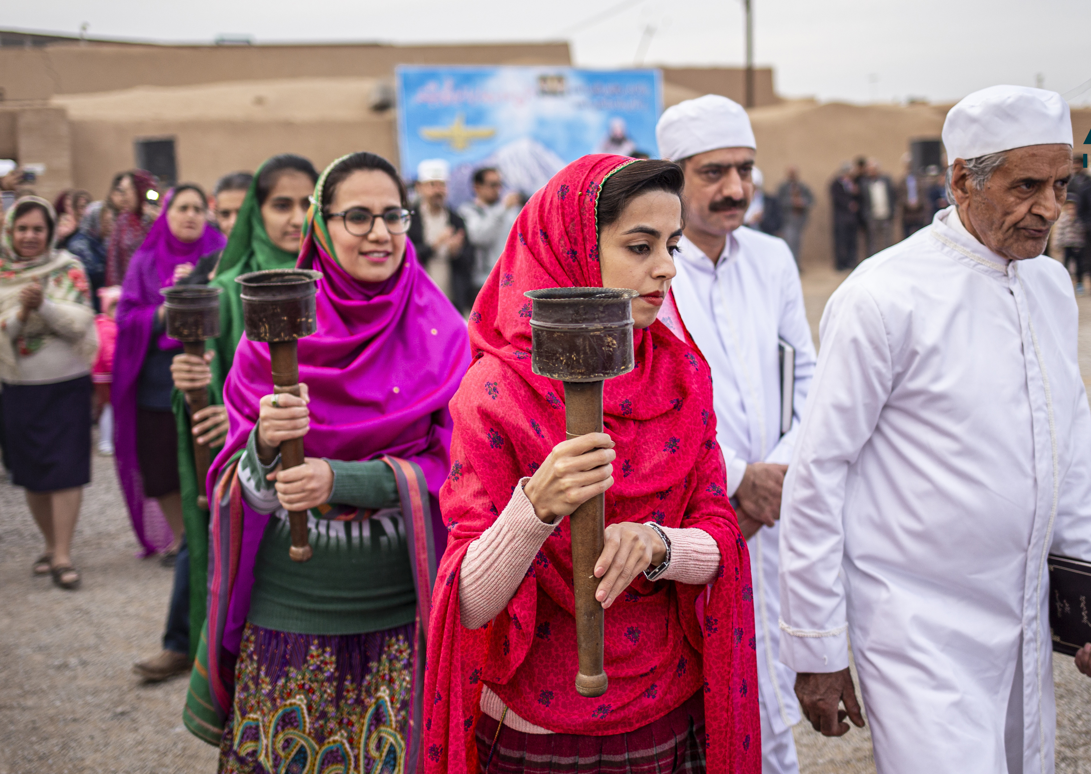
Religious Reforms
Animal sacrifice was abolished
Zoroastrian laws of marriage and divorce was reinforced
Polygamy was discouraged
Dowry to poor Zoroastrian girls was provided
Zoroastrian religious festivals including gahanbars were re-started
Zoroastrians gained confidence to wear the sedreh and koshti again

Slide 10
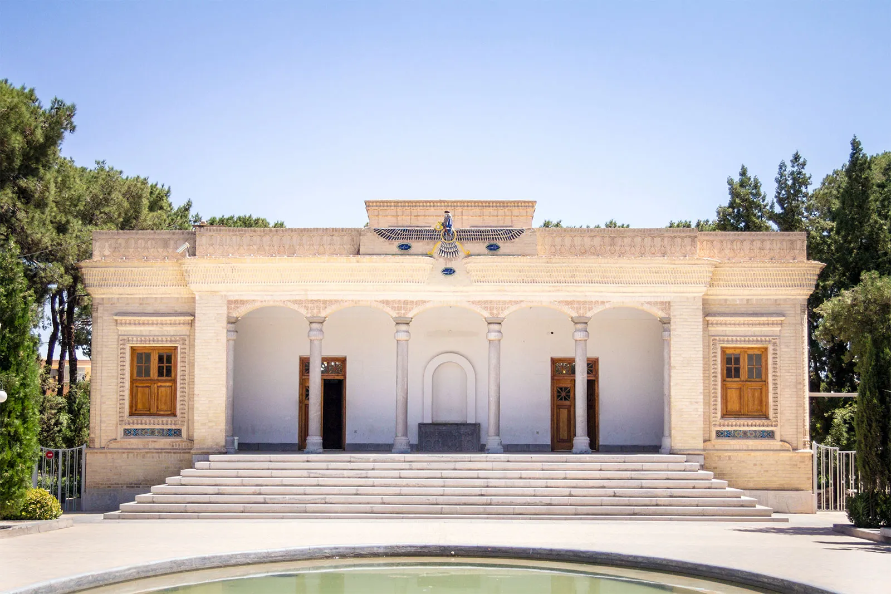
Leadership in Anjumans
Maneckji established the first Anjuman in Yazd and Kerman
Anjumans were formed in Tehran, Isfahan, Karaj, Shiraz, and Zoroastrian villages
He formed a group of elders to oversee community matters
Enabled anjumans to set up waffs or religious trusts focused on charitable donations
This allowed anjumans to maintain schools, hospitals, places of worship, dakhme and other necessary functions
Oversaw the building of Atash Kadehs, qanats, and badgirs
Encouraged Parsis to fund medical buildings, clinics, and sent doctors from India to Iran

Slide 11
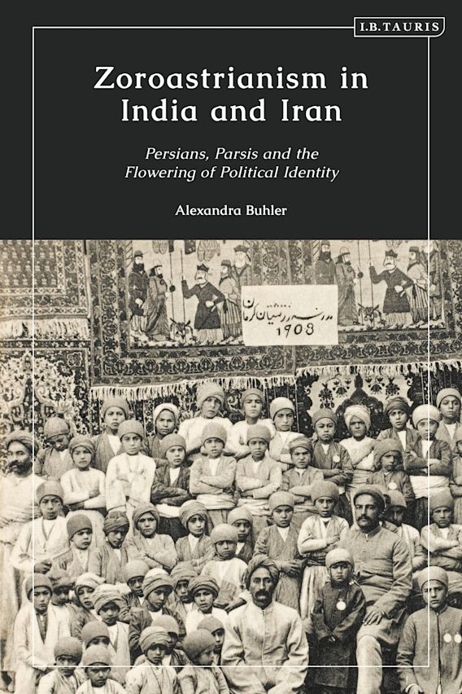
Maneckji Worked to Raise the Status of Zoroastrian Religion
Argued for Zoroastrian religion to be accepted as a “religion of book”
Associated Zoroastrian religion with the Iranian past which was attractive among progressive Muslims
As Zoroastrians became educated their economic conditions improved
They participated in civil struggles and political rights

Slide 12
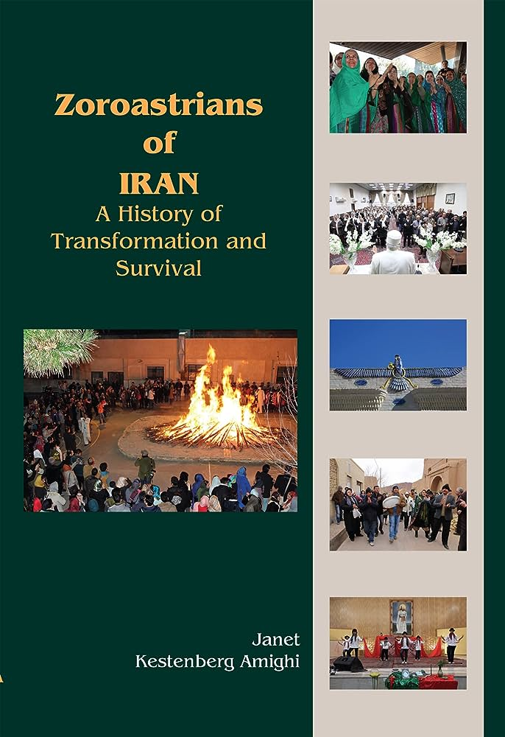
Iranian Nationalism in the Early 20th Century
Iranian and Indian Zoroastrians worked together to raise awareness about Zoroastrian faith and pre-Islamic national identity

Slide 13
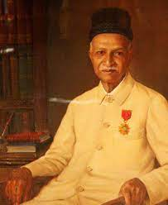
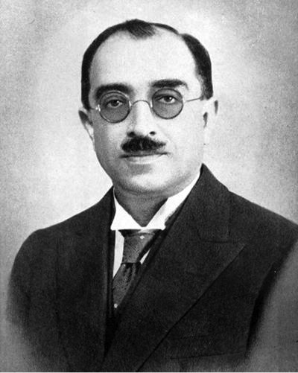
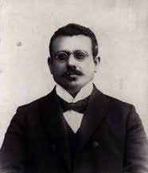
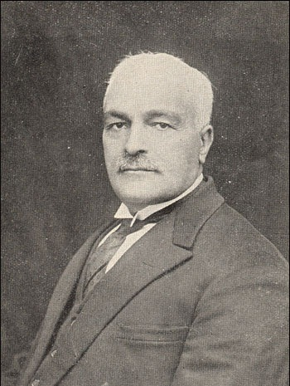
Some Notable Zoroastrians of the Time
Peshotanji Dossabhai Marker (1871-1965)
Built schools and education-based facilities in Iran
Ardeshir Edulji Reporter (1865-1932)
Lived in Iran for more than 30 years assisting Marker in the construction of Marker Orphanages in Yazd, high schools, and primary schools
Keikhosrow Shahrokh (1875-1940)
Published two instrumental books used as curriculum in Zoroastrian founded schools in Iran
Served on Iranian Parliament
Established the Ferdowsi memorial building in Tus
Dinshah J. Irani (1881-1938)
Established two civic organizations that were instrumental in teaching about pre-Islamic history and Zoroastrian religion

Slide 14
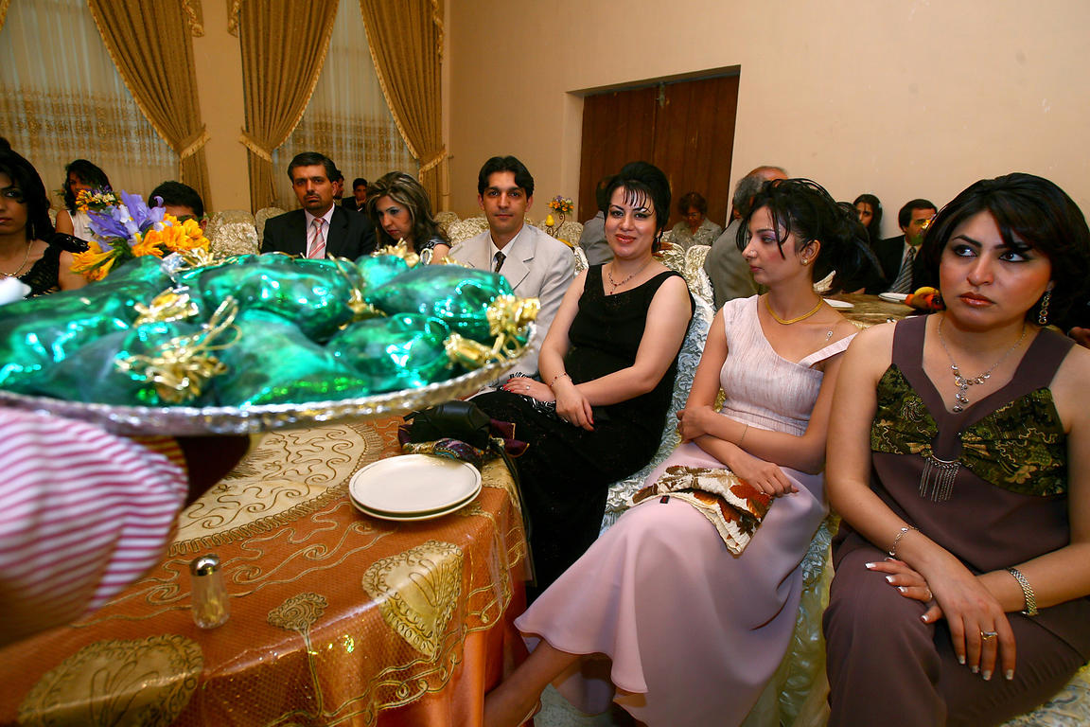
Urban Migration
As Iranian Zoroastrians became more educated, and less persecution was implemented, they moved out of desert areas of Yazd and Kerman to urban areas and capital city of Tehran for economic opportunities.
Some of these individuals became successful and gave back to the country and Zoroastrian community

Slide 15
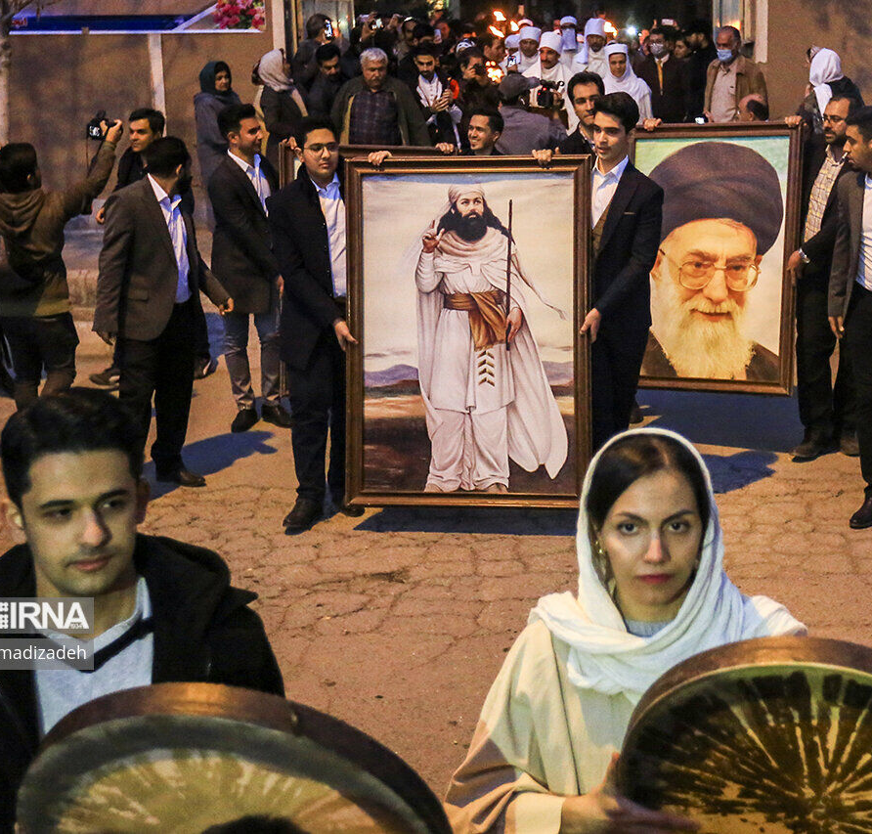
Zoroastrians After Islamic Republic of Iran (1979)
Some of the old discriminations and persecutions were implemented
Pressure on children to attend Islamic classes
Some consider Zoroastrians unclean
Torture and killing of those who help non-Zoroastrians initiate to Zoroaostrian religion
Torture and abuse for voicing slightest disagreement to Islam
A sibling who converts to Islam would receive all the inheritance
Compensation for accidental death of a Zoroastrian is less than that of a Muslim
Zoroastrians are not given well-paying jobs
Top educational opportunities are denied of Zoroastrians

