Slide 1
Sassanid Empire Lesson 5 (224-651 CE)
Khosrow I

Slide 2
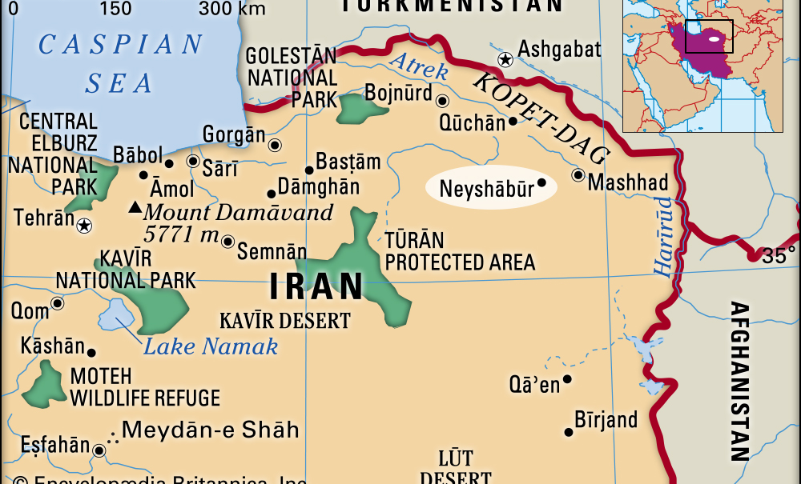
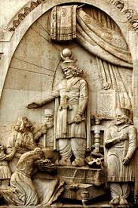
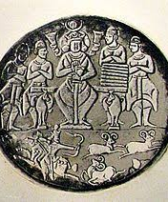
Khosrow I KhosrowAnushirvan 531-579
Kavad I’s son and his successor
Khosrow is famous for being a just and fair king, hence he was given the nickname: Khosrow Anushirvan (the Immortal Soul)

Slide 3
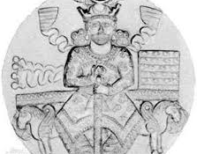
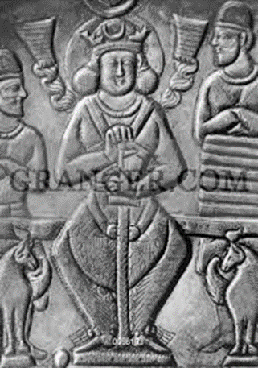
Khosrow I (531-579 CE)
Born 501 CE
Most famous of Sassanid kings
Successful in military and administrative duties
His reforms sustained the Empire for the next 100 years
Tax reforms strengthened the court by:
providing a fixed tax based on income, predicting the amount of income received
Eliminating special privileges of the local rulers and nobles who would tax others but not themselves.

Slide 4
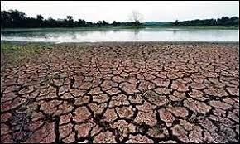
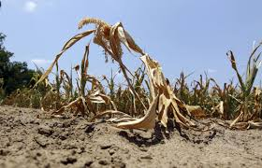
Iran in 531
When Khosrow became king:
Iran had experienced drought and shortage of food, hence people were poor
Governors or people of power were cruel to the people
Religion of Mazdak had caused division and unruliness among people especially among different socio-economic levels of people

Slide 5
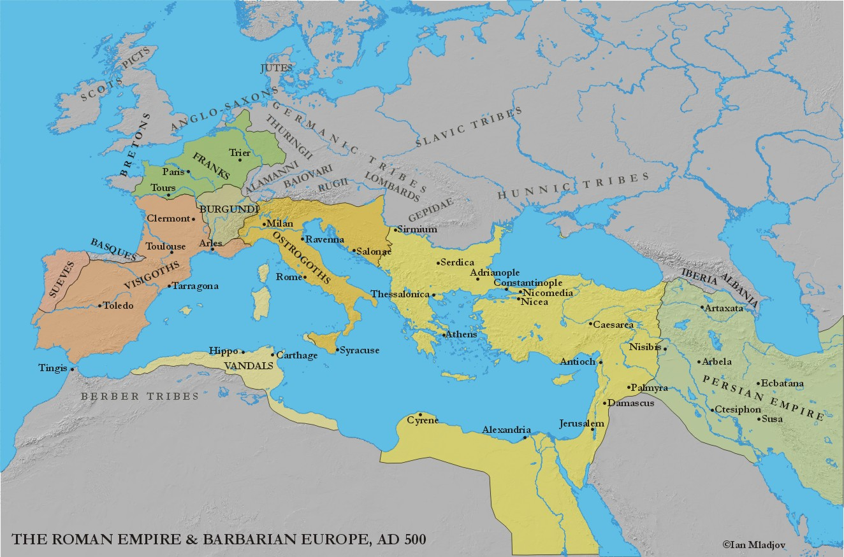
Khosrow’s Plan of Action
In order to improve the internal problems, Khosrow needed to make sure the borders were safe
He signed a peace treaty with Rome
Rome would continue paying a tax to Iran
He then concentrated on country’s internal affairs

Slide 6
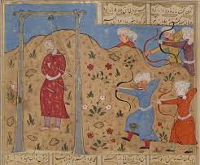
End of Mazdak
Kavad had tried to overcome Mazdakian toward the end of his reign
However, they were still powerful and caused revolts across Iran
Khosrow, killed Mazdak and put an end to his and his followers’ revolts

Slide 7
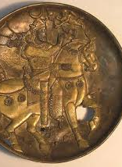
Helping People
Khosrow realized that the reason why people had joined Mazdak was because of their poor living conditions, hence he started reforms to remedy that
He put down laws so that people of power could not tax the citizens unaffordable amounts
He assigned and sent judges to each province to punish any one of power who acted unjustly towards a citizen

Slide 8
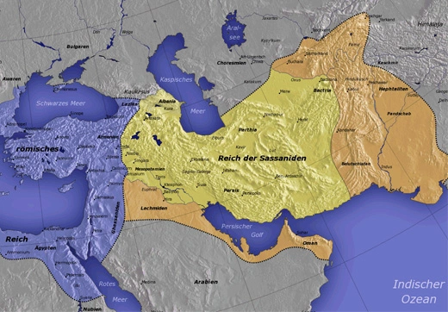
Enemies at Each Corner
Romans to the West
Huns to the East
Arabs to the South
Caucasus tribes to the north

Slide 9
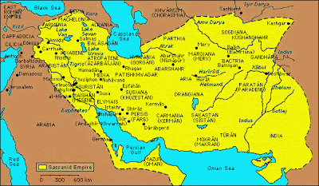
New System of Governing
Divided the country into 4 sections and assigned a governor with increased power to each section

Slide 10
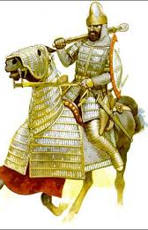
Military Reforms
Until now, when Iran went to war, men from all over the country, would report for duty. When war was over, they would get their wages and go back to their homes
Khosrow made a permanently trained military for Iran who received regular wages and were ready to fight when needed

Slide 11
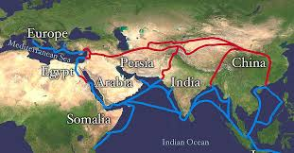
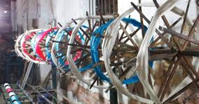
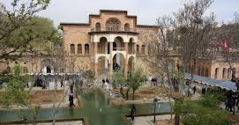
Social Reforms
Begging and not working was considered a sin and anyone who was caught begging or not contributing to society by working was punished
He encouraged and helped increase agriculture
He brought silkworms to Iran from Khatan, China
Neel was brought from India
By improving the roads and safety, he encouraged trade.
During his reign, Iran became one of the most important centers of trade

Slide 12
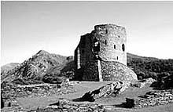
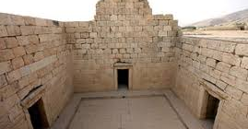
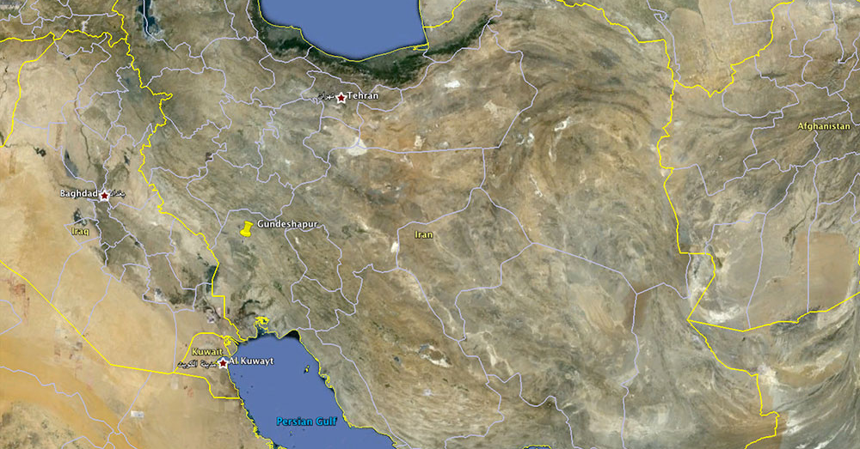
Khosrow the Seeker of Knowledge
He gave great importance to knowledge, the arts and built many universities
The most famous was Academy of Gundeshapur – Physicians from all over the world including India, Rome and Iran gathered there
Sought texts and translated them to Middle Persian and other languages- These texts were later taken by Arabs and then passed to European Culture.
These texts included:
Greek philosophies
Iranian religious texts
Indian works

Slide 13
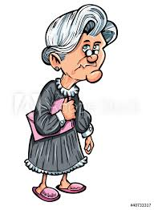
He was Famous for Being a Just King
There have been many stories about his fairness as a king
One example:
A Roman minister visited Ctesiphon,. The king’s representatives gave him a tour of the King’s splendid castle. The Roman minister was amazed when he noticed a section of the wall which was bent and not straight. He inquired about the reason. The King’s representatives explained that the area beyond the wall belonged to an old lady. When they had tried to purchase her home in order to properly build the castle, the old lady refused. Saying that she had lived in the house her whole life and she did not wish to move. The people in charge, took the news to the King, Khosrow Anushirvan ordered to build the wall so that no harm comes to the old lady’s home
Upon hearing this, the Roman minister said that the bent wall was more beautiful than any straight wall he had seen

Slide 14
Promoter of Education
Many books written in Seryani, Indian, Sanskrit, and Greek were translated to Pahlavi during his reign
Commentaries on Avestan texts (Zend Avesta) continued
The famous book of Kalila and Dimna was brought to Iran during his reign and translated to Pahlavi and later it was translated to Arabic
Gundashapur University which was advanced in medicine was promoted even further during his reign
He respected people of knowledge
During his reign a few Roman philosophers who were treated badly in Rome, asked to seek refuge in Iran, Khosrow took them in and showed them respect and supported them. When they decided to go back to Rome, he included their safety in his treaties
Bozorgmehr was his famous minister who was very educated in Persian literature and was famous for his good character

Slide 15
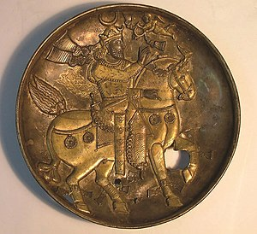
Khosrow Anushirvan’s Death
Khosrow Anushirvan reigned for 48 years
He died on January 31, 579 CE at 77 years of age
During his reign, the Empire had reached its greatest extent since Shapur II which ranged from Yemen in the West and Ghandahar in the East
He is beloved among Iranians and remembered as a great king

