Slide 1
Zoroastrians Around the World
Lesson5
Post Sassanid Empire

Slide 2
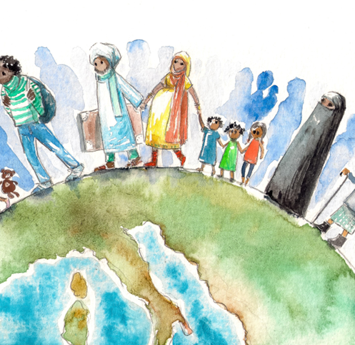
Migration
Since the dawn of time humans have migrated from their place of origin due to different reasons
Favorable lands for agriculture
Better living conditions
Escape from persecutions
Zoroastrians have migrated since the beginning of our religious history for reasons such as
Commerce and trade
Escape from Persecution
Educational opportunities

Slide 3
Zoroastrians around the globe
Today Zoroastrians are scattered around the globe, practicing their religious and cultural faith

Slide 4
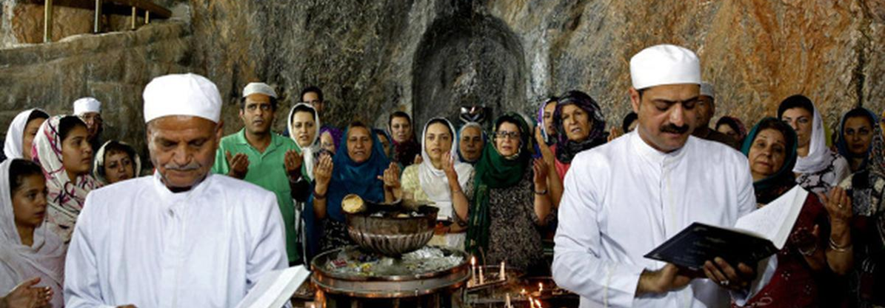
Zoroastrians in Iran
The main Zoroastrian migration out of Iran was some centuries after the Islamic Arab invasion of Iran in 631 CE
Zoroastrians decides to leave Iran due to extreme political, social, and religious persecution by the Muslim ruling class
Zoroastrians migrated to different countries, but the vast majority chose India as their new home
At the end of Qajar and during the Pahlavi era Zoroastrians in Iran flourished due to the aid from the Parsis and the established religious freedom by the Pahlavi Kings

Slide 5
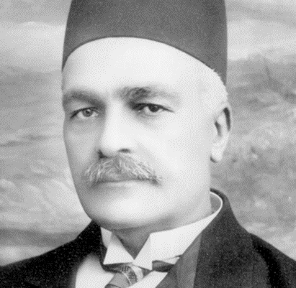
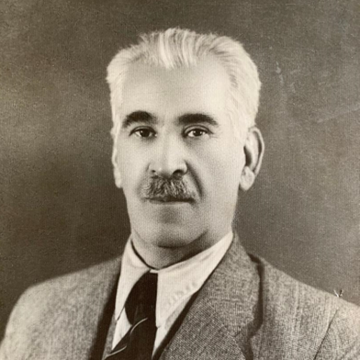
Examples of contributions by Iranian Zoroastrians
Keykhosrow Shahrokh
Director of coronation of Ahmad Shah Qajar and Reza Shah Pahlavi
Supervisor to the building of the Ferdowsi Mausoleum in Tous
Head of the Audit Department and Telephone Company in Iran
Goshtasb Firoozgar
Donated Firoozgar Hospital
One of the largest and modern hospitals in Iran today
Parimarz Firoozgar
First woman mayor and small claim court judge in Iran
Farangis Shahrokh
Improved the conditions of women prisons and orphanages
Founding member of Zoroastrian Women’s Organization and Iranian Handicraft Organization

Slide 6
Modern Day Iranian Zoroastrians
The persecution of Zoroastrians has resumed under the Islamic Republic of Iran forcing many Zoroastrians to migrate out of Iran to other countries

Slide 7
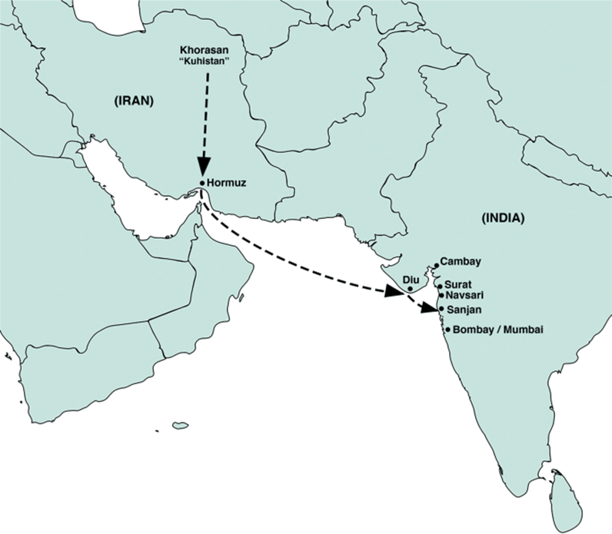
History of Zoroastrians in India
The main migration happened around the 8th century CE
Zoroastrians who migrated to India are known as Parsis because they migrated from Persia
They were an agricultural community for about 800 years
With the establishment of the British trading post in Surat, they became successful in trade and other commerce

Slide 8
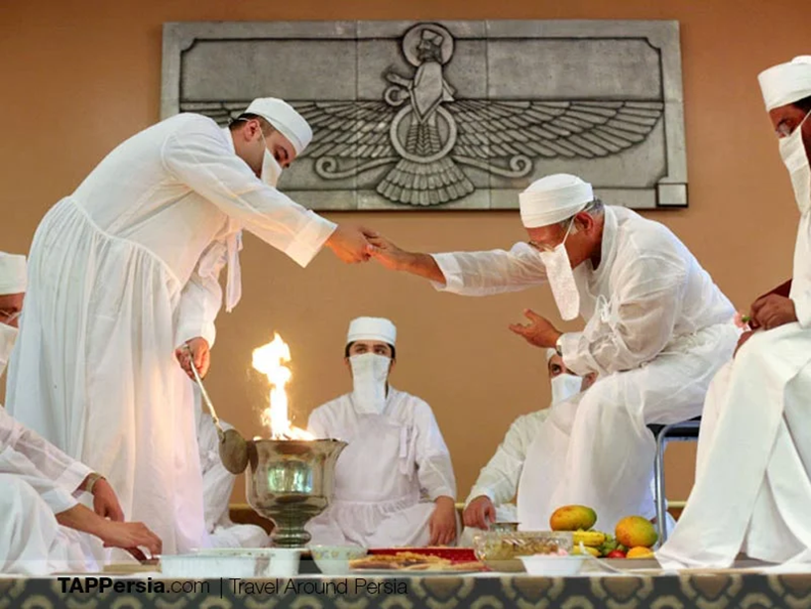
Contact between Zoroastrians in Iran and India
The contact between the Zoroastrians in the two countries was very limited
Around 1477-1768 letters were exchanged regarding matters of ritual and law known as the Rivayats
In 1800s the Parsi came to the aid of the Zoroastrians in Iran and helped improve their living conditions.

Slide 9
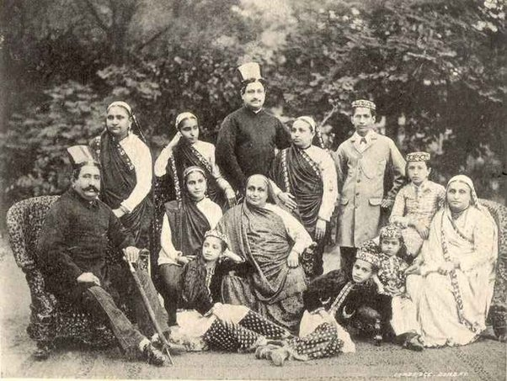
Accomplishments of Zoroastrians in India
Zoroastrians in India became a well-known and respected community involved in trading, heavy industries (railways and shipbuilding) and other commerce.

Slide 10
Examples of contributions of Zoroastrians in India
Some notable Zoroastrians in India include:
Fali S. Nariman
Contributed to jurisprudence and public affairs
Ratan Tata
Global business giant
JRD Tata
First licensed pilot in India
Homi Bhabha
Physicist and instrumental in starting India’s nuclear program

Slide 11
Modern day Zoroastrians in india
Most Zoroastrians live in Mumbai and surrounding areas
The number of Zoroastrians in India is on decline as they migrate to other countries

Slide 12
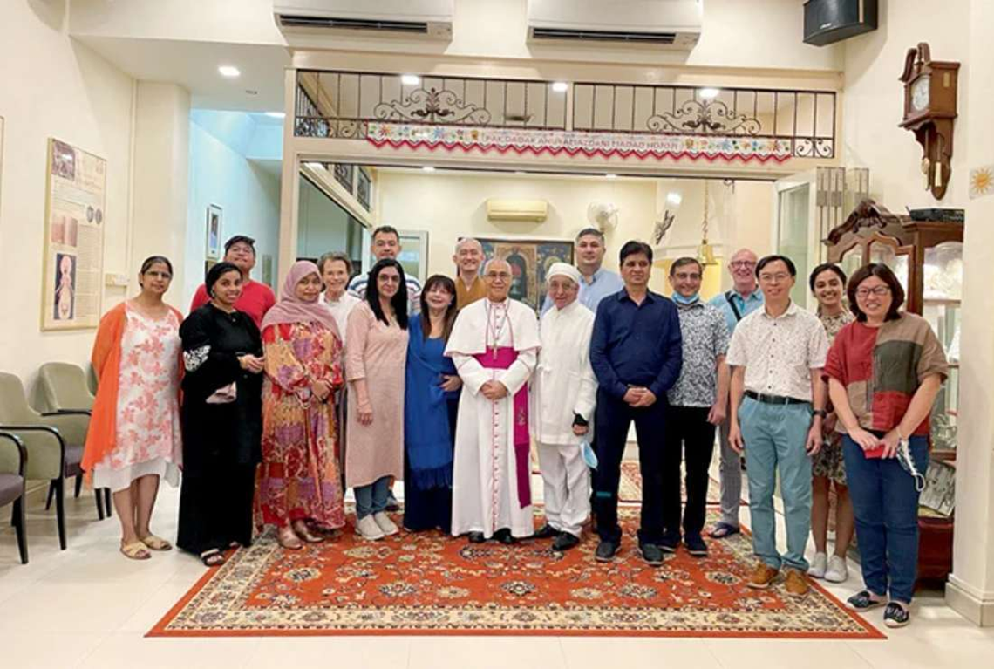
Zoroastrians in Singapore
The first known Zoroastrian entered Singapore in 1827
In 2017 the Zoroastrian population in Singapore grew to 350
The first Zoroastrian migrants were traders and agents with a Parsi firm
Parsis contributions in Singapore
Tanjong Pagar Doc Company which later became the Port of Singapore Authority
Built ships to travel between India and Singapore
Parsi theater group inspired the creation of several theater groups
First cinema film was shown in Singapore by a Parsi

Slide 13
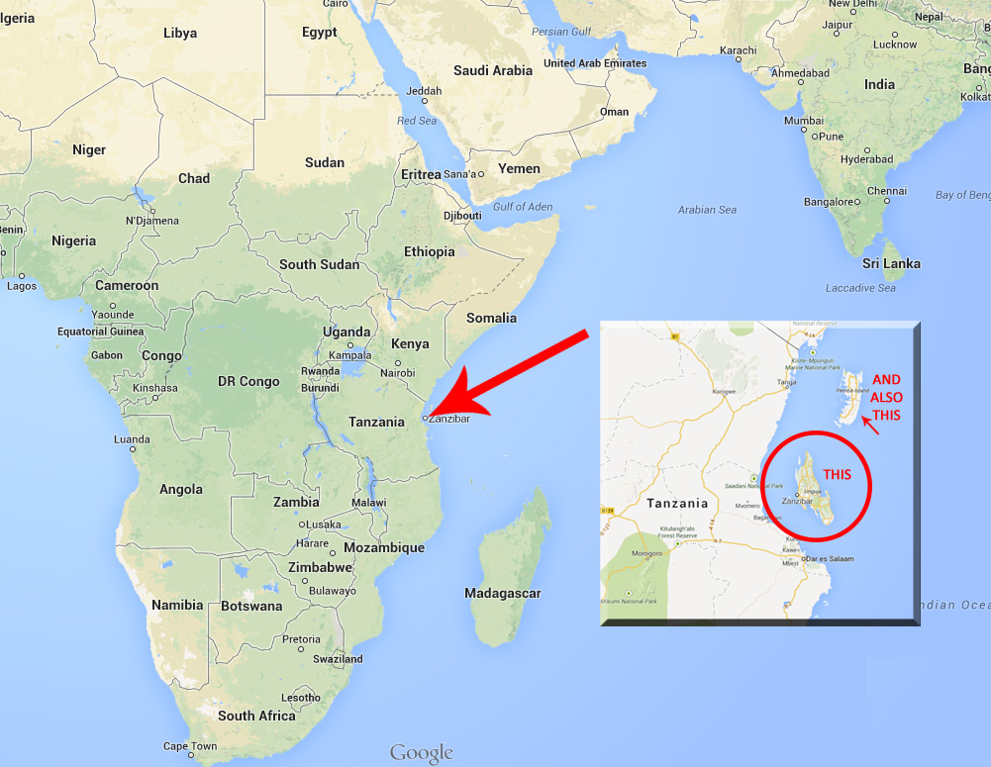
Zoroastrians in Africa
There is an account of Parsi migration to East Africa, Zanizbar in about 1845
They were traders and businessmen
A Zoroastrian Anjuman was founded in 1875
Dr. Pestonji B. Nariman, a Zoroastrian was Sultan Barghash’s personal physician
Freddy Mercury was born in Zanzibar and later migrated with his family to the UK

Slide 14
Zoroastrians in Pakistan
As Pakistan was part of the Achaemenid Empire, Zoroastrians had settled there for a long time
Zoroastrian settlement in Pakistan flourished in about 1947
The settlers were mainly tradesmen
Anjumans, charitable trusts, schools, hospitals, centers of social, cultural and sport, fire temples and towers of silence were built.
Today there are few Zoroastrians living in Pakistan and most have migrated to other areas.

Slide 15
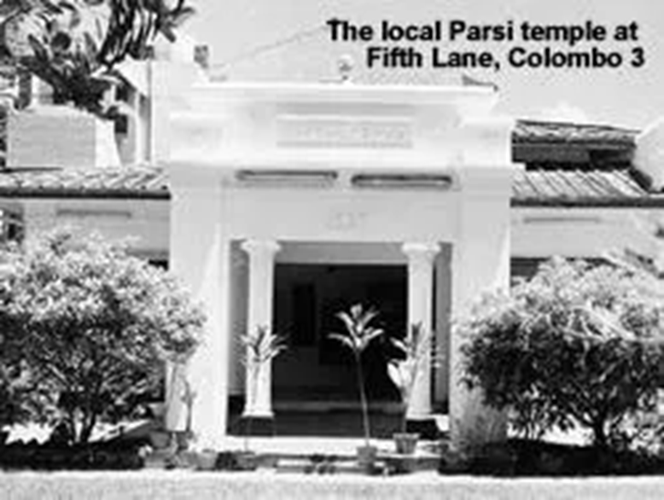
Zoroastrians in Sri Lanka
Zoroastrian gravestones have been found in Ceylon around 1603
The migration due to trade continued during the 18th century
They initially worked as planters on coffee and tea estates and later moved to professions such as law and medicine
After Ceylon became independent many Parsis left Sri Lanka and this migration continued after the official language was changed to Ceylon
Ceylon Parsi Anjuman was established in 1939

Slide 16
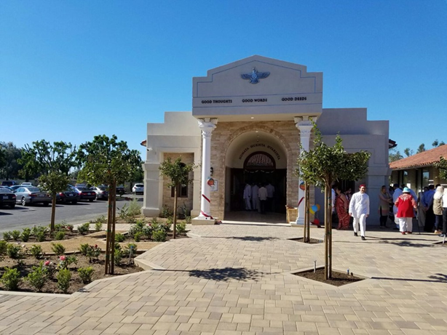
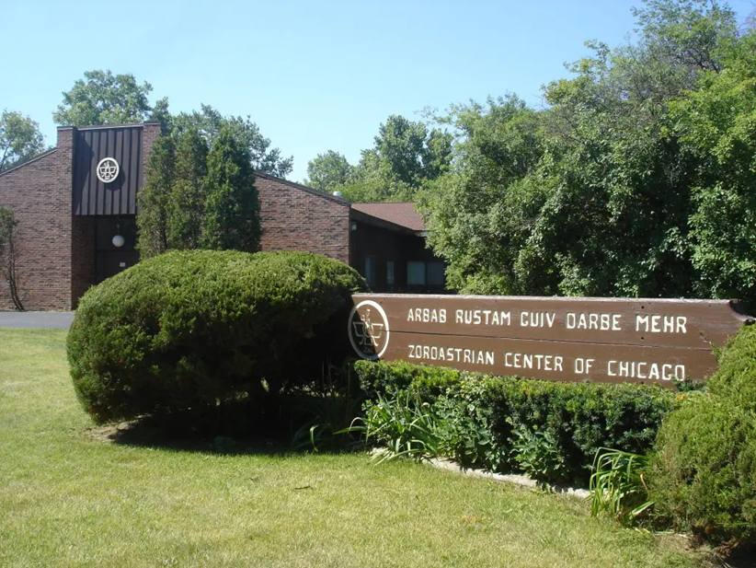
Zoroastrians in us and Canada
The first known Zoroastrian to settle in North America was in 1892
Zoroastrian migration to US and Canada has been on the rise ever since.
In recent years due to the Islamic Revolution of Iran an even increasing number of Zoroastrians have migrated to North America seeking better education, job opportunities and escaping persecution in Iran.
Zoroastrians are productive and successful in different professions in the US and Canada
Many Zoroastrian associations have been built across US and Canada mostly due to Rostam and Morvarid Guiv charity

Slide 17
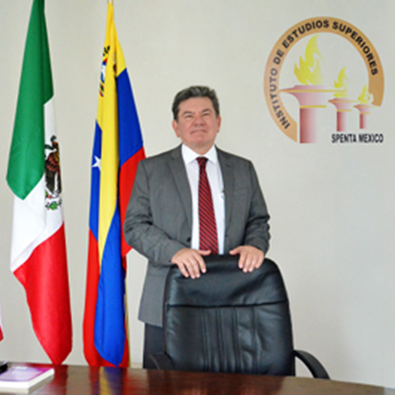
Zoroastrians in south america
A small community of Zoroastrians exist in South America
Latin America Spenta University Foundation concentrates on teaching the ethical dimensions of management influenced by Zarathushtra’s teachings

Slide 18
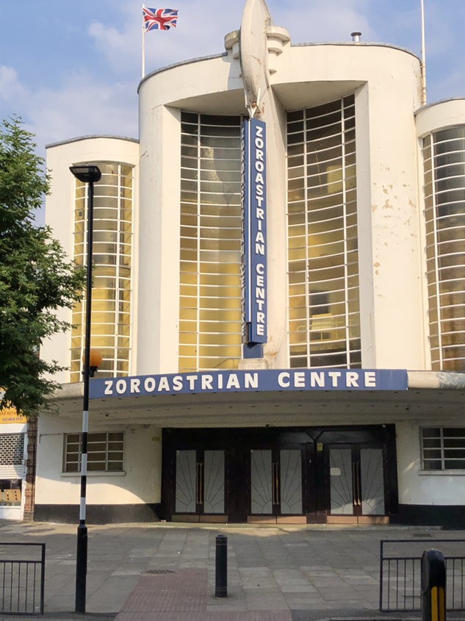
Zoroastrians in the united kingdom
The first known Zoroastrian to visit the UK was in 1724
In 1855 the first Asian and Zoroastrian firm was set up in the UK
Between 1890-1935 Zoroastrians were involved in Britain’s political life and were elected to the House of Commons
World Zoroastrian Organization and The Zoroastrian Trust Funds of Europe are among Zoroastrian organizations in the UK

Slide 19
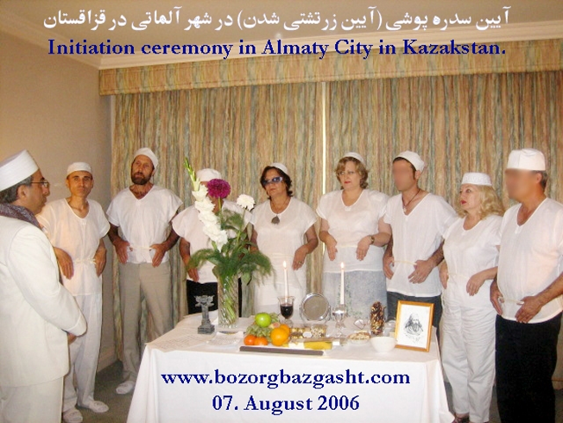
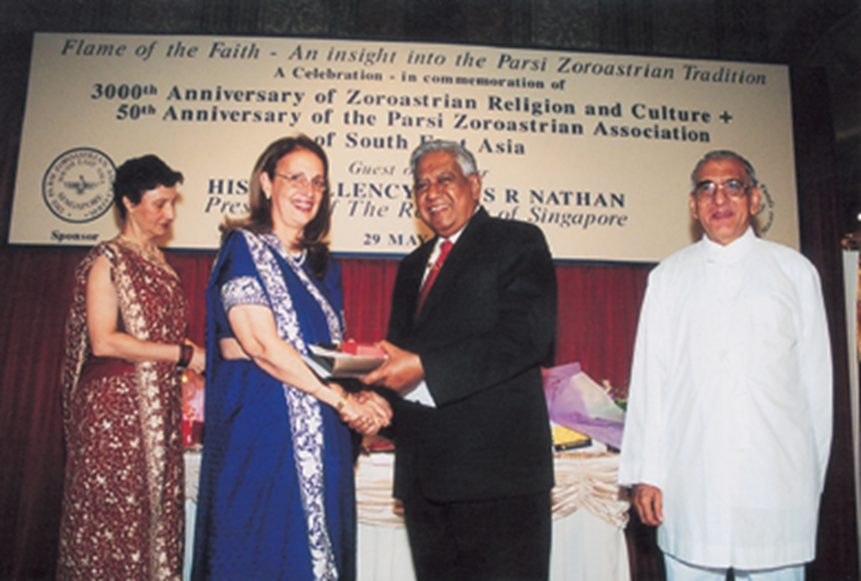
Zoroastrians in Europe and central Asia
Zoroastrians are scattered all along Europe and Central Asia including Germany, Sweden, and France

Slide 20
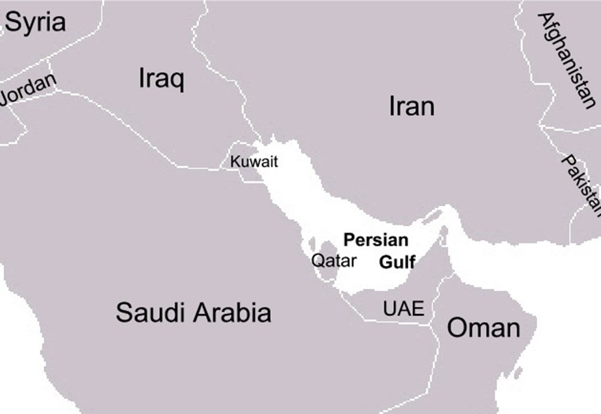
Zoroastrians in the Persian gulf
There are Zoroastrians residing in the United Arab Emirates, Oman, Qatar, Bahrain and Kuwait
Since the 1979 Islamic Revolution of Iran the number of Zoroastrian immigrants in the area has increased.
Zoroastrians follow the religious practices in their private homes

Slide 21
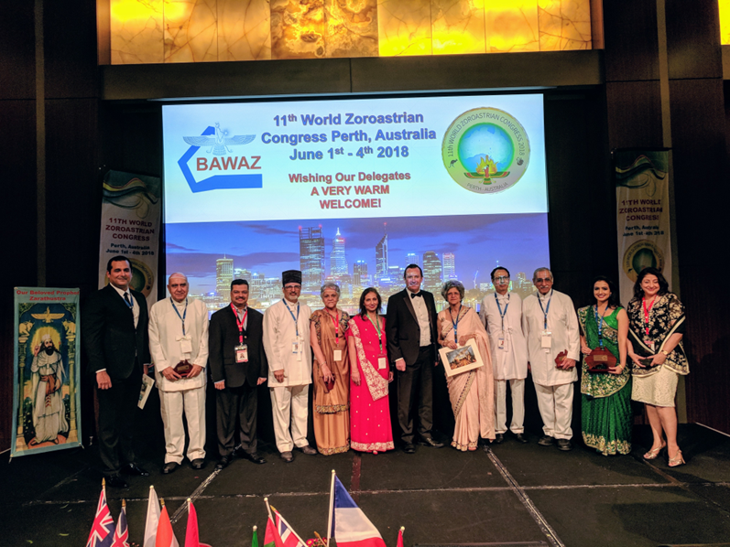
Zoroastrians in Australia
Zoroastrians settled in Australia before the 1950’s
Since 1960 a steady growing number of Zoroastrians migrated to Australia, this number has further increased due to the Iranian Islamic Revolution.
There are many Zoroastrian organization in Australia such as Zoroastrian Association of Sydney

Slide 22
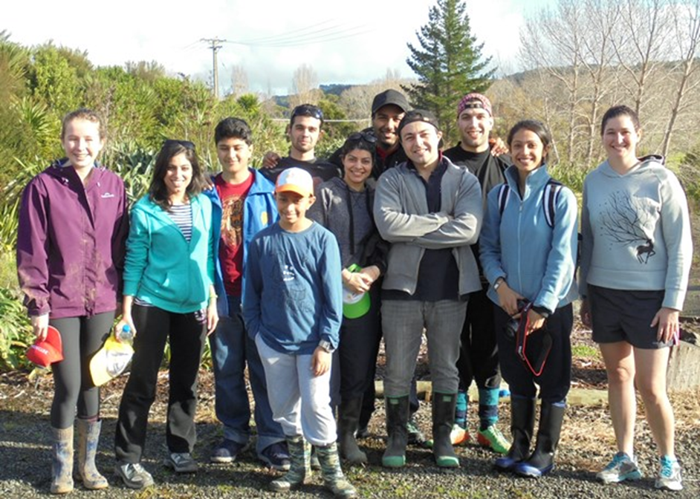
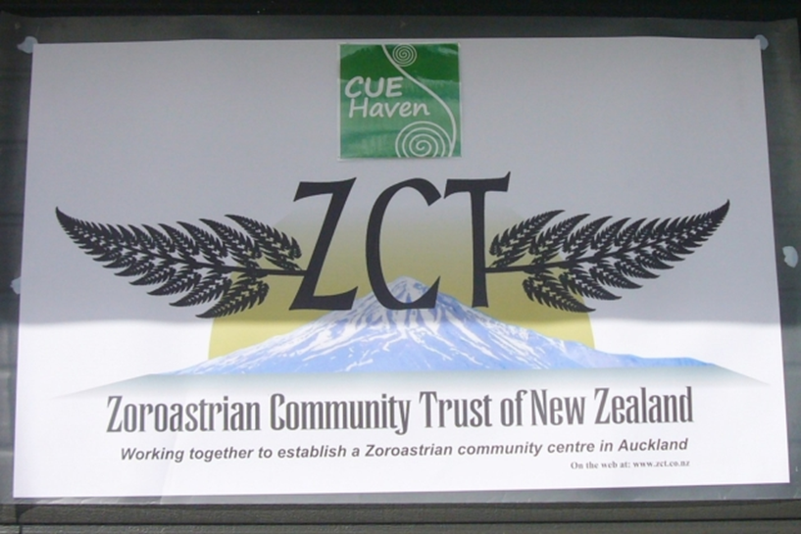
Zoroastrians in new Zealand
The first know Zoroastrian family to settle in New Zealand started a business ‘Shroff and Sons’ which is still open and run by the descendants
The Zarathushtrian Association of New Zealand is one of the existing organizations in the area

Slide 23
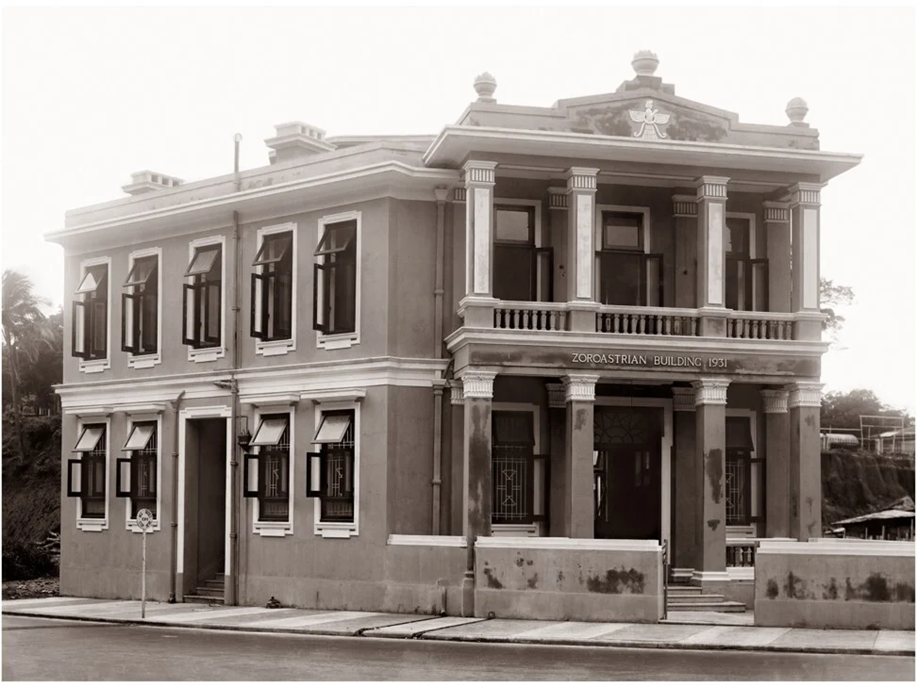
Zoroastrians in Hong Kong and Japan
Zoroastrians have lived in China as far back as 100BCE during Parthian Empire
Yazdgerd III’s son and his family took refuge in China during the 7th and 8th centuries forming Zoroastrian villages and temples
Parsi migration to Hong Kong increased especially mid 19th century due to trade and commerce
Zoroastrians in Hong Kong, served on the grand Jury, opened English school, and started a Chinese newspaper
Zoroastrian charity can be found in Hong Kong
Pesi Davar donates to education
Navroji Mistri’s trust donated to a build a wing for Singapore General Hospital

Slide 24
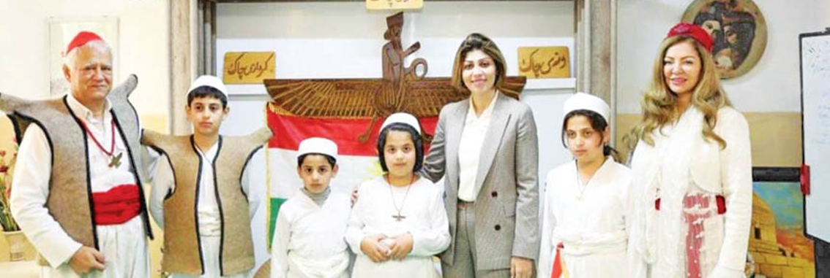
Zoroastrians in kurdistan
Kurds are descendants of Medes and Kurdish language has Avestan roots
Their language is closely related to Pahlavi, the language spoken during the Sassanid Dynasty
Today, Kurds live in parts of Iran, Turkey, Iraq and Syria
More and more Kurds are joining the Zoroastrian religion
In June 2015, the government of Kurdistan announced 100,000 citizens accepting the Zoroastrian religion

