Slide 1
Sassanid Empire Lesson 6 (224-652 CE)
Hormazd IV
Khosrow II

Slide 2
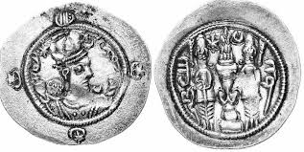
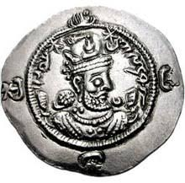
Hormazd IV 579-590 CE
After Khosrow I’s death, his son, Hormazd IV, whose mother was a Turk, became king

Slide 3
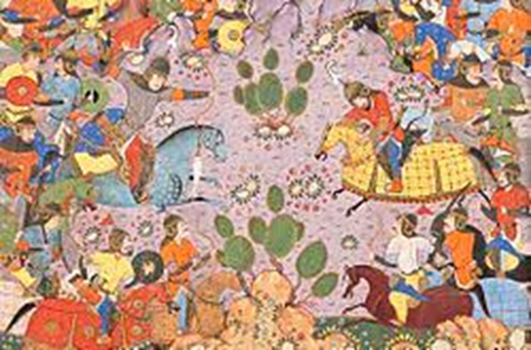
Bahram e Chobin and the War with the Romans and the Turks
During Hormazd IV’s reign, Iran was in continuous wars with the East Roman Empire and the Turks
Bahram e Chobin who was Iran’s great military man fought the Turks and won
Another war between Iran and the East Roman Empire began
Bahram e Chobin led the Iranian military, but he lost this war
Hormazd IV belittled Bahram e Chobin for his loss
Bahram e Chobin’s military men upset at Hormazd IV for disrespecting Bahram put him in jail
Hormazd IV died in jail

Slide 4
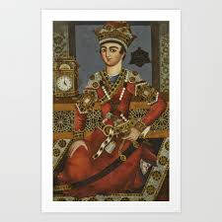
Khosrow II Known as Khosrow Parviz 590-628 CE
Bahram e Chobin had declared himself king of Iran
The Iranian nobles did not regard Bahram as the rightful heir and declared Hormazd II’s son, Khosrow II, as king

Slide 5
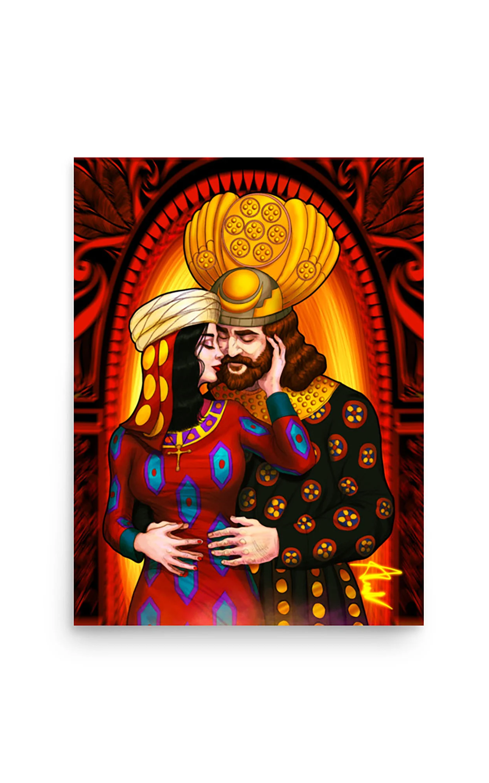
Khosrow Parviz Asks the Roman Empire for Help
Khosrow Parviz gathered his military to fight Bahram e Chobin
A surprise attack by Bahram e Chobin forced Khosrow Parviz to retreat and escape to Rome
Maurice, the Roman Emperor, accepted Khosrow Parviz and honored him
The Emperor wed his daughter, Maryam, to Khosrow Parviz and gave him an army to take back his kingship

Slide 6
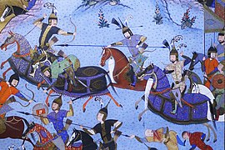
Khosrow Parviz vs Bahram Chobin
Khosrow Parviz marched to Iran with a Roman army and an army of Iranian soldiers.
He fought Bahram and won
Bahram escaped to the land of the Turkmen and was killed there.

Slide 7
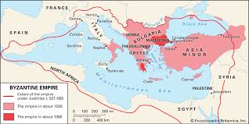
War with the East Roman Empire
While Maurice was alive, Iran and Rome enjoyed peace
Maurice was killed and his throne was not passed on to his son
His son came to Iran and asked for Khosrow Parviz’s help
Khosrow Parviz out of respect for Maurice, declared war on the East Roman Empire
In this war, Khosrow Parviz took the western provinces of Mesopotamia which were part of the Roman Empire and took their castles
Another of Iran’s troops advanced as far as Constantinople, the Roman Empire’s capital

Slide 8
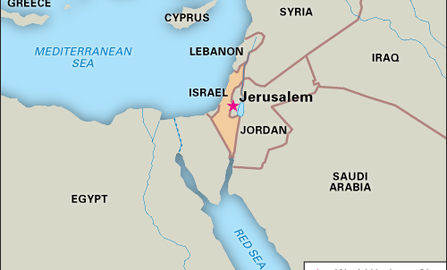
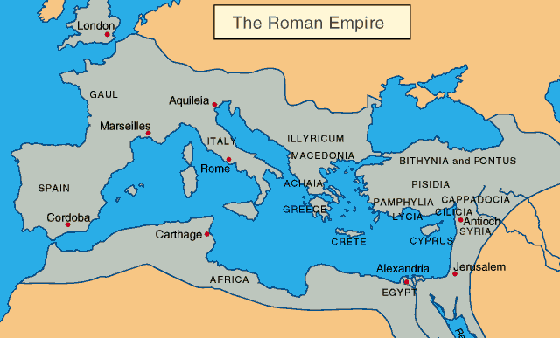
Taking Advantage of Rome’s Instability
Khosrow Parviz conquered Theodosiopolis (captured in 608), Edessa (captured in 609), Caesarea of Cappadocia (611), Antioch (612), Syria, and northern Palestine
He took the holy cross which was very sacred for Christians to Ctesiphon
With the leadership of an Iranian military commander, he took Alexandria in Egypt-an important trade center
Another of Iran’s military commanders conquered one city after another until they reached Constantinople (today’s Istanbul)

Slide 9
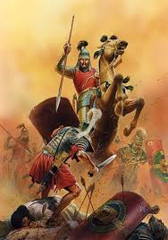
Rome Seeks Peace
The Roman Emperor sent message to Khosrow Parviz to talk peace
Khosrow Parviz refused
If he had agreed, Iran’s territory would have been close to that of the Achaemenid Empire
This refusal upset his military commanders
Romans were forced to continued the war
Romans won several battles and reached near Ctesiphon
Khosrow Parviz, panicked and escaped, however, Iran’s military men continue fighting and forced the Romans out of Iranian territory
Iran’s military men upset at Khosrow Parviz for escaping threw him in jail and killed him

Slide 10
Effects of Khosrow Parviz’s Reign
Khosrow Parviz’s long war with the Roman Empire, without a profitable victory had weakened the country
The once organized military were exhausted and weak
Many of Iran’s strong military leaders were killed in this war with the East Roman Empire

Slide 11
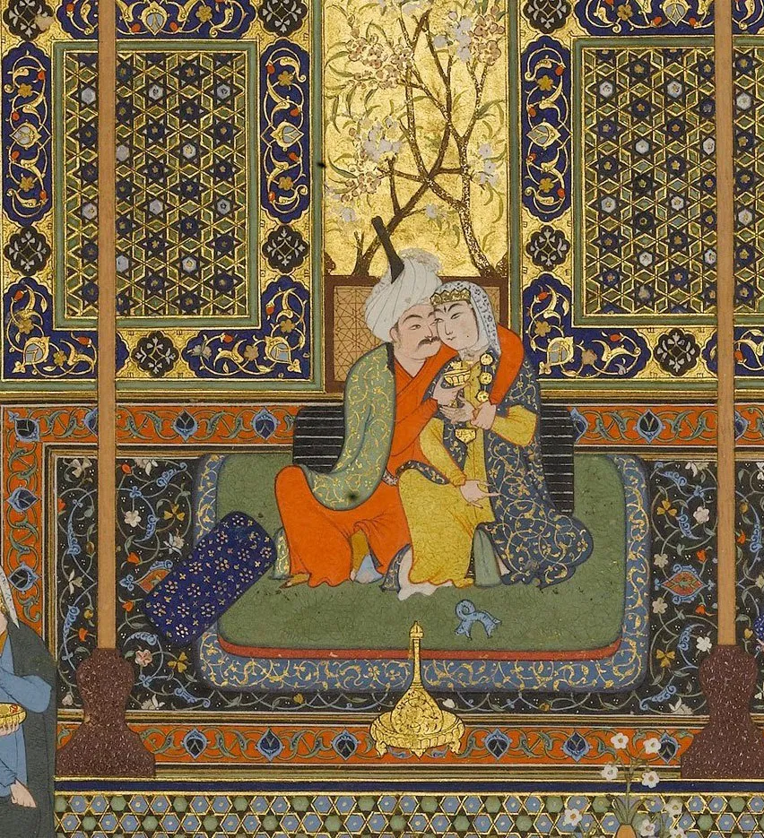
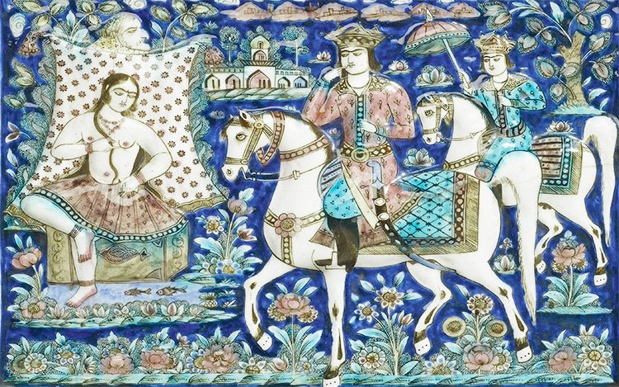
Khosrow Parviz Liked to Have Fun
Stories have been told about his love for a good time
A famous story of Shahnameh is about Khosrow Parviz falling in love with an Armenian princess named Shirin who becomes his wife

Slide 12
Sheroe 628 CE
After Khosrow Parviz’s death , his son, Sheroe, became king and renamed himself Kavad II
He made peace with Rome and gave them back Christ’s cross
He died a few months after taking the throne from the plague
His 7-year-old son, Ardeshir III, was named his successor

