Slide 1
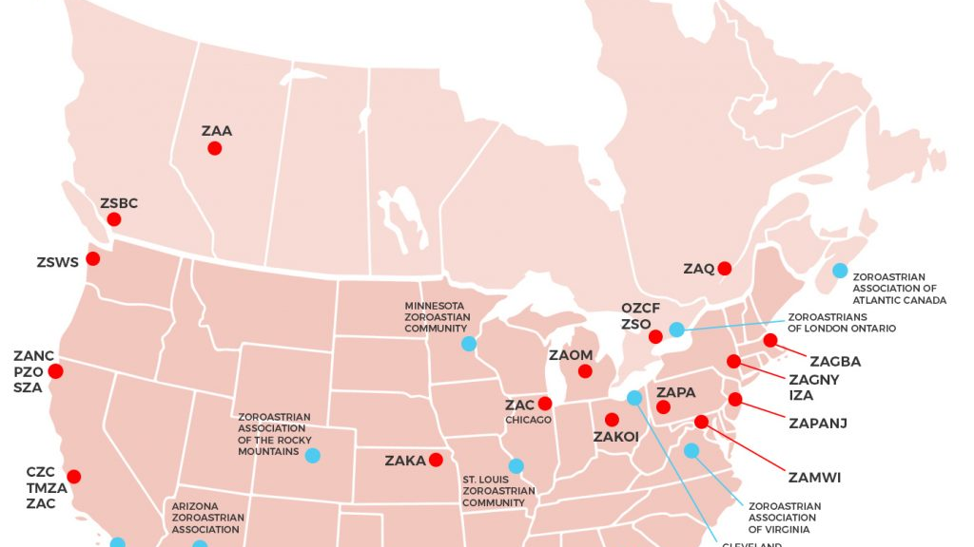
Understanding the Zoroastrian Community in North America
Post-Sassanid Empire
Lesson 6

Slide 2
Zoroastrian Migration
Zoroastrians have migrated and resided all over the globe.
At times, this migration has been on a larger scale and other times they have begun with individuals
The largest of these migrations happened after
Islamic Arab invasion of Iran in 636 CE
Islamic Revolution of Iran in 1979

Slide 3
Some Reasons for Migration
What are some of the reason people migrate from their place of origin to other areas?
Improve commerce
Better job opportunity
Education
Escape Persecution

Slide 4
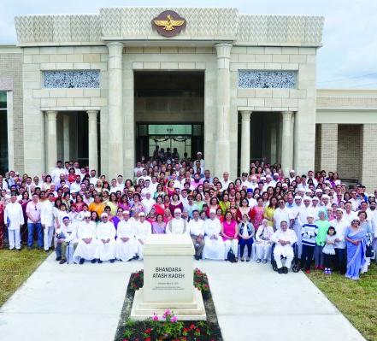
Today, many Zoroastrians live in North America
Why do you think a large community of Zoroastrians have migrated to North America?
The larger communities have raised funds and have built Darb-e-Mehrs
Smaller communities gather in private homes, parks, and community centers

Slide 5
FEZANA
Many of the North America (US and Canada) organizations are members of Federation of Zoroastrian Association of North America (FEZANA)
An umbrella organization supporting Zoroastrian centers and communities in North America

Slide 6
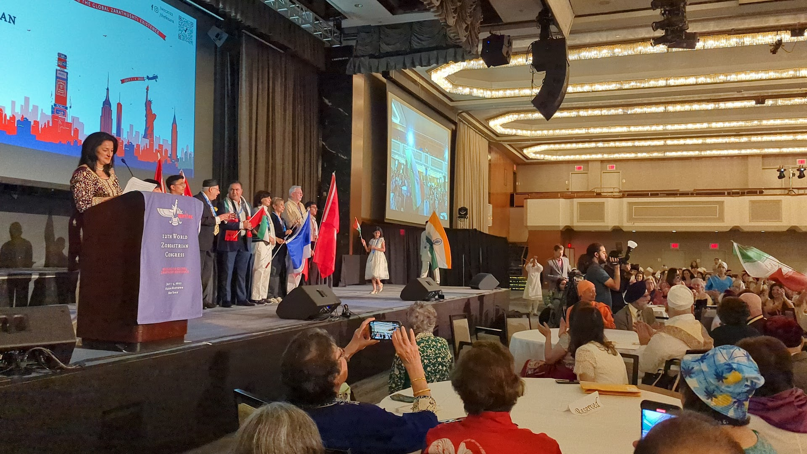
Gathering of Zoroastrian Community in NA
FEZANA Pairs up with Zoroastrian organizations to have North American Congresses
Zoroastrian Sports Committee-FEZANA
Bringing the community together through sports and social events
Various FEZANA Committees to support Zoroastrianism such as Religion Education Committee, Scholarship Committee, etc.
FEZANA Journal to share communal stories and history

Slide 7
Zoroastrian Communities in North America

Slide 8
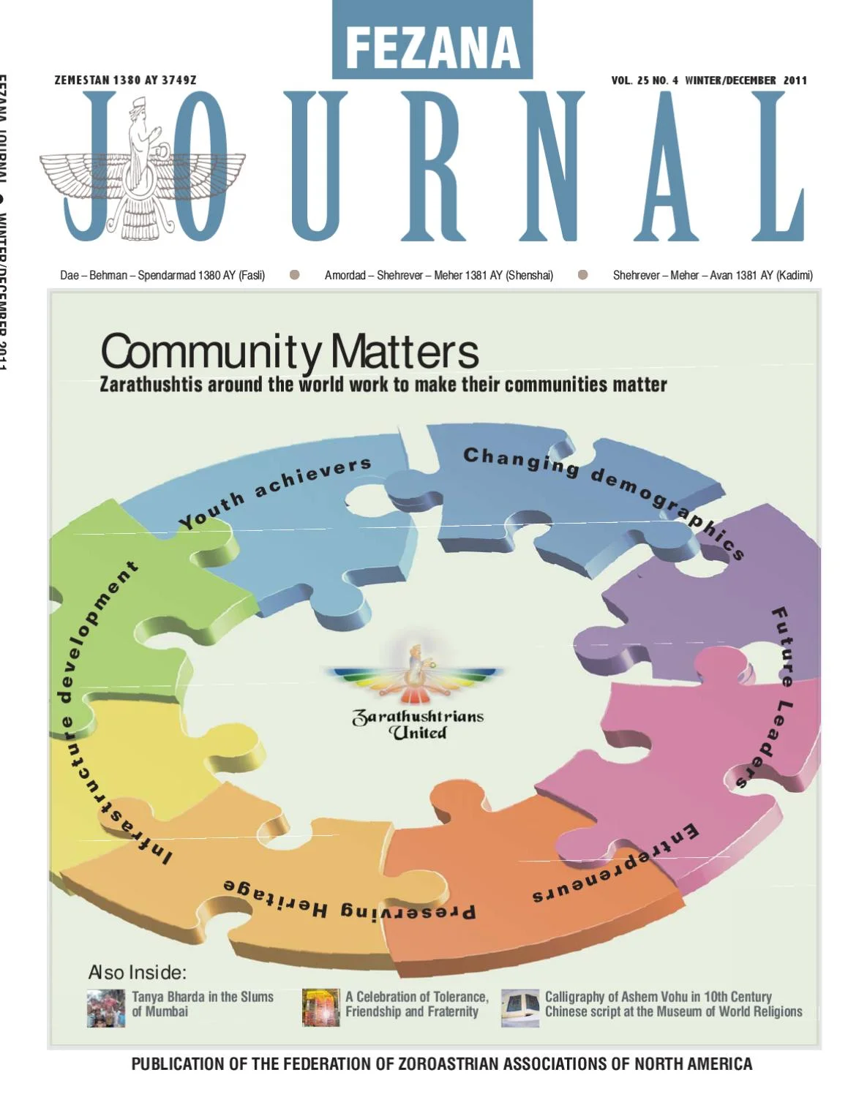
Search and Share
Search about the Zoroastrians in North America and share one interesting fact about your research

