Slide 1
ZYNA
Zoroastrian Youth
Of North America
Lesson 8
Post Sassanid Empire

Slide 2
Two Major Migrations
Islamic Arab Invasion of Iran
After the Islamic Arab conquest of Iran, many Zoroastrians migrated to India to escape persecution
Islamic Republic of Iran
Zoroastrian Iranians faced persecution after the 1979 Islamic revolution in Iran and many migrated out of Iran to different parts of the world. Mostly US, Europe and Australia.

Slide 3
Zoroastrians in North America
Building Communities
As more Zoroastrians migrated to the US and Canada small communities became larger and centers of gathering and worship were built.

Slide 4
27 Associations
13 Groups

Slide 5
New York

Slide 6
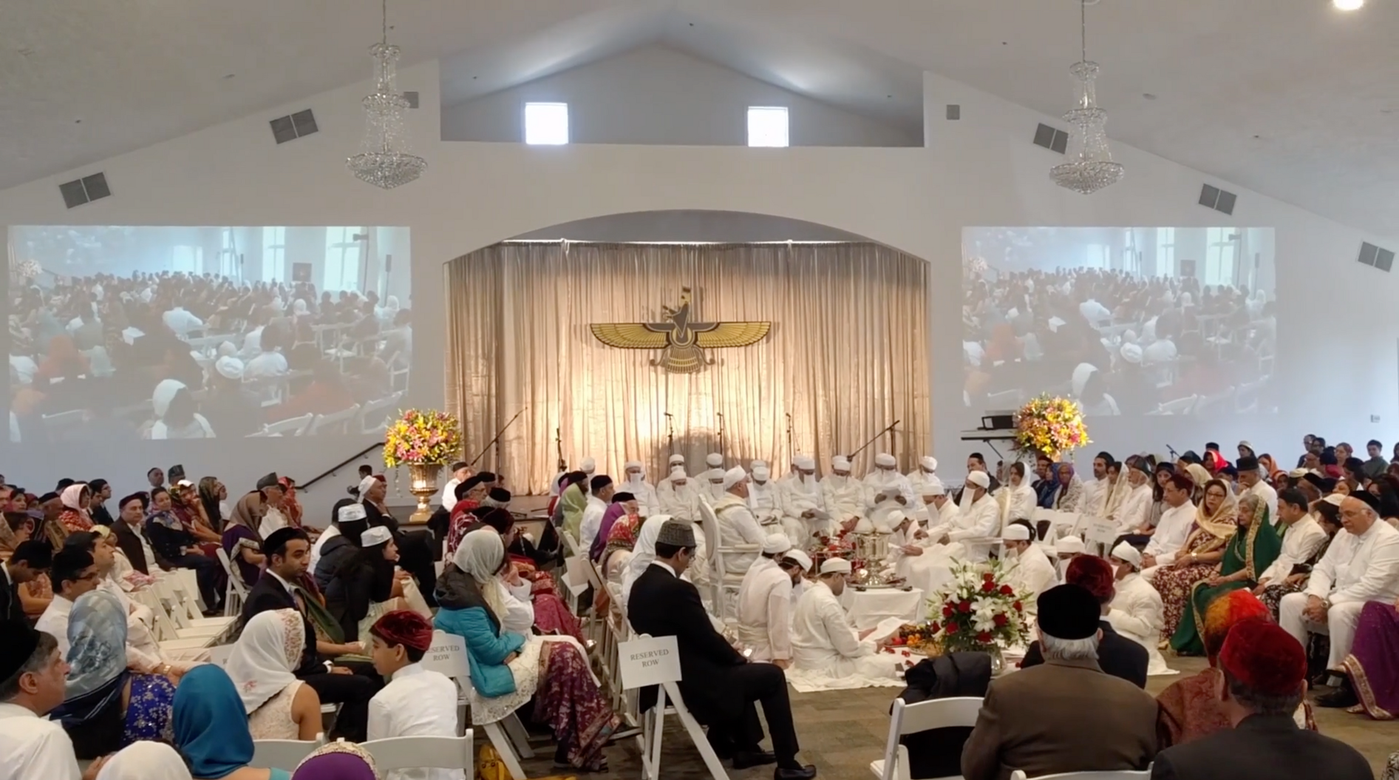

Slide 7
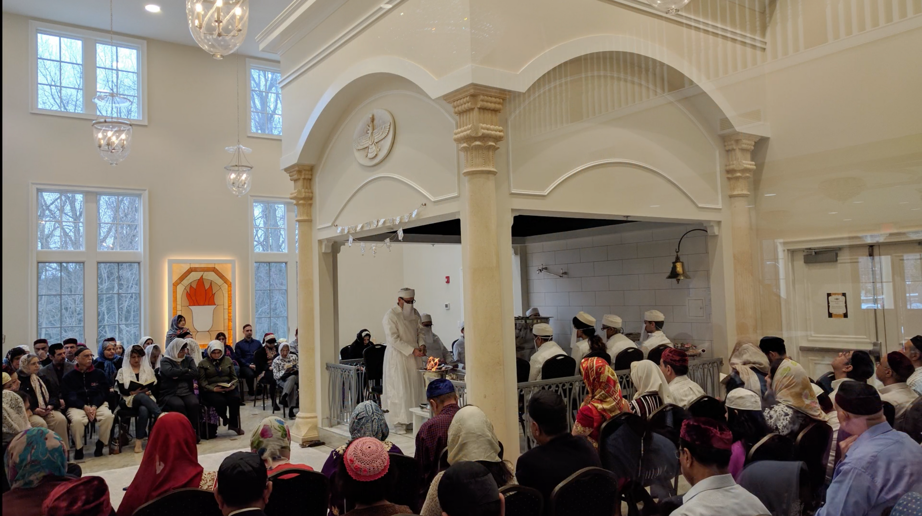

Slide 8
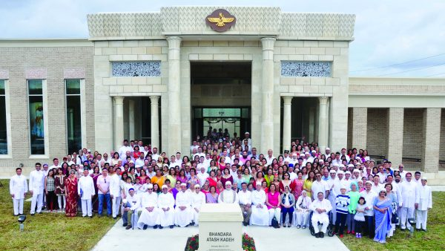
Houston

Slide 9
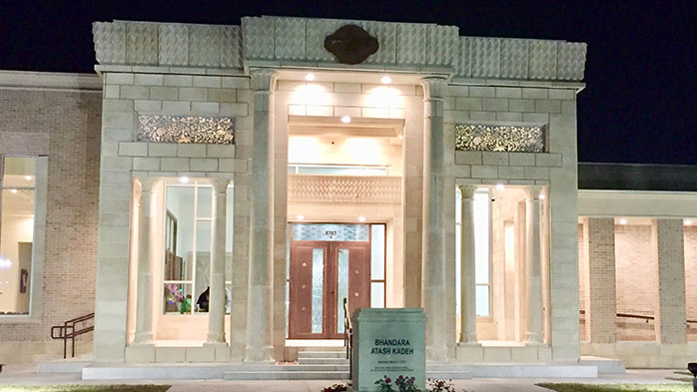

Slide 10
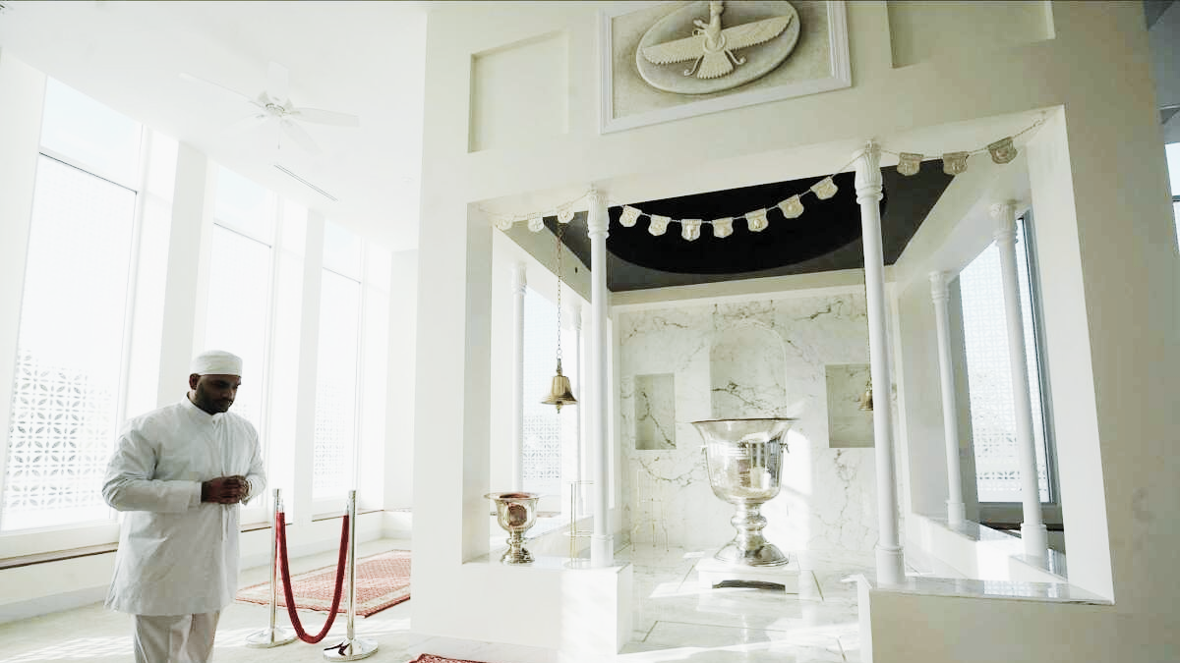

Slide 11
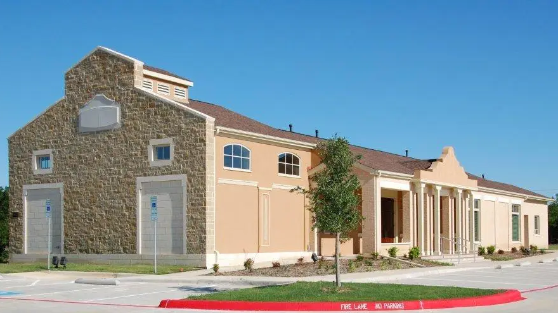
Dallas

Slide 12
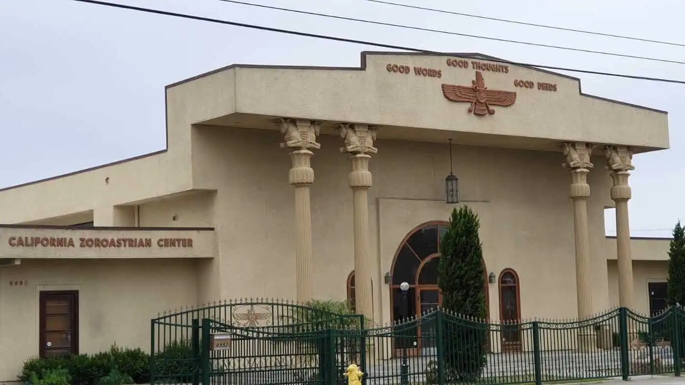
Westminster

Slide 13
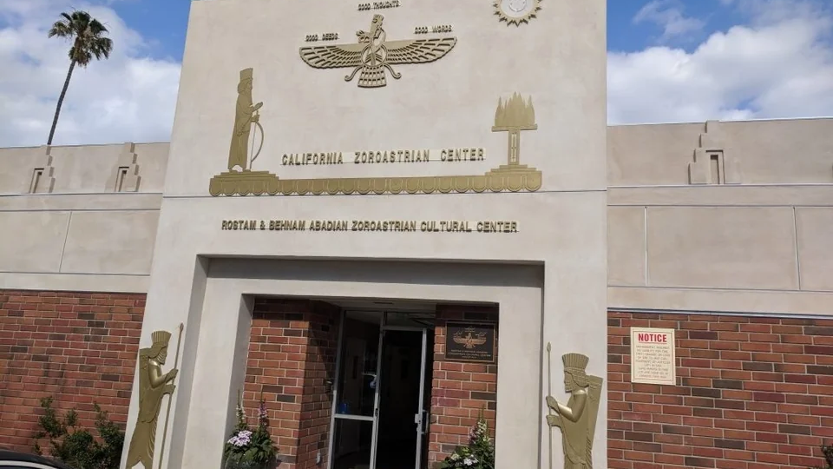
Los Angeles

Slide 14
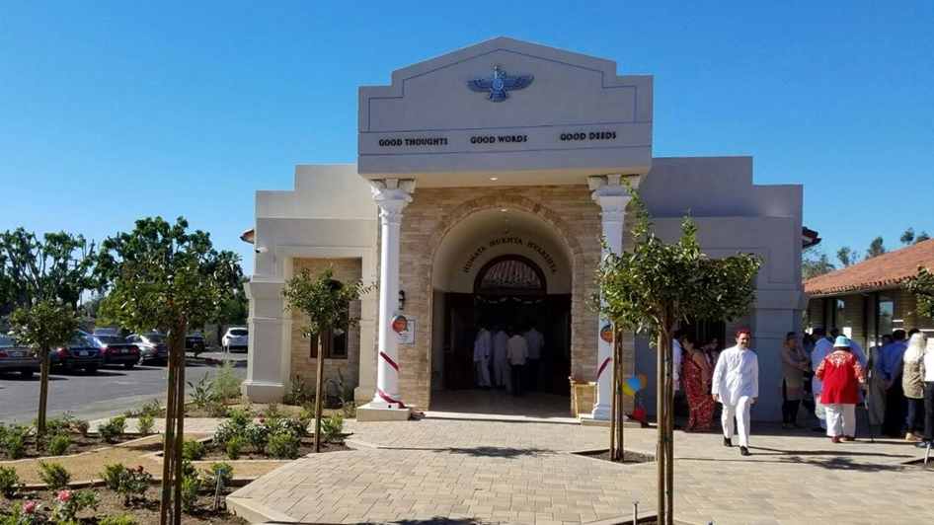
Orange County

Slide 15
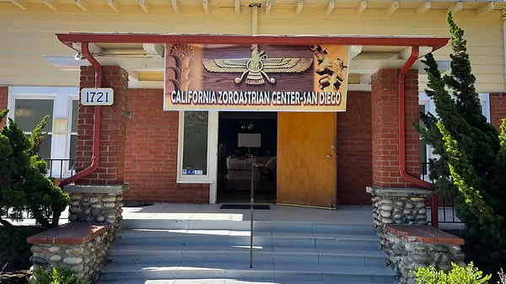
San Diego

Slide 16
San Jose

Slide 17
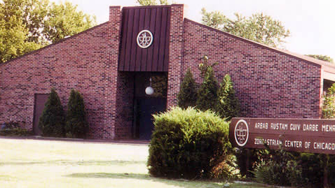
Chicago

Slide 18
Zoroastrians In North America
FEZANA
Federation of Zoroastrian Association of North America was established in 1987
Recognized by the US Government as a Non-Profit and Religious Charitable Organization
A forum to unite and strengthen individual Zoroastrian Associations
Zoroastrian Sports Committee (ZSC) Z Games
Zoroastrian Youth of North America (ZYNA)
Supporter of Return to Roots (RTR)
North American Congresses
$50K interest free loan to Entrepreneur
Scholarships

Slide 19
Z Games

Slide 20
Return To Roots

Slide 21
North American Congresses

Slide 22
oroastrian
outh of
orth
merica
ZYNA / FEZANA
Z
Y
N
A

Slide 23
ZYNA is for
young Zoros in
USA + CANADA
The future is us.
So, let's make it rock!

Slide 24
Z GROUPS
Z FITNESS + STRAVA
Z WORDLE
Z RECIPES
Z WEALTH
Z RELIGION
Z EDUCATION
Z YOUTH
Z WOMEN
SNAPCHAT
TIKTOK
INSTAGRAM
FACEBOOK

Slide 25
1st
Game Night
2nd
Hangout
Sundays @6pm pst
3rd
Movie Night
4th
Hangout

Slide 26
IRL EVENTS
Retreats
Camps
Road Trips
Around Jan/Feb
each year
USA or Canada
Around June each year
Near Toronto, Canada
California
Visiting all 6 Dare-Mehrs by bus

Slide 27
ZYNA Retreats

Slide 28
ZYNA Camps

Slide 29
ZORO EXCHANGE PROGRAM
When: July each year
Duration: 2 weeks
Who: Young Zoros around 14-18
Where: USA/Canada
Placed with Zoro families with children around the same age

Slide 30
How do you find out about events?
ZYNA
Weekly Email Newsletter
To be added email
zyna@fezana.org

Slide 31
Perks
Subsidise
Work Experience
Life Long Friends

Slide 32
NOROOZ CONCERT COUNTDOWN
You can
be in the
next one!
And so much more!

Slide 33
THANK YOU!
Hope to see you all in ZYNA :)

Slide 34
WHAT THINGS CAN YOU BE PART OF NOW?
In North America (USA + CANADA)

