Slide 1
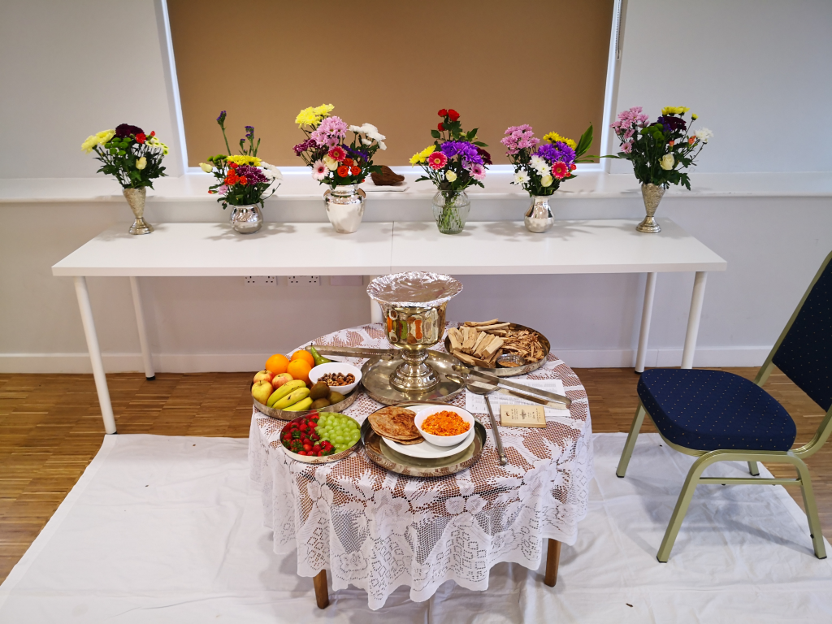
Muktads
Grades 4-12

Slide 2
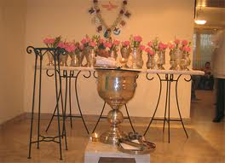
WHAT DOES MUKTAD MEAN
MUKTAD MEANS HAVING REACHED “MUKTI” – END.
END HAPPENS WHEN A PERSON DIES.
MUKTAD DAYS ARE THE DAYS DURING WHICH WE REMEMBER OUR DEPARTED LOVED ONES

Slide 3
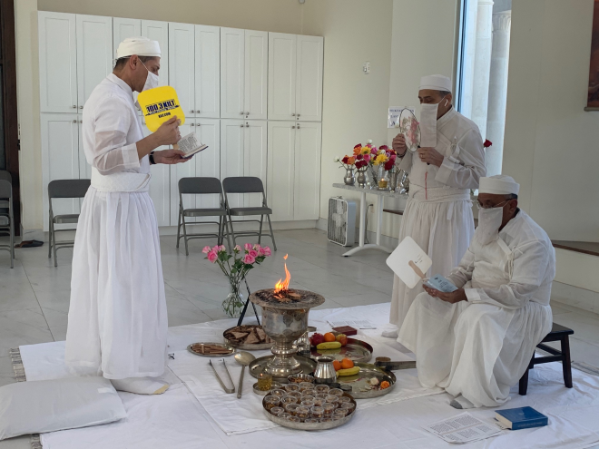
HOW MANY DAYS ARE CONSIDERED AS MUKTAD DAYS
MUKTAD PRAYERS ARE FOR TEN (10) DAYS.

Slide 4
CALENDAR
IN ORDER FOR YOU TO UNDERSTAND THE TEN DAYS OF MUKTAD, YOU NEED TO KNOW OUR CALENDAR. WE HAVE:
ROJ – MEANS DAY
MAH – MEANS MONTH
YEAR – PRESENTLY 1387 YZ
YZ = YAZDEGARD (LAST KING OF PERSIA)

Slide 5
OUR CALENDAR A BRIEF EXPLANATION
OUR CALENDAR HAS 360 DAYS
30 ROJ (DAYS)
12 MAH (MONTHS)
12 X 30 = 360
SINCE THE YEAR IS MADE UP OF 365.24 DAYS WE ADD 5 DAYS OF GATHAS TO MAKE UP TO 365 DAYS. HOWEVER SINCE WE LET GO OF .24 WE FALL BACK ONE DAY EVERY FOUR YEARS. BUT THAT IS A TOPIC FOR ANOTHER SESSION.

Slide 6
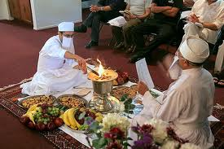
WHEN DO THE MUKTAD DAYS START?
MUKTAD DAYS START FROM
ROJ (DAY) ASHTAD
MAH (MONTH) ASPANDARMARD
TO ROJ (DAY) ANERAN MAH (MONTH) ASPANDARMARD
PLUS FIVE DAYS OF GATHAS

Slide 7
WHAT ARE THE
NAMES OF THE10 DAYS
LAST FIVE DAYS – ASHTAD, ASMAN, JAMYAD, MARESPAND AND ANERAN OF THE MONTH ASPANDARD
FIVE DAYS OF GATHAS – AHUNAVAD, USHTAVAD, SPENTOMARD, VOHUXTHRA AND VAHISHTOISHT.

Slide 8
THE LAST PAGE OF OUR CALENDAR
AUGUST 2021 ZOROASTRIAN MONTH/YR – ASPANDAD/1388 YZ
Sun | Mon | Tue | Wed | Thu | Fri | Saturday
1 (AUG) RAM (ASPANDAD | 2 GOVAD (ASPANDAD | 3 DAEP-A-DIN (ASPANDAD | 4 DIN (ASPANDAD | 5 ASHISHVANG (ASPANDAD | 6 ASTAD (ASPANDAD | 7 ASMAN (ASPANDAD
8 JAMYAD (ASPANDAD | 9 MARESPAND (ASPANDAD | 10 ANERAN (ASPANDAD | 11 AHUNAVAD | 12 USHTAVAD | 13 SPENTOMARD | 14 VOHUXSHTHRA
15 VAHISHTOISHT | 16 HORMUZD (FRAVARDIN) | 17 BAHMAN (FRAVARDIN | 18 ARDIBEHESHT (FRAVARDIN) | 19 SHEHREVAR (FRAVARDIN) | 20 ASPANDAD (FRAVARDIN) | 21 KHORDAD (FRAVARDIN)
22 AMARDAD (FRAVARDIN) | 23 DAE-PA-ADAR (FRAVARDIN) | 24 ADAR (FRAVARDIN) | 25 AVAN (FRAVARDIN) | 26 KHORSHED (FRAVARDIN) | 27 MOHOR (FRAVARDIN) | 28 TIR (FRAVARDIN)
29 GOSH (FRAVARDIN) | 30 DAEP MEHR (FRAVARDIN) | 31 MEHR (FRAVARDIN)

Slide 9
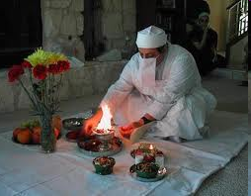
FARVARDEGAN DAYS
MUKTAD DAYS ARE ALSO KNOWN AS FARVARDEGAN DAYS.
DERIVED FROM THE WORD FRAVASHI – MEANS SOUL – SPIRIT. FRAVARDEGAN MEANS CEREMONY IN HONOR OF FRAVASHIS – FAROHARS OR GUARDIAN SPIRITS

Slide 10
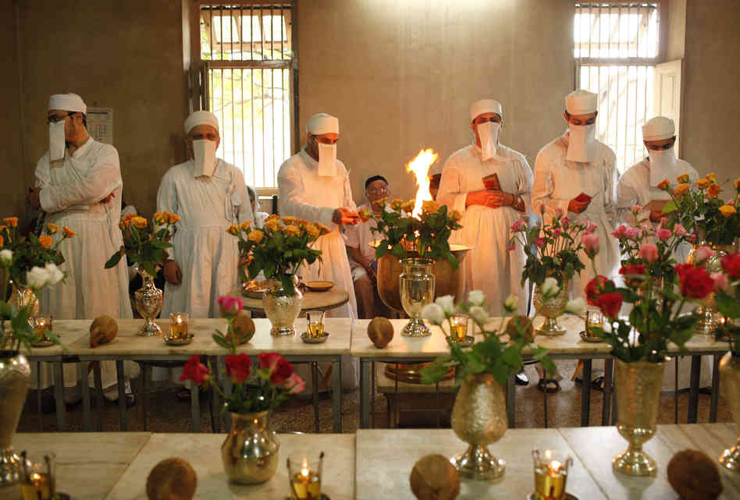
A LITTLE HISTORY
UP UNTIL 50 OR 60 YEARS AGO, PRACTICALLY EVERY ZARATHUSHTI HOUSEHOLD HELD MUKTAD CEREMONY IN THEIR OWN HOME (IT WAS MANDATED). EVERY HOUSEHOLD HAD A PRAYER AREA AND THE “AALAT” – AFARGANYU, THALI, CHIPYO, CHAMACH ETC. AND KEPT THE FIRE BURNING 24 HOURS.
NOW – THE PRAYERS ARE MAINLY HELD IN AGIYARIS AND ATASHBEHRAMS – THESE VASES ARE FOR INDIVIDUAL FAMILY.
EXPLAIN: CLEAN, SUKHAD-LOBAN, FIRE TO BE KEPT BURNING ETC.

Slide 11
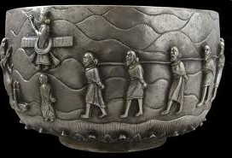
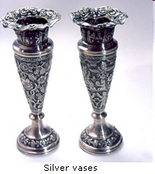
FLOWER VASE
FOR THE FIRST YEAR AFTER A PERSON PASSES AWAY, A SILVER VASE IS CONCECRATED AT THE TIME OF UTHAMNA. IT GENERALLY CARRIES THE NAME OF THE DEPARTED. THIS VASE IS USED IN SUBSEQUENT YEARS DURING MUKTAD.
NOWADAYS PEOPLE USE CRYSTAL VASE -

Slide 12
VASE
A LITTLE HISTORY OF THIS BEAUTIFUL VASE. IT IS OF SILVER AND WAS MADE BY ALPAIWALLA FAMILY IN 1875 IN BURMA, NOW KNOWN AS MIANMAR. IT IS DECORATED IN UNUSUALLY ZOROASTRIAN THEMES AND IS CONSIDERED RARE. IT WAS ACQUIRED BY ASIAN ART MUSEUM IN SAN FRANCISCO IN HONOR OF THEIR PAST PRESIDENT NAZNEEN SPLIEDT.
THOSE WHO COULD AFFORD IT, USUALLY HAD A VASE MADE RATHER THAN BUY FROM A SHOP

Slide 13
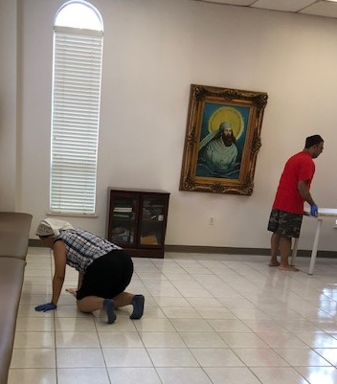
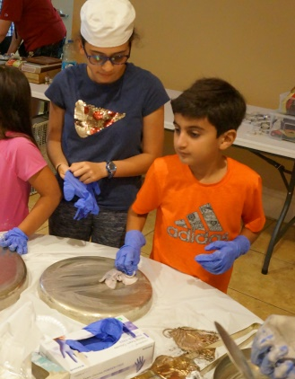
PREPARATION
WASH AND CLEAN THE FLOOR
WASH AND CLEAN THE ENTIRE ROOM – ALL THE WINDOWS, FANS AND POLISH ALL THE SILVER, PARTICULARLY THE ONES USED IN THE PRAYER CEREMONY
NOW YOU KNOW WHY WE DID THAT

Slide 14
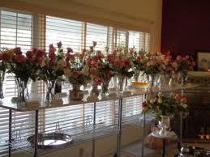
DAILY PREPARATION
BEFORE STARTING THE PRAYERS
WASH FLOWERS AND PUT IN VASES.
PUT THE VASES ON THE MARBLE TABLE.
WATER AND FLOWERS REPRESENT KHORDAD (AHURVATAT) AND AMARDAD (AMERETAT).

Slide 15
DAILY PREPARATION (CONTINUED)
WASH ALL THE FRUITS
GET A SMALL GLASS OF MILK
GET A SMALL GLASS OF WATER
PUT ALL THESE IN A SILVER TRAY AND PUT ON WHITE SHEET THAT HAS BEEN PREPARED FOR PRAYERS.

Slide 16
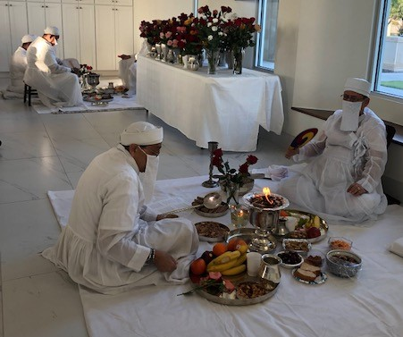
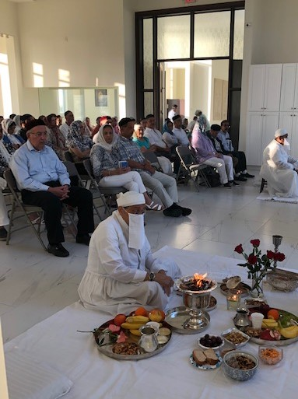
PRAYERS
THE PRAYERS RECITED ARE:
AFRINGAN, FAROKSHI, STUM.
AFRI IN AVESTA MEANS “TO INVITE”.
INVITING THE FRAVASHIS OF THE DEPARTED ONES.

Slide 17
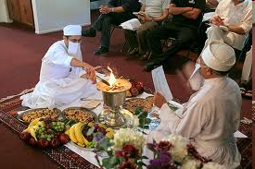
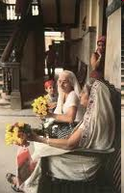
PRAYERS
WHILE THE MAIN PRIEST IS RECITING AFRIN PRAYERS, THE OTHER ONE RECITES FAROKSHI. DUE TO SHORTAGE OF MOBEDS THERE MAY BE JUST ONE MOBED WHO HAS TO RECITE ALL THE PRAYERS BY HIMSELF.

Slide 18
FARVARDIN YASHT
THE FRAVARDIN YASHT (13.14) STATES, "IN THAT HOUSE IN WHICH CLEAN AND PURE WATER AND VEGETATION IS PLACED, THE HOLY FRAVASHIS AGREE TO MOVE ABOUT." ALSO, FAKRA 13 – (IN PART) STATES: “WE WORSHIP THE GOOD, STRONG, BENEFICENT FRAVASHIS OF THE FAITHFUL WHO COME AND GO THROUGH THE WORLD.

Slide 19
FARVARDIN YASHT
FROM FRAVARDIN YASHT, WE LEARN THAT THE FRAVASHIS OF THE DEPARTED EXPECT TO BE INVOKED BY THEIR NAMES BEING MENTIONED IN THE PRAYERS. THE PRIEST RECITES THE NAMES OF ALL THE DEPARTED ONES DURING THE PRAYERS.

Slide 20
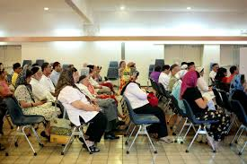
FARVARDIN YASHT
AND WHILE THE PRIESTS ARE PRAYING, THOSE ATTENDING CAN PRAY A SMALL PRAYER FOR THE DEPARTED LOVED ONES THEMSELVES. IT IS CALLED “SATUM NO KARDO”. THIS IS A PRAYER FOR THE DEPARTED SOULS AND AT A CERTAIN POINT WE PRAY “NAM CHESHTI ANUSHER RAVAN RAVANI” – AMONG ALL THE SOULS…
(TAKE THE NAME – BEHDIN/OSTA/ERVAD)

Slide 21
10 DAYS OF MUKTAD
AFTER THE BAJ, AFRIN & FAROKSHI ARE COMPLETED BY THE PRIEST THE CONGREGATION RECITES MUKTAD NO NAMASKAR AS A HAMBANDAGI (COMMUNAL PRAYERS). AFTER BREAKING FOR REFRESHMENT BY THE CONGREGATION, THE PRIEST PRAYS STUM.
AND SO IT CONTINUES FOR 10 DAYS

Slide 22
NAVROZE MUBARAK
EARLY MORNING AFTER THE TENTH DAY, AND
PRIOR TO THE SUNRISE OF THE 11TH DAY, THE PRIEST PRAYS ALL THE PRAYERS ONE MORE TIME IN USHEHN GEH, AND SAYS GOOD BYE TO ALL THE SOULS. AT THE BREAK OF DAWN, THE PRIEST PRAYS IN HAVAN GEH AND PERFORMS THE FIRST MACHI OF THE YEAR. THE CONGREGATION WISHES EACH OTHER NAVROZE MUBARAK, ALL HAVE A CUP OF TEA AND BREAKFAST AND EVERYONE DEPARTS

Slide 23
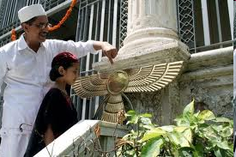
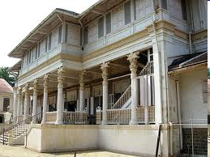
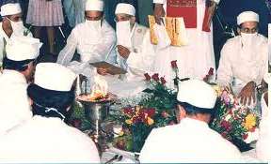
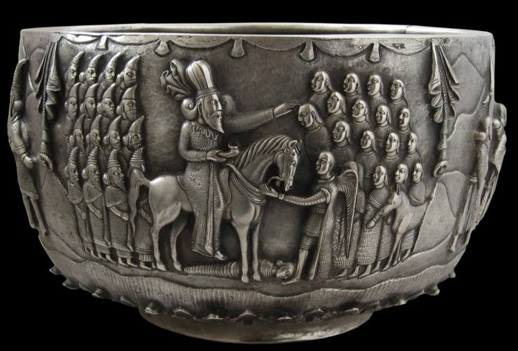
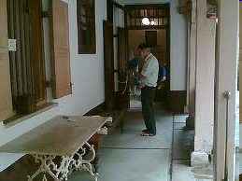
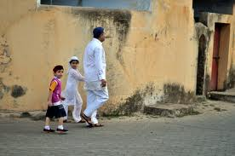
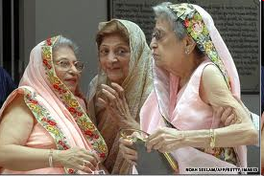
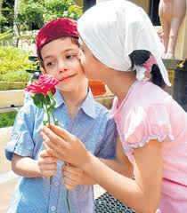
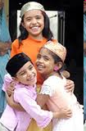
Notes:
EXPLAIN ABOUT THE NAMES TAKEN – RIGHT FROM THE TIME OF ASHO ZATUSHTRA TO THE PRESENT DAY HIGH PRIESTS AND SAVANTS.

