Slide 1
Saoshyant and Frashokereti

Slide 2
Saoshyant
Avestan term
Means “one who brings benefit”
What are some of the ways that one can bring benefit?
How do we recognize a Saoshyant?

Slide 3
Who is a Saoshyant
According to the Gathas, Saoshyant can be anyone who
follows Asha (Truth and Righteousness).
brings renovation, improvement, and benefit to the world.
Do you know anyone whom you think fits this criteria?

Slide 4
Saoshyant in the Gathas Song 8.3 (Yasna 43.3)
Much good shall belong to the one who shows others the path to happiness.
This path is through living according to Asha (Truth and Righteousness).
This person is like Ahura Mazda sincere, noble and progressive.
According to this song:
What does a Saoshyant do?
What status does a Saoshyant occupy?

Slide 5
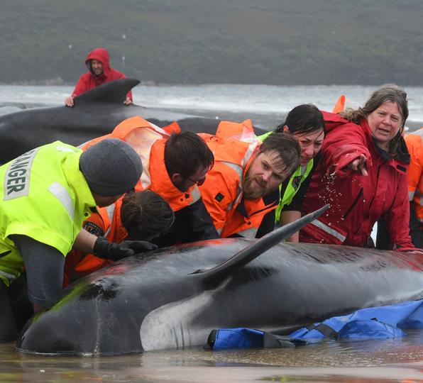
Saoshyant in the Gathas (con’t) Song 13.11-13.12 (Yasna 48.11-48.12)
Song 13.11(Yasna 48.11)
Wise One, when shall peace and righteousness rule over the land.
Who shall bring peace and stand against the wrongful and the deceitful?
This person is one with wisdom and a good mind.
Song 13.12 (Yasna 48.12)
O Mazda, the benevolent liberators of the lands, the Saoshyants are those
who use their good mind to make decisions and take action
whose actions are through Asha (Truth and Righteousness)
who use Your teachings to guide them in life
who fight injustice, and fury
Is Saoshyant singular or plural? What does this mean?

Slide 6
Frashokereti
Avestan term meaning
“making fresh”,
“making wonderful”
“made splendid”
“rehabilitated”
A Saoshyant is the person who leads the world to Frashokereti
He/she makes the world fresh or better.

Slide 7
Frashokereti in the Gathas Song 3.9 (Yasna 30.9)
To make fresh or renew
And may we be among those who make this life fresh! You, lords of wisdom, who bring happiness through righteousness, come, let us be single-minded in the realm of inner intellect.
How can we make life fresh or renew the world?
Is it the work of one person? 10? 100?

Slide 8
Saoshyant in the Gathas vs later Scripts
There is a huge difference in the two.
In the Gathas the Saoshyant can be all of us working to renew the world.
In later texts the Saoshyant is a specific person who will come as our savior.
Why do you think this shift has happened?

Slide 9
Saoshyant in the Latter Texts
In later texts:
Three Saoshyants will appear each in a thousand-year increment before the end of the world as we know it.
The last of the three is the most important.
He/She will:
Rid of the world of evil and destroy enemies of Truth
Resurrect all the dead
Cleanse everyone of evil
There will be no old age, suffering, or death
By doing the above he/she has performed Frashokereti
Do you recognize this concept in Abrahamic religions?
Jesus as the savior
Mehdi in Shi'i Islam as the promised savior

Slide 10
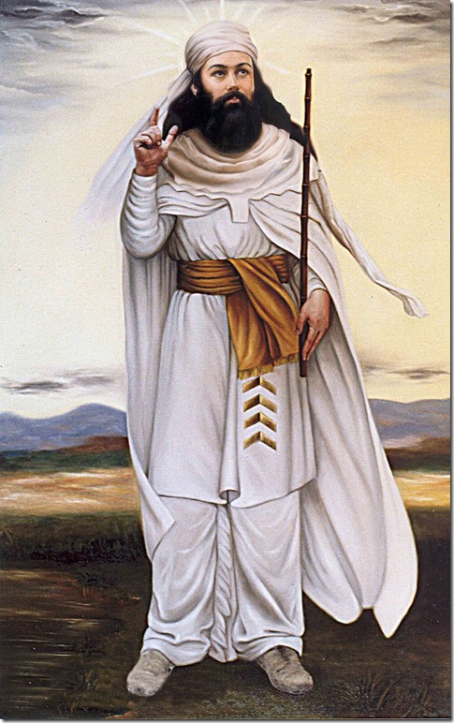
Zarathushtra Spitman
Lived about 3500-3700 years ago.
Introduced and taught a doctrine that is based on living a productive, truthful, prosperous life in harmony with other living beings.
His message spread wide and was the moto for three Persian Empires spanning over 2000 years.
His teachings influenced the Greek and European philosophy and is still influencing people’s way of life today.
Was he a Saoshyant? Why? Which part of his actions makes him a Saoshyant?

Slide 11
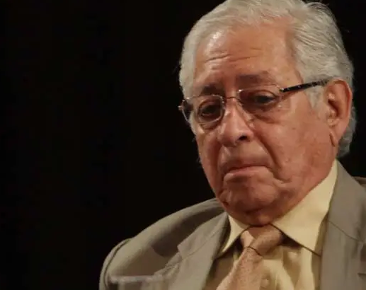
Soli Sorabjee
1953 became a lawyer.
1971 Senior Supreme Court Lawyer.
1977-1980 Solicitor General of India.
Chairman of Transparency International and Convenor of the Minority Rights Group.
Strong proponent of civil liberties and protection of human rights.
Was he a Saoshyant? Why?

Slide 12
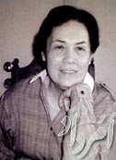
Farangis Shahrokh
Born in 1916 in Iran.
One of the founders of Anjuman of Ancient Iranian Culture.
Improved the living conditions of women in prisons (Iran).
Improved the living conditions and resources of orphanages (Iran).
Executive Director of Iranian Handicraft Organization.
Founder of Yeganegi-Kaykhosrow Shahrokh Library.
One of the founders of California Zoroastrian Center.
Is she a Saoshyant? Why?

Slide 13
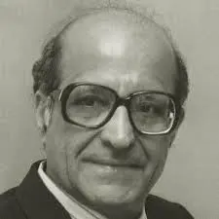
Nanabhoy Palkhiwala
1946- Passed the bar and became a lawyer.
Along with Sir Jamshedji Behramji Kanga, he wrote The Law and Practice of Income Tax, which is still considered an authoritative work in commercial and tax law.
one of the most ardent defenders of the rights of freedom of expression and freedom of the press.
Is he a Saoshyant? Why?

Slide 14
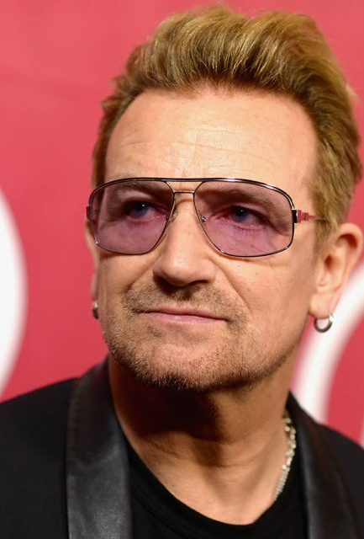
Bono
Born Paul David Hewson in 1960 in Irland.
Activist in the fight against AIDS and extreme poverty in Africa.
Founder of organizations ONE and RED
ONE: has lobbied to ensure government funds, policies and programs that have helped tens of millions of lives over the past 10 years.
RED: Partners with iconic brands to raise public awareness about and corporate contributions for the AIDS crisis. To date, (RED) has generated more than $650 million for AIDS treatment and prevention in Africa through the Global Fund to Fight AIDS, TB and Malaria.
Is Bono a Saoshyant? Why?

Slide 15
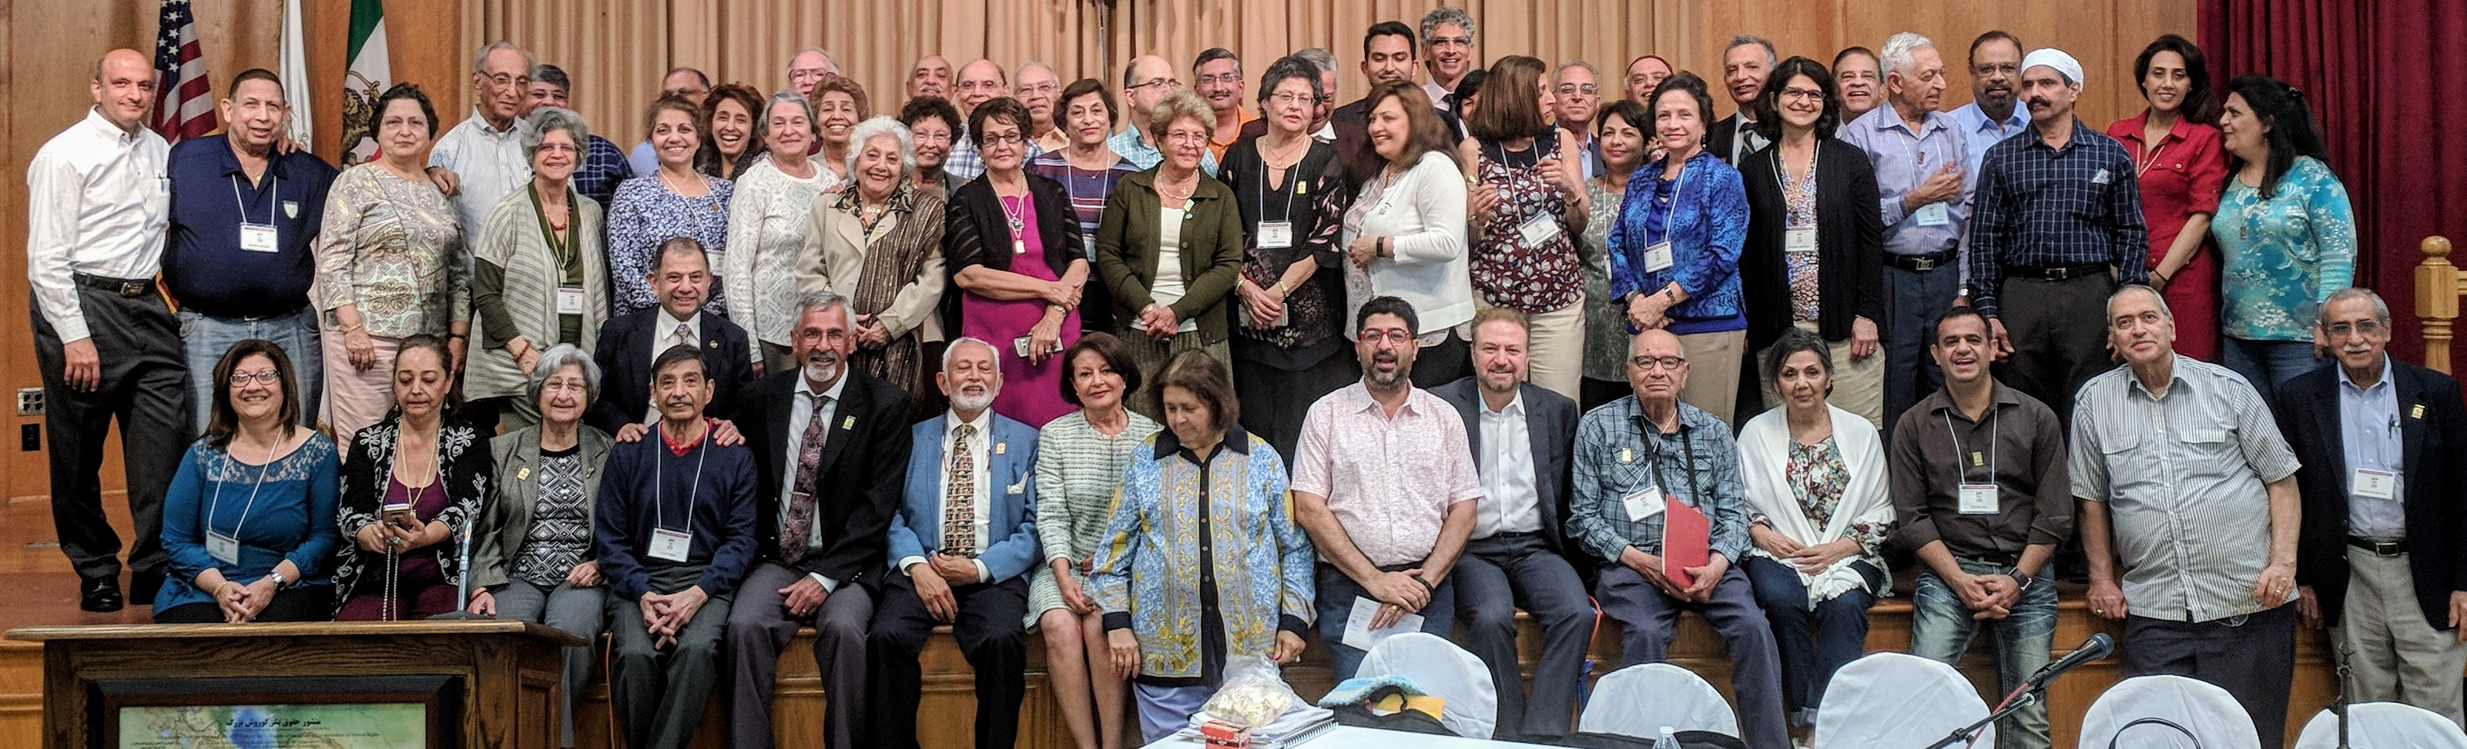
Who is a Saoshyant?
What do the people we just talked about have in common?
Can anyone be a Saoshyant? How?
Write a summary of the characteristics of a Saoshyant and share.
How do these characteristics relate to Frashokereti?

Slide 16
YouTube videos
Danzel Washington
https://www.youtube.com/watch?v=EBGb40yh4SY
Steve Jobs
https://www.youtube.com/watch?v=Tuw8hxrFBH8
Parsi story
https://www.youtube.com/watch?v=brNsbGATuio
Bono
https://www.youtube.com/watch?v=QRFiEcmbRvk

Slide 17
sources
https://zoroastrians.net/2017/09/21/15-prominent-parsis/
http://www.amordaden.blogfa.com/post/919
https://www.one.org/us/person/bono/
Gathas Our Guide Dr. AA Jafarey
The Gathas Khosro Khazai
http://www.avesta.org/zcomet.html
www. Zoroastrian.org

