Slide 1
Work, Effort, and Perseverance in Zoroastrian Culture PowerPoint by: Nina Kalianivala

Slide 2
Famous People
Think of famous/successful people you have heard about
They could be family members, friends, association members, local leaders, presidents – the people don’t have to be Zarthushtis
What common elements do these people have?

Slide 3
Zarathushtra’s words:
He who is most good to the righteous, Be he a noble, or a peasant, or a dependent, He who zealously makes the good living creation flourish, He shall come to dwell with Truth in the realm of Good Mind.
Yasna 33, verse 3

Slide 4
Yasna 44.2
‘…What is the source of Best Existence? How shall one who seeks it, receive the blessed recompense? Surely such a holy one through Righteousness, Is a healer of existence, beneficent unto all, a genuine friend, O Mazda?”

Slide 5
Yasna 46.12
“When among the kinsmen and descendants of the renowned Turanian, Fryana, Right rises, when through the spiritual zeal of Armaity, they further the welfare of the country, then shall Ahura Mazda bring them the illumination of Good Mind and show them the path of Righteousness.”

Slide 6
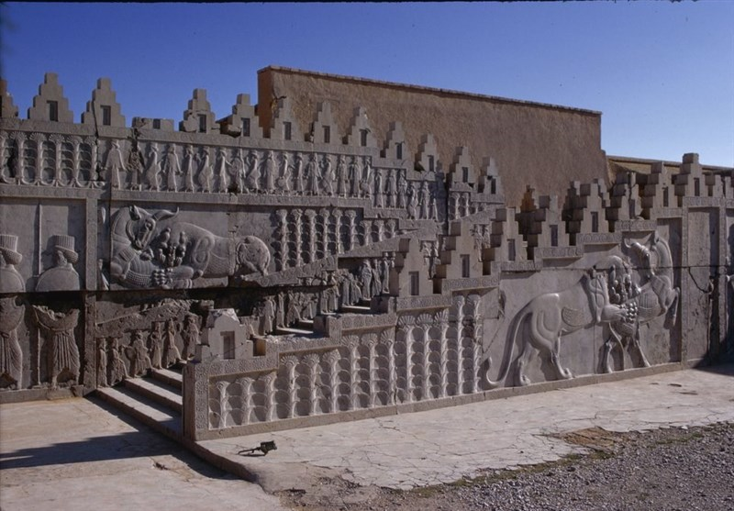
Observation in History
Persepolis built by men and women across the Persian Empire who received fair wages for their work – rulers of neighboring countries used slaves.

Slide 7
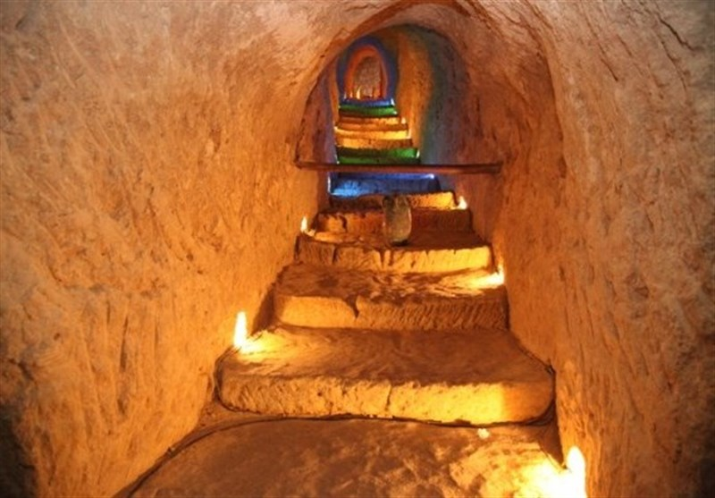
History shows…
After the collapse of the Sassanid Empire, there was hardship; yet people in the desert areas of Yazd and Kerman engineered the qanats to survive drought and desert lands.

Slide 8
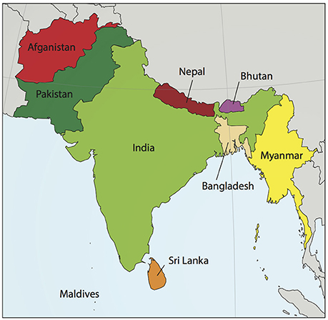
We know from history…
Zarthushtis who migrated to the Indian subcontinent worked hard, persevered, and prospered.

Slide 9
More effort required today?
State of the Earth?
Mentality of people?
Morals and values?
Universality and timelessness of Zarathushtra’s message

Slide 10
Poet Eghbal Lahouri
“God gave grandeur to the people,
Who wrote their own fate.”
Lahouri emphasizes that success is reached and progress is made when we practice our freedom of choice.
Set a goal and follow it with actions to achieve the goal in an effort to shape a future that is beneficial to all.

Slide 11
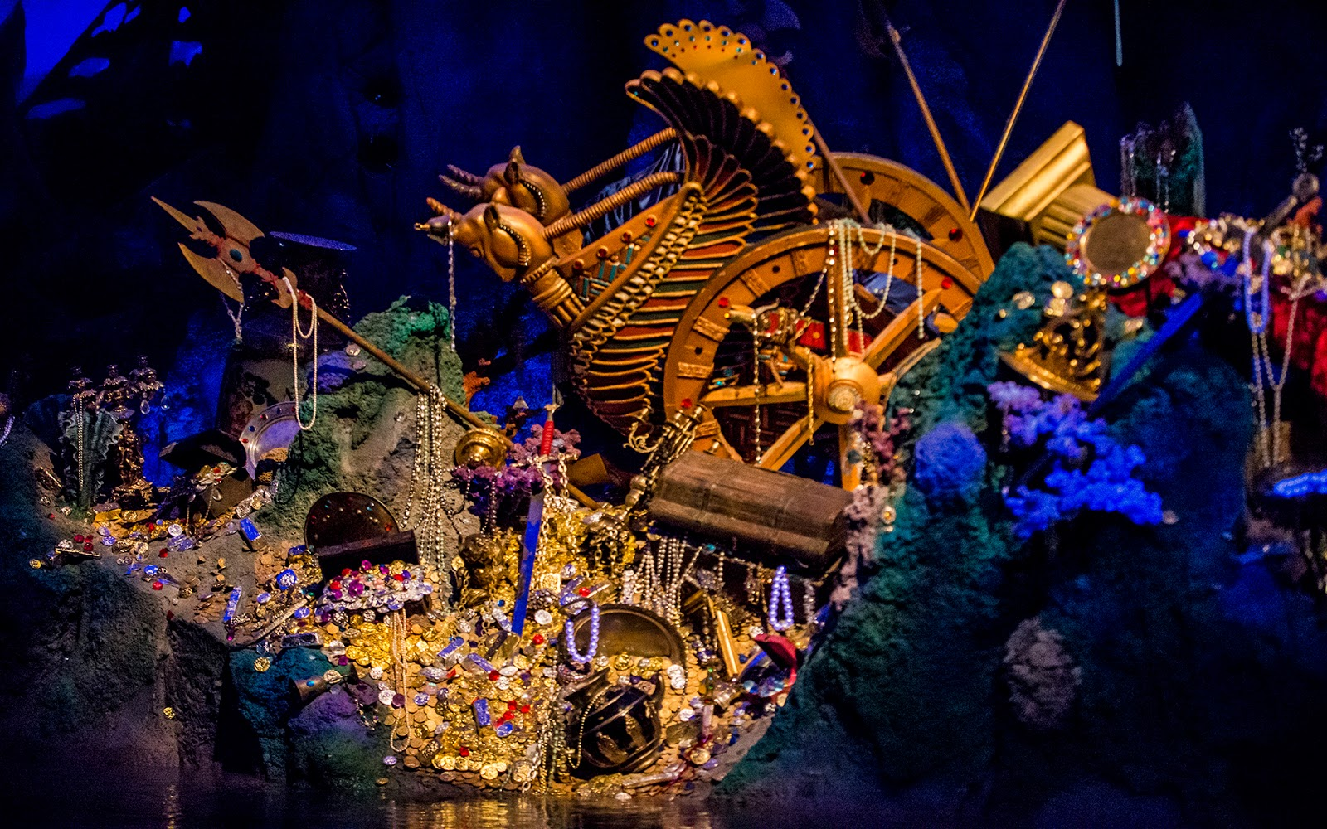
Poet Sa’di:
Treasure will not be found without hard work
The person who worked received wages.
Does hard work have to be physical?
Do wages have to be money?
This Photo by Unknown Author is licensed under CC BY-NC-ND

Slide 12
Sa’di again:
Sa’di, a righteous person who does good deeds will not die
Dead is one whose name is not associated with good deeds.
Do you become immortal?
Is Zarathushtra immortal?

Slide 13
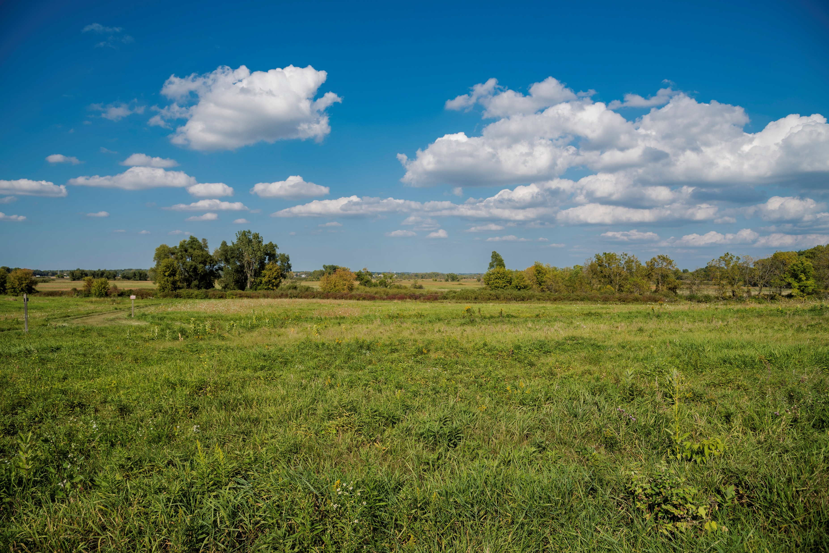
Poet Malek al Shoara Bahar
The story about the advice a dying farmer gives his son.
What is treasure?
Do you have to work hard to find treasure?

Slide 14
The Jahanian Family
Established a firm, became a banking facility
Worked to get a member of the Zoroastrian community in the legislative assembly
The first Iranian and national bank of Iran was established

Slide 15
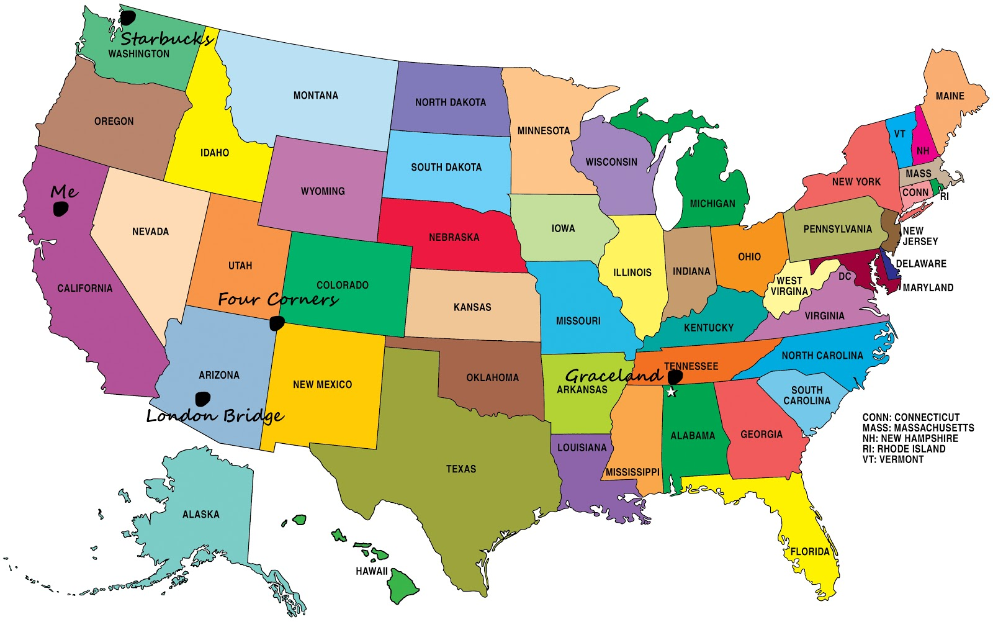
The US today
What are some changes you’d like to see in the country today?
Social
Economic
Healthcare
Climate

