Slide 1
Yazatas Bingo and Matching Game
By: Mahtab B. Dastur

Slide 2
Instructions:
1 sheet is the control, and the other one is cut into pieces
Then you match the cut pieces to the control sheet (i.e. match the cut names to the “control” or sheet of pictures)
Now you have a matching game!
Once all names and pictures have been matched, check with the key (last page)

Slide 3
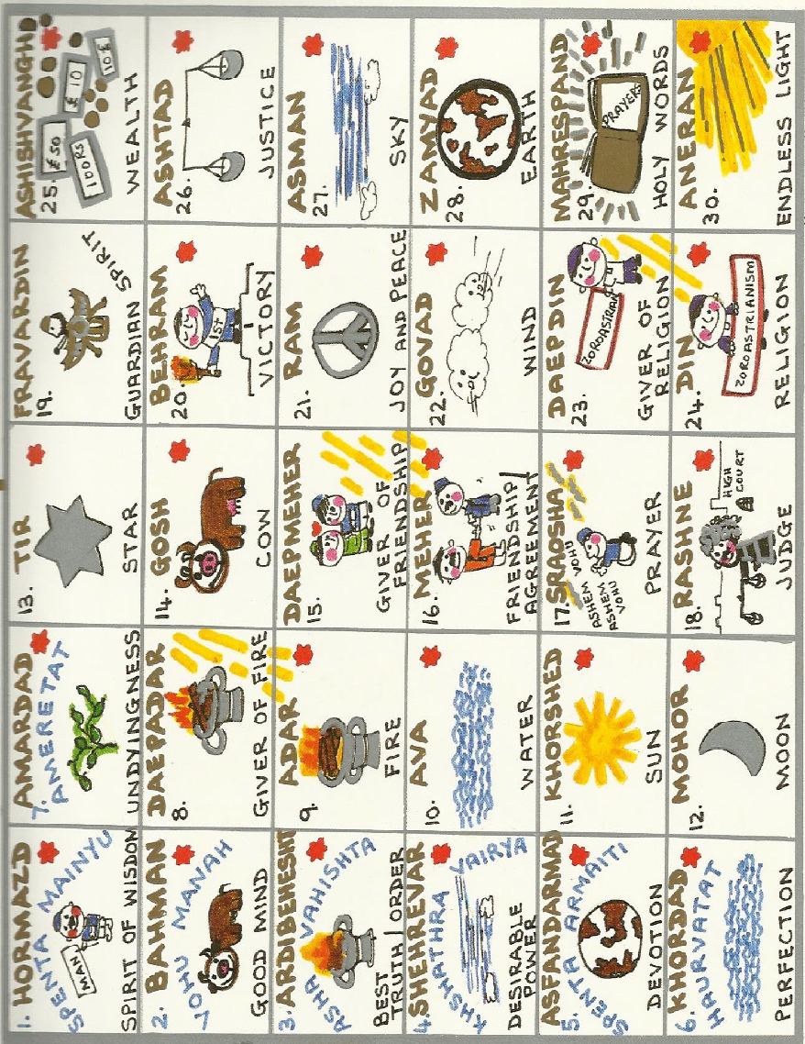

Slide 4
1. Hormazd | 7. Amardad | 13. Tir | 19. Fravardin | 25. Ashishvangh
2. Bahman | 8. Daepadar | 14. Gosh | 20. Behram | 26. Ashtad
3. Ardibehesht | 9. Adar | 15. Daepmeher | 21. Ram | 27. Asman
4. Shehrevar | 10. Ava | 16. Meher | 22. Govad | 28. Zamyad
5. Asfandarmad | 11. Khorshed | 17. Sraosha | 23. Daepdin | 29. Mahrespand
6. Khordad | 12. Mohor | 18. Rashne | 24. Din | 30. Aneran

